Slide 1
2024 SURVEY OF INCOME AND PROGRAM PARTICIPATION
Disability, Hardship,
& Wealth
in the United States
How disability relates to material hardship, wealth, and saving
Yejun · Mourya · Kalash · Hailey

Slide 2
THE POLICY PROBLEM
Disability & Supplemental Security Income (SSI)
1
Disability is widespread
1 in 4
1 in 4 U.S. adults reports a disability: functional limits across six domains, closely tied to poverty and financial insecurity.
U.S. adults live with a disability
2
The safety net has a catch
SSI, the federal cash program for low-income disabled adults, imposes a $2,000 asset limit, unchanged since 1989.
$2,000
3
A testable critique
Critics argue the limit penalizes saving and traps recipients in poverty. We can test that claim with data.
SSI asset limit, the same cap for 35+ years
01

Slide 3
RESEARCH QUESTIONS
Does disability worsen financial well-being, and why?
Research Question #1:
Research Question #2:
Research Question #3:
Hardship
Wealth
Savings
How well does disability predict material hardship?
Do disabled households hold less net worth, and does the gap widen with severity?
Does the SSI $2,000 asset limit discourage saving?
02

Slide 4
THE DATA
The 2024 SIPP: a monthly panel of U.S. households
The Survey of Income and Program Participation is the Census Bureau's flagship longitudinal survey of income, assets, and program receipt.
~16k
~37k
households
people
Longitudinal panel: the same people tracked month-by-month across all of 2023
437k
5,203
Person-month format: one row per person per month
person-month records
variables
Nationally representative: survey-weighted (WPFINWGT); oversamples low-income areas
03

Slide 5
FROM RAW FILE TO ANALYSIS SAMPLE
Data Pipeline: clean, filter, build variables, then pick the sample
THE PIPELINE
KEY VARIABLES
1
Clean
Disability - the predictor
recode missing values (no SSI amount → $0); keep complete cases per outcome
Any disability (yes / no)
Severity: count of 6 functional limits (0–6)
2
Filter
December 2023 snapshot · adults 18+ · one reference person per household
Outcomes - what we explain
Material hardship (4 items)
Household net worth
3
Build
Countable savings (SSI test)
disability presence + 0–6 severity; hardship (4 items); net worth; savings
Controls - held constant
Select
Demographics: age, sex, race, city
4
Economic: income, education, work
≈15,600 households (hardship & wealth) · 8,147 disabled adults (savings)
Household: size, ownership, location
04

Slide 6
01
EXPLORATORY DATA ANALYSIS
What the raw data shows

Slide 7
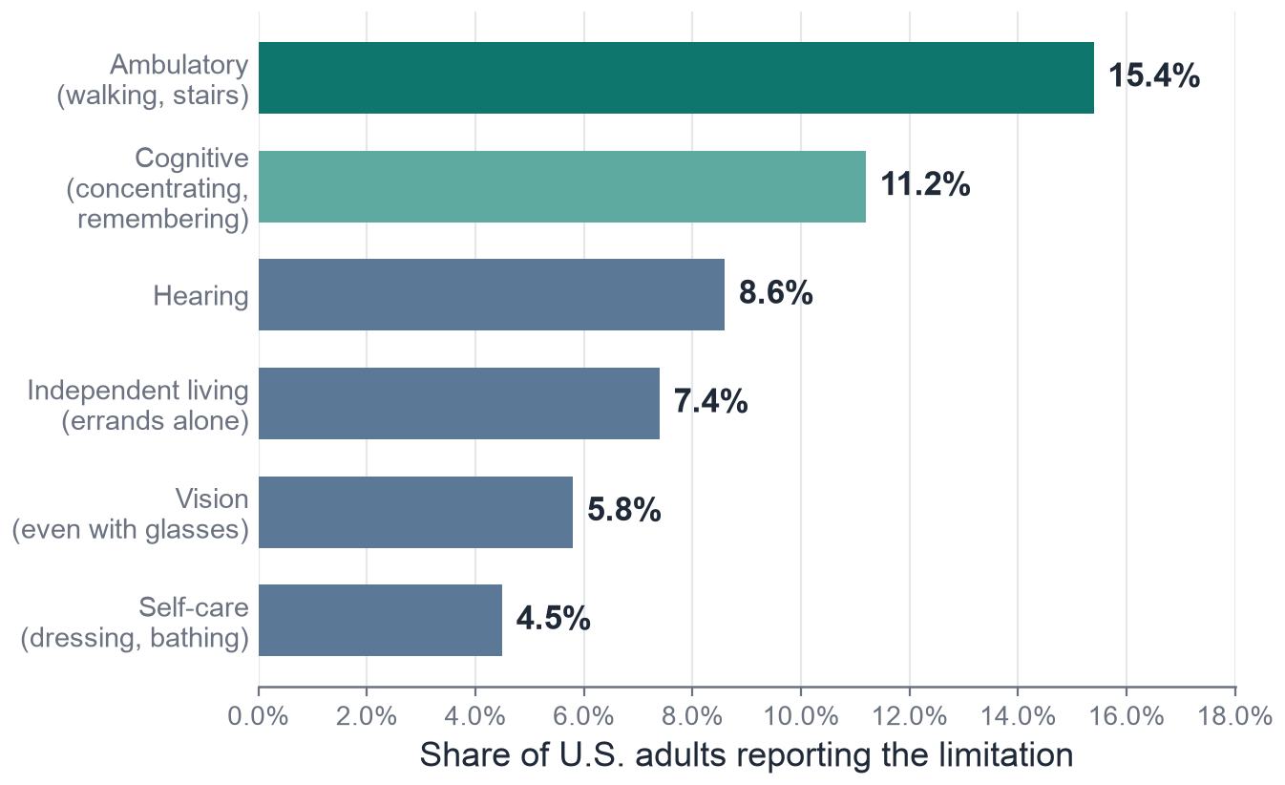
DISABILITY
Six functional limits and how common each one is
SIPP measures disability as serious difficulty in six areas of daily life. We use two things: whether a person reports any limitation, and how many (0–6) according to our severity scale.
of U.S. adults report at least one of the six limitations
27.5%
05

Slide 8
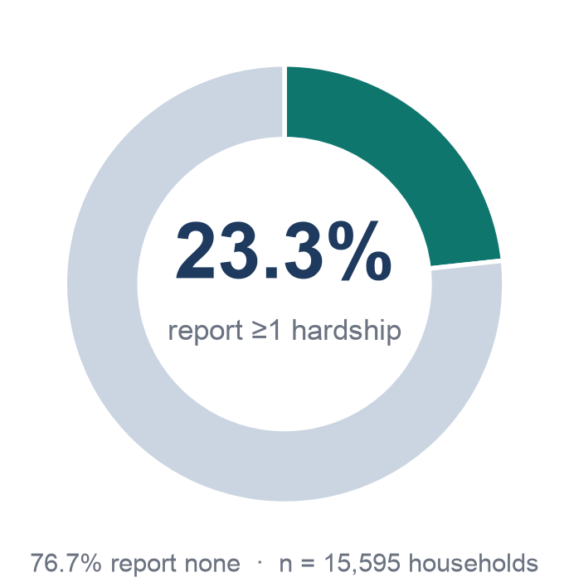
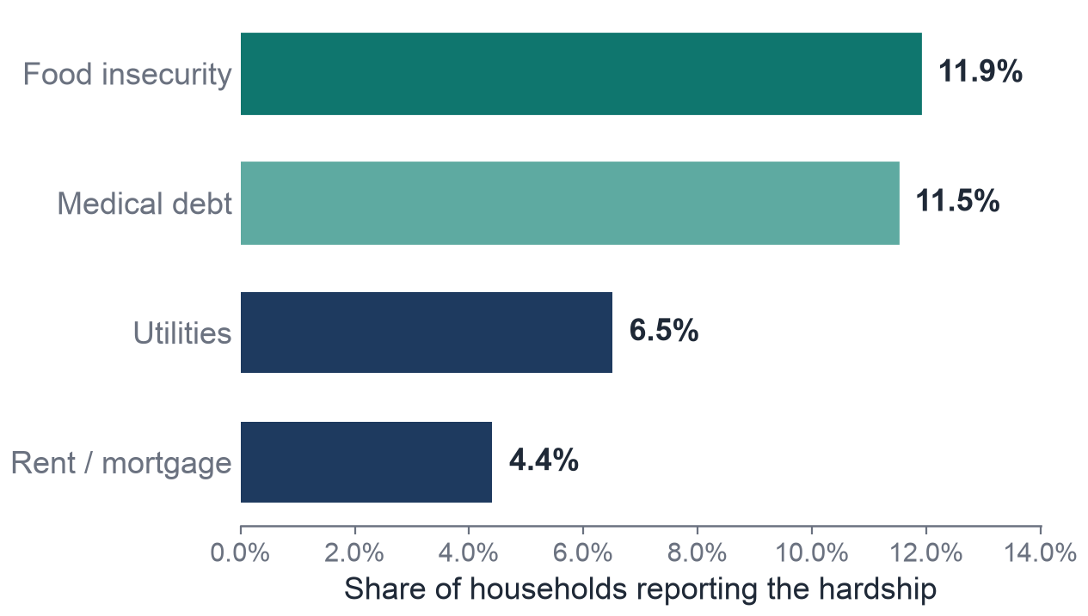
HARDSHIP
About one in four households reports a hardship
06

Slide 9
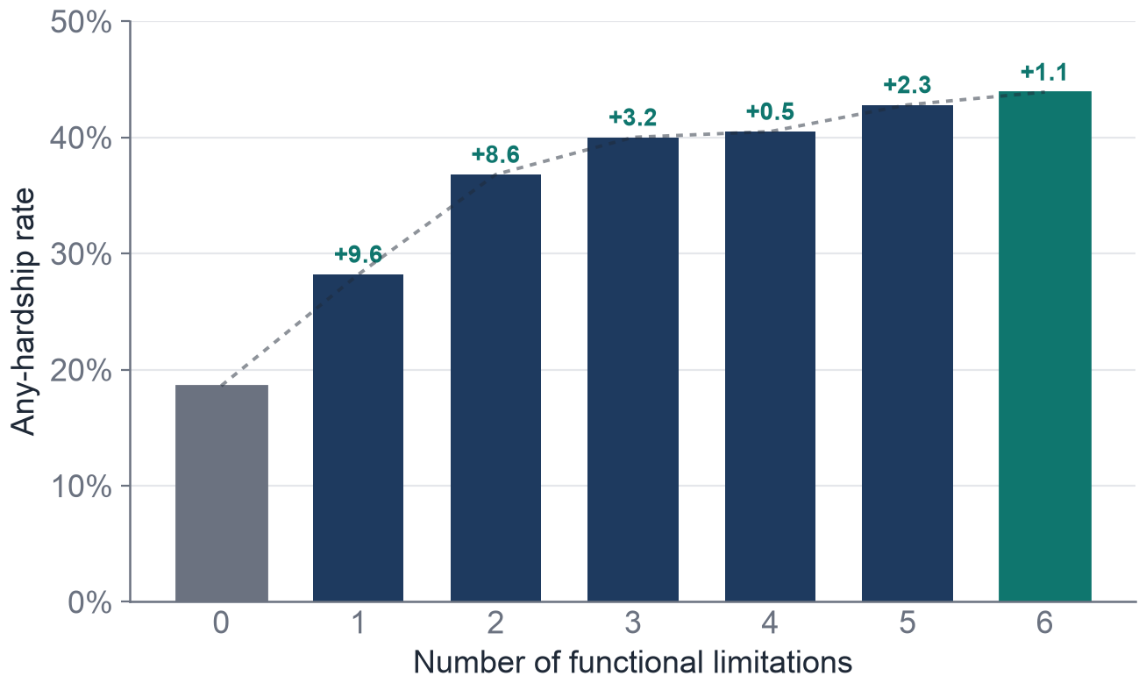
DISABILITIES DOSE-RESPONSE
Each added limitation raises hardship rate
Hardship rate increases at every severity step, steepest early (0→2), then flattening. It is a dose-response.
+25 %
in hardship rate from no limitations (18.6%) to level six (43.9%)
07

Slide 10
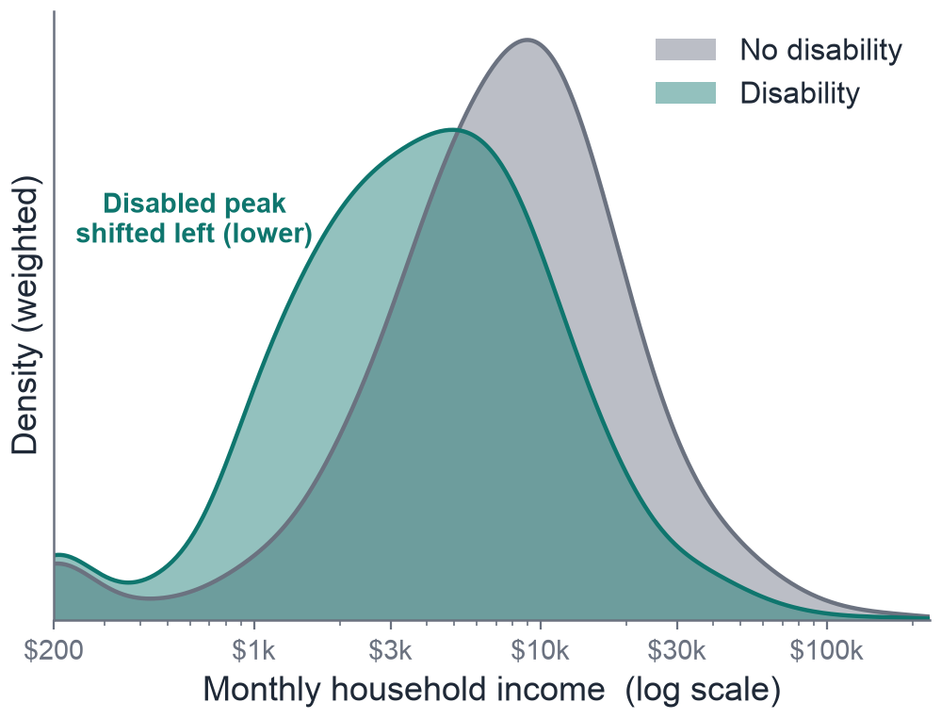
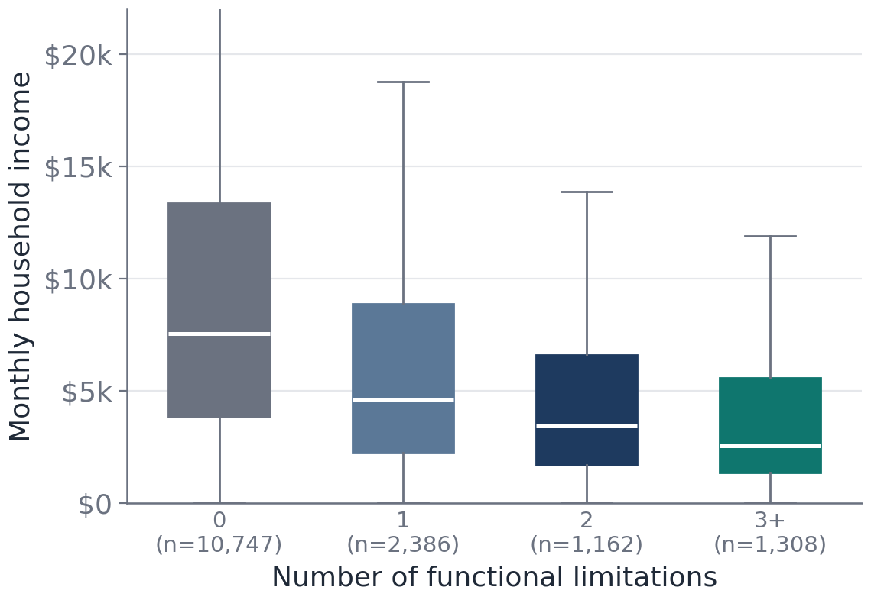
INCOME
The Impact of Disability on Household Income
08

Slide 11
02
PREDICTION · MODEL 1
How predictive is disability?
Four models predicting material hardship, and where disability ranks.

Slide 12
MODEL #1: PREDICTING HARDSHIP
A prediction task
We predict any material hardship (food, utilities, rent/mortgage, or medical debt) from disability plus demographic, household, employment, and income features.
THE PREDICTION TARGET
23.3%
Disability enters as presence + severity (0–6)
of households report at least one hardship
Assistance-program flags excluded (they leak the outcome)
n ≈ 15,595 December adult reference persons
09

Slide 13
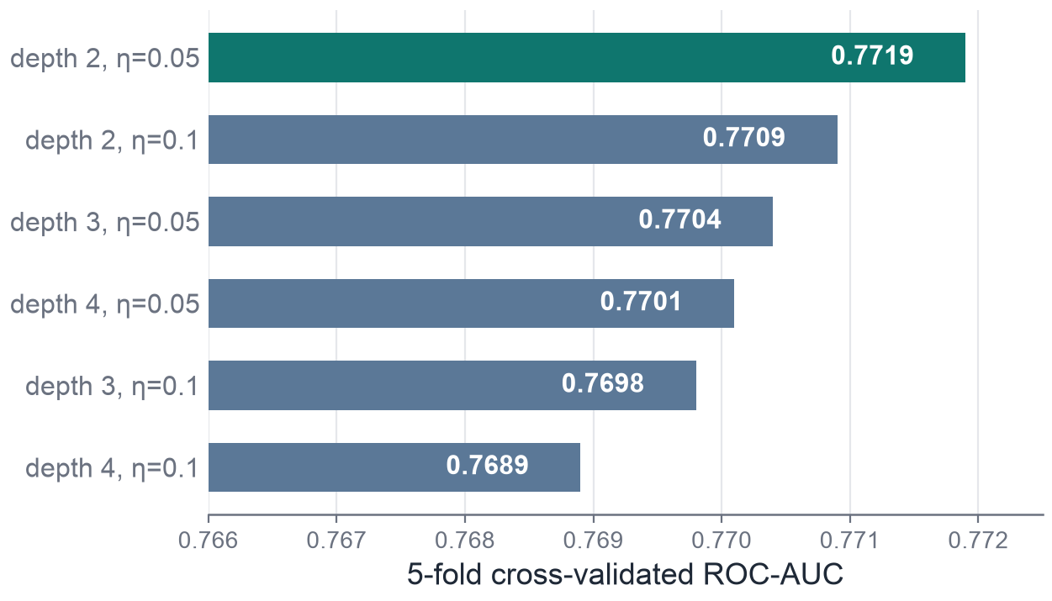
Model #1: Several Models
Four models, tuned by 5-fold cross-validation
Tuning the winner
01
02
Grid search over tree depth and learning rate, scored on cross-validated ROC-AUC.
The shallow, slow setup (depth 2, η 0.05) wins: many weak trees rather than a few strong ones.
Logistic
Penalized logistic
Baseline · no tuning
glmnet · tuned α × λ
Interpretable reference point
α = 1 (LASSO), λ = 1e-4
03
04
Random forest
Gradient boosting
500 trees · tuned mtry
xgboost · tuned depth × η
mtry = 5
depth 2, η 0.05, 252 rounds
10

Slide 14
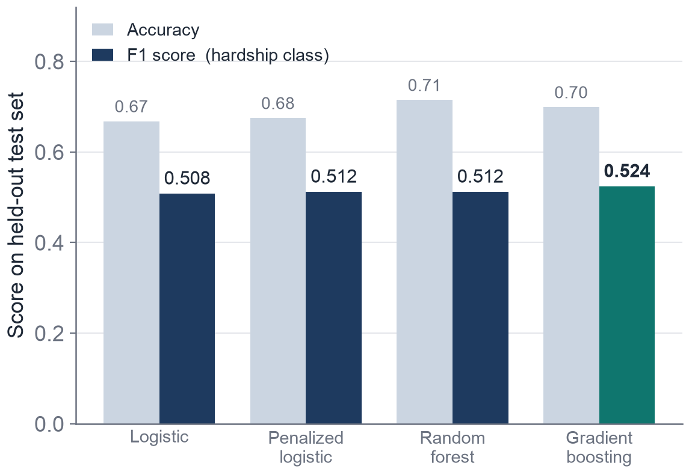
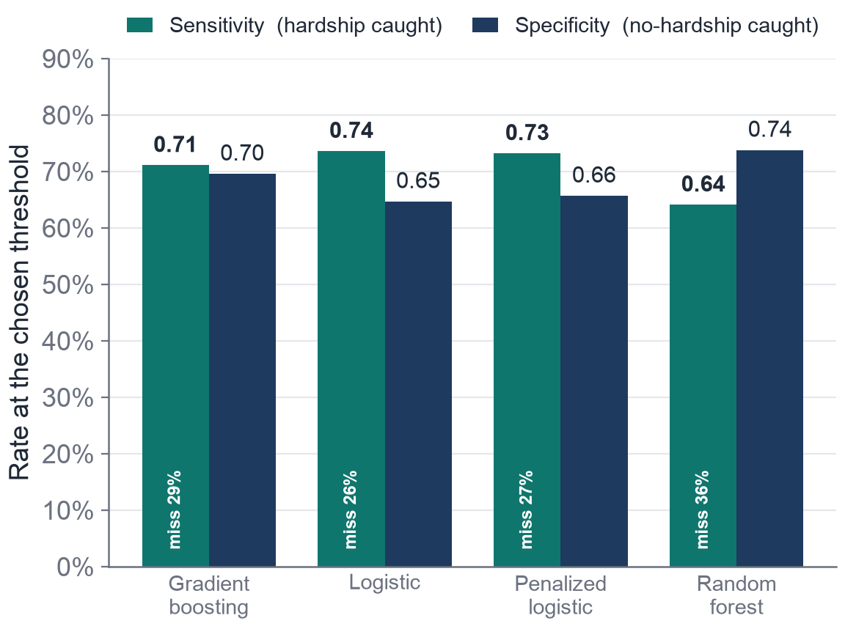
Model #1: MODEL COMPARISON
Model comparison
F1 is valued over accuracy | Gradient boosting has the highest F1 | Random forest captures 64% hardship
Models cluster near 0.51 | Gradient boosting captures 71% hardship
11

Slide 15
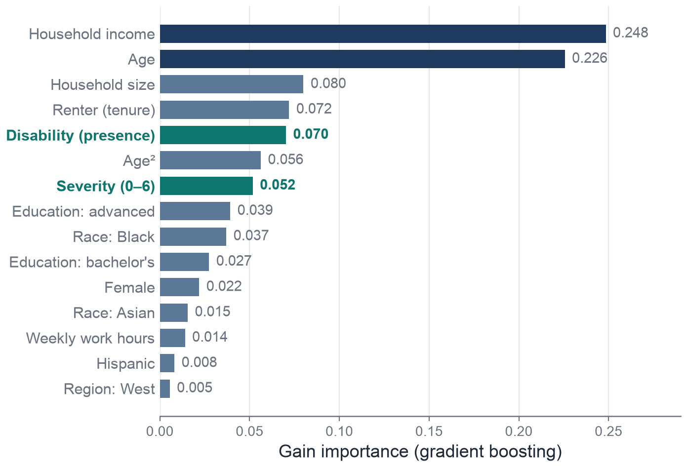
Model #1: WHERE DOES DISABILITY RANK?
Top predictors of material hardship
READING THE RANKS
Income & age lead
the two dominant predictors, as expected.
Disability presence: 5th
Severity: 7th
Because income and employment are already in the model, the signal of disability is not just poverty.
12

Slide 16
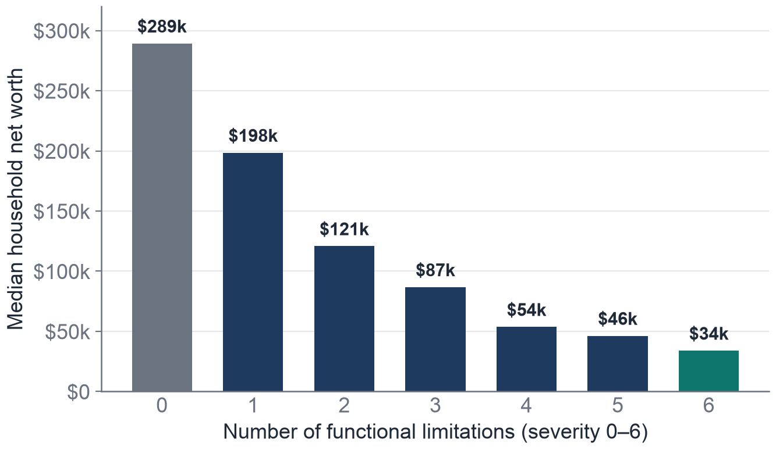
MODEL #2: THE NET-WORTH GAP
Disabled households hold far less wealth
$289k → $147k
median net worth, no-disability vs disability and it falls at every severity step.
~48% lower
per added limitation, adjusted (95% CI 41–54%).
14

Slide 17
MODEL #2: INCOME CAN'T EXPLAIN IT
The effect of income on the wealth gap
~95%
MODEL A · TOTAL GAP (NO INCOME)
−0.651 ≈ −48% / limitation
The full adjusted association, before any income control.
of the disability–wealth gap persists
When household income is added as a control, the per-limitation coefficient barely moves: −0.651 → −0.618. Only about 5% of the gap runs through current earnings.
MODEL B · STRUCTURAL GAP (+ INCOME)
−0.618 ≈ −46% / limitation
Almost unchanged — 94.9% of the gap remains after income.
15

Slide 18
03
Bunching Impact before $2000
Discussion on SSI exploitation

Slide 19
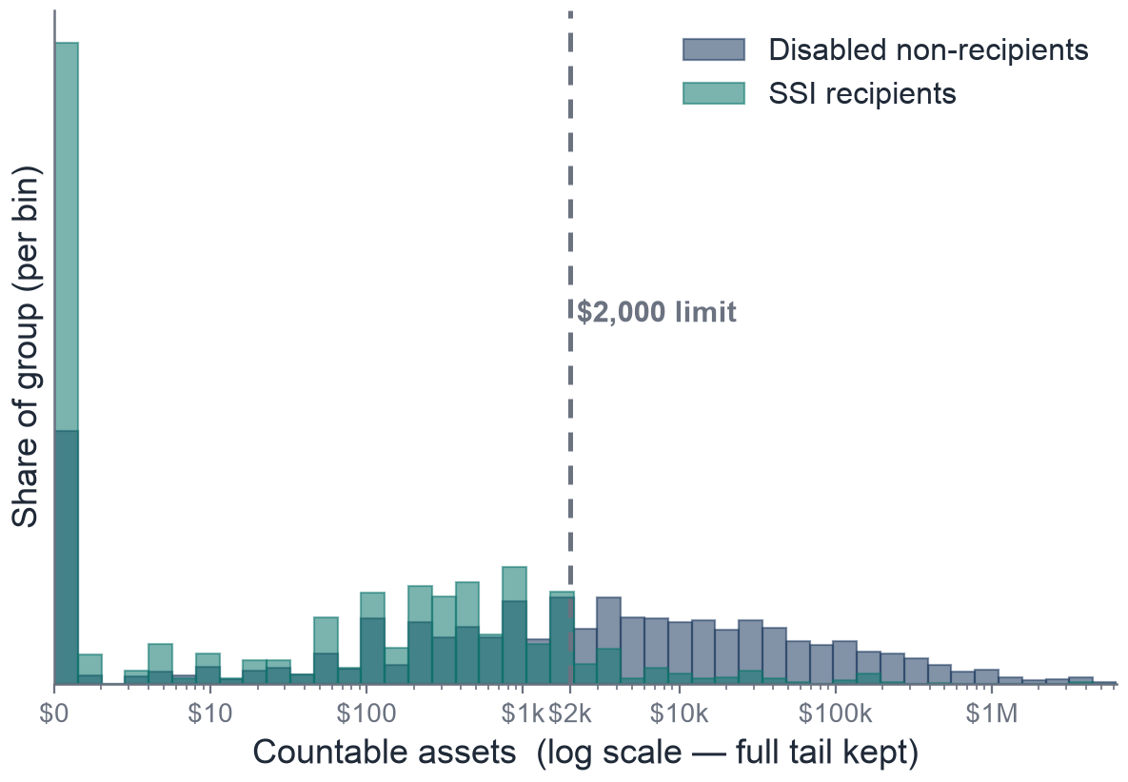
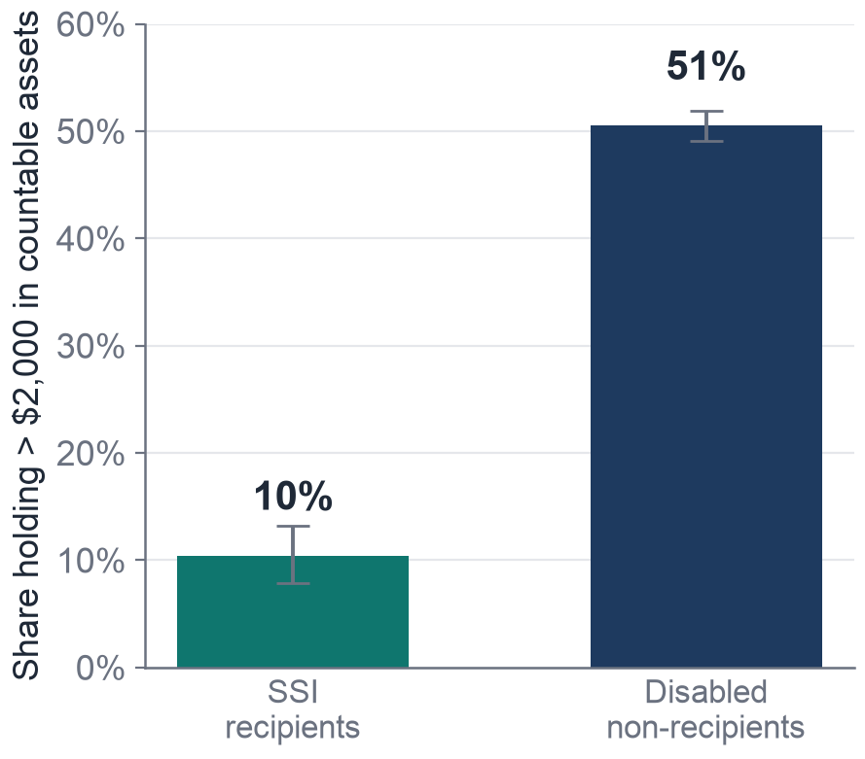
Discussion
Recipients net worth distribution
Countable Assets (log scale)
16

Slide 20
Disabled households fare worse, and it looks structural
CONCLUSION
RQ #1:
RQ #2:
RQ #3:
Prediction
Wealth
Savings
Disability is a leading predictor of hardship, independent of income and employment.
A large net-worth gap that widens with severity; ~95% is not explained by income.
The frozen $2,000 SSI limit is one concrete mechanism; recipients rarely exceed it.

Slide 21
REFERENCES
Data, policy, and methods
DATA & POLICY
METHODS
U.S. Census Bureau. Survey of Income and Program Participation (SIPP), 2024 Public-Use File.
Chen & Guestrin (2016). XGBoost: A Scalable Tree Boosting System.
Social Security Administration. Supplemental Security Income (SSI) resource limits ($2,000, unchanged since 1989).
Lundberg & Lee (2017). A Unified Approach to Interpreting Model Predictions (SHAP).
SSI Savings Penalty Elimination Act; ABLE Age Adjustment Act (pending federal legislation).
Tibshirani (1996). Regression Shrinkage and Selection via the Lasso.
CDC. Disability and Health Data System: disability prevalence among U.S. adults (“1 in 4”).
Burbidge, Magee & Robb (1988). Alternative Transformations to Handle Extreme Values (IHS).
Analysis in R (glmnet, ranger, xgboost, SHAPforxgboost) and Python; all figures generated from the 2024 SIPP microdata.
17

Slide 22
AI Usage
AI Usage
Wrangling a massive dataset: The raw SIPP file had 5,203 variables and ~437k records (~3GB). We used AI to write Python scripts that pulled only the ~30 columns we needed, so we could work with the data at all.
Building the prediction pipeline: AI helped us set up the hardship-classification model: constructing the binary target from survey items, one-hot encoding, handling class imbalance, and running several models.
Debugging tricky problems: When our numbers didn't line up during EDA, AI helped us trace it to 26 dropped cases with missing asset data.
Slides & interpretation: We used AI to give feedback to our slides and edit our slides. For example, we asked to refine working, remove awkward phrases, etc..
17

