Slide 1
Zoo
流程說明

Slide 2
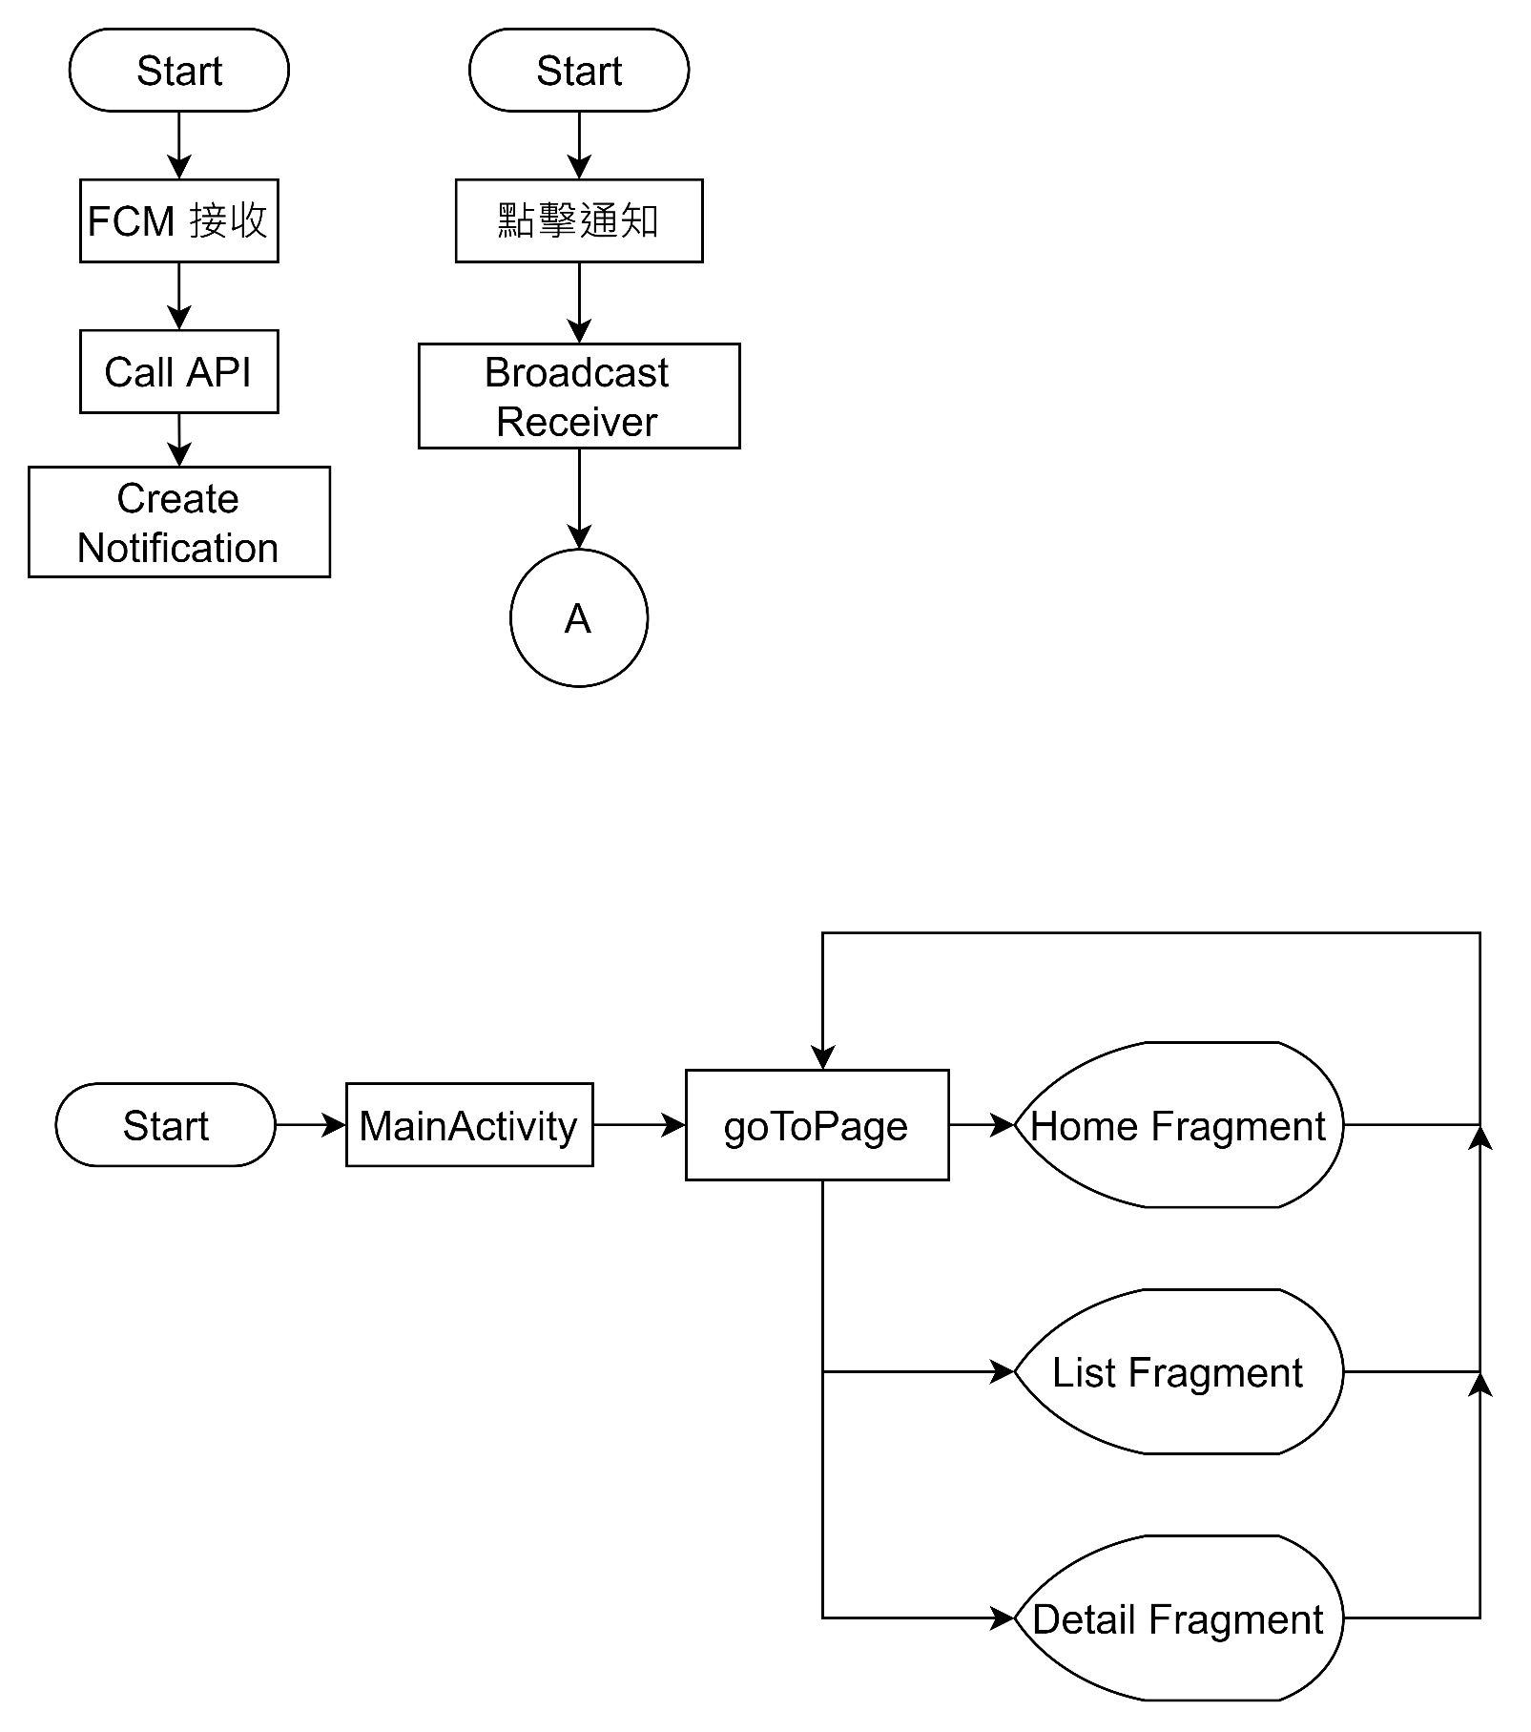
App 流程
A

Slide 3
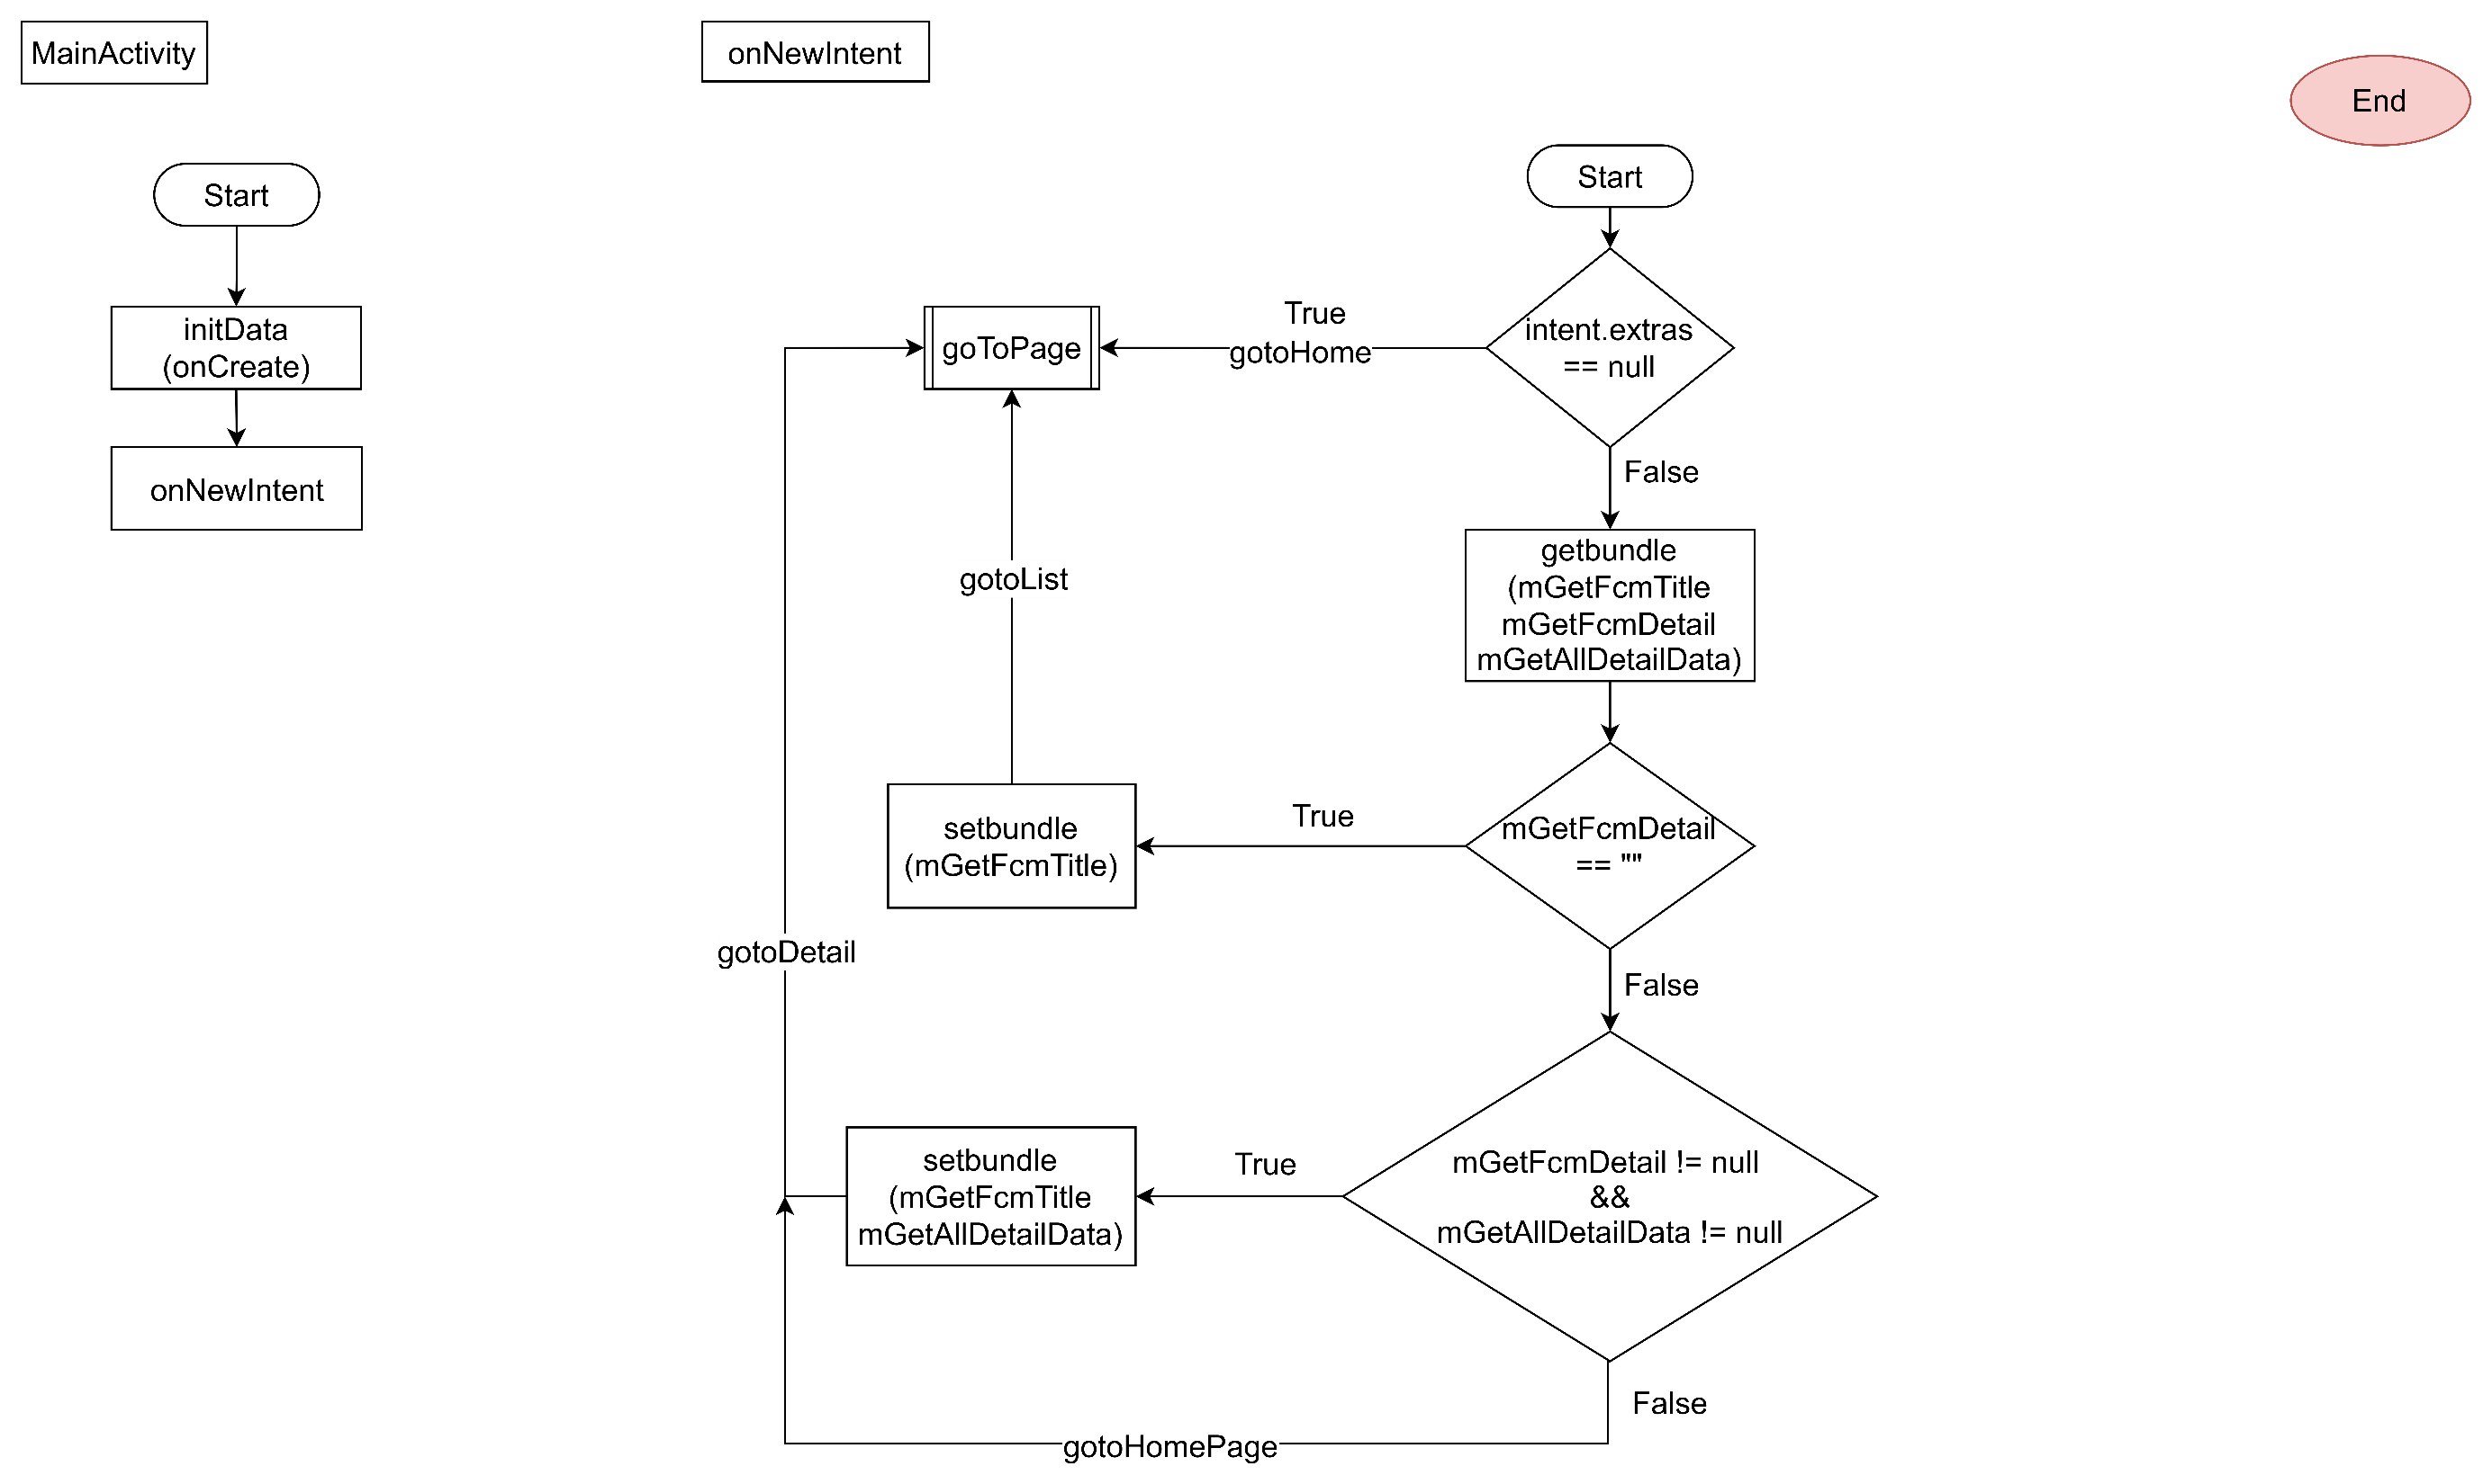
MainActivity

Slide 4
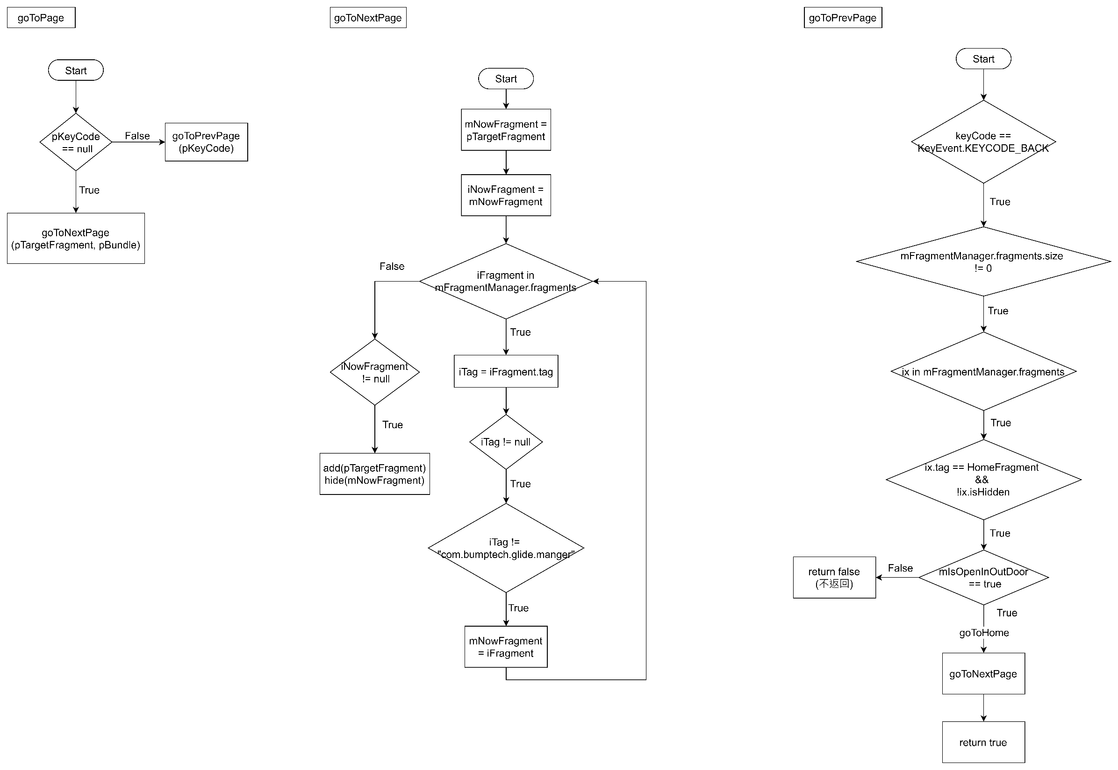
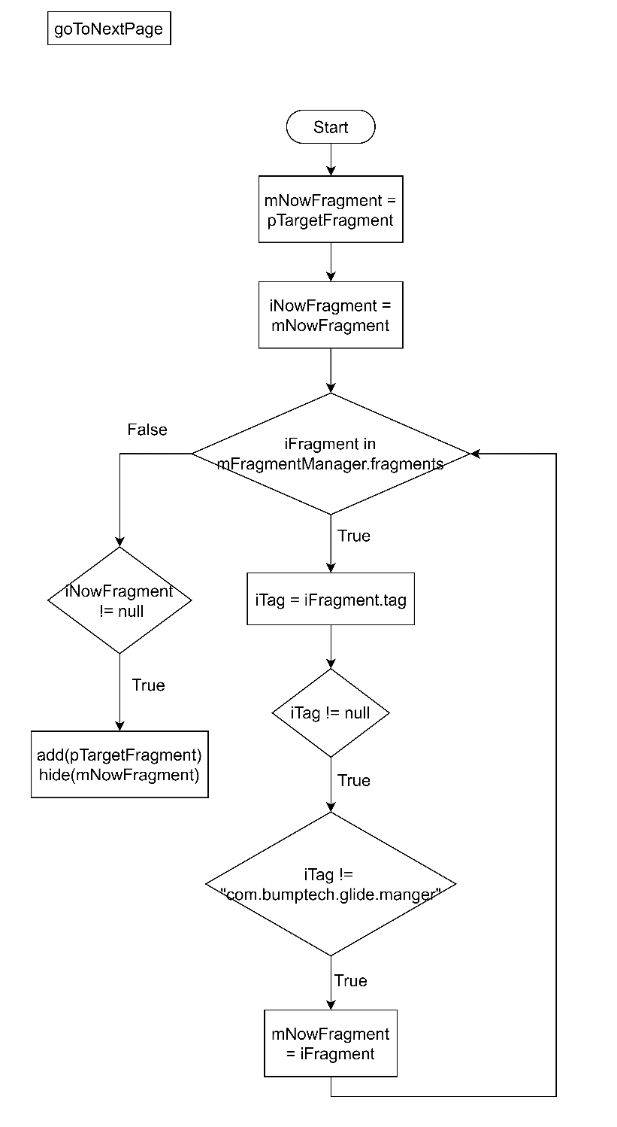
Application_goToPage

Slide 5
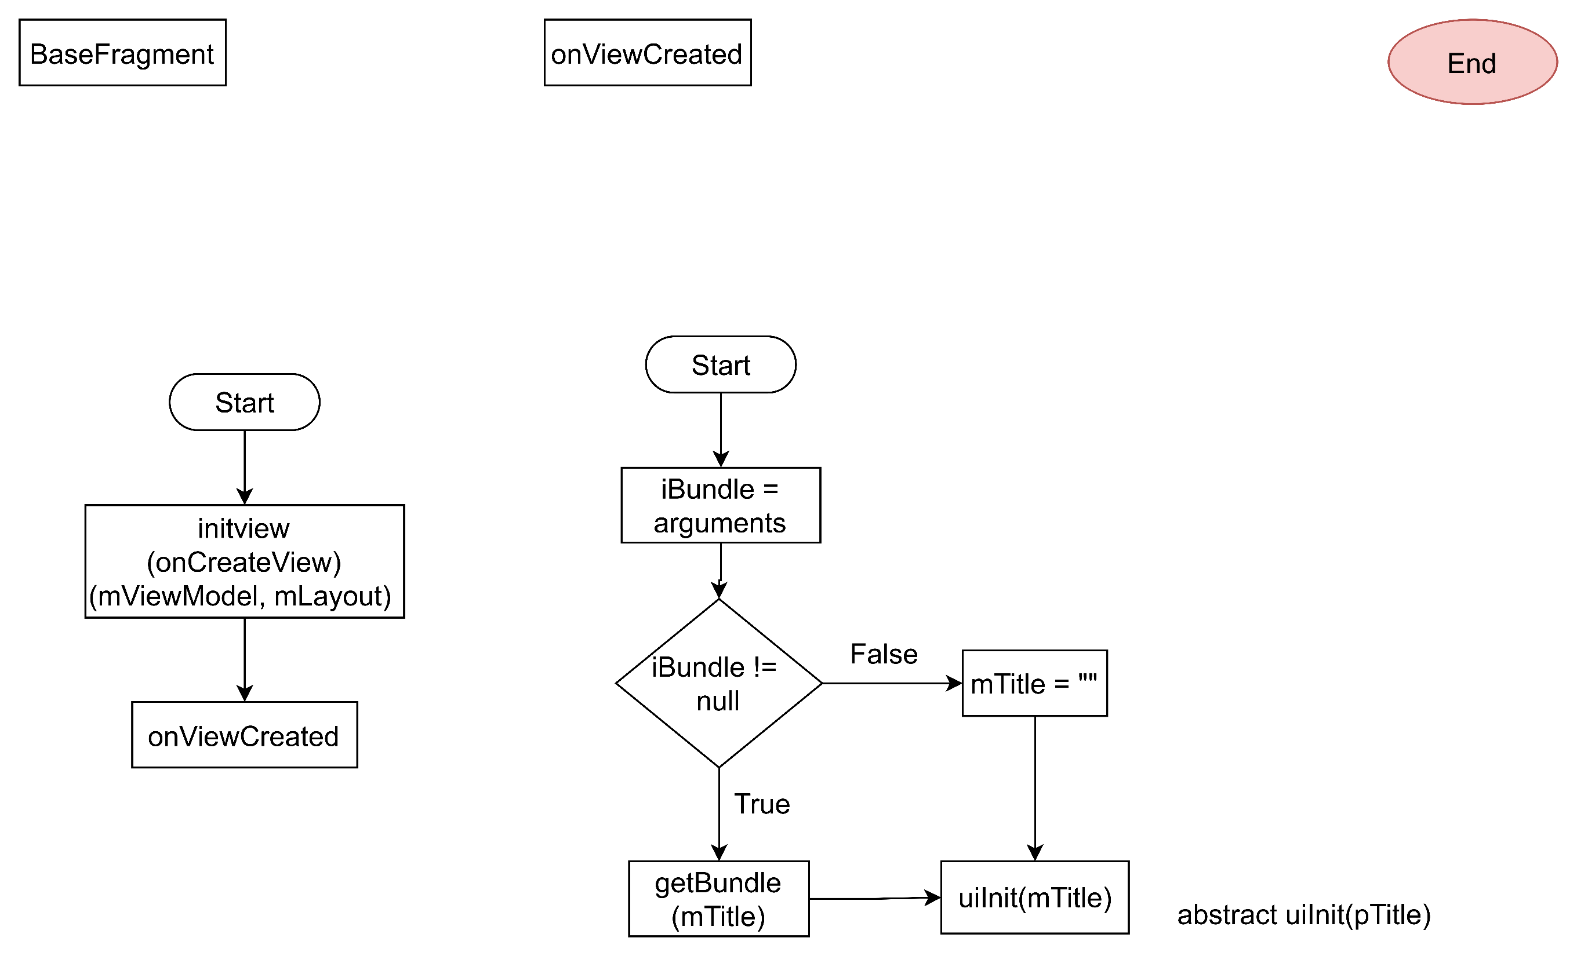
BaseFragment
onViewCreated

Slide 6
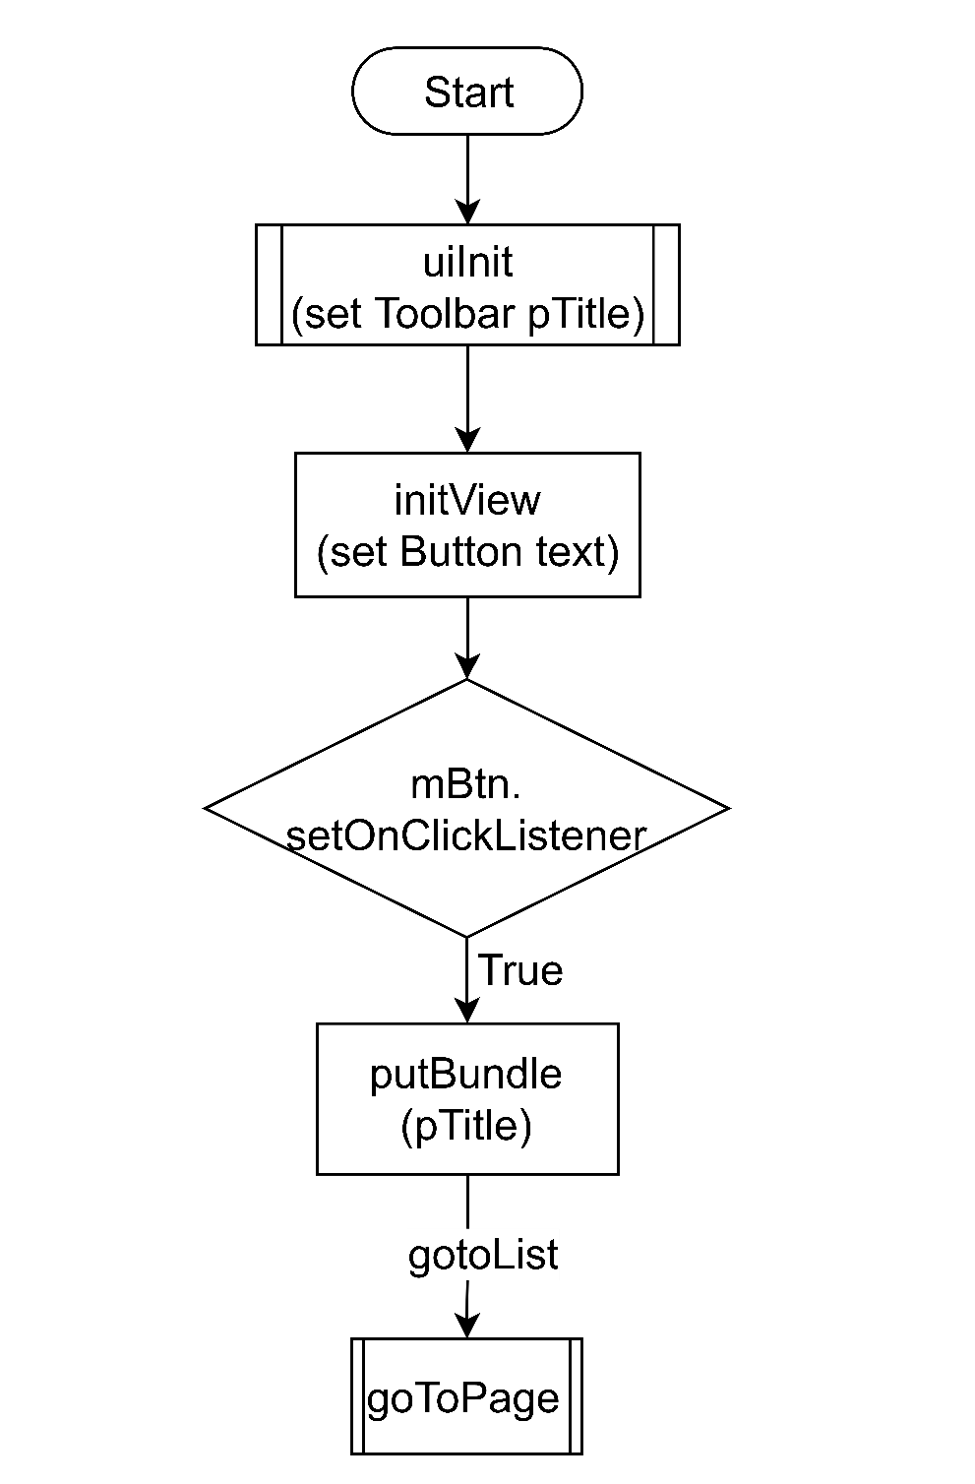
Home Fragment

Slide 7
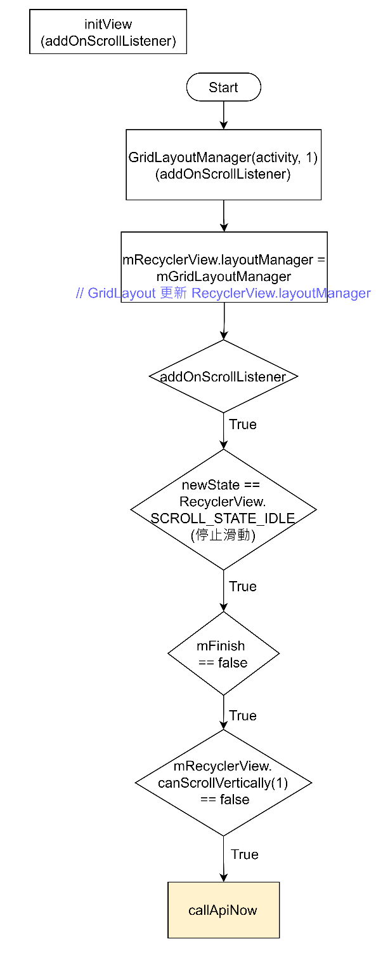


ListFragment

Slide 8
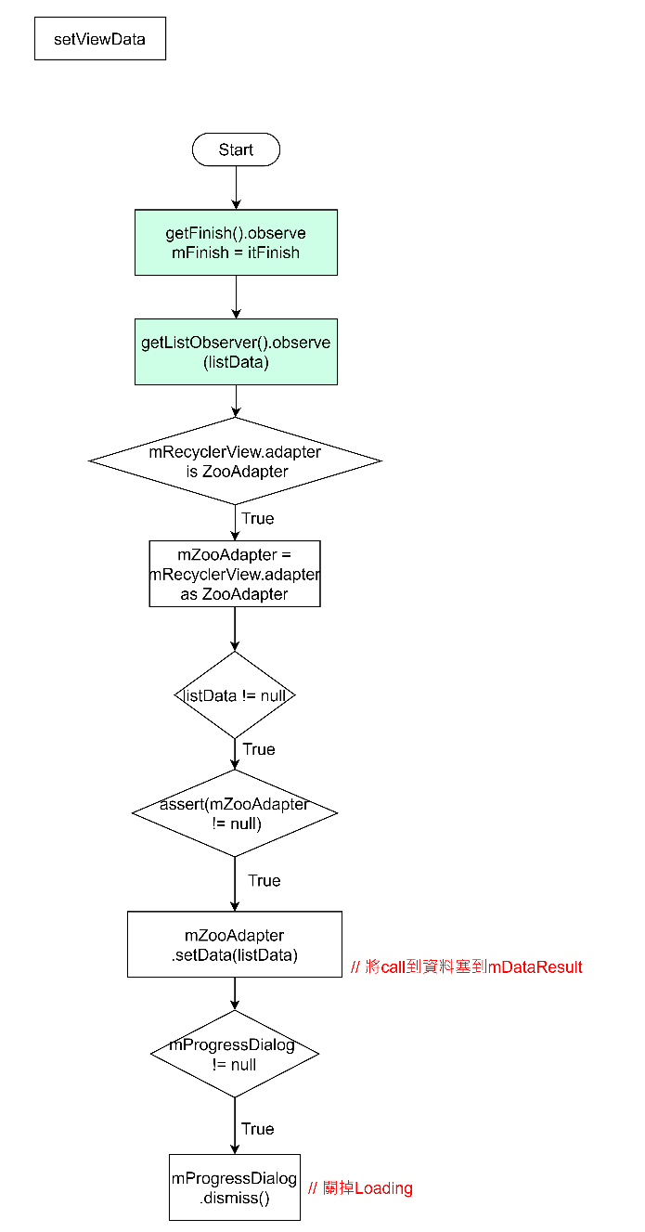


Slide 9
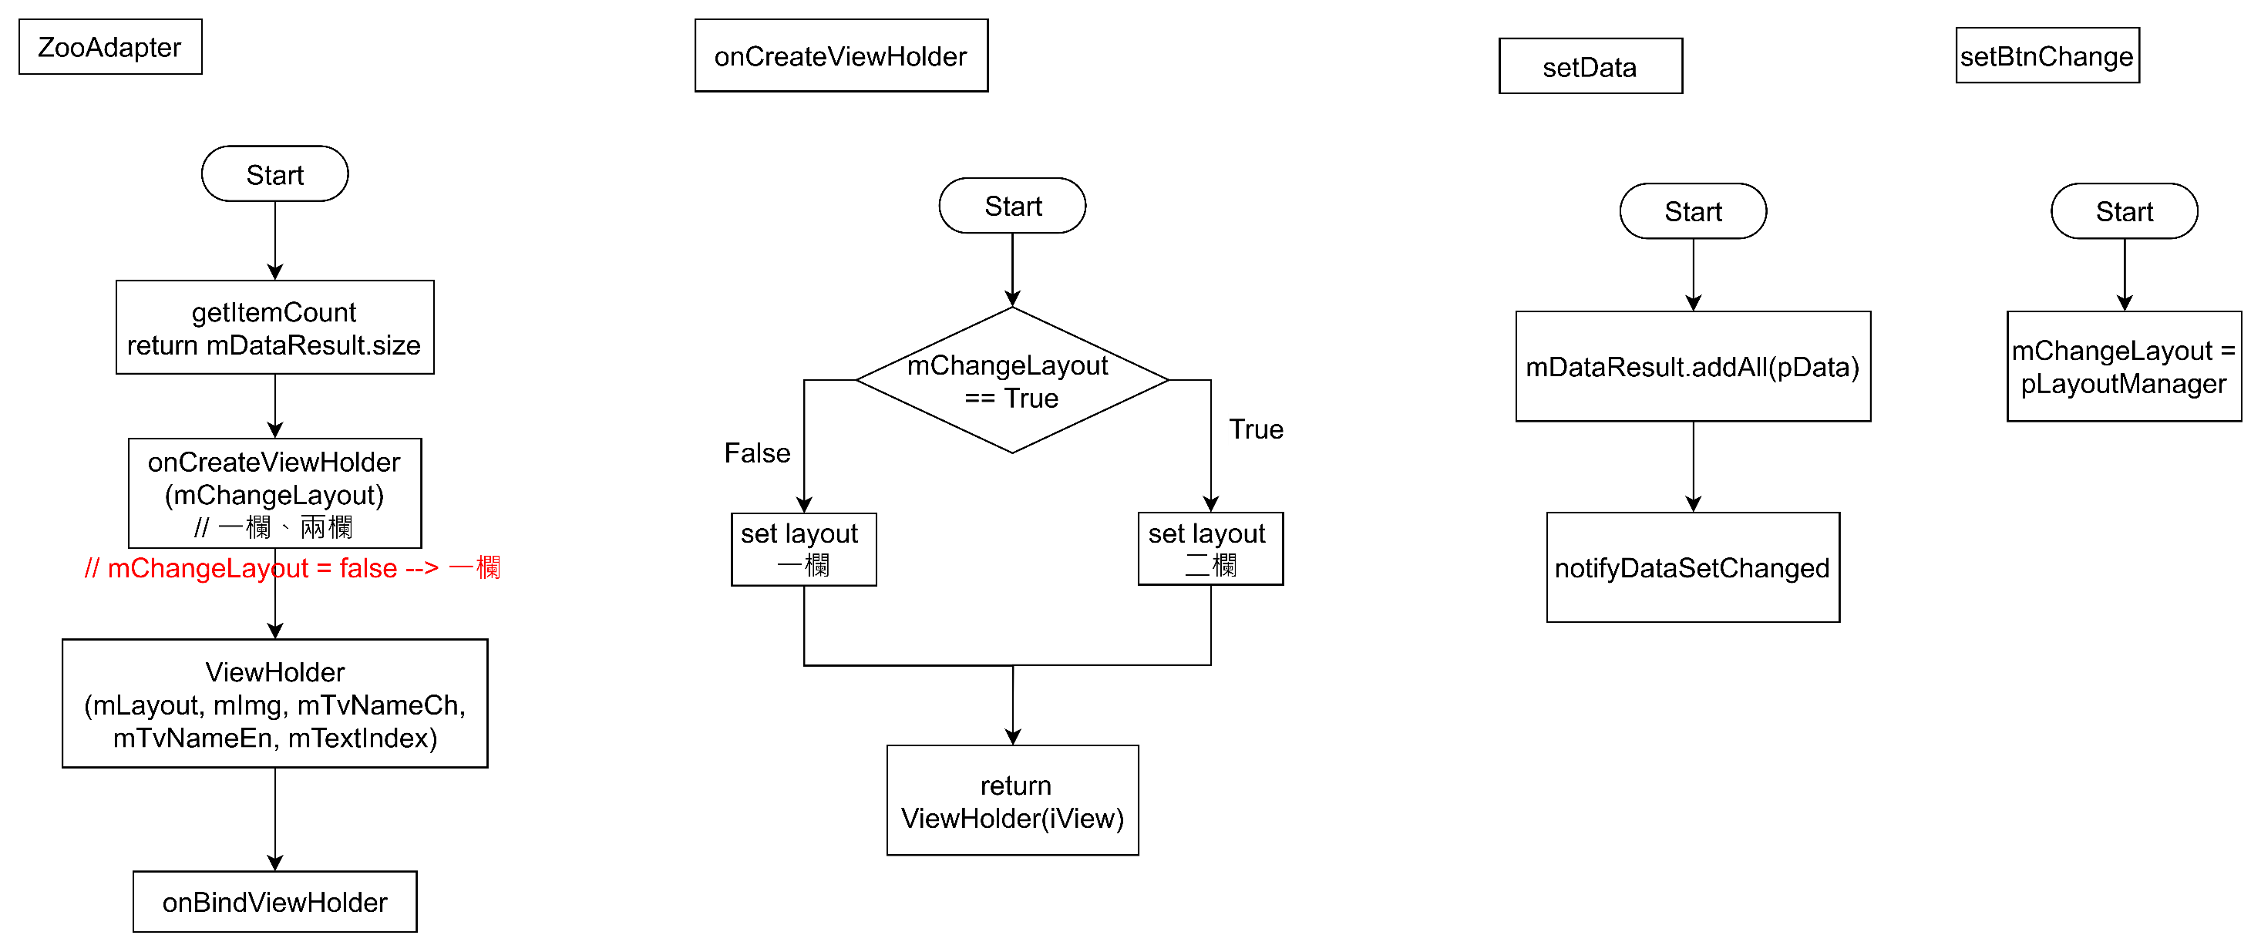
ZooAdapter

Slide 10
ZooAdapter
onBindViewHolder
getRoomQuery

Slide 11
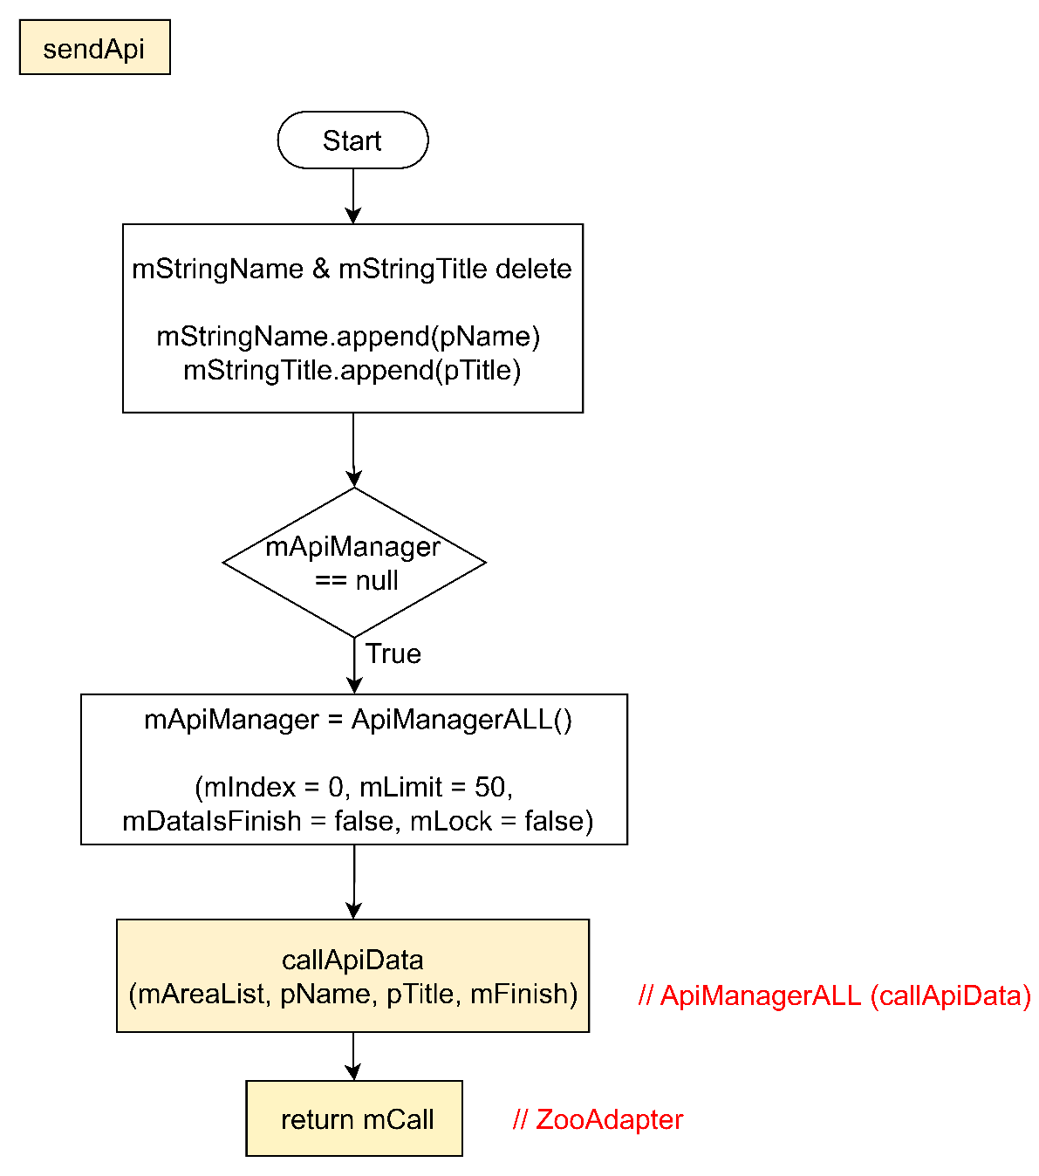
AllViewModel

Slide 12
DetailFragment

