Slide 1
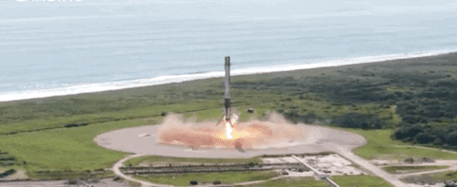
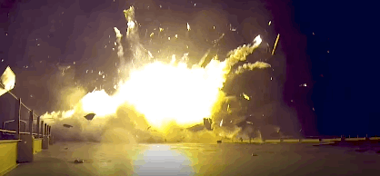
Analysis of SpaceX Launch Data
Predicting when Falcon 9 landings are successful... or not

Slide 2
Executive Summary
Introduction
Methodology
- Data Collection
- Exploratory Analysis and Visualization
- Predictive Analysis
Results
- Exploratory Visualization and SQL results
- Interactive Map with Folium
- Predictive Model results and scores/metrics
Conclusion

Slide 3
Introduction
Background
In the business of launching rockets into space, one of the key factors is, of course, the cost.
SpaceX has been able to offer launches at a lower cost in part because they have been developing rockets with which they are able to land the first stage booster back to Earth for it to be reused, instead of discarding it.
While this is not always successful, it has huge cost saving potential. (To the tune of tens of millions of dollars.)
In this project we aim to collect and use data from SpaceX Falcon 9 launches to predict whether the first stage will successfully land for a given launch.

Slide 4
Introduction
Goals
Gather available data for Falcon 9 launches
Determine what factors influence the success or failure of landing the rocket
Test and compare the performance of multiple methods/models for predicting success/failure of the landing based on the selected features
See which features give the best chance of success

Slide 5

Methodology

Slide 6
Methodology
Data collection
Data was collected into Pandas DataFrames with Python using the “requests” package to access SpaceX API and web scraping from Wikipedia using requests and “BeautifulSoup” packages

Slide 7
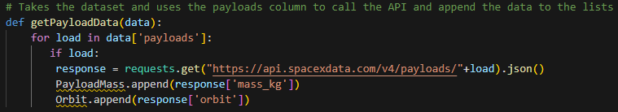
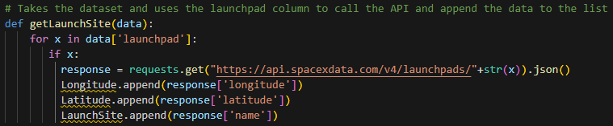
Methodology
Data collection
Data was collected into Pandas DataFrames with Python using the “requests” package to access SpaceX API and web scraping from Wikipedia using requests and “BeautifulSoup” packages
API Example Code:

Slide 8
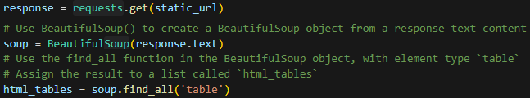
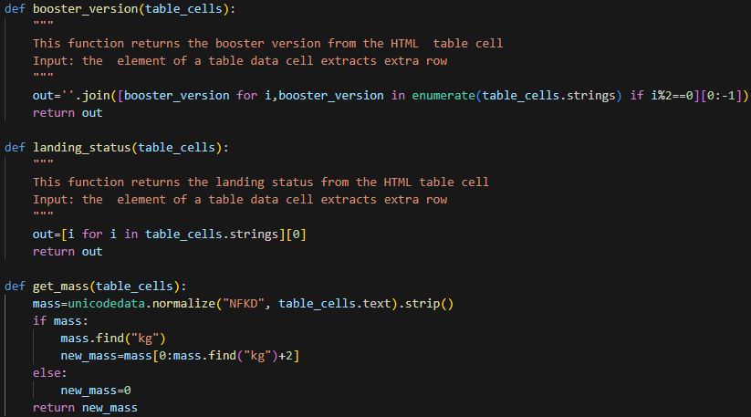
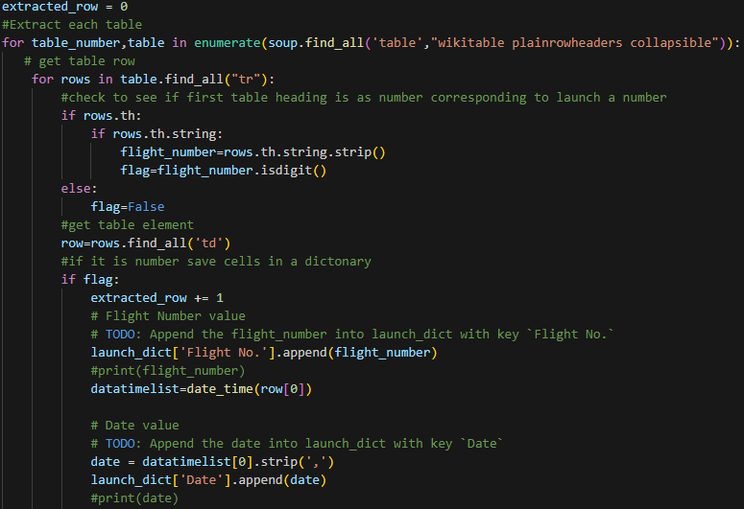
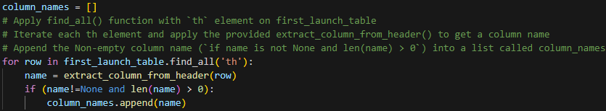
Methodology
Data collection
Web Scraping Example Code:

Slide 9
Methodology
Data Wrangling/Cleaning
With the data in a Pandas data frame, it was then preprocessed to select relevant features, remove/replace null values where applicable
Keep only Falcon 9 launches, deleting others
Created a new column called “Class” to be the target variable for prediction (1 for successful, 0 for failure)
Used One-Hot encoding to transform categorical features into numerical format with Pandas get_dummies() method

Slide 10
Methodology
Exploratory Analysis
Used seaborn and pyplot packages to visualize how some of the variables relate to one another as well as the landing success rate

Slide 11
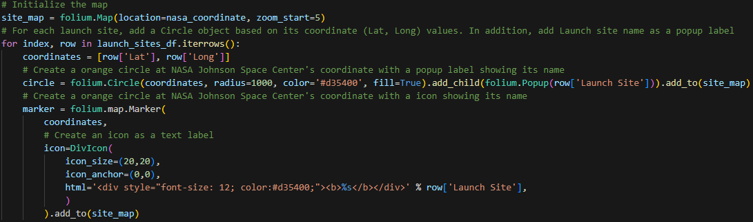
Methodology
Exploratory Analysis
Used seaborn and pyplot packages to visualize how some of the variables relate to one another as well as the landing success rate
Also used SQL queries to examine certain aspects of the data, such as:
Success and failure of landings based on the type of landing pad. Some are done on land, some are done in the ocean.
Average mass of payloads carried by Booster Versions
Check the unique launch sites
Created an interactive map using the Folium package, showing launch sites and adding markers showing successful and failed landings.

Slide 12
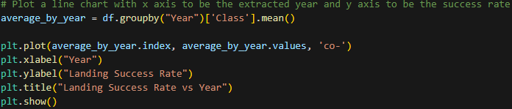
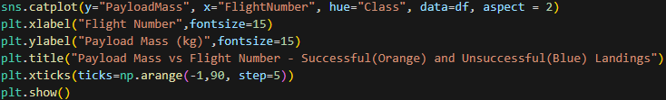



Methodology
Exploratory Analysis
Used seaborn and pyplot packages to visualize how some of the variables relate to one another as well as the landing success rate
Also used SQL queries to examine certain aspects of the data, such as:
Success and failure of landings based on the type of landing pad. Some are done on land, some are done in the ocean.
Average mass of payloads carried by Booster Versions
Check the unique launch sites

Slide 13

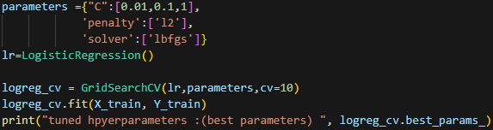


Methodology
Predictive Analysis
Used scikit-learn package to split data into training and testing sets, normalize the features data, then use GridSearchCV() method with 4 different machine learning classifiers and check their accuracy
Models used: Logistic Regression, Support Vector Classifier, Decision Tree Classifier, and K Nearest Neighbors
Plotted confusion matrix with seaborn for each model’s test data predictions

Slide 14
Results

Slide 15
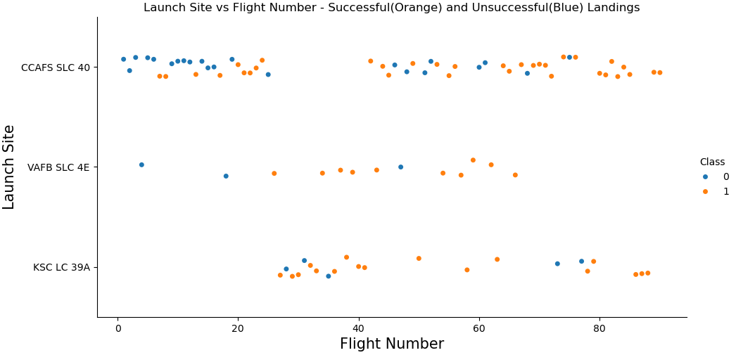
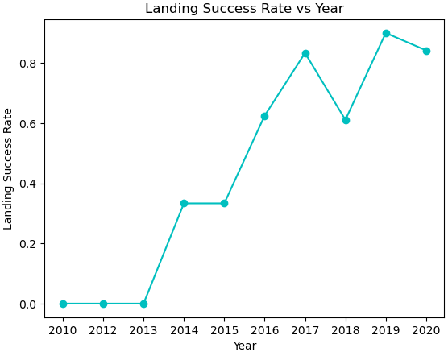
Results
Exploratory Analysis
From the first catplot we noticed that with higher flight numbers, the success rate was higher
A line graph showing the success rate over time shows us the same thing. SpaceX has gotten better at landing the booster as they’ve gotten more experience attempting it.

Slide 16
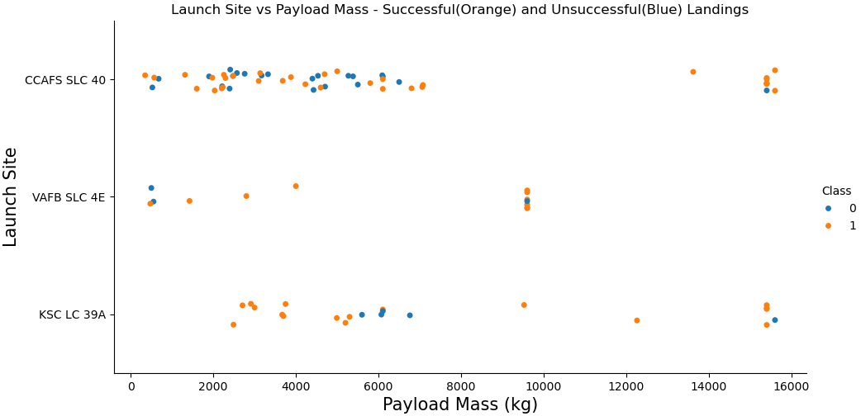
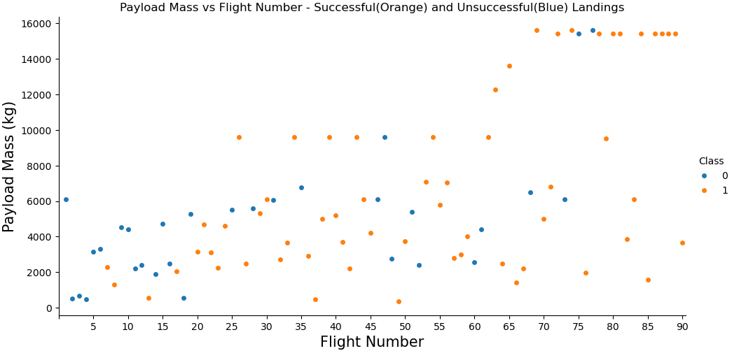
Results
Exploratory Analysis
The Vandenberg Space Launch Complex in California has not had any pay loads at 10,000 kg or higher, while the launch sites in Florida have.
SpaceX has gradually increased the maximum pay load masses carried by Falcon 9 over time and the larger pay loads do not seem to negatively affect the booster landing success rate. The success rate still increases.

Slide 17
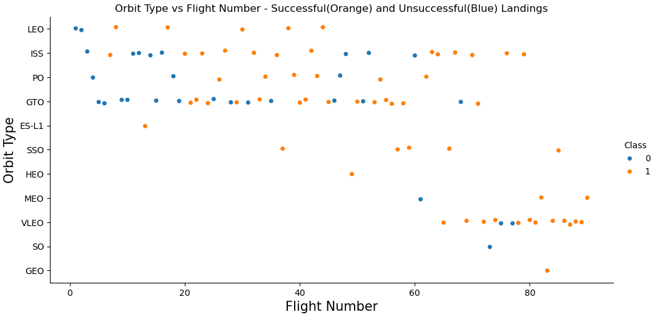
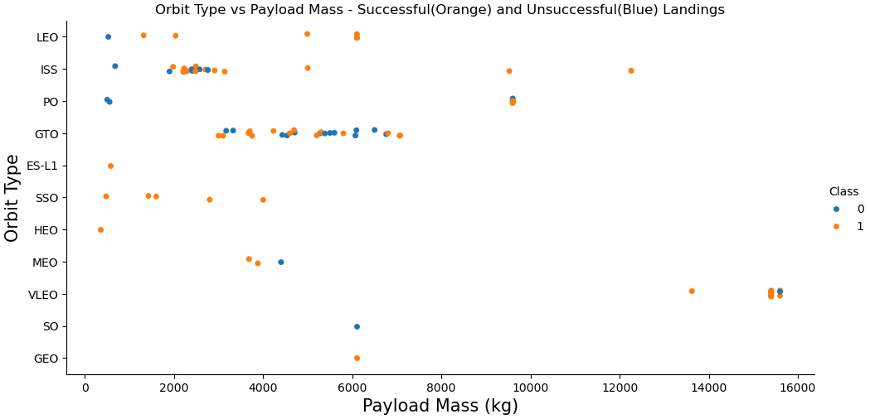
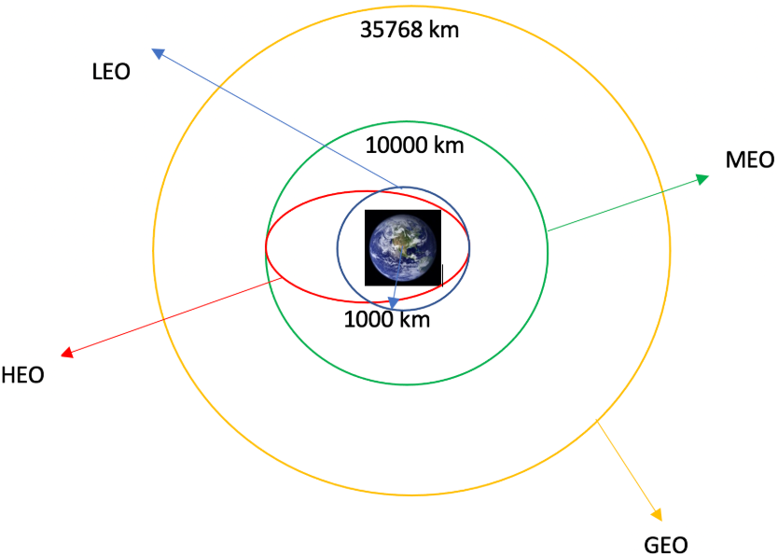
Results
Exploratory Analysis
Launches have expanded into a larger variety of Orbit Types over time
ISS and PO (Polar Orbit) have some launches with higher than average pay load mass, while VLEO (Very Low Earth Orbit) has several launches with significantly higher mass than all other types
ISS and GTO (Geosynchronous Transfer) launches fail to land more often than others
Orbit Type Examples

Slide 18
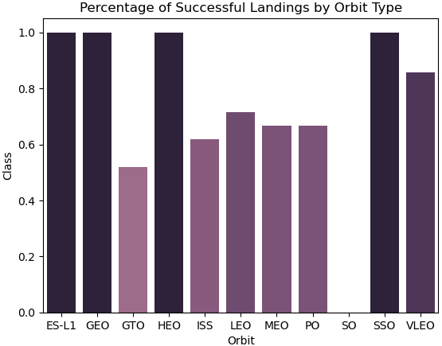
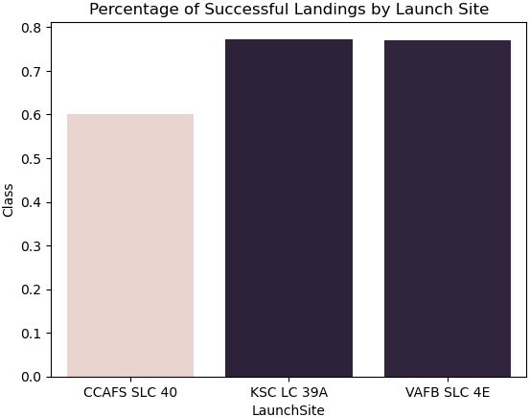
Results
Exploratory Analysis:
Bar Charts showing Landing Success Rates for different Orbit Types and Launch Sites
Orbit Type Examples

Slide 19
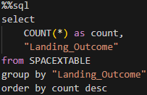


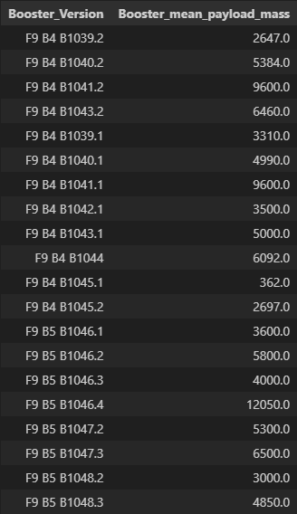
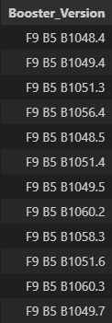
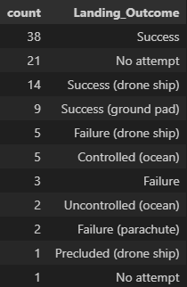
Results Exploratory Analysis: SQL
Landing Outcomes by Type of Landing:
Average Pay Load Mass by Booster Version:
Boosters which have carried the Highest Pay Load (15,600 kg):
(96 total versions
20 shown)

Slide 20
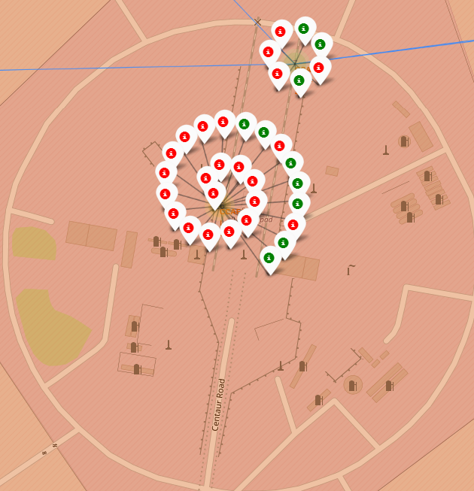
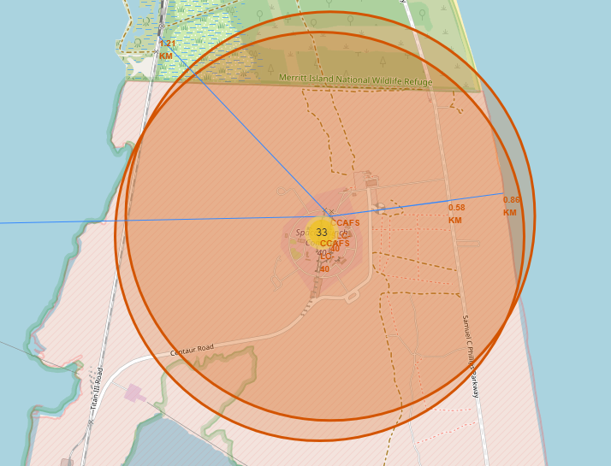
Results Exploratory Analysis: Interactive Map with Folium
Markers placed around Cape Canaveral Space Launch Complex in Florida.
Number of Launches shown in yellow circles. Blue lines showing distance to nearest coastline, railroad, and city.
Zooming in and clicking on yellow circles reveals pop-ups showing individual launches, colored for Landing Success or Failure.

Slide 21
Results Predictive Analysis: Scikit-learn Machine Learning Models
Training Set: 72 records
Testing Set: 18 records
For each model, created a GridSearchCV object to test multiple hyper-parameters and return the best scoring version on the training data.
Then, checked how well the model predicted the testing data.
Each model was a classification model, attempting to predict Landing Success or Failure based on all of the selected features.

Slide 22
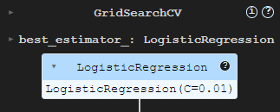

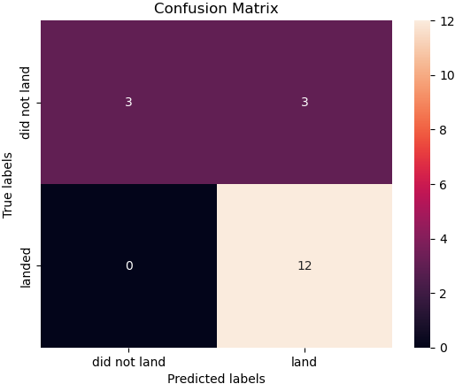
Results Predictive Analysis: Logistic Regression Model

Slide 23
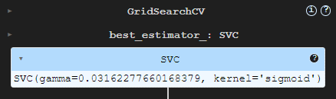
Results Predictive Analysis: Support Vector Machine Model

Slide 24
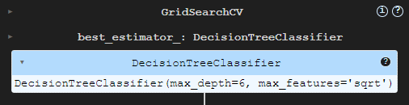

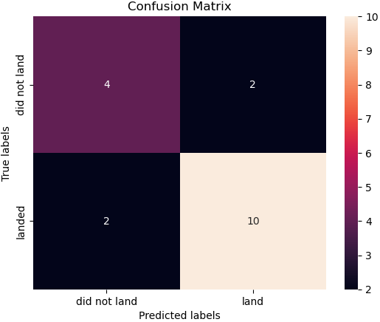
Results Predictive Analysis: Decision Tree Classifier Model

Slide 25
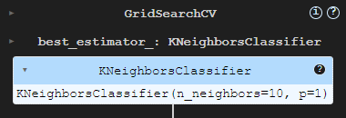
Results Predictive Analysis: K Nearest Neighbors Model

Slide 26
Results Predictive Analysis: Scikit-learn Machine Learning Models
The models all performed somewhat similarly.
Their training accuracies varied, but on the training data, 3 of the 4 got the same results with 15 of 18 of the test records predicted correctly. The predictions that were incorrect came from predicting 3 launches that failed would’ve been successful.
The Decision Tree Classifier was inconsistent and predicted 13 of the 18 test records correctly, classifying 2 of the successful landings as failures.

Slide 27
Conclusions
Landing success has increased over time and launch sites with more launch attempts have a higher landing success rate
Vandenberg (CA) and Kennedy Space Launch (FL) Complexes successfully land more often than Cape Canaveral (FL) site
ES-L1, GEO, HEO, SSO, VLEO Orbit Type launches successfully land more often than other orbits
Higher Pay Load Mass doesn’t seem to negatively effect landing success

Slide 28
Conclusions
The predictive analysis using various machine learning models appears promising. Their accuracy is serviceable with a final data set of only 90 records and 18 of them used for testing.
Analysis of their performance as well as their reliability can be improved if we obtain more quality, relevant data to train and test on.

Slide 29
THANK YOU!
Cody Cline
cccline4@gmail.com

