Slide 1

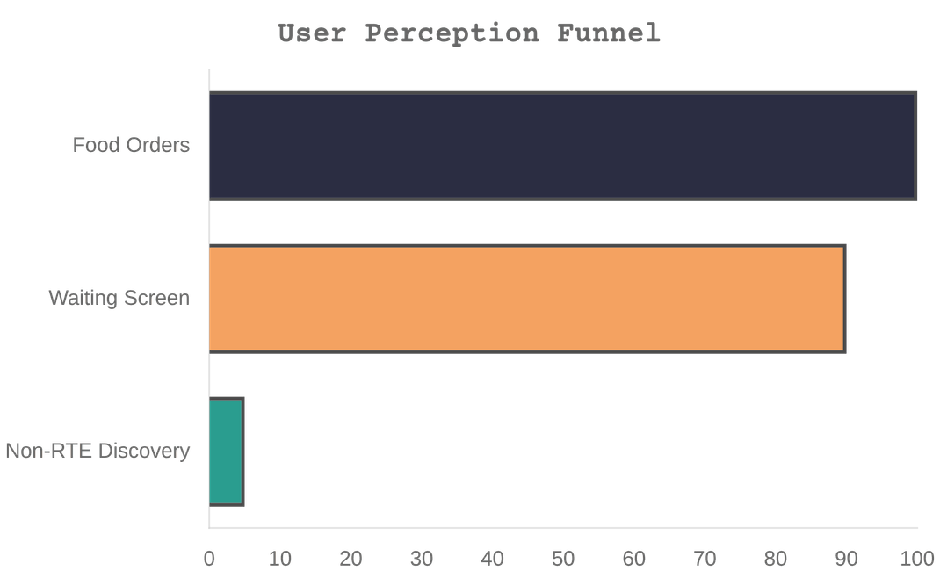
Uzum Tezkor: Food App Perception Gap
Low Non-RTE Share: Users primarily use the app for ready-to-eat food delivery.
➢
Low Cross-Category Usage: Minimal transition to supermarket, flowers, or pet shop.
➢
Waiting Screen: The 30-minute post-order window is a major missed opportunity.
➢

Slide 2




Insight: Waiting Time is a Growth Opportunity
"Post-checkout is not just engagement; it's a high-attention window for category discovery."
➢ Captive Audience: 100% of users stay in-app to track their order.
➢ Natural Discovery: Introducing new categories during "idle" time is less intrusive.
➢ Attention Peak: User focus is highest right after the transaction.
Order Placed
Waiting Window
Discovery
Transaction complete
20-40 mins of attention
Non-RTE activation

Slide 3





Solution: Play & Discover AI
Uzum Tezkor - Tracking
Mini-Game Integration
Your order is coming!
A short, interactive experience embedded directly into the order tracking screen.
Play a quick game while you wait!
Personalized Rewards
WIN $3 OFF FLOWERS
AI-driven incentives (promo codes/cashback) tailored to individual user profiles.
Non-RTE Trigger
Strategic rewards designed specifically to drive first-time purchases in new categories.

Slide 4
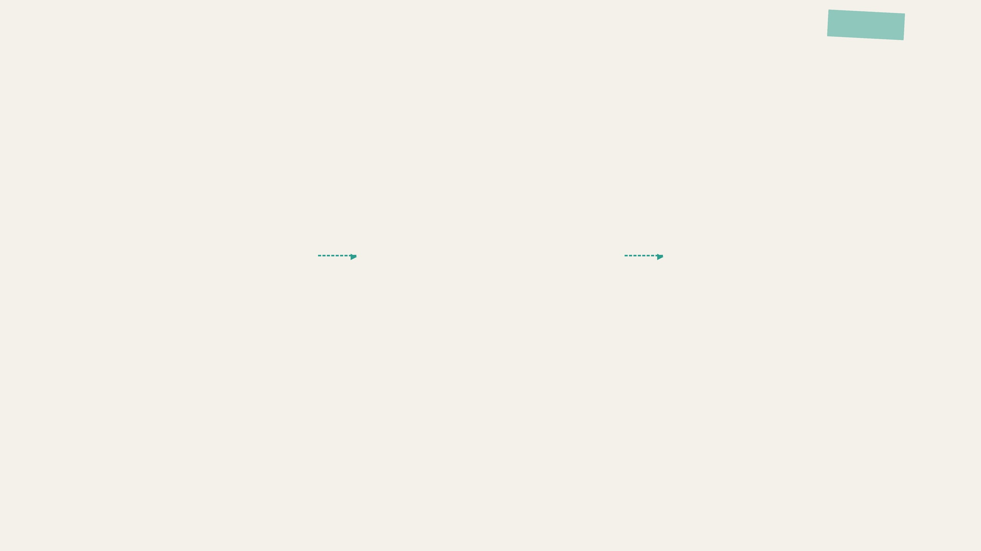
How AI Works: The "Next Best Offer"
Data Inputs
ML Scoring
Personalized Offer
Optimal Category
Order History
•
•
Category Affinity
▶
•
▶
Dynamic Discount
App Behavior
•
•
Promo Sensitivity
•
Custom Creative
Time & Location
•
•
Churn Risk Score
•
Push Timing
Weather Context
•
•
Propensity Model
•
"The engine doesn't just predict what you want; it predicts what will trigger your first cross-category purchase."

Slide 5







UX Flow: Order to Conversion
1. Order
2. Tracking
3. Game
4. Reward
5. Category
6. Conversion
User places a standard food order
Game invite on tracking screen
30-sec interactive experience
Personalized Non-RTE promo
User explores new category
First Non-RTE order placed

Slide 6

Smart Reward Engine
Moving beyond generic promotions: Personalized incentives for every segment.
First-Time Non-RTE
One-Time Explorer
Users who only order food. Goal: Lower the trial barrier for new categories.
Users who tried non-RTE once. Goal: Encourage repeat behavior and habit formation.
High-Value Discount ($3+ Off)
Cashback on Next 2 Orders
Active Cross-Category
Churn-Risk User
Loyal multi-category users. Goal: Increase LTV and reward loyalty.
Inactive users. Goal: Re-activation through high-relevance "We Miss You" offers.
Exclusive Access / Free Delivery
Personalized Re-engagement Promo

Slide 7




MVP Architecture: Realistic & Scalable
Tech Stack
• Python / FastAPI
• Scikit-learn
Data Ingestion Layer
Feature Store & Profile Service
• Redis (Feature Store)
• Existing CRM API
Real-time events & order history from Uzum Tezkor core
Pre-computed user attributes and category affinity scores
ML Scoring Engine (Python/Scikit-learn)
Delivery & CRM Layer
Real-time "Next Best Offer" prediction during tracking window
In-app game trigger and automated push reminders

Slide 8

KPI & A/B Testing: Success is Measured
SUCCESS METRICS
Experimental Design
North Star Metric Non-RTE GMV Share of Total Revenue
Group
Strategy
Expected Impact
Control
No offer / Standard tracking
Baseline
Fixed
Generic 10% discount for all
+5% Conversion
Primary KPI First-time Non-RTE Conversion Rate
AI Group
Personalized "Next Best Offer"
+15-20% Conversion
Secondary KPIs Redemption Rate, Retention Uplift, Repeat Rate
*Targeting 95% statistical significance within 14 days of pilot.

Slide 9

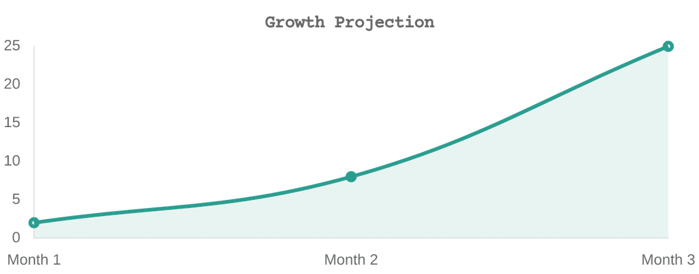
Roadmap & Unit Economics
Days 0-30
Days 30-60
Days 60-90
MVP Development
Smart Pilot
Full Scale-up
Integration with tracking screen and initial ML scoring setup.
A/B testing with 5% user base to refine reward sensitivity.
Rollout to 100% of users and expansion to all categories.
Economic Drivers
Promo Waste Reduction: Dynamic discounting saves ~15% in marketing spend.
➔
Incremental GMV: Unlocking non-RTE spend from existing food users.
➔
Zero CAC: Growth powered by internal traffic, not external ads.
➔

Slide 10





Why This Wins
"We didn't just build a game. We turned idle waiting time into a Zero-CAC Growth Engine for Uzum Tezkor."
Zero CAC Growth
Personalized Activation
Leveraging existing high-intent traffic instead of expensive ads.
Every user gets a relevant reason to explore new categories.
Scalable AI Layer
Measurable Impact
A system that learns and improves with every order placed.
Direct contribution to Uzum's strategic cross-category goals.

