Slide 1
程式人
邏輯語的文法
陳鍾誠
ccckmit@gmail.com
2015年12月5日

Slide 2
本文來自
The Lojban Reference Grammar
第二章：A Quick Tour of Lojban Grammar, With Diagrams
網址： https://lojban.github.io/cll/2/1/

Slide 3
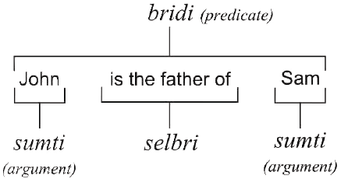
邏輯語的語句結構

Slide 4
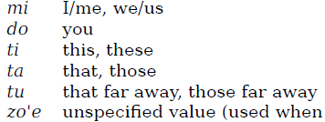
填充語 sumti

Slide 5
動詞 selbri
vecnu x1 (seller) sells x2 (goods) to x3 (buyer) for x4 (price)
tavla x1 (talker) talks to x2 (audience) about x3 (topic) in language x4
sutra x1 (agent) is fast at doing x2 (action)
blari'o x1 (object/light source) is blue-green
melbi x1 (object/idea) is beautiful to x2 (observer) by standard x3
cutci x1 is a shoe/boot for x2 (foot) made of x3 (material)
bajra x1 runs on x2 (surface) using x3 (limbs) in manner x4 (gait)
klama x1 goes/comes to x2 (destination) from x3 (origin point)
via x4 (route) using x5 (means of transportation)
pluka x1 pleases/is pleasing to x2 (experiencer) under conditions x3
gerku x1 is a dog of breed x2
kurji x1 takes care of x2
kanro x1 is healthy by standard x2
stali x1 stays/remains with x2
zarci x1 is a market/store/shop selling x2 (products)
operated by x3 (storekeeper)

Slide 6
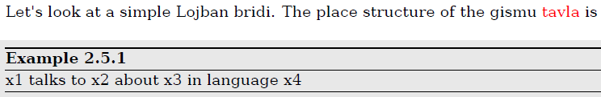



bridi 的範例

Slide 7
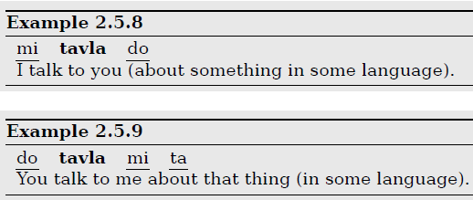
後面的格可以省略

Slide 8
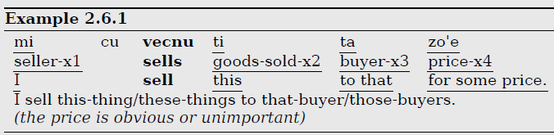
cu後面一定接動詞

Slide 9
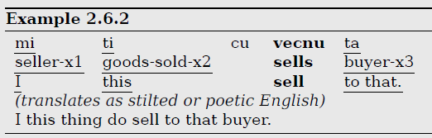
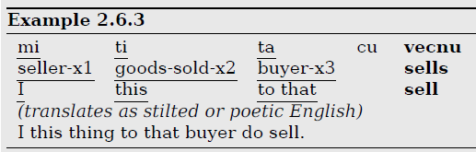
用cu將動詞延後

Slide 10
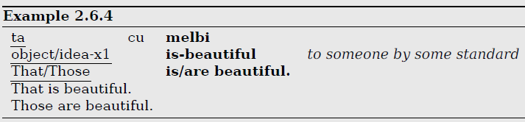
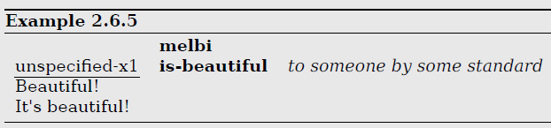
動詞前的主詞可省略
單純動詞有強調、緊急、警告意味！

Slide 11



交換: se te ve xe
se:填充格12交換
te:填充格13交換
ve:填充格14交換
xe:填充格15交換

Slide 12
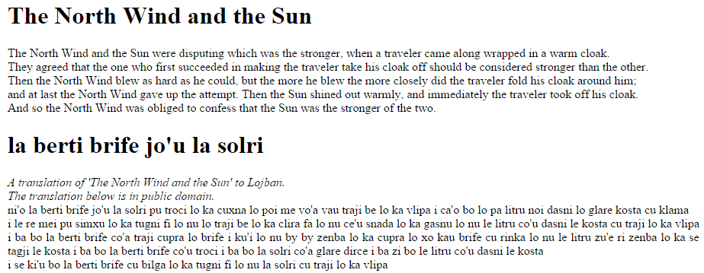
分隔
ni'o分隔段落(paragraph), i分隔語句

Slide 13


複合動詞tanru
當兩個gismu相連時，前者修飾後者，最後一個的結構會起作用
tavla x1 (talker) talks to x2 (audience) about x3 (topic) in language x4
sutra x1 (agent) is fast at doing x2 (action)
When two gismu are adjacent, the first one modifies the second, and the selbri takes its place structure from the rightmost word. Such combinations of gismu are called “tanru”.

Slide 14
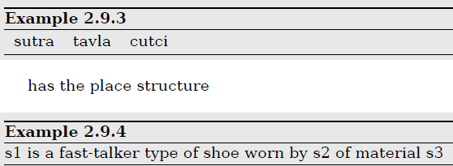
三連複合動詞
tavla x1 (talker) talks to x2 (audience) about x3 (topic) in language x4
sutra x1 (agent) is fast at doing x2 (action)
cutci x1 is a shoe/boot for x2 (foot) made of x3 (material)
That is, it is a shoe that is worn by a fast talker
rather than a shoe that is fast and is also worn by a talker.

Slide 15



更多複合動詞

Slide 16


複合動詞的填充欄
以最後一個為準
有 se, te, ve, xe 的話也要比照套用

Slide 17
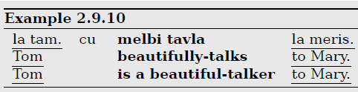
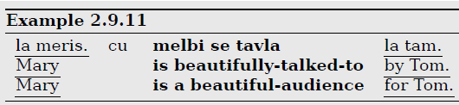
多義的情況

Slide 18


用se,te,ve,xe轉變填充欄

Slide 19
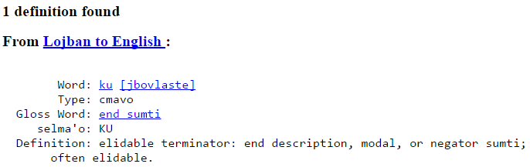
ku:可省略的結束語

Slide 20
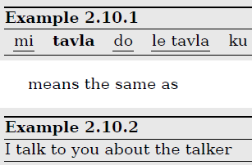

省略ku的語句

Slide 21

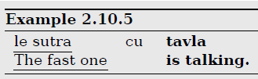

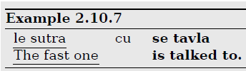
用cu 斷開複合動詞

Slide 22
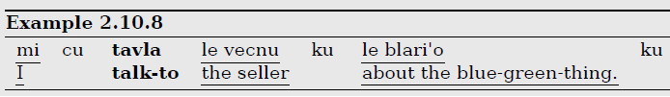
通常ku, cu 都可省略
It is safe to omit both occurrences of “ku” in Example 2.10.8,
and it is also safe to omit the “cu”.

Slide 23
Brivla : 動詞
A word which may by itself express a selbri relation is called a “brivla”

Slide 24
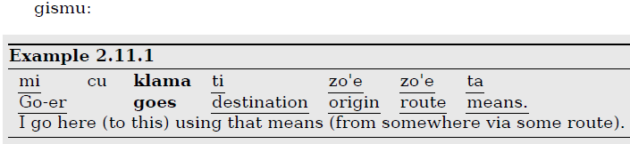
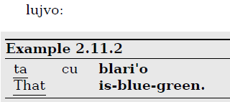
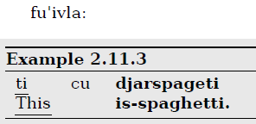
Brivla的例子
The three types of brivla are gismu (root words), lujvo (compounds), and fu'ivla (borrowings from other languages)

Slide 25
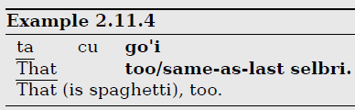
go'i : 也是
cmavo 有時也可當selbri
go'i : 也是(代表前一句的 selbri)

Slide 26




di'u 和 la'e di'u
上一句:
di'u :上一句的語句
la'e di'u :上一句的意義

Slide 27
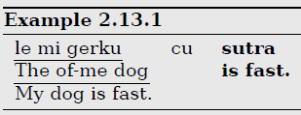
擁有:所有格
範例：le mi gerku

Slide 28



招呼注意
doi : 嗨, hi
coi : hello
co'o : good-bye

Slide 29



命令指示
陳述:
指示:
陳述:
你說話
說吧
快點

Slide 30
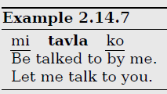
Ko 可以放在任何填充格
ko :你(指示)

Slide 31
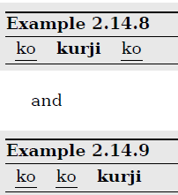
ko 可以填不只一格
You take care of you
Take care of yourself

Slide 32
問句
ma: 問填充者(名詞)
mo: 問動詞

Slide 33
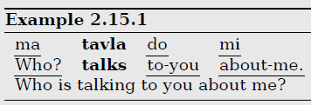



ma:問填充者

Slide 34
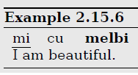


mo: 問動詞

Slide 35

xu: Yes/No 問句

Slide 36



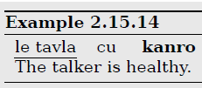

xu 問句的各種回答方法

Slide 37
指示詞
態度指示詞:attitudinal indicator
連接指示詞: and, but, however,…
見證指示詞：evidential indicator

Slide 38
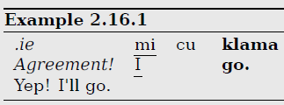
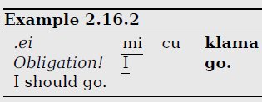
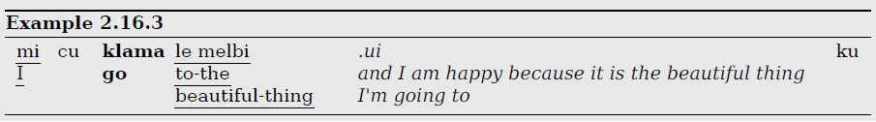
態度指示詞

Slide 39
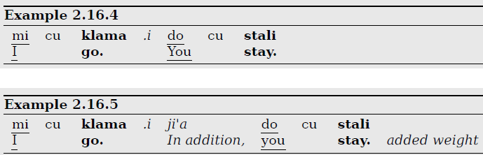

連接指示詞

Slide 40
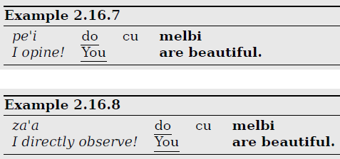
見證指示詞

Slide 41



過去、現在、未來

Slide 42

空間指示詞
vu :很遠的那個
vi :很近的那個

Slide 43

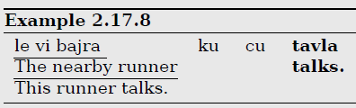
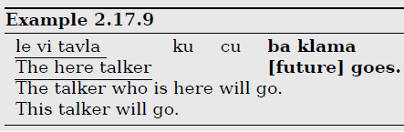
時空指示詞填入

Slide 44
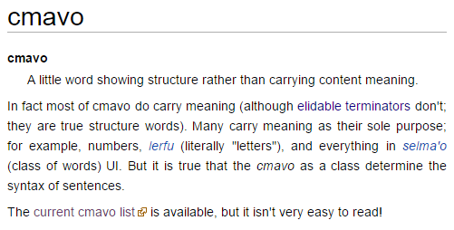
cmavo 結構詞
A little word showing structure rather than carrying content meaning.

Slide 45
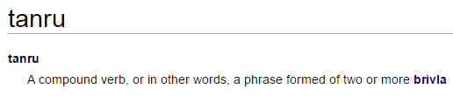
tanru : 複合動詞
A compound verb, or in other words, a phrase formed of two or more brivla

Slide 46
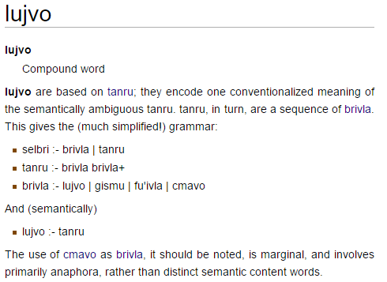
lujov : 複合詞

Slide 47
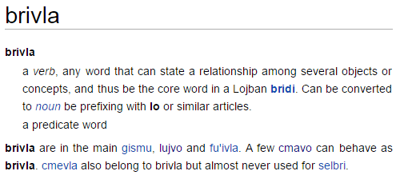
brivla :動詞

Slide 48
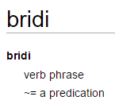
Bridi : 動詞短語

Slide 49
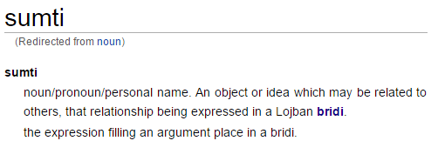
sumti : 名詞

Slide 50
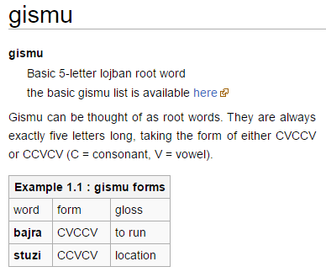
gismu : 根詞

Slide 51
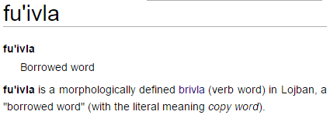
fu'ivla : 借用語

Slide 52
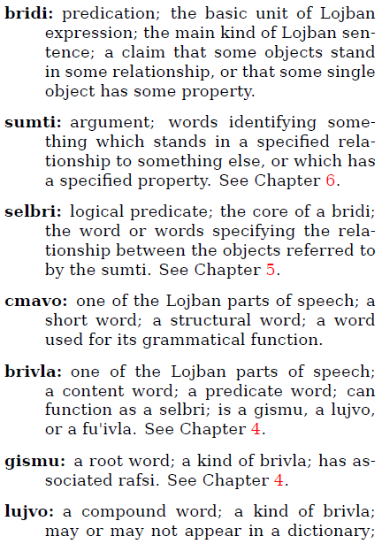
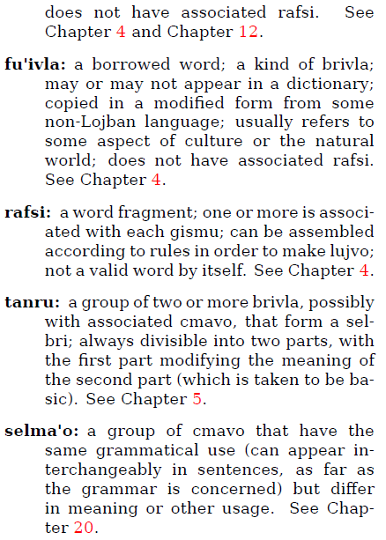

Slide 53
再見了！

Slide 54
Good bye

Slide 55
Co'o ro do

