Slide 1
楚河漢界教學法

Slide 2
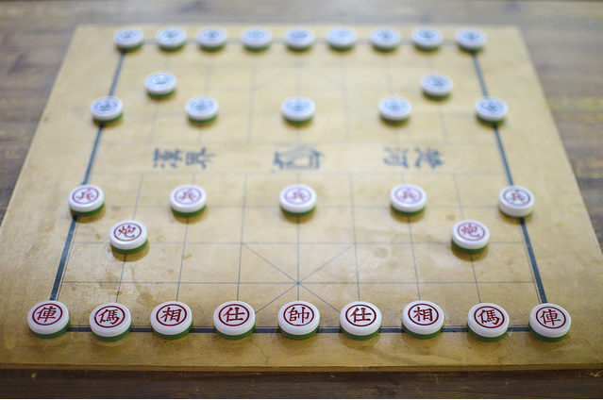
楚河漢界教學法
圖片作者: Ronald Sarayudej – https://www.flickr.com/photos/honorphotobar/
授權: https://creativecommons.org/licenses/by/2.0/

