Slide 1
Paul Allen Y362220 S284 TMA_06
Question 2

Slide 2
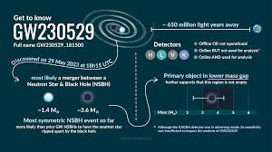
A Mass‑Gap Merger in O4
Detected 29 May 2023, Livingston only
Primary 2.5–4.5 M⊙ ⇒ “lower mass gap”
Secondary 1.2–2.0 M⊙ neutron star
Adds new evidence the gap isn’t empty
Image from:https://ligo.org/detections/gw230529/, accessed:28:03/25

Slide 3
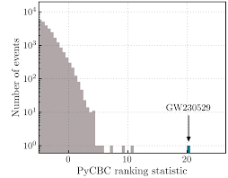
Signal Stands Out from Noise
Three matched‑filter pipelines → FAR < 1 in 1000 yr
S/N ≈ 11; strong single‑detector event
Living­ston only ⇒ poor sky‑map (~2 × 10⁴ deg²)
Waveform = asymmetric NS‑BH chirp
Image from: https://dcc.ligo.org/public/0190/P2300352/009/gw230529-discovery-8.pdf, acessed: 28/03/2025

Slide 4
Component Masses & Spins
m₁ ≈ 3.6 M⊙ in mass gap
m₂ ≈ 1.4 M⊙ – consistent NS
Chirp mass 1.94 M⊙; total 5.1 M⊙
Distance ~200 Mly (z ≈ 0.04)
Little evidence for spin‑induced precession

Slide 5
No Confirmed EM Counterpart
Single detector → wide sky area
Multiple GRB / optical / neutrino searches → null
Models: NS disruption unlikely (low ejecta ≲ 0.05 M⊙)
Faint or off‑axis kilonova not ruled out

Slide 6
Re‑thinking the Lower Mass Gap
Shows 3–5 M⊙ region is populated
Low‑mass BHs challenge core‑collapse models
Updates NS‑BH merger‑rate estimates (∼60 yr⁻¹ Gpc⁻³)
O4 could exceed 200 GW events (Pratten 2024)
“In addition to GW230529, we have identified about 80 other significant event candidates to investigate. We expect that by February 2025, when the fourth observing run ends, we will have observed more than 200 gravitational-wave signals. Future detections of similar events, especially those accompanied by bursts of electromagnetic radiation, could hold the key to solving this cosmic mystery of mass-gap and further our understanding of the universe.— BofB news, Apr 2024 .”
UofB News, Apr 2024, https://www.birmingham.ac.uk/news/2024/mass-gap-gravitational-wave-signal-discovered-by-international-scientists

