Slide 1


VTC Fall 2021
August 31, 2021
Joint Resource Allocation and User Scheduling Scheme
for Federated Learning
Jinglong Shen
Nan Cheng
Zhisheng Yin
Wenchao Xu
1
1,2
3
4
jlshen@stu.xidian.edu.cn
dr.nan.cheng@ieee.org
zsyin@xidian.edu.cn
wenchao.xu@polyu.edu.hk
1
School of Telecommunications Engineering, Xidian University, Xi’an, China
2
State Key Lab. of ISN, Xidian University, Xi’an, China
3
School of Cyber Engineering, Xidian University, Xi’an, China
4
Department of Computing, The Hong Kong Polytechnic University, 11 Yuk Choi Rd, Hung Hom, Hong Kong

Slide 2
CONTENT
1
Introduction
2
System Model
3
Problem Formulation
4
Simulation Result

Slide 3
INTRODUCTION
Centralized Scheme
We need a server in the center of the system to collect all users’ data set, which may infringe users’ privacy and bring a lot of communication overhead.
Federated Scheme
Training a Model without data sharing. Only model parameters are shared during training, which can reduce communication cost and protect user privacy.

Slide 4
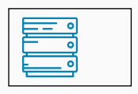

INTRODUCTION
Federated Learning (FL) is designed to coordinate user collaboration to train an ML model while keeping each user's data local.

Slide 5

INTRODUCTION
Federated Learning (FL) is designed to coordinate user collaboration to train an ML model while keeping each user's data local.
Initialize Global Model

Slide 6
INTRODUCTION
Federated Learning (FL) is designed to coordinate user collaboration to train an ML model while keeping each user's data local.
Broadcast Global Model

Slide 7




INTRODUCTION
Federated Learning (FL) is designed to coordinate user collaboration to train an ML model while keeping each user's data local.
Each user trains the model with their own local dataset

Slide 8
INTRODUCTION
Federated Learning (FL) is designed to coordinate user collaboration to train an ML model while keeping each user's data local.
The updated model is passed back to Server for aggregation, resulting in a new global model

Slide 9
INTRODUCTION
Federated Learning in Wireless Network
Limited Communication Resource:
Due to limited wireless communication resources, we select a portion of our users to participate in training. However, different users contribute differently to the federated learning task. Therefore, we optimize the scheduling of users to schedule users with large contributions to participate in training.
Communication Delay:
Due to the instability of the wireless channel, there may be a large delay in communication between the user and the server. So we optimize the allocation of communication resources to improve communication efficiency.

Slide 10
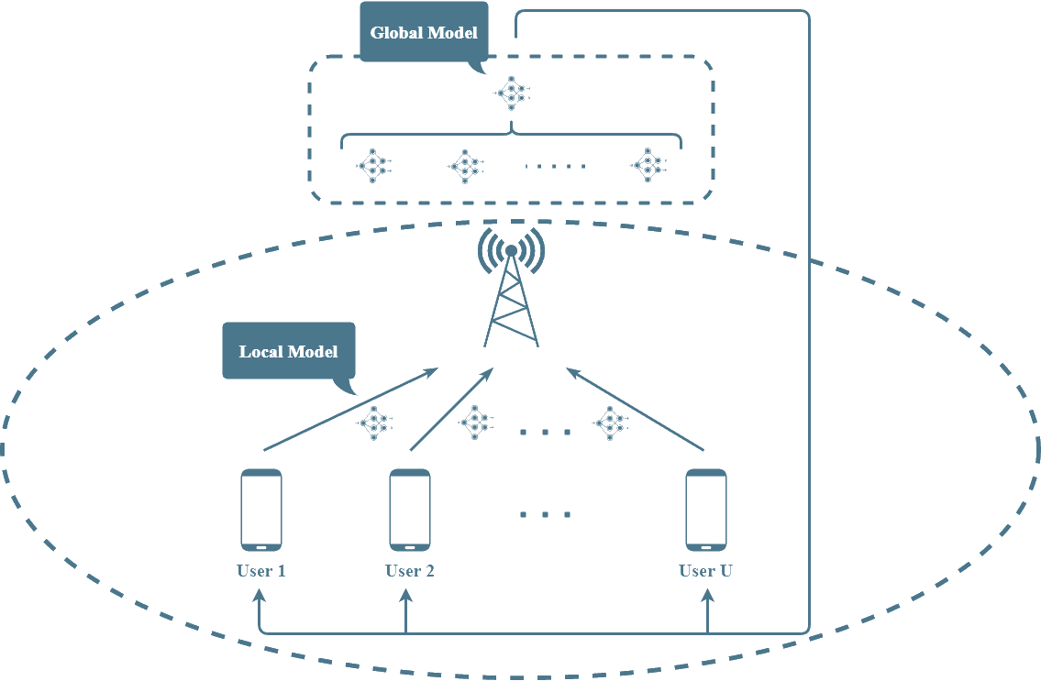
SYSTEM MODEL

Slide 11
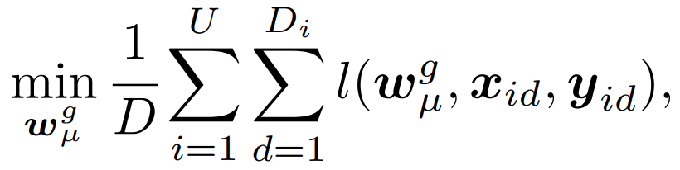
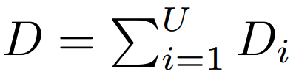


SYSTEM MODEL
Federated Learning Task
The training process of FL can be regarded as solving the following optimization problem:
denotes the total number of data samples held by all users.
represents the global model in the training process after server aggregation.
represents the loss function.

Slide 12
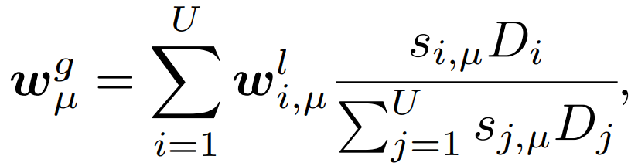



SYSTEM MODEL
Federated Learning Model
Global Aggregation Process:
denotes the local model obtained by user $i$ at round $μ$.
denotes the user’s scheduling vector,

Slide 13
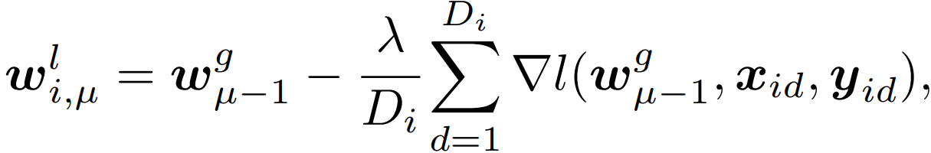



SYSTEM MODEL
Federated Learning Model
Local Training Process:
is the learning rate.
is the gradient of loss function with respect to

Slide 14
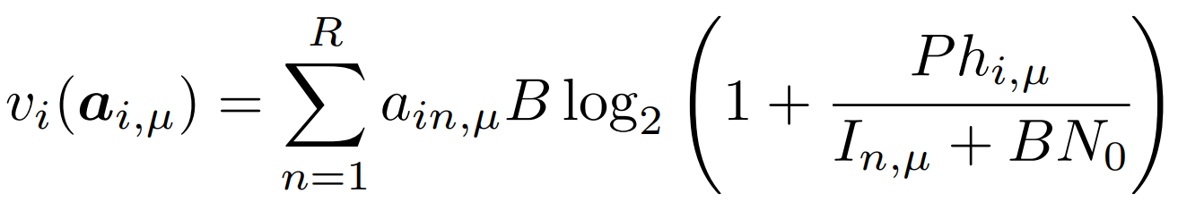


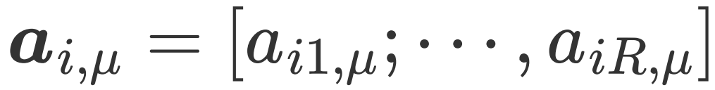


SYSTEM MODEL
Communication Model
is the total resource block available.
is the transmit power of user.
is the resource allocation vector of user $i$ at round $μ$,
is the channel gain from the user to BS

Slide 15
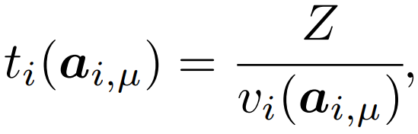



SYSTEM MODEL
Maximum Update Delay Definition
Communication delay:
Maximum update delay:
is the data size for transmitting.
is a matrix composed of resource allocation vectors.
is the time spent on user training.

Slide 16
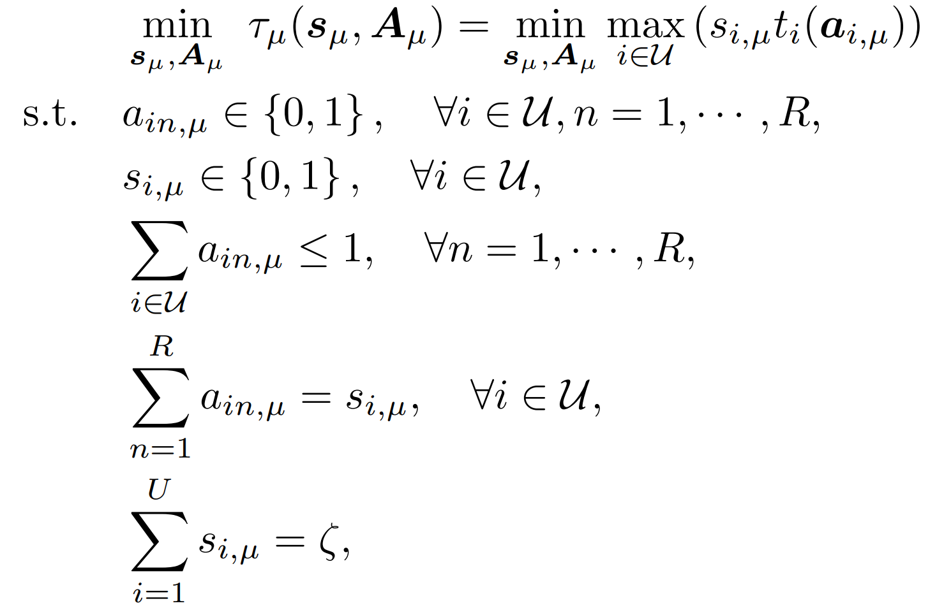

PROBLEM FORMULATION
0-1 constraints of the optimization variables.
Ensures that a RB can only be consumed by one user at most.
Ensures only one RB can be allocated to the scheduled user.
Specifies
users will be scheduled in each iteration.

Slide 17
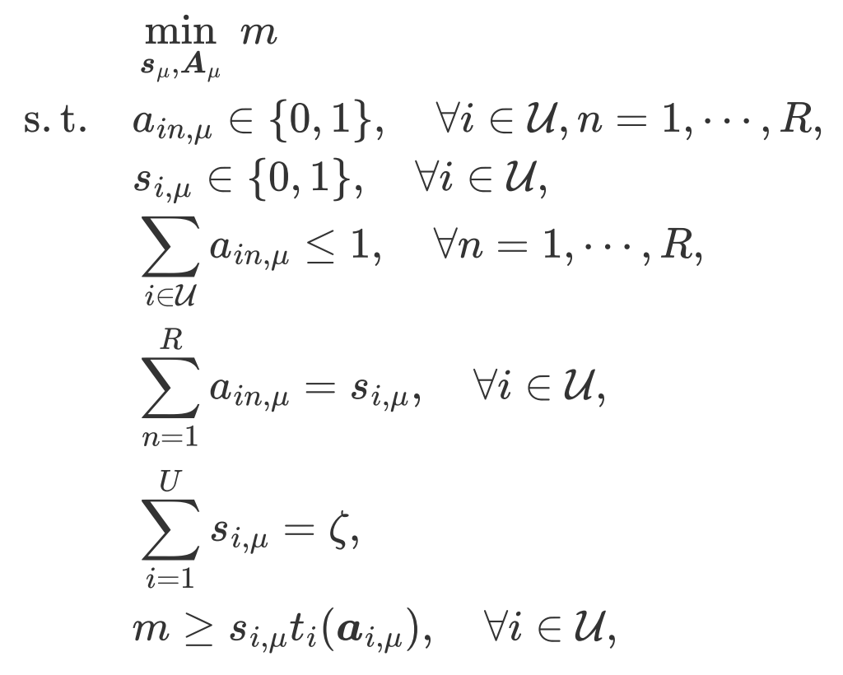
PROBLEM FORMULATION

Slide 18

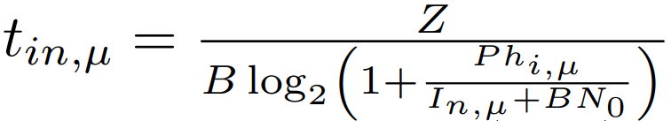
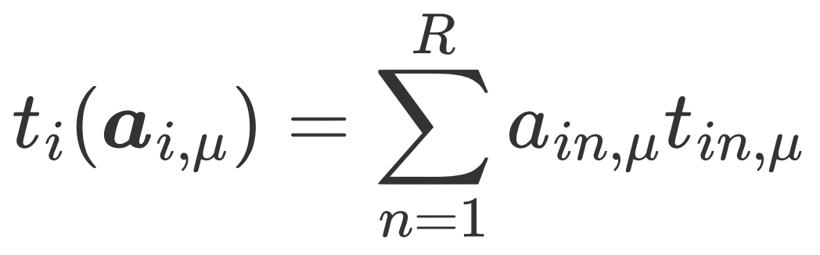
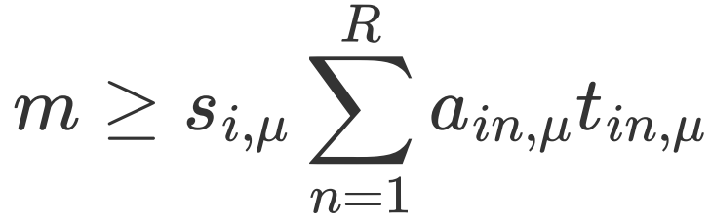
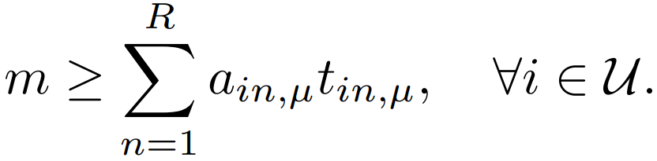
PROBLEM FORMULATION

Slide 19
PROBLEM FORMULATION
Convergence Performance
Communication Delay
Local Model’s Quality

Slide 20
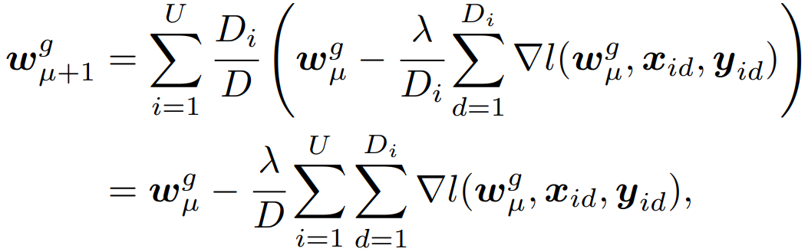
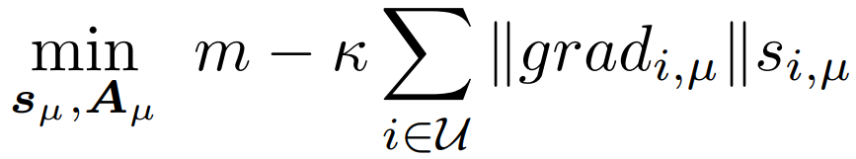
PROBLEM FORMULATION
The iterative process of the Global Model

Slide 21
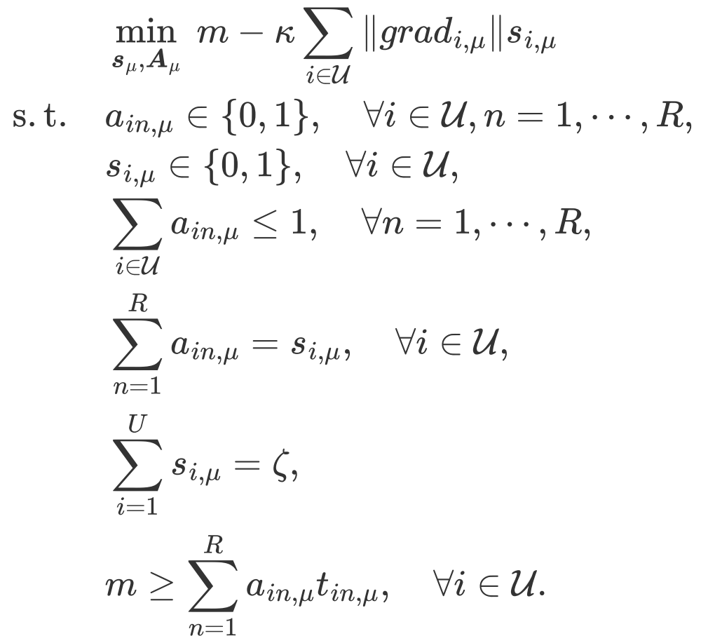
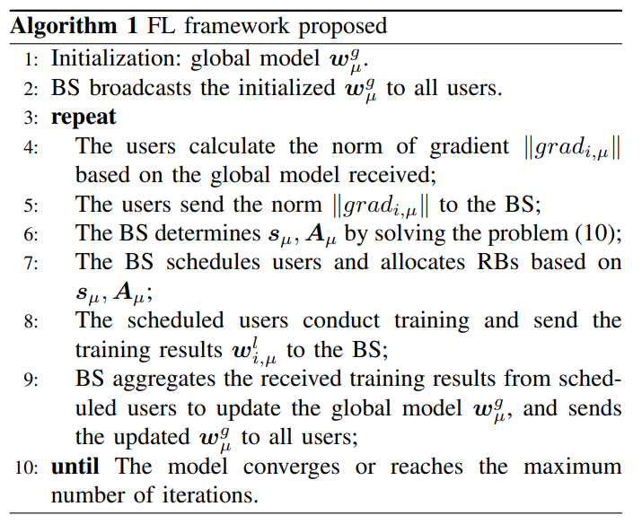
PROBLEM FORMULATION

Slide 22
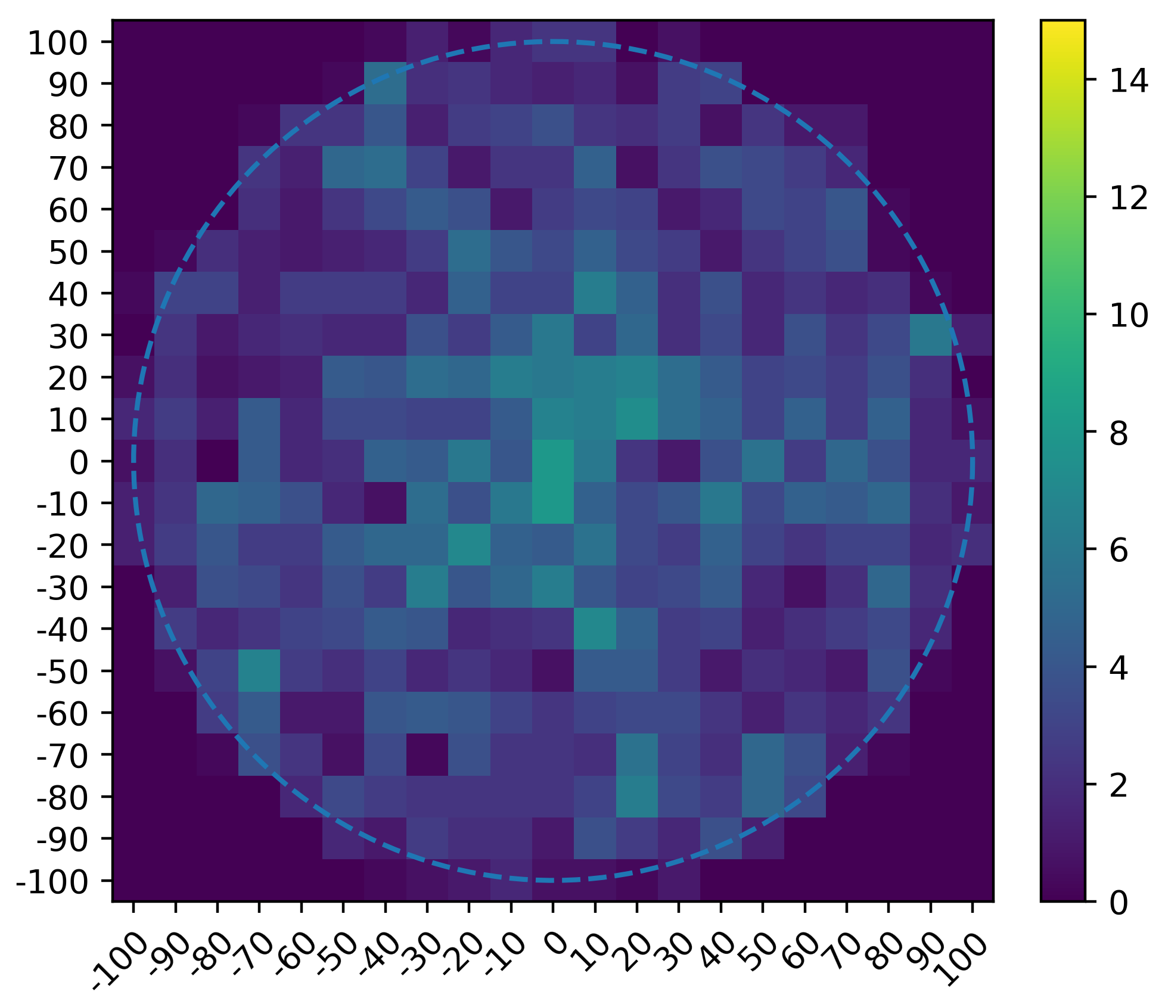
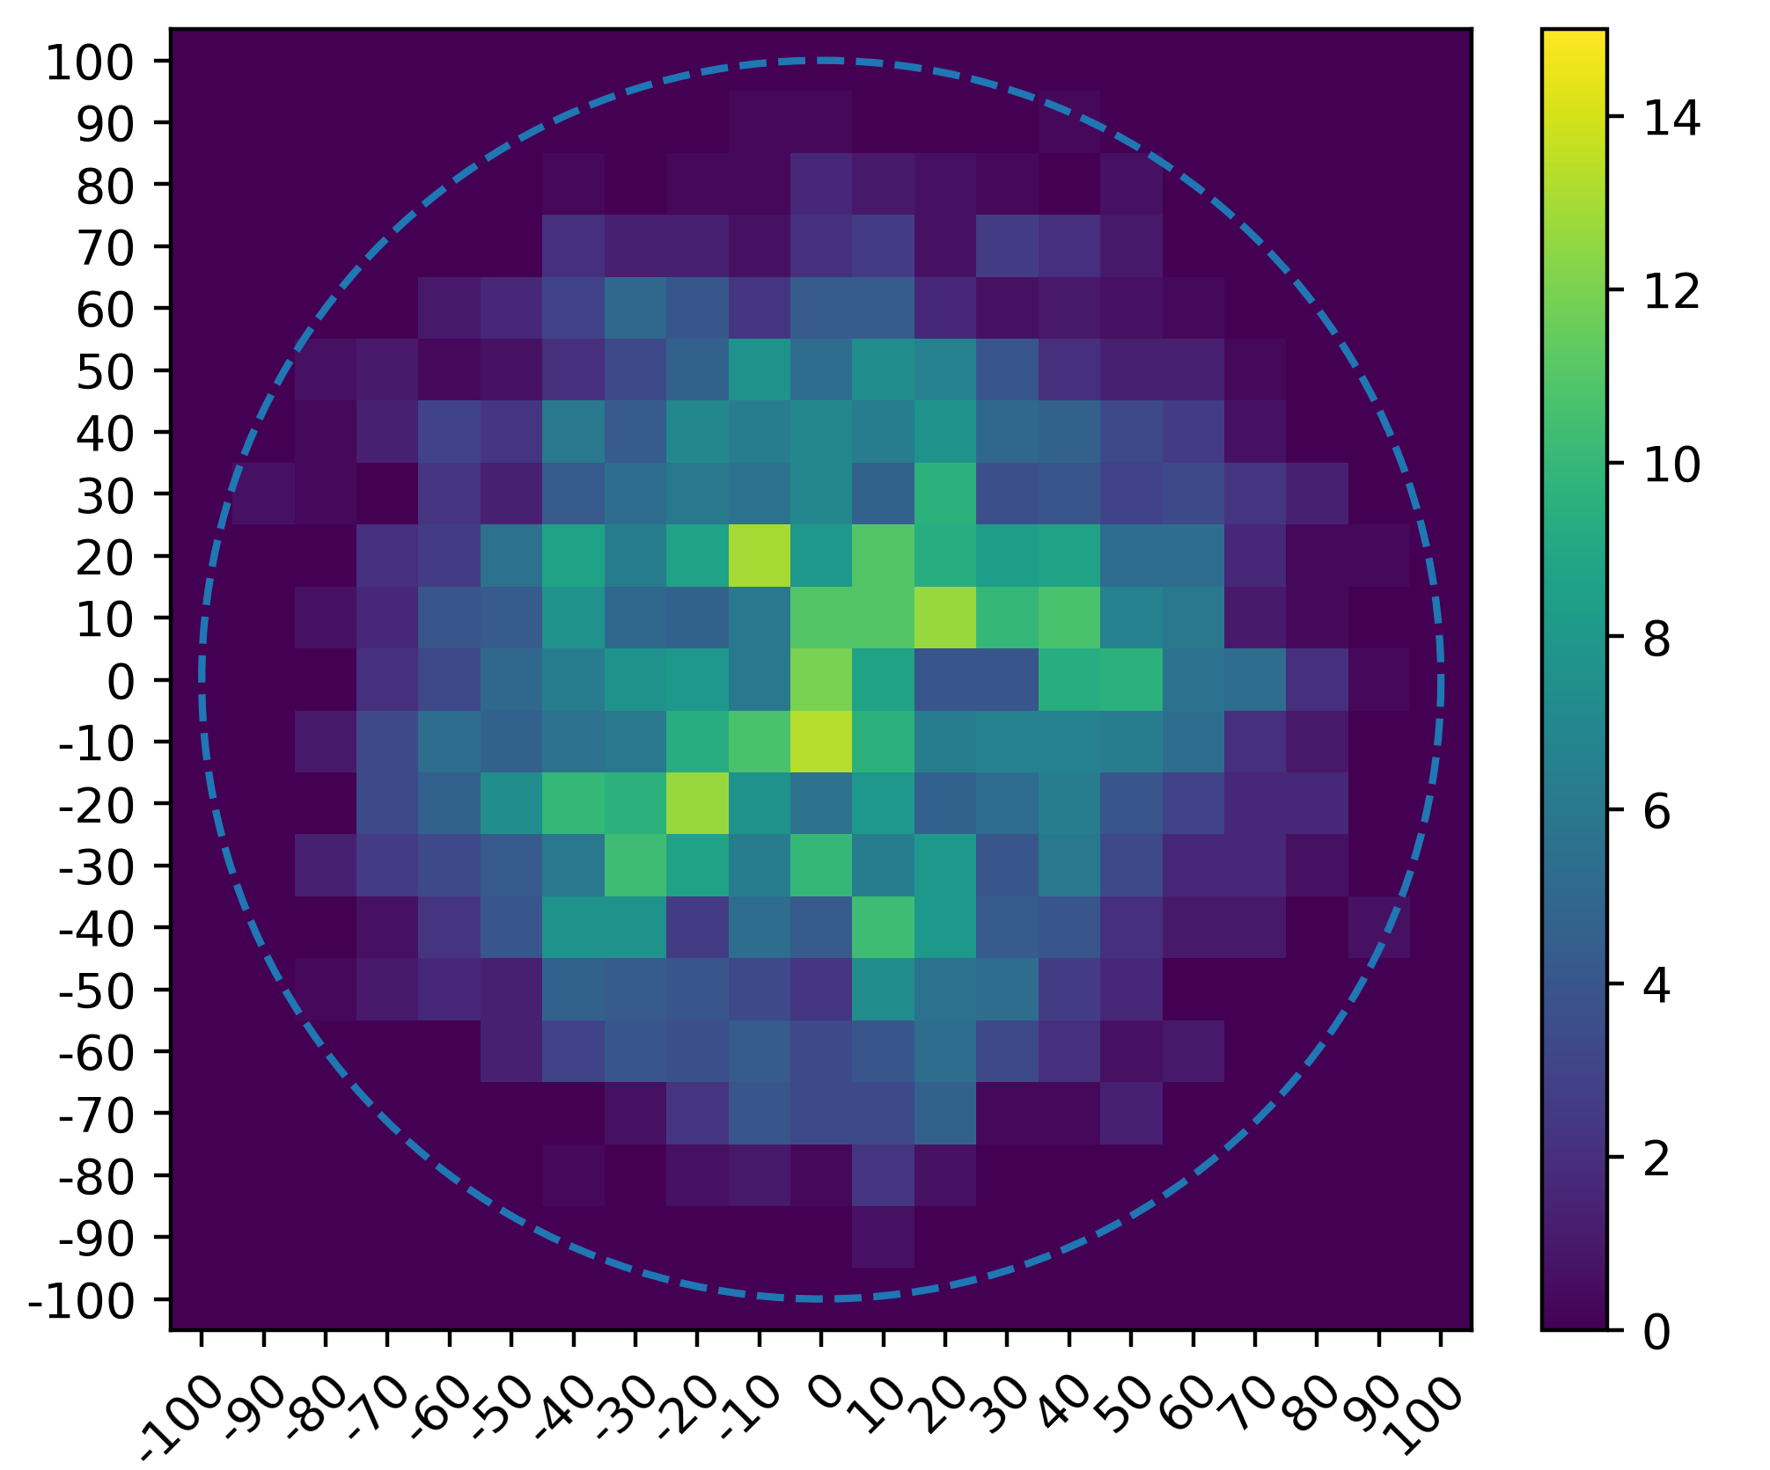
SIMULATION RESULT

Slide 23
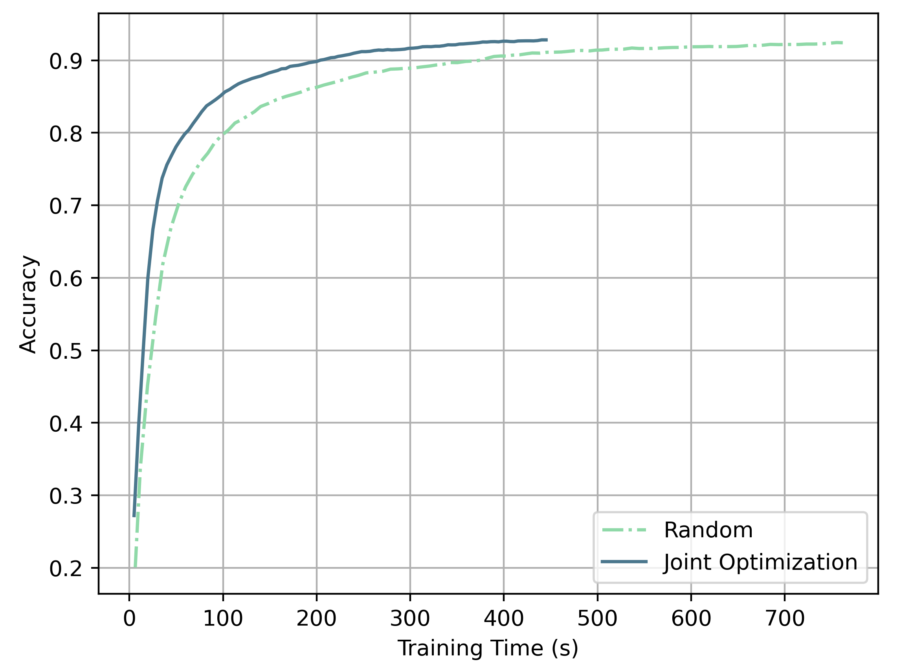
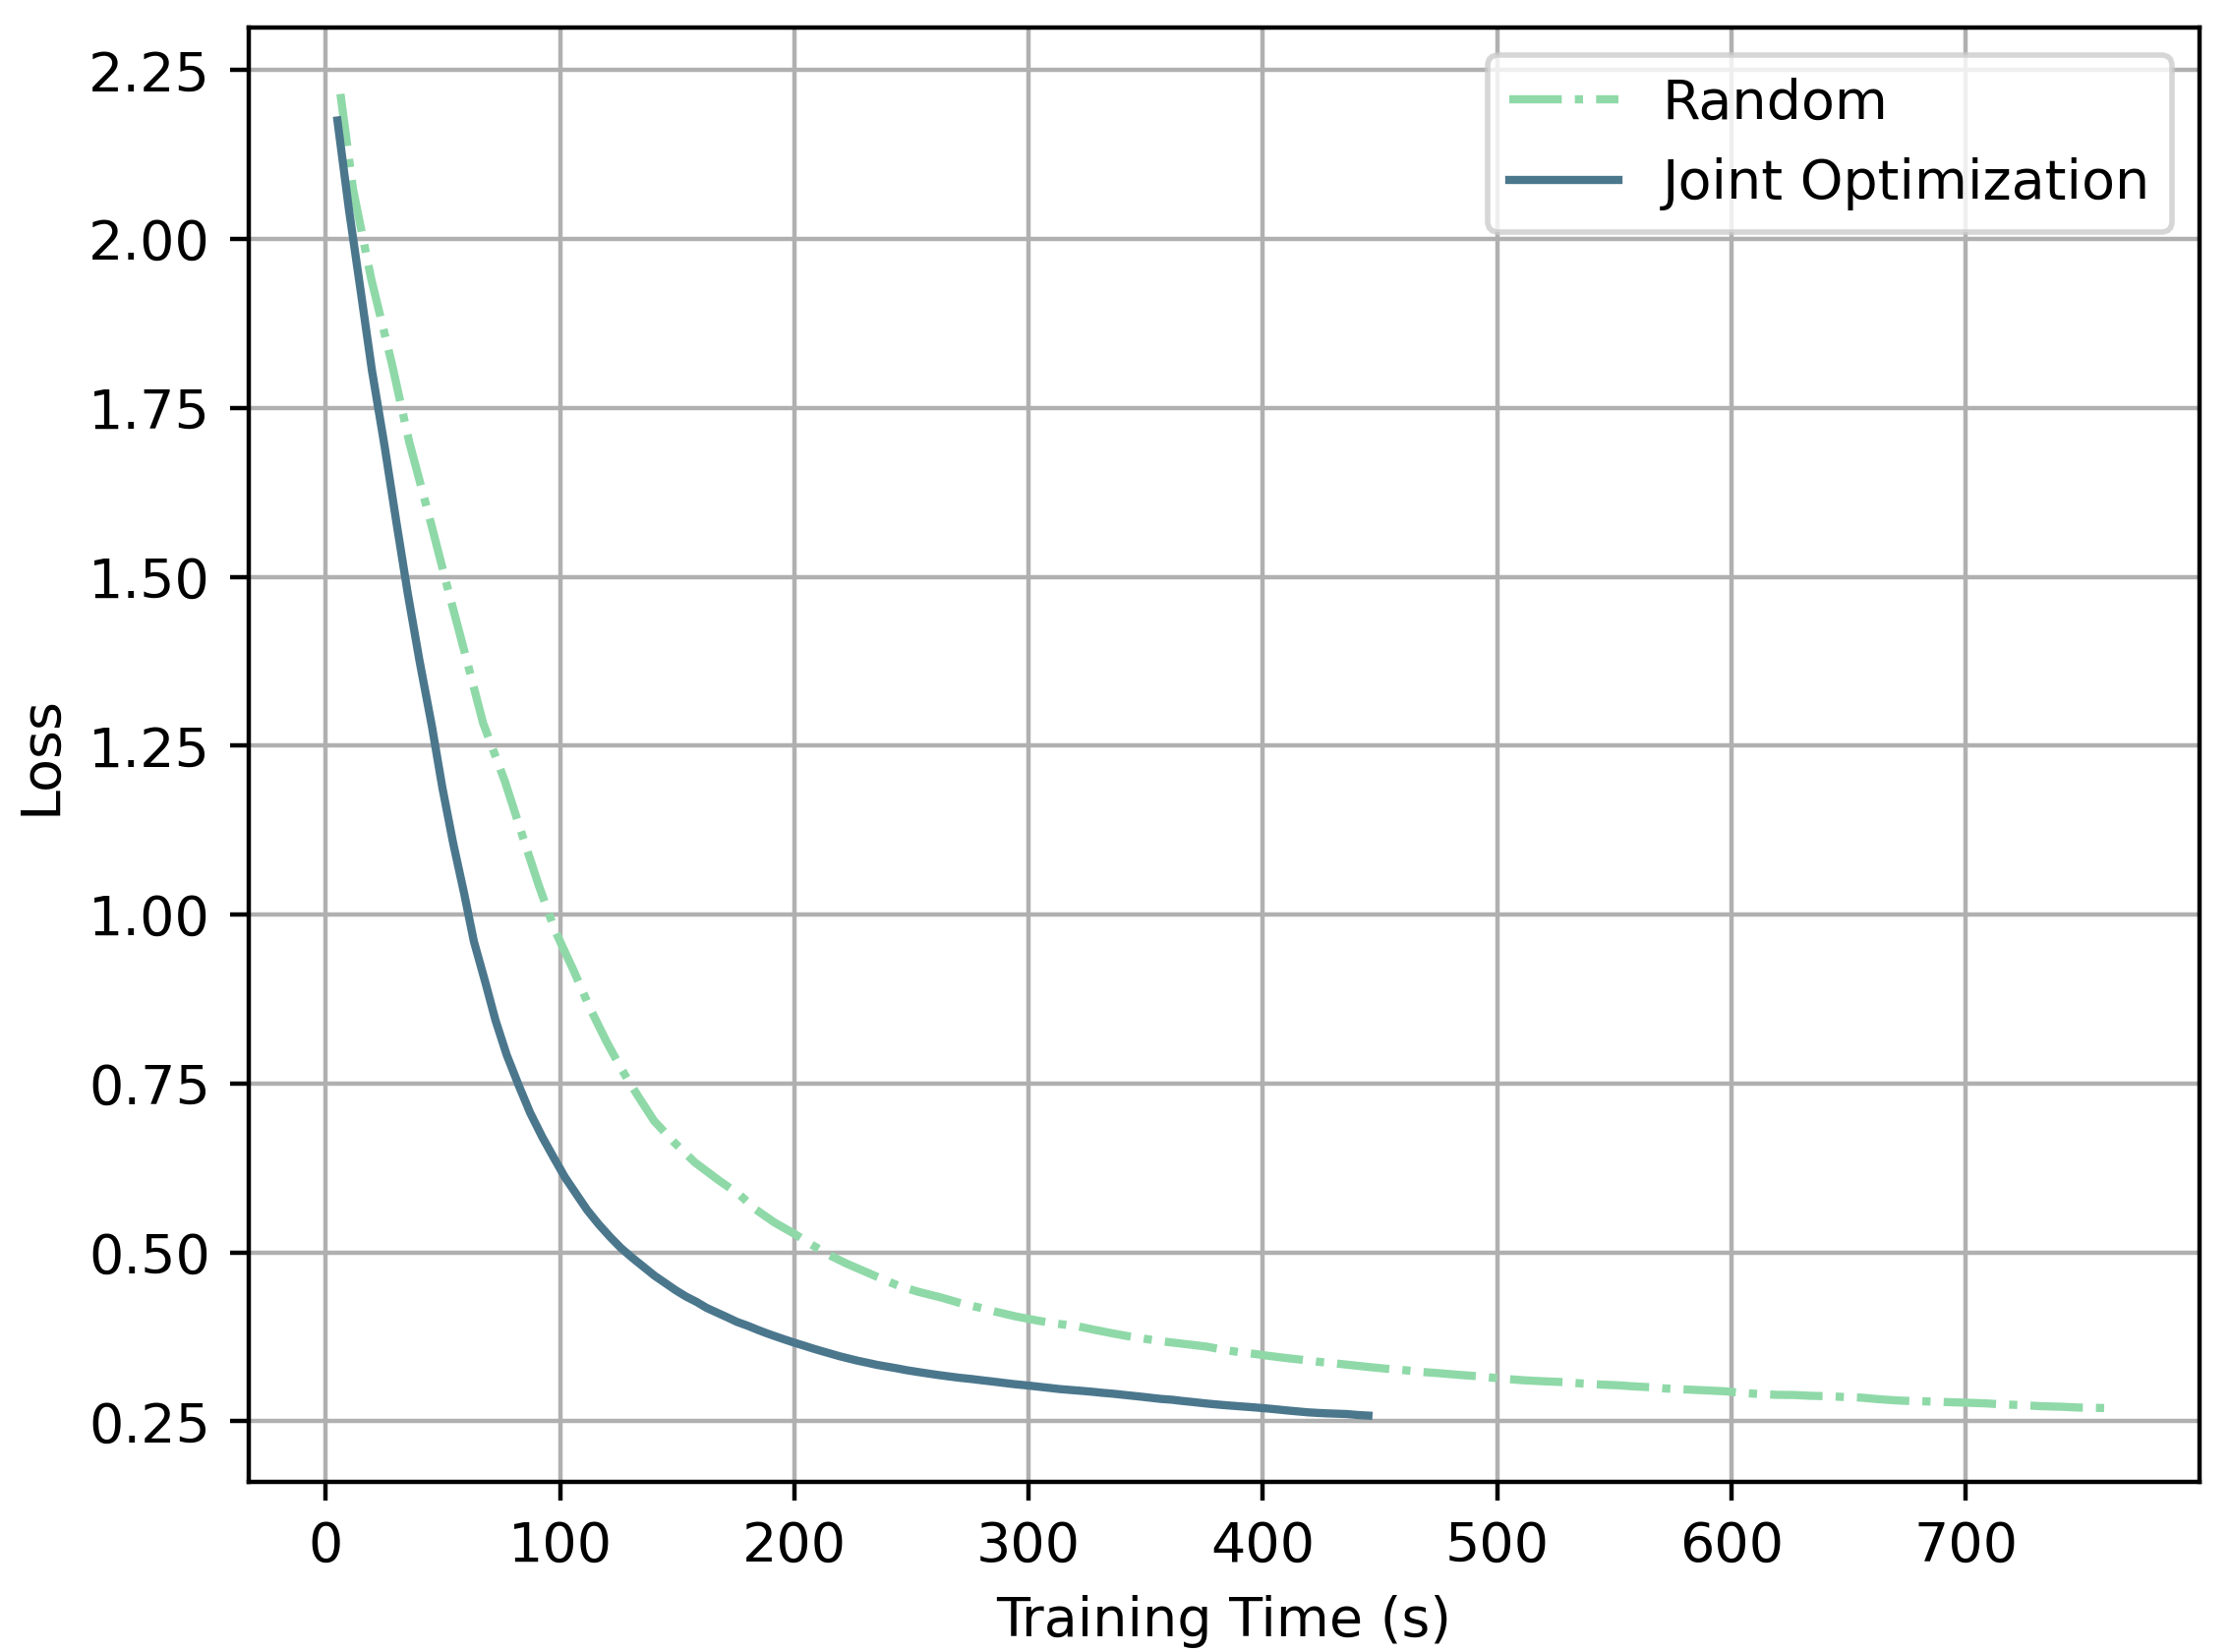
SIMULATION RESULT

Slide 24
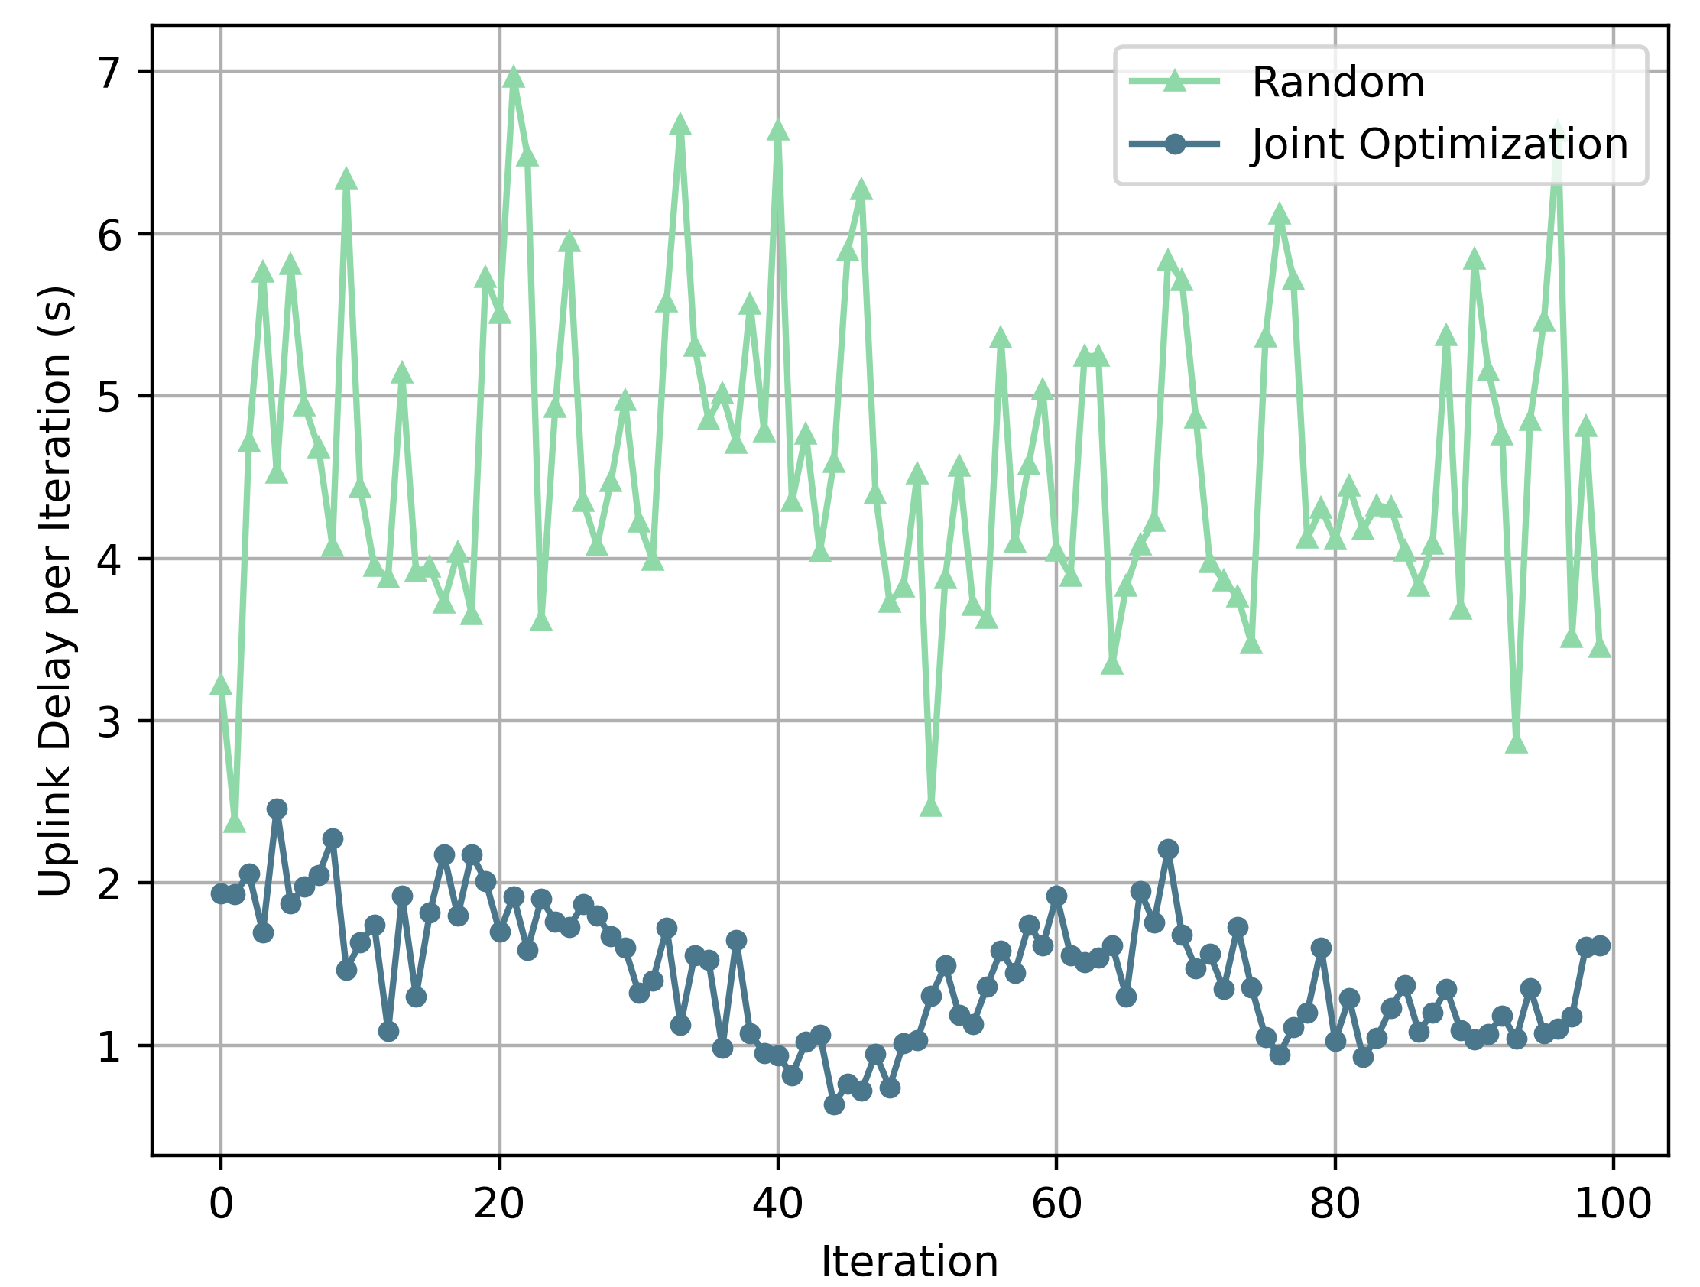
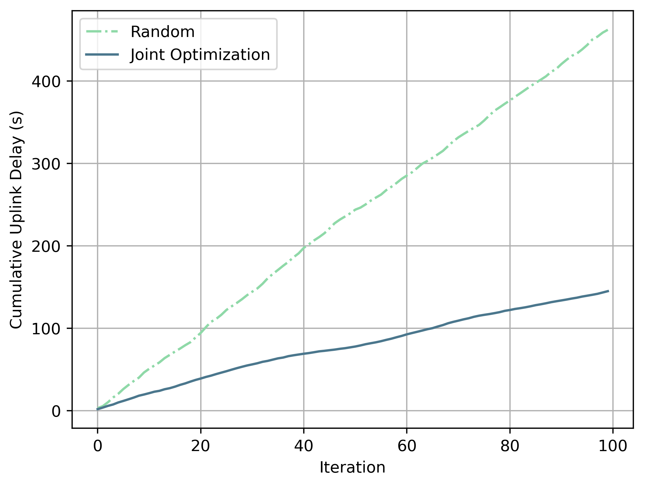
SIMULATION RESULT

Slide 25
THANKS

Slide 26
Server.py
Trainer.py
CommServer.py
TCP socket
CommClient.py
Client.py
Trainer.py

