Slide 1
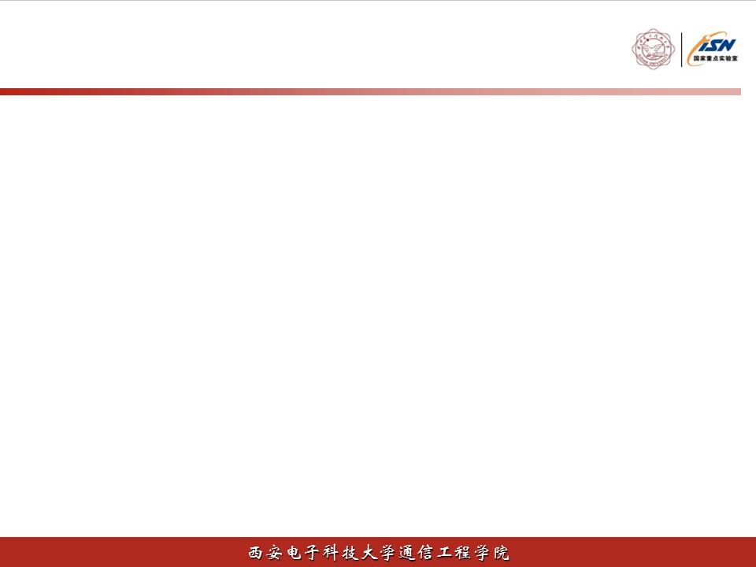
车辆编队的资源分配
报告人：张达越
时间：2021年10月10日

Slide 2
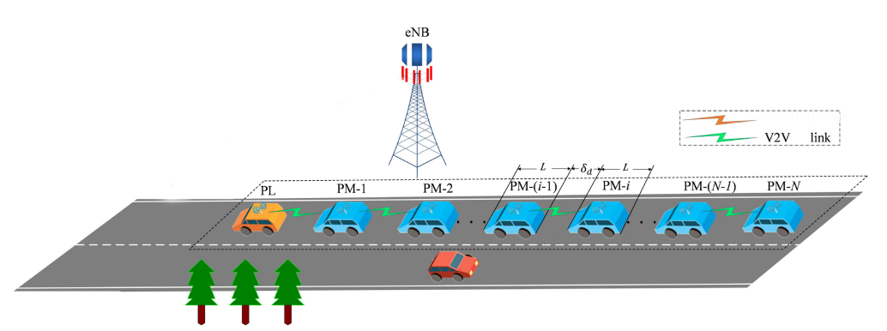
背景
V2I link
3GPP已经完成了5G V2X的业务场景及需求的讨论，并在技术报告TR 22.886中提出了车辆编队（Vehicles Platoonning）的业务场景：车辆编队使车辆动态形成编队一起行驶，编队中的所有车辆从编队头车获取信息来管理这个编队，这些管理信息使车辆能够以更接近（编队车辆之间间隔仅2~5m）更协调的方式同向行驶。
Study on Enhancement of 3GPP Support for 5G V2X Services,document 3GPP TR 22.886

Slide 3
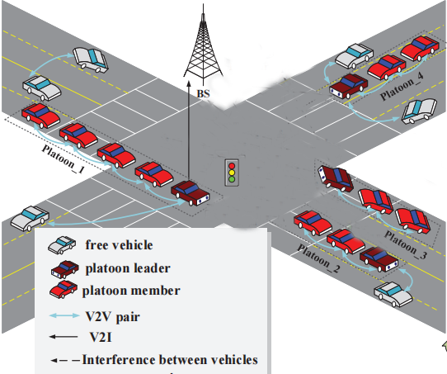
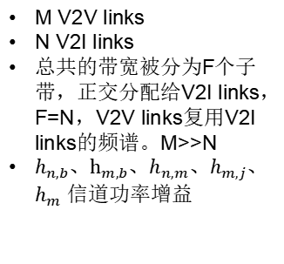





系统模型
M V2V links
N V2I links
总共的带宽被分为F个子带，正交分配给V2I links，F=N，V2V links复用V2I links的频谱。M>>N
$h_{n,b}、h_{m,b}$、$h_{n,m}$、$h_{m,j}$、$h_{m}$ 信道功率增益
$$h_{n,b}$$
$$h_{m,b}$$
$$h_{m}$$
$$h_{n,m}$$
$$h_{m,j}$$

Slide 4






问题建模
$ρ_{m,f}^{V2V}$ $ρ_{n,f}^{V2I}$ $∈\left\{0,1\right\}$
$γ_{n,f}^{V2I}$=$\frac{P_{n,f}^{V2I}h_{n,b}}{σ^{2}+\sum_{m}{ρ_{m,f}^{V2V}{P_{m,f}^{V2V}h}_{m,b}}}$
$R_{n}=\log_{2}$(1+$γ_{n,f}^{V2I}$)
$γ_{m,f}^{V2V}$=$\frac{P_{m,f}^{V2V}h_{m}}{σ^{2}+\sum_{n}{ρ_{n,f}^{V2I}{P_{n,f}^{V2I}h}_{n,m}}+\sum_{j≠m}{ρ_{j,f}^{V2V}{P_{j,f}^{V2V}h}_{m,j}}}$
$R_{m}=\log_{2}$(1+$γ_{m,f}^{V2V}$)

Slide 5









问题建模
$$\max_{\begin{aligned}\left\{ρ_{m,f}^{V2V} ρ_{n,f}^{V2I}\right\} \\ \left\{P_{n,f}^{V2I}{ P}_{m,f}^{V2V}\right\}\end{aligned}}{\sum_{n}{\sum_{f}{ρ_{n,f}^{V2I}}}}R_{n}$$
最大化N个V2I links 的总容量
s.t. $ρ_{m,f}^{V2V}Pr\left\{γ_{m,f}^{V2V}≤γ_{o}^{V2V}\right\}≤p_{0}$, $∀m,f$
V2V links 的可靠性约束
$\sum_{n}{ρ_{n,f}^{V2I}=1}$, $∀f$
V2I links 的频谱正交
$\sum_{f}{ρ_{n,f}^{V2I}=1}$, $∀n$
每个V2V link或V2I link 用一个子带
$\sum_{f}{ρ_{m,f}^{V2V}=1}$, $∀m$
$\sum_{f}{ρ_{n,f}^{V2I}P_{n,f}^{V2I}≤P_{max}^{V2I}}$, $∀n$
$\sum_{f}{ρ_{m,f}^{V2V}P_{m,f}^{V2V}≤P_{max}^{V2V}}$, $∀m$
$P_{n,f}^{V2I}{≥0, P}_{m,f}^{V2V}$ $≥0 ∀m,n,f$
$ρ_{m,f}^{V2V}$ $ρ_{n,f}^{V2I}$ $∈\left\{0,1\right\}$ $∀m,n,f$

Slide 6
问题求解
1.图论+优化
L. Liang, S. Xie, G. Y. Li, Z. Ding and X. Yu, "Graph-Based Resource Sharing in Vehicular Communication," in IEEE Transactions on Wireless Communications, vol. 17, no. 7, pp. 4579-4592, July 2018, doi: 10.1109/TWC.2018.2827958.
V2V分组 功率分配 资源匹配
2.机器学习
Z. Liu, Y. Han, J. Fan, L. Zhang and Y. Lin, "Joint Optimization of Spectrum and Energy Efficiency Considering the C-V2X Security: A Deep Reinforcement Learning Approach," 2020 IEEE 18th International Conference on Industrial Informatics (INDIN), 2020, pp. 315-320, doi: 10.1109/INDIN45582.2020.9442103.
Agent
State Space
Action Space
Reward Function
DQN

Slide 7
THANKS!

