Slide 1

ChatGPT写作修改
汇 报 人： 王秀程
2023.03.30

Slide 2
使用方法
Step1: 引导1:
I'm going to give you some information before asking you to write an article. Do you understand?
Step2: 引导2:
When it comes to writing content, two factors are crucial, "perplexity" and "burstiness." Perplexity measures the complexity of text. Separately, burstiness compares the variations of sentences. Humans tend to write with greater burstiness, for example, with some longer or complex sentences alongside shorter ones. Al sentences tend to be more uniform. Therefore, when writing the following content I am going to ask you to create, I need it to have a good amount of perplexity and burstiness. Do you understand?
Step3: 重写指令：
using the concepts written previously, rewrite this article with a high degree of perplexity and burstiness: ${内容}

Slide 3

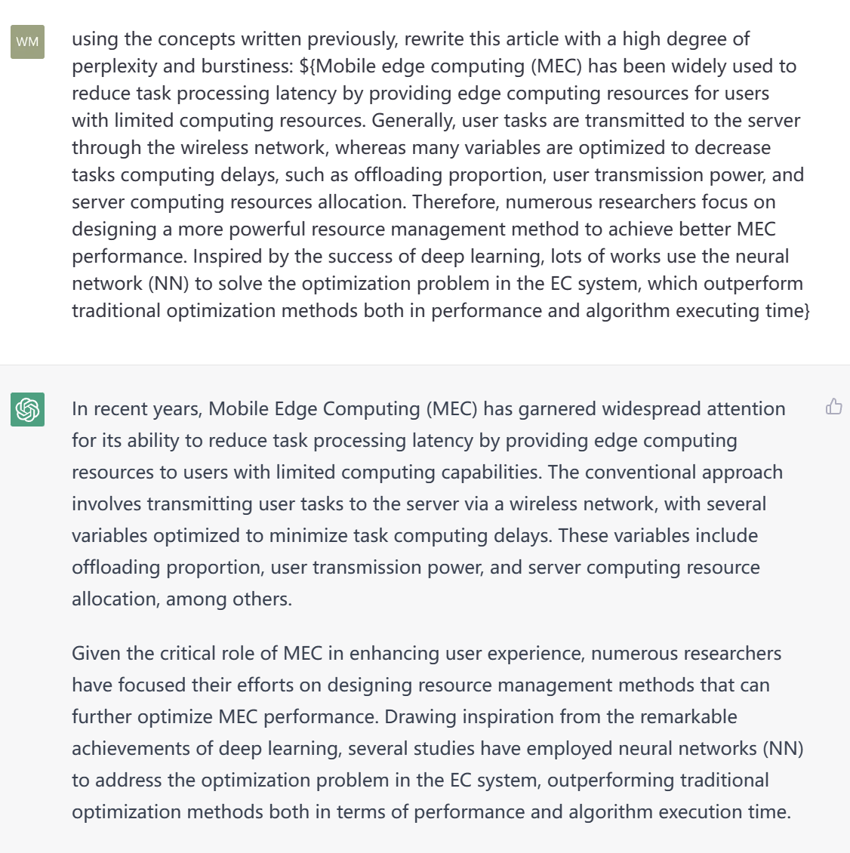
使用方法

Slide 4
效果
原论文:
The dynamics of MEC systems, which are changes in numbers and locations of the edge servers and users, raise two challenges in using NN-based methods: low scalability and high training costs. The scalability determines whether a new NN architecture needs to be manually designed and retrained when the number of edge servers and users changes. The training costs determine whether an NN-based method can be rapidly deployed in the edge network when an optimization problem arises. Some recent works explore using graph neural network (GNN) to deal with the scalability issue in input space, which includes usually the features of network nodes. This is because the inference of GNN relies on the message passing method which is an input dimension-independent method. However, in MEC, the dimension of the offloading and resource allocation decision can also change as the network scales, e.g., a task can be offloaded to a changing number of servers, which leads to a special scalability issue, i.e., the scalability in the decision space. Unfortunately, conventional node-output GNN which allocates resources from an edge node to others through the dimension fixed node features vector cannot deal with the dimension change of the decision space caused by the changing size of the edge network.
修改后：
The utilization of neural network (NN) based methods for optimizing Mobile Edge Computing (MEC) systems poses several challenges due to the dynamic nature of such systems. Changes in the numbers and locations of edge servers and users present two key challenges - low scalability and high training costs.
Scalability plays a crucial role in determining whether a new NN architecture needs to be manually designed and retrained when the number of edge servers and users undergoes changes. Additionally, training costs are a key factor in determining the ability of an NN-based method to be rapidly deployed in the edge network in response to an optimization problem.
In recent times, some scholars have attempted to overcome the scalability issue in input space using graph neural network (GNN). This approach includes features of network nodes, given that the inference of GNN relies on the message passing method, which is an input dimension-independent method.
However, in MEC, the dimension of offloading and resource allocation decisions can also change as the network scales. For instance, a task can be offloaded to a varying number of servers, thereby leading to a unique scalability issue, i.e., scalability in the decision space.

Slide 5
效果
原论文:
In this paper, a link-output GNN (LOGNN)-based resource management scheme is proposed for dynamic MEC to flexibly offload tasks and allocate edge resources, with varying sizes of the edge network. Despite the fixed dimension of output link features, the number of graph links increases as the number of edge servers and users increases. Therefore, by defining the proportion of resources allocated from the servers/users to each user/server as the link feature from server/user nodes to user/server node, the proposed LOGNN-based resource management scheme can efficiently deal with the scalability issue in decision space. In addition to scalability, high training cost is another essential drawback of using NN-based methods in dynamic MEC. The high training cost consists of two main parts: the extreme costs of obtaining optimal solutions as training labels and the low convergence speed. Although the reinforcement learning (RL)-based training method alleviates the dependency on training labels, its convergence speed and performance cannot be guaranteed. In this paper, a label-free unsupervised method is exploited to train LOGNN. Parameters in LOGNN are updated by the gradient of edge task processing delays with respect to the LOGNN parameters, where the task processing delays are derived explicitly from the output of the LOGNN. The main contributions are as follows.
修改后：
This paper presents a novel resource management scheme for dynamic Mobile Edge Computing (MEC) that leverages the capabilities of a link-output Graph Neural Network (LOGNN). With varying sizes of the edge network, the proposed scheme offers flexibility in offloading tasks and allocating edge resources. One of the primary challenges in using NN-based methods for dynamic MEC is the issue of scalability. As the number of edge servers and users increases, the number of graph links also increases. Despite the fixed dimension of output link features, the proposed scheme efficiently addresses the scalability issue in decision space by defining the proportion of resources allocated from the servers/users to each user/server as the link feature from server/user nodes to user/server node.
In addition to scalability, high training costs are another essential drawback of NN-based methods in dynamic MEC. The high training cost comprises two main parts: the extreme costs of obtaining optimal solutions as training labels and the low convergence speed. Although the reinforcement learning (RL)-based training method alleviates the dependency on training labels, its convergence speed and performance cannot be guaranteed.
To overcome these challenges, this paper exploits a label-free unsupervised method to train the LOGNN. Parameters in the LOGNN are updated by the gradient of edge task processing delays with respect to the LOGNN parameters, where the task processing delays are derived explicitly from the output of the LOGNN. This approach not only reduces the training cost but also improves the convergence speed of the LOGNN.

Slide 6
效果
原论文:
To evaluate the proposed unsupervised training method, the LOGNN and MLP are both trained by three different methods. These methods include the default unsupervised learning method, the supervised learning method, and the actor-critic-based RL training method. The labels in supervised learning for LOGNN(Sup) and MLP(Sup) are obtained by the GA method. In the RL training method, an actor net is used to optimize the resource allocation while a critic net is used to provide the update gradient for the actor net. Since label generation latency is considered as part of the training delay, in Table II the supervised training method has the largest training delay for each training epoch. Meanwhile, as is shown in Fig. 2, the supervised training method has worse convergence performance than the proposed unsupervised training method on the training set. This is because the performance of NN trained by supervised learning depends on the performance of the training labels. As the GA cannot exactly give optimal solutions for supervised labels, the performance of supervised training cannot be guaranteed. Moreover, the supervised training method has a larger performance gap than the unsupervised training method on the test set. This is because the supervised training method is easy to overfit the training set.
修改后：
To effectively evaluate the proposed unsupervised training method, we employ three different methods to train the LOGNN and MLP models. These methods include the default unsupervised learning method, the supervised learning method, and the actor-critic-based Reinforcement Learning (RL) training method. In the supervised learning method, the labels for LOGNN(Sup) and MLP(Sup) are obtained using the GA method. In contrast, the RL training method employs an actor net to optimize resource allocation, while a critic net provides the update gradient for the actor net.
As label generation latency is considered as part of the training delay, the supervised training method has the largest training delay for each training epoch, as illustrated in Table II. Additionally, the supervised training method has worse convergence performance than the proposed unsupervised training method on the training set, as shown in Fig. 2. This can be attributed to the fact that the performance of an NN trained using supervised learning depends heavily on the quality of the training labels. Since the GA cannot precisely provide optimal solutions for supervised labels, the performance of supervised training cannot be guaranteed.
Furthermore, the supervised training method has a larger performance gap than the unsupervised training method on the test set. This is because the supervised training method is prone to overfitting the training set. In contrast, the proposed unsupervised training method leverages a label-free approach, resulting in superior convergence performance and reduced training costs, making it a more suitable method for optimizing dynamic MEC systems.

Slide 7
谢谢！新春快乐！
Notes:
谢谢各位专家。下面各个任务依次进行中期考核。

