Slide 1
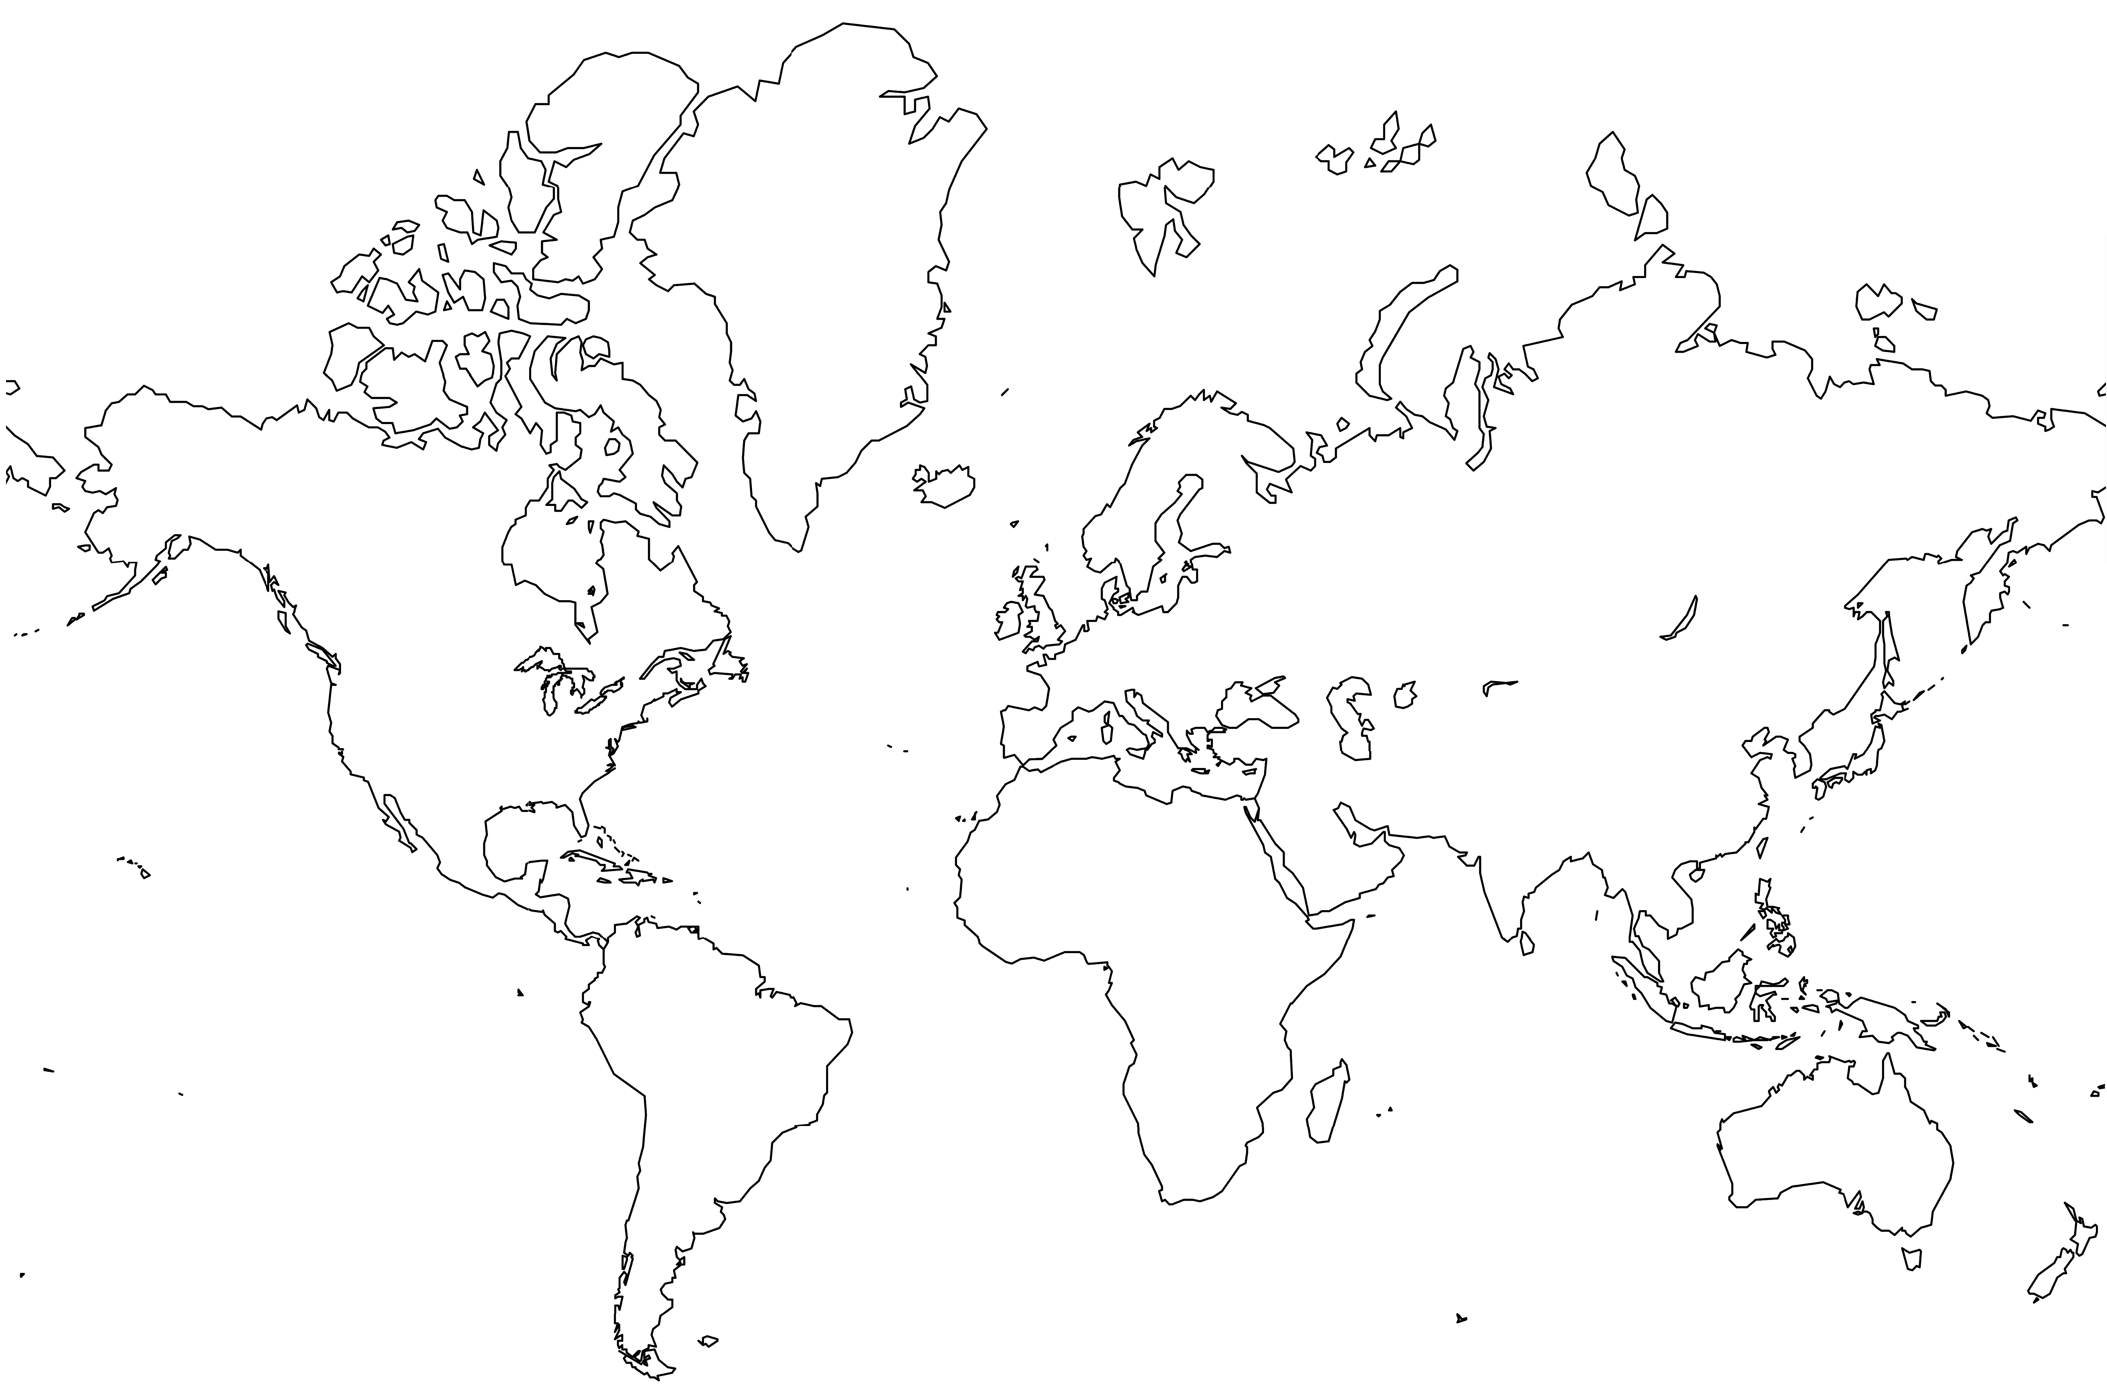
versity Bing Overseas Studies Progra
1 2 3 4 5 6 7 8 9 10
c
d
a
b

Slide 2
2
Internet published 50 word stories
7 ball cascade juggling qualification
1
First place IM indoor soccer
Months lived in Japan
3
4
6 Raymond Chandler novels read
Minute 52 second PR mile
1
club passing juggling qualification
3
Years lived in Rome
3
3
3
10 My graduation year in base 2012
KZSU indie music radio shows DJed

Slide 3
0
Coffees consumed per day
1
IM indoor soccer title
2
Internet published 50 word stories
3
Years lived in Rome
4
Minute 52 second PR mile
5
Months lived in Japan
6
Raymond Chandler novels read
7
Ball cascade
juggling pattern
8
States
camped or
canoed in
9
KZSU indie music radio shows DJed

Slide 4
0
1
2
3
4
5
6
7
8
9
|
|
|
|
|
|
|
|
|
Coffees consumed per day
IM indoor soccer title
Internet published 50 word stories
Years lived in Rome
Minute 52 second PR mile
Months lived in Japan
Raymond Chandler novels read
Ball cascade
juggling pattern
States
camped or
canoed in
KZSU indie music radio shows DJed

Slide 5
4.23/4.00
Graduate GPA
800/800
GRE Quantitative
3.80/4.00
Undergraduate GPA
35/36
ACT Composite
5/5
Seven AP Tests

Slide 6
35
MS (to date)
Units
201
BS
EE
Science
Math
CS
Japanese
Other

Slide 7
Charles Dunn 27950 Elena Road, Los Altos Hills, CA 94022 Cell 224-628-0603 ccdunn@stanford.edu Education Stanford University Coterminal MS in Electrical Engineering – Signal Processing Concentration, Class of 2012 Stanford University BS in Electrical Engineering – Circuits and Devices Concentration, Class of 2011 Stanford Graduate GPA: 4.22/4.0 Stanford Undergraduate GPA: 3.80/4.0 (Technical 3.86/4.0) Stanford University Bing Overseas Studies Program 2009 – Kyoto, Japan GRE: 800/800 Quantitative ACT Composite: 35/36 Work and Research Experience Johns Hopkins University Applied Physics Laboratory, Global Engagement Department — 2011 GPS simulation, RF testing and post-processing. Contact: Martin Sommerville (Martin.Sommerville@jhuapl.edu, 443-778-7630) Johns Hopkins University Applied Physics Laboratory, Global Engagement Department — 2010 Board design and production for GPS systems. Contact: Martin Sommerville (Martin.Sommerville@jhuapl.edu, 443-778-7630) Hitachi Works, Nuclear Power Plant Division, Radiation Shielding Group – Hitachi-shi, Ibaraki-ken, Japan — 2009 Monte Carlo simulations and radiation enclosure design. Stanford University Electrical Engineering, Research Experience for Undergraduates Program, VLF Group — 2008 LEO Cubesat tracking and ground station design. Contact: Dave Lauben (dsl@stanford.edu) Active DOD Security Clearance Awards Tau Beta Pi Engineering Honor Society – California Gamma Chapter US National Physics Team Semifinalist (200 nationwide) National AP Scholar AP Scholar with Distinction SPARK Arts Grant Recipient Rolling Meadows High School Physical Science Senior Medallion Chicago Tribune All-Academic Team Finalist Personal Interests President, Stanford Juggling Club – Cofounder, Stanford Unicycle Basketball Team – Cofounder, Treeswingers indie music blog – Senior Blogger, The Unofficial Stanford Blog – Champion, Stanford Intramural Indoor Soccer – Member, Stanford Running Club – Enthusiast, World War II History – Viewer, Coen Brothers Movies – Paddler, eleven Boundary Waters Canoe Area Wilderness trips

