Slide 1
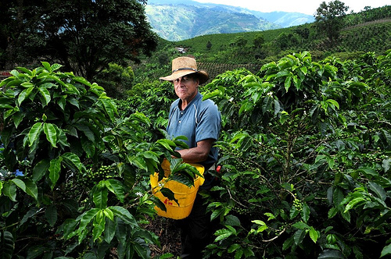
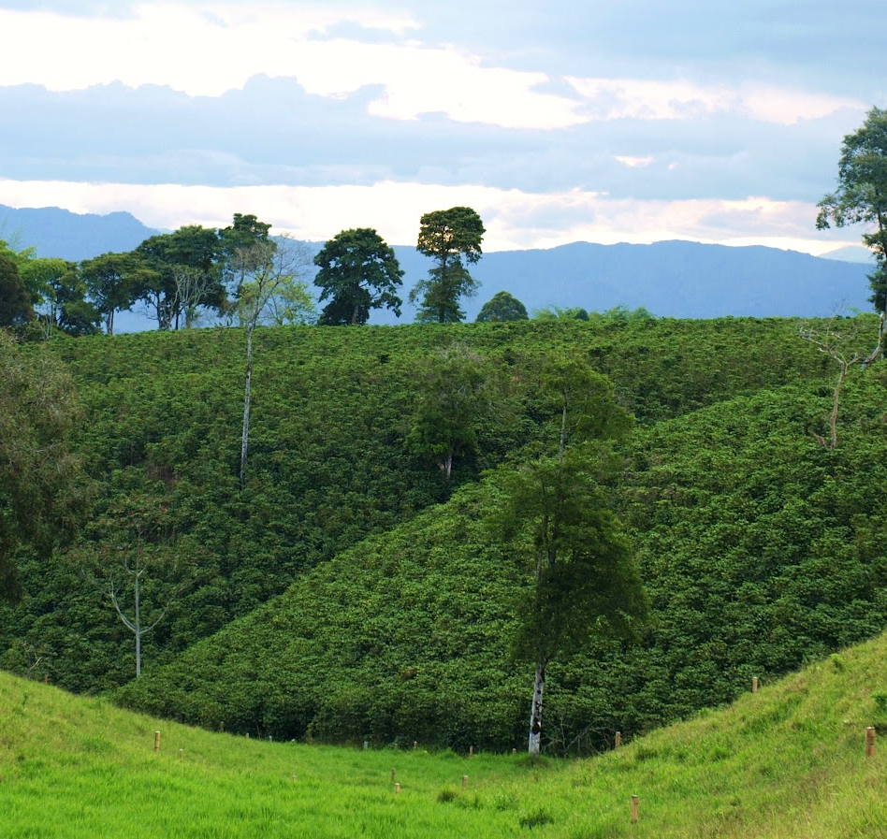
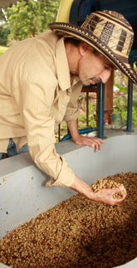
Colombia
A business case for sustainable
coffee production
August 2014

Slide 2
Executive summary
Colombia is the world’s second largest Arabica producer, accounting for 15 percent of global Arabica exports. Colombia has a rich tradition of coffee production, an efficient supply chain, and a premium market for most of its coffee exports. Coffee farming remains the leading source of livelihood for rural Colombians, though its importance to the broader economy has declined in significance over the past several decades.
95% of Colombian farms have less than 5 hectares of coffee and account for over 70% of national production. Between 2008 and 2012, Colombia’s output dropped due to adverse weather conditions and a national tree renovation program to combat coffee leaf rust. Estimates suggest that over 50% of coffee areas have been renovated so far. As these new trees start bearing, production has started to rise again and amounted to 10.9 million bags in 2013.
Farmers’ margins from coffee have been eroding. The costs associated with key production inputs including labor and fertilizer have increased rapidly over the past decade. Rising costs have made Colombia less competitive than other Arabica origins. In 2013, for the first time the Colombian government provided direct cash subsidies to farmers and paid more than US$ 600 million to bolster farmers’ incomes. As a result, farmers are increasingly weighing the opportunity cost of coffee farming, both in terms of land and labor (time).
Colombia’s coffee sector is at a crossroads. Efforts targeted at producers should focus on making farms more profitable. No single solution can address this challenge. Some farmers have opportunities to excel in specialty coffee; others may need to diversify their farm enterprises beyond coffee. However, for a large subset of the farmer population, there exist opportunities to boost yields, improve labor productivity, and reduce overall farming costs. These interventions offer the combined potential to increase farmers’ net incomes by 50% and reduce the overall amount of family labor required for coffee farming.
If this issue is not addressed, it will be difficult for certification and verification to expand. Colombia was an early adopter of certification/ verification and has a higher share of certified/verified sales than other countries surveyed by IDH. In addition, large volumes are already double-certified. However, economic constraints may limit future growth. With farmers already facing high production costs, there is resistance to the creation of new costs in the supply chain. New environmental laws, particularly regarding wastewater disposal, are likely to make compliance more difficult and costly for individual small farms in the future. Improving the profitability of farming would make it easier for farmers to absorb added sustainability costs and thus improve the business case for them to invest in sustainability.
There is a convincing business case for private and public market actors and the government to co-invest in these efforts in order to improve the competitiveness of the sector and to avoid the exit of coffee farmers. An ambitious program could reach potentially up to 50% of active farmers (230,000 farmers) over 10 years and increase production by 1.5 million bags. This would raise coffee export revenues by US$ 260 million while achieving cost savings of US$ 75 million. Implementing these opportunities would requiring new approaches for reaching farmers and cost the sector approximately US$ 200 million over 10 years.

Slide 3
Content
Colombia coffee industry primer
Analytical framework
Colombia business case discussion

Slide 4
Colombia is the world’s second largest Arabica producer
Arabica coffee production*
Bags (60-kg), millions
Arabica as share of total production
 | 72%
 | 100%
 | 100%
 | 100%
 | 100%
 | 100%
 | 96%
 | 32%
 | 16%
 | 3%
 | 25%
Brazil
37.9
Colombia*
8.8
Ethiopia
6.3
Honduras
5.1
Peru
4.8
Guatemala
4.3
Mexico
4.2
India
1.7
Indonesia
1.5
Vietnam
0.9
Uganda
0.8
* Average of 2011/12 and 2012/13 coffee years
Source: USDA; TechnoServe analysis

Slide 5
About 14% of Colombia’s exports are either certified or verified
Conventional exports
Exports as certified or verified coffee as share of total exports*
Percent
Total exports
Bags, million
Exported as certified or verified*
Colombia
(2012/13)
86%
10
Brazil
(2011/12)
88%
31
Vietnam
(2011/12)
91%
24
Ethiopia
(2012/13)
97%
3
Uganda
(2012/13)
98%
3
12.5%
Global Average
certified/verified sales***
* Most recent year of available data
** Based on 2013 data; Fairtrade data not available at time of publication; excludes Nespresso AAA and Starbucks C.A.F.E. Practices
Source: USDA; ICO; TCC Coffee Barometer 2012; stakeholder interviews

Slide 6
Roughly 45% of production is under one or more certification or verification
Coffee production by certification/verification, 2013
Bags (60-kg), millions
10.9 total
production
9.9
0.8
0.1
1.3
1.7
5.0
5.0
6.1
4C
Fairtrade
UTZ
Rainforest
Alliance
Organic
Sub-total
Less coffees in multiple schemes
Total certified/ verified production
Source: Stakeholder interviews; FNC; TechnoServe analysis

Slide 7
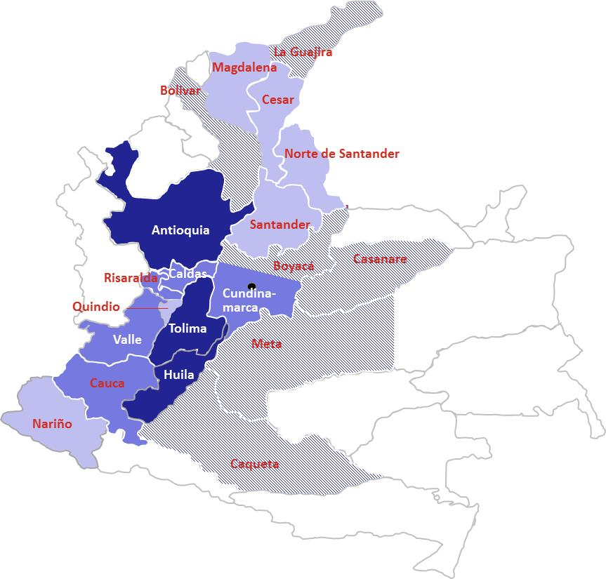
Colombia has a range of Arabica growing regions and more than half a million farms
Production per coffee growing region
2012/13, million bags green coffee
2012/13 production of bags green coffee
> 1 million bags
0.5 – 1 million bags
0.1 – 0.5 million bags
< 0.1 million bags
Source: Agronet, FNC

Slide 8
95% of Colombian coffee farms have less than 5 ha of coffee
Distribution of Colombian coffee farms by coffee farm size
Area under coffee (ha) | Number of coffee farms | Share of coffee area | Share of production
< 1 | 305,200 (54.5%) | 21% | 20%
1.1 – 5 | 224,000 (40%) | 48% | 50%
5.1 – 10 | 24,800 (4.4%) | 14% | 12%
> 10 | 6,000 (1.1%) | 17% | 18%
Total farms | 560,000 | 974,000 ha* | 10.9 m bags
Active farms | 460,000 | Est. 100,000 inactive farmers**
> 10 ha
5-10 ha
Farm size (hectares)
1-5 ha
< 1 ha
0
100,000
200,000
300,000
400,000
500,000
600,000
Coffee farms (households)
* Based on planted coffee area
** > 100,000 farmers did not take advantage of the direct income subsidy paid by the government (PIC scheme)
Source: FNC; interviews

Slide 9
A generation ago, only half of Colombia’s farms were smaller than 5 hectares
Coffee farms by farm size
Percentage of coffee farms
300,000
460,000 to 560,000
4%
1%
>10 ha
31%
5-10 ha
16%
1-5 ha
< 1 ha
1970s
2010s
Average coffee farm size
3.5 ha
~ 2 ha
Note: Data based on 1970 National Coffee Census and 2013 SICA data
Source: FNC; FONAC

Slide 10
A combination of demographic and economic factors have contributed to diminishing farm size
Decreasing farm size due to inheritance traditions
Traditionally, families distributed coffee land between heirs
With average household sizes of up to 6 this led to considerably decreasing farm sizes
Exit of large farms due to unfavorable economics
High cost structure due to large share of external farm workers has forced larger farms to give up their farms, in particular in times of low coffee prices (e.g., beginning of the 90s)
Smaller farms have proven to be more resistant to price falls due to lower cash costs
Many new small farms due to attractiveness of sector
Many farmers moved into the sector, starting to grow coffee on small farms because they perceived coffee to be an attractive and stable income alternative
Coffee sector is only sector with purchase guarantee and high institutional support (e.g. technical assistance, transfer of technological innovation, credit, infrastructure, social protection, health services, education programs)
Source: World Bank, stakeholder interviews

Slide 11
The number of coffee farms peaked in the 1990s, but fell in the early 2000s
Estimated number of coffee farms
Thousands
Decrease due to
“coffee crisis” and escalation
of armed conflict*
660
560
500
100***
450
300
460
1970s
1980s
1990s
2000s**
Current
* Combination of low international coffee prices from 2001 to 2003 (“coffee crisis”) and armed conflict caused farmers to abandon land and/or switch to other crops with a quicker cash cycle, including coca, in particular in lower altitudes
** As of 2008 *** Inactive farmers
Source: FNC; FONAC; 1993-1997 National Coffee Survey; Universidad de los Andes – CEDE: “ Abandoning Coffee under the Threat of Violence and the Presence of Illicit Crops. Evidence from Colombia”; TechnoServe estimates

Slide 12
Output fell due to adverse weather and a national tree renovation program, but is now expected to rise
Colombia national coffee production
Millions of bags (60-kg), green
18
16
Renovated farms have come back into production
Range of estimates
14
12
10
8
Drop of ~4M bags due to renovation to address leaf rust (~2M bags) and weather conditions* (~2M bags)
6
4
2
0
2000
2002
2004
2006
2008
2010
2012
2014
2016
2018
2020
* El Niño and La Niña
Source: USDA FAS; FNC; Interviews
12

Slide 13
Renovation is ongoing and more than half of existing trees have already been replanted
Renovated, in production
Cultivated coffee area
Thousand hectares
Renovated, not yet in production*
Original tree stock (not renovated)
931
974
974**
878
887
914
921
809
742
687
577
470
443
19
2008
2009
2010
2011
2012
2013
2020
(projection)
* Estimate based on assumption that a tree is “in production” in the 3rd harvest after planting
** Assuming that total coffee area remains constant at 2013 value; FNC aims to renovate 98% of tree stock by 2020
Source: FNC

Slide 14
Colombia’s supply chain has six distinctive attributes in comparison to other countries
Colombia’s coffee supply chain (Arabica)
Distinctive to Colombia
Farming
Processing: Wet milling
Aggregation
Exporting
Roasting
Majority of farms are smallholders (with less than 5 ha under coffee)
Harvesting occurs year-round in most areas, with a main harvest and a 2nd mid-year harvest (mitaca)
Nearly all farmers wet-mill at home and sell dry parchment (in most regions there is no market for cherry)
Some wet mills have gaps in infrastructure, e.g., insufficient drying space, inadequate wastewater disposal, etc.
Aggregation is done both by cooperatives and private buyers
~ 35% of volume goes through coops* , the highest share in Latin America
A purchase guarantee exists at all aggregation points
Competition exists between local and multinational exporters (multi-national exporters have ~33% market share)
The FNC**, a nonprofit, is the largest exporter (25% market share)
~90% of total production is exported***
~10% of production is consumed internally
Internal demand is mainly for roast & ground (rather than soluble)
Soluble manufacturing capacity exists, both for export and internal markets
Strong institutional framework through the establishment of the National Coffee Fund, which provides support to the coffee sector and is managed by the FNC
* There are 34 coops with 515 purchase points country-wide; while in 2013 45% of volume went though cooperatives, the share has been ~35% on average over the last years ** Federación Nacional de Café; responsible for the implementation of the National Coffee Fund
*** Coffee not fulfilling export quality standards is used for internal consumption
Source: FNC; interviews

Slide 15
Average farming cash costs are estimated to be around US$1.10 per lb and farmers receive ~ 80% of export price
Cash cost of production for average Colombian farm
US$ per lb green
Negative margin if family labor is factored in at full value (US$ 0.56 per lb)
1.74
0.06
0.29
1.39
0.29
1.10
0.11
0.14
0.33
0.52
Export price*
Coffee contribution
Supply chain costs
Farm-gate price
Cash margin
Farming costs
Other costs**
Wet-milling
Farm labor
Agro-inputs
Note: Cost of production does not include costs for installation of wet milling equipment, tree renovation or financing
*Normalized to 2012/13 average commodity prices – Arabica ICE “C” of $1.50 but adjusted for market differentials)
** Includes farm tools, equipment, internal transport, etc.
Source: Stakeholder interviews, TechnoServe analysis

Slide 16
Colombia’s farm-to-export chain is efficient relative to regional peers (e.g., Peru, Honduras)
Efficiency levels of major Latin American coffee supply chains, 2012/13
US$ per pound green
$1.34
$1.74
$1.49
$1.61
Export (FOB) price*
0%
3%
0%
2%
Taxes / deductions**
Farm-to-export
(aggregation, grading,
exportation, etc.)***
90%
Farmer share
(before processing,
harvesting and
other on-farm costs)
80%
75%
74%
Brazil (Natural Arabica)
Colombia (Washed Arabica)
Peru (Washed Arabica)
Honduras (Washed Arabica)
*Prices are normalized to 2012/13 average commodity prices – Arabica (ICE “C”) $1.50 but adjusted for market differentials
** Coffee contribution of US$ 6 cents/lb in Colombia and US$ 4.25 per 46-kg bag in Honduras (not considering ‘retención’ of US$ 9 per 46 kg bag that is reimbursed to registered farmers after payment)
*** Calculated as difference between farm gate price and ICO price
Source: trade statistics; TechnoServe analysis and interviews in Brazil, Colombia, Honduras and Peru

Slide 17
However, Colombia’s farm-level costs are significantly higher than the two cost leaders (Brazil and Ethiopia)
Cash cost of production breakdown
US$ cent per lb green
Export price
1.43
Total cost
Higher agro-input costs (compared to Brazil)
Less competitive market for agro-inputs
Prices are 30+% higher than international prices
No local production
Lower yields
Less efficient fertilizer usage
1.20
0.34
Farm-to-export*
1.03
0.14
0.12
0.21
Other farm-level**
0.75
0.42
0.44
0.52
Agro-inputs
0.51
0.31
0.33
0.10
0.02
0.33
0.38
Paid labor***
0.12
0.15
Higher labor costs (compared to Brazil)
Lower yields
Lower labor efficiency
Ethiopia (<1 ha farm)
Brazil (50 ha farm, Mechanized)
Brazil (5 ha farm, Naturals)
Colombia (2 ha farm, Washed)
* Includes secondary processing (e.g., dry-milling, grading); also includes primary processing for Ethiopia
* Includes depreciation, fuel, internal transport, other fixed costs
** Excludes family labor
Source: Stakeholder interviews, TechnoServe analysis

Slide 18
Colombia’s farming costs have risen over the past decade
x%
2005-14 growth rate
Labor
+97%
Minimum wage (US$ per month)
+97%
235
231
271
290
315
315
324
164
173
209
Fertilizer
+49%
Price of urea (US$ per ton)*
+ 49%
493
421
405
219
223
309
250
289
340
326
Currency
+22%
Colombian peso relative to US dollar, indexed (2005=100)**
+ 22%
1.00
0.94
1.15
1.26
1.14
1.24
1.21
1.28
1.23
1.22
2005
2006
2007
2008
2009
2010
2011
2012
2013
2014
* Average sales price of key importers; import taxes on fertilizers higher in Colombia than in other coffee producing countries
** Rise is appreciation of the Colombian peso relative to the US dollar
Source: Ministerio de la Protección Social (minimum wage); indexmundi.com (urea price); xe.com (exchange rate)

Slide 19
As prices have fallen, the farmer’s margin has been eroded
Colombia prices and production costs*
US cents per lb green
Farm gate price
300
Government supported coffee farmers with direct subsidy payments
250
200
Drop in number of coffee farmers as many looked for better income opportunities, including coca
150
100
Farmer’s margin
50
Cost of production
0
2003
2004
2005
2006
2007
2008
2009
2010
2011
2012
2013
* Cash production costs
Source: ICO, FNC, TechnoServe analysis

Slide 20
The government has helped farmers by offering a cash subsidy when the market falls below US$1.50 (COP 700,000)
Colombia average farm-gate price
US$ per lb green
3.00
Historically, direct government subsidies were not common in the coffee sector
Subsidy is triggered when coffee price falls below COP 700,000 (~ $1.50 per lb)*
More than $ 600 million in subsidies paid to farmers in 2013
2.50
2.00
1.50
Subsidy
1.00
0.50
Jan-12
Feb-12
Mar-12
Apr-12
May-12
Jun-12
Jul-12
Aug-12
Sep-12
Oct-12
Nov-12
Dec-12
Jan-13
Feb-13
Mar-13
Apr-13
May-13
Jun-13
Jul-13
Aug-13
Sep-13
Oct-13
Nov-13
Dec-13
*At current exchange rate; subsidy paid if internal base price is below COP 700,000; sum of income from coffee sale and subsidy cannot exceed COP 700,000; subsidy of COP 165,000 paid if price is below COP 480,000; otherwise payment of up to COP 145,000; between Oct 2012 and March 2013 producers received COP 20,000 and later 60,000 per load if price was below 650,000
Source: FNC, TechnoServe analysis

Slide 21
Farmers will increasingly weigh the opportunity cost of coffee farming, both in terms of land and time (labor)
Labor utilization
Share of total working days worked²
Base net income¹
2012/13, US$
/
=
Annualized net income
US$
50%
75%
100%
100%
100%
Coffee farming (2 hectares)³
1,430
2,860
Informal agri- cultural worker⁴
2,200 - 2,500
3,000 – 3,350
Textile factory worker
3,600
3,600
Truck driver
4,900
4,900
Bank teller
6,300
6,300
$3,950
Minimum wage
1 Entry level salary
2 Assuming 260 work days per year for office job and 300 days for agricultural workers
4 Assuming daily rate of COP 20,000 and 220 work days per year
Source: DANE, tusalario.org, stakeholder interviews, TechnoServe analysis

Slide 22
Colombia is at a crossroads
Slowly exit coffee
Shift away from coffee farming and move into other economic activities that provide better income prospects
In particular, in peri-urban areas and in places most vulnerable to climate change
Facing eroding margins and decreasing competitiveness, Colombian coffee farmers have several options to address this situation
Keep coffee but diversify
Diversification into additional crops that provide income and decrease dependency on coffee prices
In particular, in lower altitudes that are more susceptible to disease and climate change
Focus on quality
Focus on specialty coffee and implement activities to improve quality in order to achieve higher margins
In particular for farmers at higher altitudes or with traditional varieties
Improve efficiency
Decrease cost of production in order to improve efficiency and gain higher profit margin
Source: Stakeholder interviews, TechnoServe analysis

Slide 23
Contents
Colombia coffee industry primer
Analytical framework
Colombia business case discussion

Slide 24
Different groups of farmers will need to respond in different ways
Addressed by business cases
High
Potential Impact
Net Benefit / ROI
Revenue – GDP increase
Employment – Potential for job creation or preservation
Scope – Broadly applicable or impacting a narrow segment
Durability– Ability to preserve jobs/wealth over 5-20 year time frame
Price subsidy
Agronomy / GAPs
Institutional reform
Central milling
Fertilizer subsidy
Renovation*
Ease of Implementation
Time Frame – Time required to generate economic growth
Cost – Investment required
Political Feasibility – Ability to reach stakeholder agreement and long term commitment
Technical Feasibility – Complexity of solution and availability of local skills to implement
Input credit
Farm diversification
Farm consolidation
Potential impact
Harvesting technology
Quality differentiation
Domestic consumption
Farmer organizations
Robusta introduction
Interpreting this matrix
“High Impact / Less Difficult” items are recommended co-investments
“High Impact / Difficult” items are worth pursuing but likely require long-term funding or should be government led
“Low Impact / Less Difficult” items are likely to happen on their own (i.e., via private sector or existing initiatives)
“Low Impact / Difficult” items should be considered on a case-by-case basis but may not be replicable to all farmers
Wastewater compliance
Certification expansion
Ban prohibited agrochemicals
Branding / trademarks
Low
Difficult
Less Difficult
Ease of implementation
* Addressed by different schemes
Source: Stakeholder interviews, TechnoServe analysis

Slide 25
We have segmented Colombia’s farms on the basis of region, farm size and altitude
Implication
Categories
Region
Some regions have higher labor and opportunity costs (availability of other income opportunities), as well as better infrastructure (e.g., roads)
Central/northern region
Southern region
A
Farm size
Smaller farms typically have lower labor costs because they primarily utilize (unpaid) family labor
< 1ha
1 – 5 ha
> 5 ha
B
Altitude
Higher altitude areas are more likely to produce premium coffees; lower altitude areas are more vulnerable to pest/disease and climate change
Low (< 1,200m)
Medium (1,200 – 1,600m)
High (> 1,600m)
C
Source: Stakeholder interviews, TechnoServe analysis

Slide 26
REGIONAL ARCHETYPES Southern farms tend to have lower opportunity costs (and labor costs)…
A
Major coffee growing regions
Southern
Central/Northern*
Shows some characteristics that are similar to Southern region
Note: Regional classification based on Cenicafé definition
*Inclusion of northern regions into central region despite regional differences
Source: Agronet, Cenicafé

Slide 27
REGIONAL ARCHETYPES …Evidenced in part by growing coffee areas and lower rural migration rates
A
Southern region
Central/Northern region
Difference in area cultivated for coffee between 2004 and 2013
Percent
Migration rate of rural population, 1993-2005
Incidents per 1,000
Region
Narino
50
-4
Cauca
31
-5
Huila
65
-8
Valle
-20
-11
Cundinamarca
-21
-14
Risaralda
-10
-16
Antioquia
6
-17
Tolima
13
-21
Caldas
-15
-24
Source: FNC, DANE, TechnoServe analysis

Slide 28
FARM SIZE ARCHETYPES Larger farms tend to utilize labor more efficiently
B
Number of labor days per 100 lbs per year
Days
7
6
Increasing levels of labor efficiency
-15%
5
4
3
Farm size
Hectares
0
1
2
3
4
5
6
7
8
9
10
Source: Interviews; TechnoServe analysis

Slide 29
FARM SIZE ARCHETYPES Smaller farms, which rely mostly on family labor, tend to have lower cash costs
B
Estimated distribution of family vs. hired labor by farm size
US$ per lb green
Average farm size
1.00
0.80
Family labor (non-cash cost)
0.60
0.40
Hired labor (cash cost)
0.20
0.00
Farm size
Hectares
0
1
2
3
4
5
6
7
8
9
10
Source: Interviews; TechnoServe analysis

Slide 30
ALTITUDINAL ARCHETYPES Most of Colombia’s major growing regions exhibit a range of altitudes
C
Major coffee growing regions
Note: Usage of average altitude range of 1,600m for specialty coffee; does not account for fact that altitudes might have different meanings in different departments
* Low: < 1,200m; medium: 1,200 – 1,600m; high: > 1,600m
Source: AGRONET, FNC, TechnoServe analysis

Slide 31
ALTITUDINAL ARCHETYPES Higher altitude farms have opportunities to focus on top specialty production while lower altitude farms are more vulnerable
C
Potential for top specialty production (by altitude)
Altitude
Meters
Low
High
2,000
Opportunities in specialty coffee (achieving higher prices)
1,600
1,200
More vulnerable to disease/pest epidemics, climate change
800
400
0
10
20
30
40
50
60
70
80
90
100
Percent of Colombian production
Source: AGRONET, FNC, TechnoServe analysis

Slide 32
PRIORITIZING ARCHETYPES Our solution approach will focus on active farmers in the “mainstream” archetype
Key intervention opportunity
Identify specialty opportunities
Identify diversification opportunities
Identify ways to technify farms
Improve farms’ efficiency
100%=
560,000
18%
25%
21%
2%
35%
Total farms
Inactive farmers
High altitudes
Low altitudes
Large farms
(> 5 ha)
Small farms at medium altitudes
Focus archetype
Source: TechnoServe analysis

Slide 33
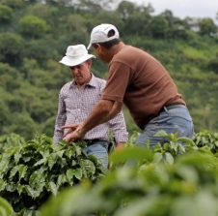
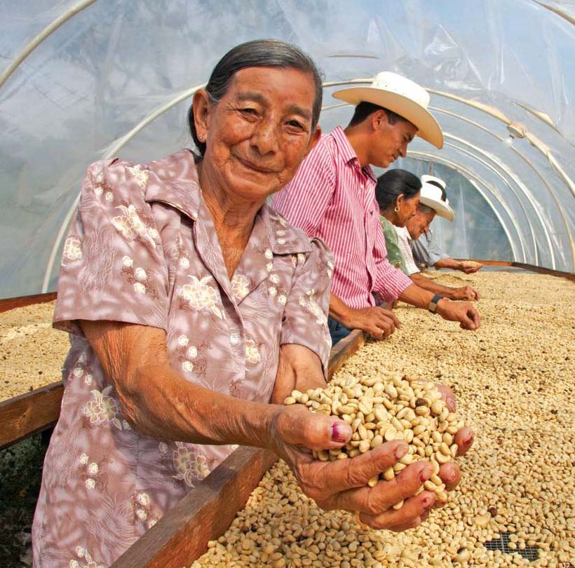
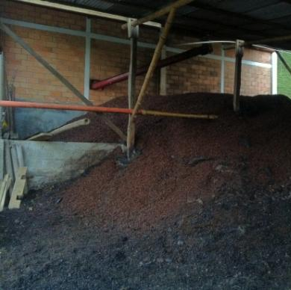
ESTABLISHING THE BUSINESS CASE STUDIES Three business cases were analyzed in depth targeted at mainstream archetype
Business cases and key challenges
Farmers can increase yields through improved agronomy and technical assistance
Colombia’s farm yields could be increased by 20 to 30% by transferring improved agronomy practices to farmers, in particular effective fertilizer usage
Achieving yield improvement requires high adoption level of best practices; high average age of farmer population could pose a challenge
Higher yields contribute to a 5% cost reduction and net income increase of 30-50%
Overall, production would increase by 1.5M bags and exports by US$ 260M per year
Cost of US$ 200M to train 50% of active farmers (230,000) over 10 years
Training should complement FNC’s individual farm extension visit s with a “farmer field schools” methodology and should actively try to involve the youth
1
Production costs could be reduced modestly through various sector efficiencies
Colombia’s coffee farming is already quite sophisticated and shows limited potential for reducing production costs
By reducing farmers’ labor requirements for harvesting and in particular home wet-milling, production costs could be reduced by up to 10%
For harvesting, there are conceptually opportunities for improving productivity; however, implementation will be difficult and results may not justify costs
For wet-milling, the introduction of central milling could reduce labor requirements by 50-70% and produce other financial and nonfinancial benefits
Farmers facing the highest opportunity costs to time and labor should be prioritized
2
Supply chains can meet stricter environmental standards with minimal added cost
Challenging for farms to meet new, stricter environmental regulations – requires new wastewater treatment systems that are complicated and expensive
Ensure compliance with environmental laws cost-effectively through central wet mills; a single system now benefits many farms
The combination of all three business cases would increase net income by more than 50% and reduce time spent for coffee farmers, enabling them to earn more from coffee than other rural employment options
3

Slide 34
Contents
Colombia coffee industry primer
Analytical framework
Colombia business case discussion

Slide 35
BUSINESS CASE DISCUSSION Business case 1: Improving yields
Business cases and key challenges
Farmers can increase yields through improved agronomy and technical assistance
Colombia’s farm yields could be increased by 20 to 30% by transferring improved agronomy practices to farmers, in particular effective fertilizer usage
Achieving yield improvement requires high adoption level of best practices; high average age of farmer population could pose a challenge
Higher yields contribute to a 5% cost reduction and net income increase of 30-50%
Overall, production would increase by 1.5M bags and exports by US$ 260M per year
Cost of US$ 200M to train 50% of active farmers (230,000) over 10 years
Training should complement FNC’s individual farm extension visit s with a “farmer field schools” methodology and should actively try to involve the youth
1
Production costs could be reduced modestly through various sector efficiencies
Colombia’s coffee farming is already quite sophisticated and shows limited potential for reducing production costs
By reducing farmers’ labor requirements for harvesting and in particular home wet-milling, production costs could be reduced by up to 10%
For harvesting, there are conceptually opportunities for improving productivity; however, implementation will be difficult and results may not justify costs
For wet-milling, the introduction of central milling could reduce labor requirements by 50-70% and produce other financial and nonfinancial benefits
Farmers facing the highest opportunity costs to time and labor should be prioritized
2
Supply chains can meet stricter environmental standards with minimal added cost
Challenging for farms to meet new, stricter environmental regulations – requires new wastewater treatment systems that are complicated and expensive
Ensure compliance with environmental laws cost-effectively through central wet mills; a single system now benefits many farms
The combination of all three business cases would increase net income by more than 50% and reduce time spent for coffee farmers, enabling them to earn more from coffee than other rural employment options
3

Slide 36
Colombia’s farm yields could be increased by 20 to 30%
1
Average coffee farm yields (Arabica)
Metric tons green coffee per ha
+20 - 30%
1.4
1.2
0.8
0.9
0.6
0.6
0.3
Ethiopia
Guatemala
Peru*
Honduras*
Colombia
Costa Rica
Brazil
* Drop of yield in recent years due to leaf rust
Source: ICO (production volume), national coffee associations and stakeholder interviews for coffee area information

Slide 37
Improved agronomy can boost yields by 20 to 30%
1
Yields could increase by 20 to 30%*…
Kg green coffee per ha
… Through improved adoption of agronomic best practices
1,120-1,200
Increased and optimized fertilization
Integrated pest management (IPM)
Control of soil erosion
Effective shade management
Proper tree establishment and density
190-
270
+20-30%
Realistic level for smallholders, though research trials show higher potential
930
These practices are well-known (and established by Cenicafé), however, the majority of farms have not fully adopted , thus yields are below potential
Current yield**
Improved agronomy
Total
* According to stakeholder interviews; yield improvement potential depending on current level of adoption of best practices
** Current yield of 930 kg/ha assumes that a significant share of renovation has already happened
Source: Stakeholder interviews

Slide 38
Overall, farmer net income would increase by 30 to 50%
1
Cash-flow for typical smallholder farmer in central region (excluding training costs)*
Annual net income
US$
2,500
Investment in fertilizer and other inputs right from the beginning while yields increase over time
2,000
+30-50%
1,500
1,000
500
Year
0
1
2
3
4
5
* Assumes farm of 2.0 ha in central region and farm-gate price of $1.50/lb
Source: Interviews with farmers, industry stakeholders and project visits; TechnoServe analysis

Slide 39
While some farmers require support to increase input usage, further gains require innovation and input optimization
1
Yield
Optimize input usage
Requires innovation (e.g., new varieties), research
Prioritized to farmers with higher yields / input usage
Increase input usage
Requires models for training, distribution, financing
Prioritized to farmers with low yield / input usage
Input usage
Source: Adapted from framework developed by Yara

Slide 40
An ambitious program to increase adoption could potentially reach up to 50% of Colombia’s active coffee farmers
1
Phase 1:
Focus on mainstream archetype
Phase 3:
Scale up to reach other archetypes
210
230
230
Number of farmers trained by the program (cumulative)
Thousands
150
180
95
120
20
40
60
2015
16
17
18
19
20
21
22
23
2024
Phase description
Roll out training program with focus on farmers in mainstream archetypes
Focus on highest-potential areas and farmer groups at the beginning to pilot and test program
Scale program to cover 75% of farmers in mainstream archetype
Scale up program beyond mainstream archetype to include farmers from other archetypes
Overall, reach ~50% of active farmers
Approx. US$ 200 million*
over 10 years
*Total cost of about $800-1,000 per farmer (for two-year program)
Source: TechnoServe analysis

Slide 41
Achieving yield improvement requires high adoption level of best practices that might face several challenges
1
Barriers that might hinder adoption of best practices
High age of coffee farmers
Increasing average age of coffee farmers as younger – currently 56 years - generations leave rural areas and look for income opportunities in urban areas
Less likely to adopt new practices and technologies
Lower skill levels
Lower educational level of many coffee farmers, especially from older generations,
Might not have the required skill levels to adopt new practices
Remoteness / access
Difficult to reach farmers that are remotely located and face transport challenges (e.g., bad roads)
Less likely to ensure adequate coverage to achieve high adoption rates
Source: TechnoServe analysis

Slide 42
There are four common types of farmer training models with varying impact and cost
1
Recommended approach
Training model
How it works
Likely impacts
Cost per farmer
Classroom
1-2 large trainings (50-500 farmers) organized at meeting venue to create awareness and provide basic training
Effective at teaching a small set of concepts
Typically most useful for preparing for certification
$
Demonstration plots
Demonstration plots established and several trainings (2-4) organized for smaller groups (50-80 farmers) to show impact of GAPs
Effective at demonstrating GAPs and reaching quick adopters
May be less effective in changing behavior of slower adopters
$$
Farmer field schools
Small demo plots established and frequent trainings (6-12) organized for small groups (20-30) and rigorous data collection and analysis
Effective at providing hands-on experience for implementation of GAPs
Typically high adoption rate of farmers with varying skill levels
$$$
Individual visits
Individual, personalized training (4-6 visits/year) organized onsite to demonstrate and directly implement GAPs
Effective for more advanced, technically skilled farmers
May be less effective for farmers who learn better through peer interaction
$$$$
Farmer field schools are recommended based on scalability, impact potential, and the cost of the approach to increase outreach and improve adoption rate of farmer training
Source: MEAS report, stakeholder interviews

Slide 43
Innovative strategies to target youth in training program could enhance program’s results
1
Training program should actively involve the youth to ensure that coffee farming continues to be a key source of rural development
Benefits of including youth on farm-level
Higher likelihood of adopting new practices and technology, leading to more productive and efficient coffee farming
Currently many youth migrate to more urban areas as coffee farming does not constitute an interesting income opportunity for many of them
Higher likelihood of managing farm as a business and applying basic business and financial management skills
More open to invest in coffee farming
Coffee continues to be a key source for rural employment (both for coffee farmers and coffee workers)
Source: TechnoServe analysis

Slide 44
Besides engaging the youth on-farm, the coffee industry offers a variety of employment opportunities
1
Potential employment opportunities for the youth
Direct Farm
NOT EXHAUSTIVE
Wider coffee sector
Cupper
Barista
Fertilizer sales/distribution
Trainer / auditor for certifier
Researcher / investigator
Regional coffee industry
Truck driver for collecting coffee
Cooperative management
Management of central wet mills
Regional coffee committees
On-farm
Farm manager
Extension worker
Source: TechnoServe analysis

Slide 45
This intervention could increase production by at least 1.5 million bags and exports by over US$ 260m after 10 years
1
Nationwide coffee production by 2024
Million bags green coffee
2013 production
10.9
Renovation*
2.5
Yield increase extension program**
1.5
Potential production in 2024
14.9
Coffee below export standards***
1.8
Additional export revenues of US$ 260 m***
Potential exports in 2024
13.1
Note: Forecast based on expected yield increase of 20%
* Production from areas already renovated and not in production yet and yield increase from areas to be renovated
** Assuming yield increase will be fully achieved in the 3rd year
*** Assuming 10% of production does not pass export quality standards and price of US$ 1.50 per lb green
Source: FNC; Stakeholder interviews, TechnoServe analysis

Slide 46
Overall, the program could generate additional export earnings of US$ 1.3bn over 10 years
1
The training of farmers can be scaled up over time, reaching 230,000 farmers
Farmers newly enrolled in program, thousands
Total over 10 years
35
35
30
30
230,000 farmers
20
20
20
20
20
0
The training would cost ~US$ 200 m over 10 years
Training costs per year , US$ million
US$ 200 million
24
30
28
26
22
10
17
17
17
9
Through improving yields, Colombia’s exports will increase over time
Incremental export volume, million 60kg bags green*
6.6 million bags
0.8
0.9
1.1
1.2
1.3
0.0
0.1
0.2
0.4
0.6
Resulting in additional export earnings
Incremental export value, US$ million**
244
259
US$ 1.3 bn
149
186
217
46
75
110
8
23
2015
16
17
18
19
20
21
22
23
2024
* Assuming yield improvement to be achieved over 3 years
** Assuming price of US$ 1.50/lb
Source: TechnoServe analysis

Slide 47
Climate change will likely put additional pressure on smallholders, especially on farms at lower altitudes
1
Climatic variable
Anticipated change
Expected impact
Rising temperatures
Temperatures are expected to rise by 2.5°C by 2050
Melting of glaciers in the Andes and disappearance of important moorlands that act as important sources of water
Decreased groundwater recharge
Decreased water resources
Increased pest and diseases
Higher price volatility
Erratic precipitation
Average increase in precipitation of 2.5% by 2050 (3-5% expected for coffee growing areas)
Driest periods will likely be less dry, while wettest periods are projected to become wetter
Increased risk of soil erosion and suboptimal infiltration of saturated soils
More unfavorable conditions for drying of coffee
Farms at lower altitudes are most vulnerable to impact of climate change and should be targeted for diversification opportunities
Source: CIAT

Slide 48
BUSINESS CASE DISCUSSION Business case 2: Improving sector efficiencies
Business cases and key challenges
Farmers can increase yields through improved agronomy and technical assistance
Colombia’s farm yields could be increased by 20 to 30% by transferring improved agronomy practices to farmers, in particular effective fertilizer usage
Achieving yield improvement requires high adoption level of best practices; high average age of farmer population could pose a challenge
Higher yields contribute to a 5% cost reduction and net income increase of 30-50%
Overall, production would increase by 1.5M bags and exports by US$ 260M per year
Cost of US$ 200M to train 50% of active farmers (230,000) over 10 years
Training should complement FNC’s individual farm extension visit s with a “farmer field schools” methodology and should actively try to involve the youth
1
Production costs could be reduced modestly through various sector efficiencies
Colombia’s coffee farming is already quite sophisticated and shows limited potential for reducing production costs
By reducing farmers’ labor requirements for harvesting and in particular home wet-milling, production costs could be reduced by up to 10%,
For harvesting, there are conceptually opportunities for improving productivity; however, implementation will be difficult and results may not justify costs
For wet-milling, the introduction of central milling could reduce labor requirements by 50-70% and produce other financial and nonfinancial benefits
Farmers facing the highest opportunity costs to time and labor should be prioritized
2
Supply chains can meet stricter environmental standards with minimal added cost
Challenging for farms to meet new, stricter environmental regulations – requires new wastewater treatment systems that are complicated and expensive
Ensure compliance with environmental laws cost-effectively through central wet mills; a single system now benefits many farms
The combination of all three business cases would increase net income by more than 50% and reduce time spent for coffee farmers, enabling them to earn more from coffee than other rural employment options
3

Slide 49
There may be modest opportunities to reduce the cost of production in Colombia’s supply chain
2
Cash cost of production for average Colombian farm
US$ per lb green
1.74
Focus of improving farming efficiencies
0.06
0.29
1.39
0.29
1.10
0.11
0.14
0.33
0.52
Export price*
Coffee contribution
Supply chain costs
Farm-gate price
Farmer’s cash margin
Farming costs
Other costs**
Wet-milling
Farm labor
Agro-inputs***
Farm to export costs
Cash cost of production
Note: Cost of production does not include costs for installation of wet milling equipment, tree renovation or financing
*Normalized to 2012/13 average commodity prices – Arabica ICE “C” of $1.50 but adjusted for market differentials)
** Includes farm tools, equipment, internal transport, etc.
*** May be possible through optimized fertilizer and distribution methods (see Business Case 1, page 47)
Source: Stakeholder interviews, TechnoServe analysis

Slide 50
Harvesting and home wet-milling comprise 70% of total on-farm labor requirements
2
Est. work days
per year
Allocation of
total work day
Total labor days
(Full time equivalency)
Remarks
100%
100%
60%
40%
50%
Family or hired labor
Family or hired labor
Mostly hired labor during peak harvest; family during mitaca
Family labor
Family labor
Weeding¹
25
25
Fertilization²
20
20
Harvesting³
200
120
Wet milling⁴
150
60
Others⁵
64
32
Total
¹ Assumes three rounds per year at rate of 1,200 trees per worker per day
² Assumes two rounds per year at rate of 1,000 trees per worker per day
³ During main crop, assumes 80 kg/day (cherry) x 1.5 workers x 60 harvest days; during mitaca, assumes 35 kg/day x 0.5 workers x 60 harvest days
⁴ During main crop, assumes 60 days of pulping/washing/drying at 5 hours/day, plus 15 days after harvest for final drying and transport at 2 hours/day; during mitaca, assumes 60 days of pulping/washing/drying at 2.25 hours/day, plus 15 days after harvest for final drying and transport at 1 hour/day
⁵ Includes replanting, pest control, shade management, erosion control, and transport
NOTE: Modeled on 2 ha farm with 5,000 trees per ha and yield of 850 kg/ha green
Source: CRECE, interviews, TechnoServe analysis

Slide 51
There may be ways to reduce farmers’ labor requirements in harvesting and wet-milling, saving them time and some money
2
Est. work days
per year
Allocation of
total work day
Total labor days
(Full time equivalency)
Efficiency gains
100%
100%
60%
15%
50%
Not modeled
Not modeled
5-10% through various improvements
50-70% through central wet milling
Not modeled
Weeding
25
25
Fertilization
20
20
a
Harvesting
175
105
b
Wet milling
120
18*
Others
64
32
Total
* Home wet-milling time replaced with cherry transport time; during main crop, assumes 1.5 hours for 60 days; during mitaca, assumes 1 hour for 60 days
NOTE: Modeled on 2 ha farm with 5,000 trees per ha and yield of 850 kg/ha green
Source: CRECE, interviews, TechnoServe analysis

Slide 52
While conceptually there may be ways to reduce harvesting costs, implementation will be difficult
2a
Improvement opportunity
Description
Implementation challenges
Train farm workers on more efficient picking practices to pick cherries faster
Could potentially involve the use of support tools
Mostly external labor used for harvesting
High fluctuation of external farm labor
Farm laborers mostly receive variable payments based on cherry volumes picked
Risk to lower quality when improving picking speed
Faster picking
Use machines to improve harvesting efficiency and lower manual labor requirement
Topography - relatively flat landscape required to use machines
Harvesting throughout the year
Risk to lower coffee bean quality
Mechanical harvesting
Terrace coffee farms to establish flat coffee areas that allow to improve picking speed and potentially use harvesting machines
Expensive
Topography is difficult
Leveled terrain
Critical to assess whether cost savings potential justify implementation costs for achieving increased harvesting productivity
Source: TechnoServe analysis

Slide 53
Due to agro-climatic factors, there is limited opportunity to apply technology for improving harvesting productivity
2a
Harvest progression for an average farmer
Percentage of total production
COLOMBIA DATA BASED
ON HUILA EXAMPLE
Pronounced harvest peak facilitates strip-picking / mechanical harvesting
Colombia*
45
Brazil
40
35
30
25
20
15
10
5
0
Month 1
2
3
4
5
6
7
8
9
10
11
12
* Based on data from Huila
Source: Stakeholder interviews, TechnoServe analysis

Slide 54
There is usually a trade-off between quality and harvesting efficiency
2a
Cherry quality
Selective hand-picking
Higher ratio of fully ripe, red cherries
Improved cup quality, weight and out-turn
Strip picking or mechanical harvesting
Higher ratio of under-ripe and over-ripe cherry
Requires extra post-harvest sorting
Harvesting efficiency
Source: TechnoServe analysis

Slide 55
A combination of approaches could likely deliver a 5 - 10% harvesting labor efficiency improvement over time
2a
Frequency distribution of harvesting labor productivity
% of surveyed harvest workers
Factors influencing harvesting labor productivity
+5-10%
harvesting efficiency
improvement
Easier to influence
Harvester incentives
Harvester skills
Farm management
Picking technology
Planting density
Crop pattern
Topography
20
21
16
12
8
7
7
2
2
3
0
1
1
0
15
30
45
60
75
90
105
120
135
150
165
180
Impossible to influence
Harvesting efficiency
Kg cherry picked per day
Source: CENICAFÉ; based on a study conducted in Manizales, Chinchiná, Palestina and Risaralda, TechnoServe analysis

Slide 56
Centralized wet milling could reduce the need for wet mill labor by 90% although it is mostly family labor
2b
Labor required per mill
Equiv. full-time workers
Number of wet mills
Total labor required
Equiv. full-time workers
Home wet mill
0.2*
200
40
-90%
Central wet mill
(serving 200
farmers)
4.0
1
4
Central wet milling leads to more than 90% labor time savings
However, it is difficult to value this saving potential as the majority of home wet-milling labor is family (unpaid)
* Assuming 60 out of 300 working days per year (including Saturdays)
Source: Stakeholder interviews, TechnoServe analysis

Slide 57
Farmers would save 3-4 hours per day during the main harvest period
2b
ILLUSTRATIVE
Time allocation for coffee farming family during peak harvest
Total time spent on wet-milling
Drying
Drying
Drying
5 hrs / day
Home Wet-Milling
Washing
Pulping
Harvesting
Harvesting
Harvesting
1.5 hrs / day
Central Wet-Milling
Harvesting
Cherry
transport
6
8
10
12
14
16
18
20
Source: TechnoServe analysis

Slide 58
However, it is uncertain how farmers will value or invest this additional time
2b
Options how farmers could use additional time
Result
Farmers use additional time to take over some of the harvesting work previously done by external labor
Labor cash cost savings
Substitute paid labor
Generate additional income
Farmers use additional time to pursue income generating opportunities, e.g., casual work, small business, growing other crops, etc.
Income opportunities will vary considerably by locality
Higher overall household income
Do not use additional time
Farmers use additional time for leisure, family activities, etc., rather than investing it in additional work
Social benefits (higher quality of life)
More research is necessary to understand how farmers value their time and respond to the creation of additional time
Source: TechnoServe analysis

Slide 59
Besides improving labor productivity, central wet mills provide additional benefits
2b
✓
Improved quality by reducing processing-related defects that are common at home wet-milling, e.g., over-fermentation, poor drying / storage, etc.
Improved consistency by employing standardized quality controls, versus each farmer employing different practices at his/her home wet mill
ILLUSTRATIVE
Improved quality and consistency
Inherent
potential
10%
Approved
Farm A (good processing)
Farm B (poor processing)
Central Mill (A+B)
✓
2.6
Reduced sampling losses and costs by eliminating the need for a parchment sample to be taken from each delivery from each farmer in order to assess cup quality and net green weight (factor)
Faster payment for farmer by paying upon delivery of cherry instead of parchment (savings of 7-10 days and improved cash flow)
US cents per lb
Reduced aggregation costs
0.6
1.2
0.8
Sample material
Sampling cost
Financing
Total cost savings
✓
Significantly lower water usage through eco-pulping technology
Simplified wastewater treatment by installing a system for one mill, instead of for every farm
Improved and more cost-effective compliance with laws and certification standards
Average water usage per kg parchment
Improved environmental compliance
40
-75%
10
Without WM
With WM
Source: Stakeholder interviews, TechnoServe analysis

Slide 60
These benefits are likely to be more attractive to farmers than to potential investors
2b
Cash costs/benefits
Cost benefit analysis of central mill
US cents per lb green
Non-cash costs/benefits
Farmer-level
Net cash benefits: +3 c/lb
Net non-cash benefits: +11 c/lb
Central mill owner
Net cash benefits: -4 c/lb
Net non-cash benefits: -5 c/lb
+14 c/lb
-9 c/lb
1
Home wet-milling costs
Home wet-milling labor
Added cherry transport costs
Improved farmer cashflow
Improved quality / consistency
Savings on parchment aggregation
Central mill operating expenses
Central mill depreciation
The overall cash benefit is negative (-1 c/lb), but the overall non-cash benefit is positive (+6 c/lb). Thus, central mills do create some added cost for the overall sector, but this is justified by reducing the amount of time required from farmers.
Source: TechnoServe analysis

Slide 61
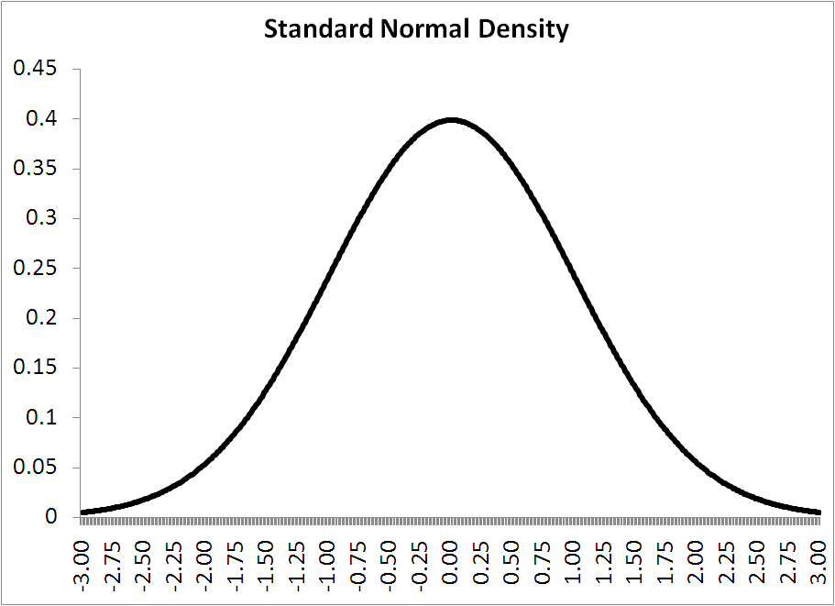
Some farmers are likely to shift from selling parchment to selling cherry more quickly than others
2b
Rate of adoption of central wet mills
Viability should be assessed on a case-by-case basis, evaluating likelihood of famers to change to central milling
Fast adopters
Slow adopters
Farm traits
Insufficient home wet-milling facilities (e.g., lack of drying space)
High opportunity cost of labor / time
High potential to improve quality
Committed buyer present
Good road access
Recently built and well-maintained home wet-milling facilities
Low opportunity cost of labor / time
Less potential to improve quality
No committed buyer
Poor road access / remote areas
Particularly relevant to archetypes in higher altitudes in the South (lack of infrastructure) and central parts with high opportunity costs
Particularly relevant to archetypes in lower altitudes in the South with low opportunity costs and in remote areas
Source: Stakeholder interviews, TechnoServe analysis

Slide 62
Several risks have to be managed to ensure successful implementation of central wet mills
2b
Risk | Description | Mitigating factors
Reduced negotiating power for farmers | Unprocessed coffee needs to be sold quicker and might lead to reduced negotiating power for farmers as they need to sell cherries within a specific timeframe. Farmers might not be able to hold coffee to wait for better prices | Ensure balanced ownership structure and competition Ensure transparency Regular monitoring of purchase prices
Ownership and corruption | Potential for corruption in management of wet mill (misusage of wet mill income; farmers do not receive fair prices) | Establish sound financing model, using a mix of local banks and international investors Implement sound management controls Implement rigid evaluation and monitoring system Provide training on governance
Negative environmental impact | Wet mills can have negative environmental impact as pollution is highly concentrated in wastewater | Ensure correct management of concentrated wastewater pollution through implementation of adequate systems/ processes
Low capacity usage | Farmers might be reluctant to sell their whole harvest to wet mill, e.g., due to high transport cost | Inform farmers on costs and benefits of using wet mill Assess transport aspect on a case by case basis and try to work with local/ regional authorities to overcome potential barriers
Source: Stakeholder interviews, TechnoServe analysis

Slide 63
Overall, on farm costs could be reduced by up to 10%
2
Average on-farm costs for mainstream archetypes*
US$ per lb green
CURRENT
YIELD INCREASE
YIELD INCREASE + EFFICIENCY GAINS
-5%
-10%
Paid labor
0.38
0.38
0.34
Agro-inputs
0.52
0.48
0.48
Other farm-level
0.21
0.18
0.18
Cash cost of production
1.10
1.04
1.00
* Including cash and non-cash costs
Source: Interviews; TechnoServe analysis

Slide 64
BUSINESS CASE DISCUSSION Business case 3: Improving environmental management
Business cases and key challenges
Farmers can increase yields through improved agronomy and technical assistance
Colombia’s farm yields could be increased by 20 to 30% by transferring improved agronomy practices to farmers, in particular effective fertilizer usage
Achieving yield improvement requires high adoption level of best practices; high average age of farmer population could pose a challenge
Higher yields contribute to a 5% cost reduction and net income increase of 30-50%
Overall, production would increase by 1.5M bags and exports by US$ 260M per year
Cost of US$ 200M to train 50% of active farmers (230,000) over 10 years
Training should complement FNC’s individual farm extension visit s with a “farmer field schools” methodology and should actively try to involve the youth
1
Production costs could be reduced modestly through various sector efficiencies
Colombia’s coffee farming is already quite sophisticated and shows limited potential for reducing production costs
By reducing farmers’ labor requirements for harvesting and in particular home wet-milling, production costs could be reduced by up to 10%,
For harvesting, there are conceptually opportunities for improving productivity; however, implementation will be difficult and results may not justify costs
For wet-milling, the introduction of central milling could reduce labor requirements by 50-70% and produce other financial and nonfinancial benefits
Farmers facing the highest opportunity costs to time and labor should be prioritized
2
Supply chains can meet stricter environmental standards with minimal added cost
Challenging for farms to meet new, stricter environmental regulations – requires new wastewater treatment systems that are complicated and expensive
Ensure compliance with environmental laws cost-effectively through central wet mills; a single system now benefits many farms
The combination of all three business cases would increase net income by more than 50% and reduce time spent for coffee farmers, enabling them to earn more from coffee than other rural employment options
3

