Slide 1
The Value Chain Framework
Global Markets
National Markets
Supporting Service Markets
Export
Wholesale
Sector Specific
Processing
Cross Cutting
Embedded Services
Production
Financial
Input Supply
End Markets
Vertical Linkages
Horizontal Linkages
Supporting Markets
Enabling Business Environment
National Enabling Environment
Global Enabling Environment
Notes:
Adapt to coffee:
Inputs → Production → Processing → Sales
Global macro environment
National macro environment
Supporting services: finance, marketing, technology

Slide 2
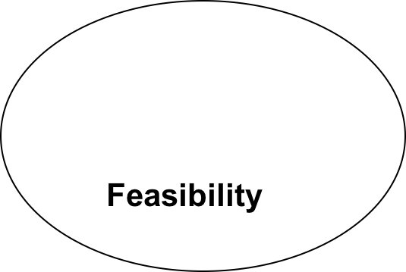
Stage 1: Value Chain Selection
Developing filters/criteria for value chain selection
  Potential for growth
  Potential for development impact
  Feasibility
Growth Potential
Ability to have impact – leadership, enabling environment
Development Impact
Notes:
Simplify to two-by-two (impact, feasibility)

Slide 3
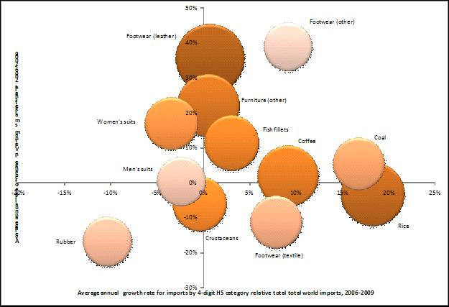
Analyzing growth potential:
The Boston Matrix
Notes:
Change to example

Slide 4
Value chain structure and dynamics: value chain mapping
Map provides a visual analysis of the value chain:
  Functions - what are the steps in the value addition process?
  Markets – who buys the products, in what forms and at what prices?
  Channels – how many market channels exist in the value chain and what differentiates them?
  Participants - who are the economic actors? What kinds of enterprises do they own?
  Business support services – do strong markets exist for business support services (e.g. finance, agricultural extension, marketing)?
  Global linkages – what is the volume of imports coming
Notes:
Good value chain analysis:
Who are the actors? How do they relate to each other?
How does cost / value flow through the chain?
Context. Benchmarks.

Slide 5
KENYAN GREEN BEAN VALUE CHAIN MAP
(OVERVIEW)
Wholesale Markets
Supermarkets
(pre pack and prepared Pack)
Markets
Importers
Wholesale Importers
Distributors
Dedicated Distributors
Transport
Shipping
small to medium exporters
(15-20 exporters)
10-15% of exports
Large vertically integrated exporters
(8-10 exporters)
(80 % of exports)
Exporters
Briefcase Exporters (50 exporters) less than 5% of exports
Brokers
Brokers(??) 5% of total product
Growers
Small to Medium Contract Growers (4000)
Large Contract Growers(100?)
Small Growers
(20-50,000?)
Input Supply
CHANNEL 1
BROKER CHANNEL
CHANNEL 2
SMALL TO MEDIUM EXPORTERS
CHANNEL 3
INTEGRATED LARGE EXPORTERS

