Slide 1
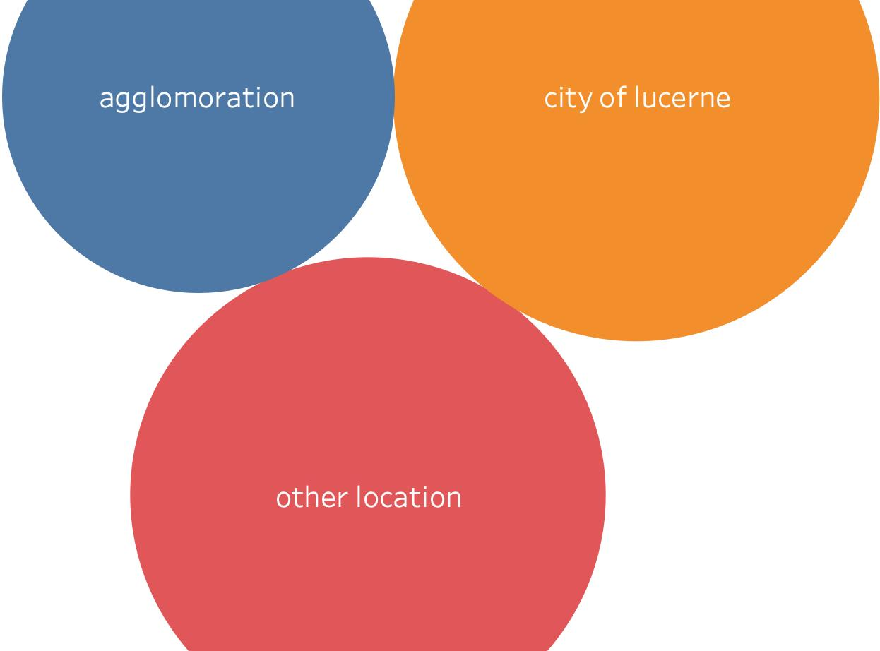

Slide 2
early bird

Slide 3

120
184
176

Slide 4
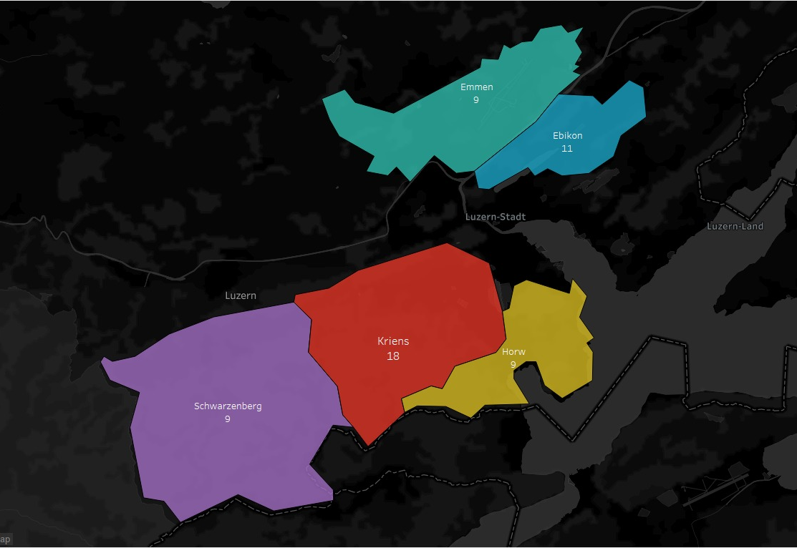

Slide 5
you are the 100. visitor

Slide 6
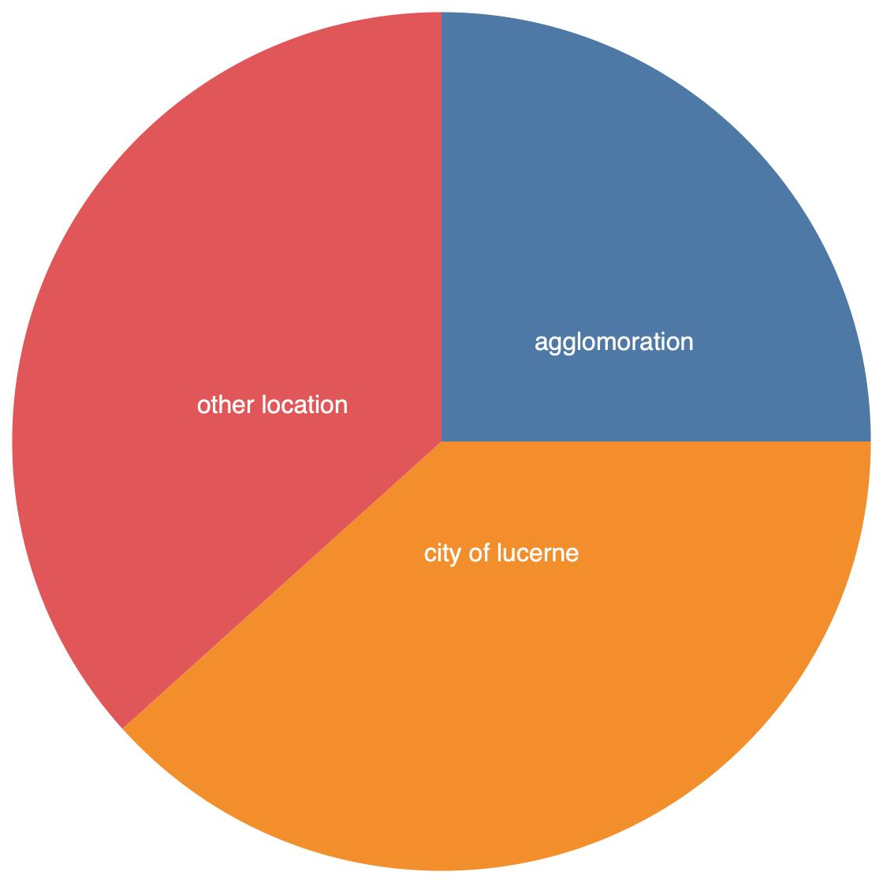
25%
37%
38%

Slide 7
you are just in time

Slide 8
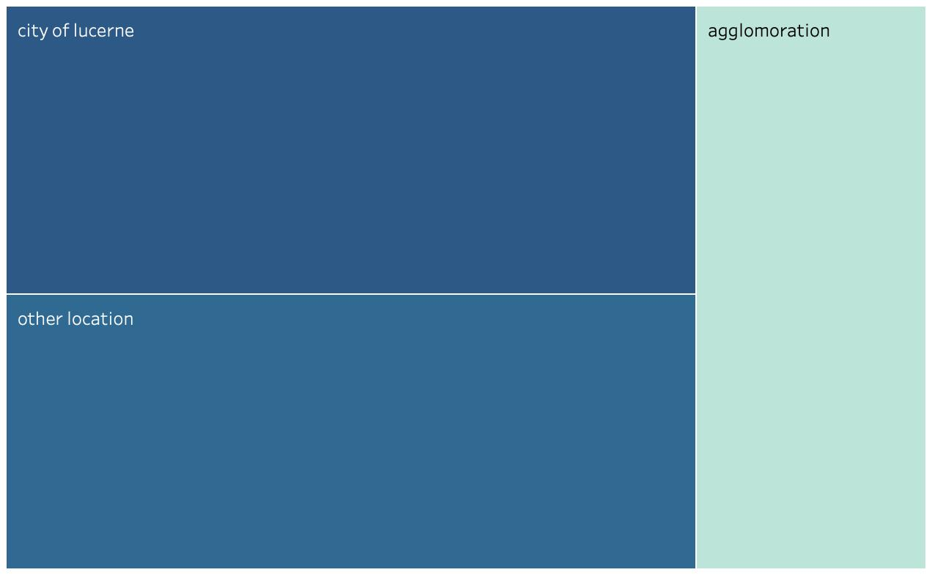

Slide 9
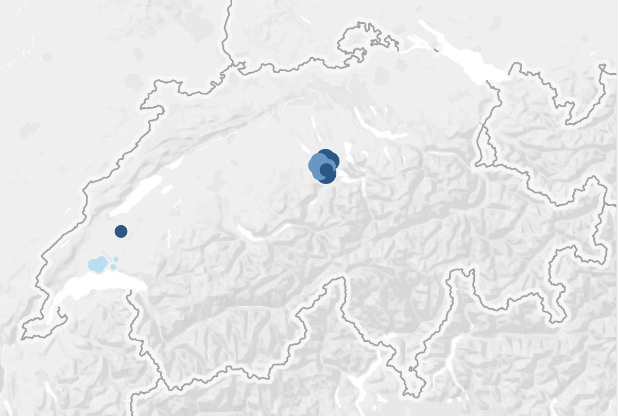

Slide 10


Slide 11
You are late

Slide 12
