Slide 1
CIP-50 Diagrams
CIP-50 | Liesenfelt-Shelleys_Voltaire_decentralization_update Notebook
Author of CIP: Michael Liensenfelt | github | twitter
Supporting Work: Christophe Garant | github | twitter
Date: June 2022
Ref:
CIP-0050? | Liesenfelt Shelleys Voltaire decentralization update
CIP-0050? | Liesenfelt Shelleys Voltaire decentralization update FULL VERSION
Cardano Foundations - Cardano Improvement Proposals (CIPs)
Garant cip-50 supporting work
Design Spec for Delegations and Incentives in Cardano, IOG, July 2020
Reward Sharing Schemes for Stake Pools, Brunjes et al., June 2020

Slide 2
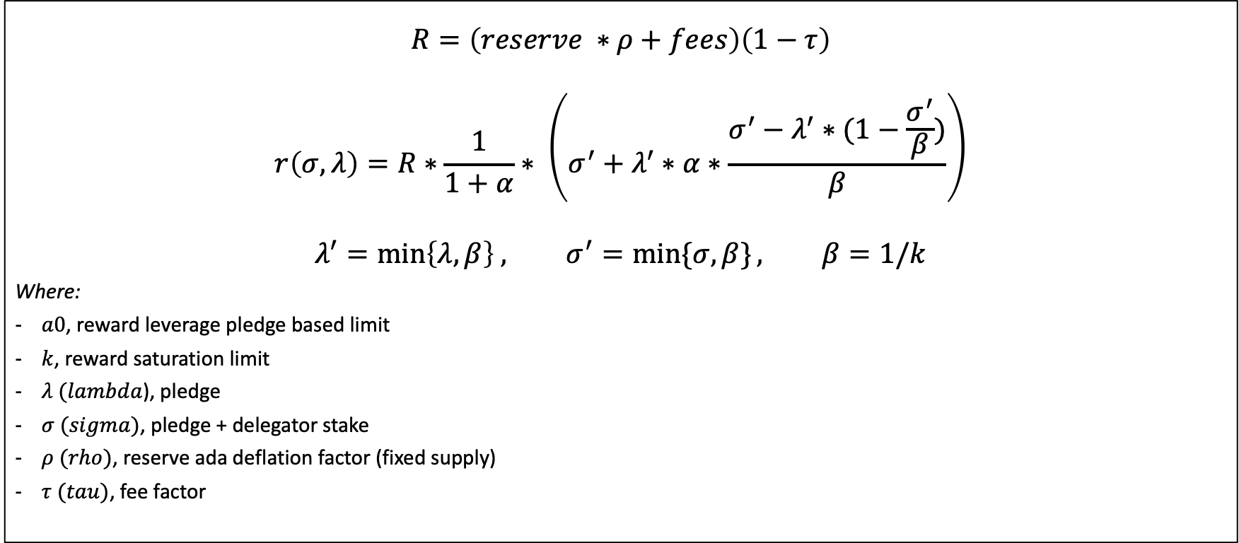
Legacy Reward Formula
$$R=\left(reserve ∗ρ+fees\right)\left(1−τ\right)$$
$$r\left(σ,λ\right)=R∗\frac{1}{1+α}∗ \left(σ^{′}+λ^{′}∗α∗\frac{σ^{′}−λ^{′}∗(1−\frac{σ^{′}}{β})}{β}\right)$$
$$λ^{′}=\min\left\{λ,β\right\} , σ^{′}=\min{\{σ,β\}}, β=1/k$$
Where:
$a0$, reward leverage pledge based limit
$k$, reward saturation limit
$λ (lambda$), pledge
$σ (sigma)$, pledge + delegator stake
$ρ (rho)$, reserve ada deflation factor (fixed supply)
$τ (tau)$, fee factor

Slide 3
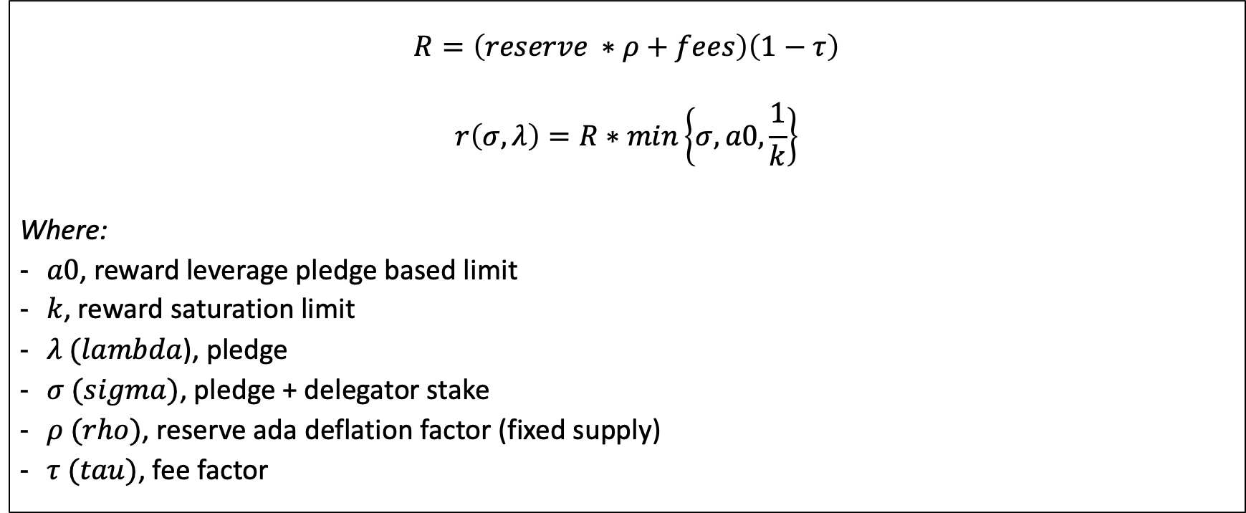
CIP-50 Proposed Reward Formula
$$R=\left(reserve ∗ρ+fees\right)\left(1−τ\right)$$
$$r\left(σ,λ\right)=R∗min\left\{σ,a0,\frac{1}{k}\right\}$$
Where:
$a0$, reward leverage pledge based limit
$k$, reward saturation limit
$λ (lambda$), pledge
$σ (sigma)$, pledge + delegator stake
$ρ (rho)$, reserve ada deflation factor (fixed supply)
$τ (tau)$, fee factor

Slide 4
Legacy: Same pledge, same saturation The lower the pledge, the higher the leverage
68 M₳
(3.57% pledge)
68 M₳
(6.25% pledge)
68 M₳
(25% pledge)
17
M₳
4.25 M₳
2.4 M₳
1 million Ada = M₳
Note: pledge to saturation scale done to percent area ratio

Slide 5
CIP-50: saturation relative to pledge fixed leverage, the higher the pledge, the higher the saturation. Assume same saturation, same pledge amounts, a0=50 leverage factor, or ~50% pledge till saturation Note: a0=100, 1% pledge; a0=1, 100% pledge
34 M₳
(50% pledge)
8.5 M₳
(50% pledge)
4.86 M₳
(50% pledge)
17
M₳
4.25 M₳
2.4 M₳
1 million Ada = M₳
Note: pledge to saturation scale done to percent area ratio

