Slide 1
PROJECT PHASE 1
CO-4441
Network Mapper
Guided by:
Mr. Rajesh Dhakad
Co-guided by:
Ms. Neha Mehra
Sarvagya Soni
Shivam Joshi
Shubham Kumawat
Sourabh Shrivastava
Yashil Jijhotiya

Slide 2
Contents
Introduction
What is network
What is network mapping
Project overview
Need of project
How it will help network admin
Existing tools and technologies
SNMP
SNMP overview
Drawbacks of SNMP
Active probing
Overview
Advantages
Project Description
Current approach and demo
Version control

Slide 3
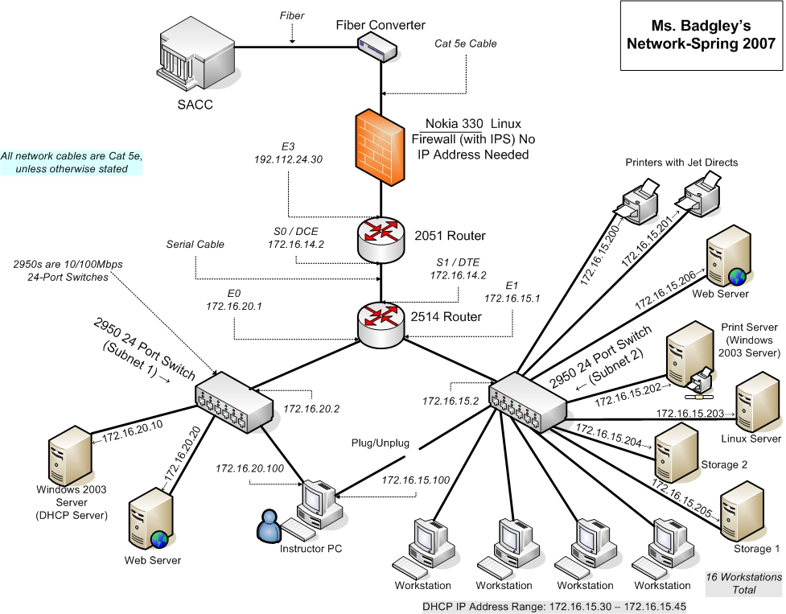
WHAT IS NETWORK ?
A network is a series of points or nodes interconnected by communication paths. Networks can interconnect with other networks and contain subnetworks.

Slide 4
What is Network Mapping ?
A network map is a graphical representation of all the computers and devices on your network that shows how each is connected.
Network mapper is a dynamic discovery and mapping tool that helps network administrators/ Data center admins to visualize their complete network infrastructure with a live network map.

Slide 5
Our project
Network mapping tool
Based on active probing technology.
Will generate a network tree.
help network admin to visualize and monitor the network.

Slide 6
Why our project ?
Generate network tree dynamically.
Provide GUI of the network.
Generate instant notifications automatically.
Add and delete node.
Maintain a log about links.

Slide 7
How it will help network Admin ?
Generate tree dynamically.
Will notify network admin about down links.
Network admin need not to worry about the security.
Easy to understand and use.

Slide 8
Existing tools and technologies
There are various tools which is to monitor and maintain the network . Some tools are:-
Zabbix
Icinga
Nedi
All these tools are SNMP(Simple network Management protocol) based tools.

Slide 9
SNMP
SNMP stands for simple network management protocol.
SNMP is an application layer protocol defined by the Internet Architecture Board (IAB) in RFC1157.
It is a protocol to manage and monitor network elements
The SNMP based approach retrieves data from Router in order to build the network map.

Slide 10
Drawbacks of SNMP based approach
Large header size.
Not compatible with all the hardware.
Security issues.
-- It has security issues in SNMP v1 and
v2 i.e. there's no encryption of data.
-- In SNMP v3 cryptographic calculations
Is present but it can increase CPU load
approx. by 20 %.

Slide 11
Active Probing
This technique relies on traceroute-like probing on the IP address space. These probes report back IP forwarding paths to the destination address.
By combining these paths one can infer router level topology.

Slide 12
Advantages of Active Probing
Active probing is advantageous in that the paths returned by probes constitute the actual forwarding path that data takes through networks. It is also more likely to find peering links between ISP's.
Less packet size as compared to SNMP message.
All devices support ping action. No hardware dependency.

Slide 13
Project description
Its a network mapping and monitoring
tool.
Network Admin can add and delete nodes from the network.
Addtion of a node -
for adding a node,network admin has to
to provide the following info.
i). Ip address of the node.
ii). Ip address of the predecessor.
iii). Type of device.
After the confirmation from the admin the node will be shown in the GUI at its respective place.

Slide 14
Deletion of a node -
For the deletion of a node,network admin
has to provide the ip of that node only.
Once the admin confirms the deletion of
the node, the node will automatically get
deleted from the database.
Update database -
After the addition or deletion of a node,the
entries in the database will be updated.
Mapping the network -
The software will take data from the database
to create the network tree dynamically.

Slide 15
Detecting the broken/down links -
We are using active probing to detect the broken
links.Our software will use the probes to detect
all the nodes in the tree. If server gets reply
from the node then the link is up else it is down
which will be shown in the GUI by red links.
Generate notification -
The software send notification to the network
admin when some link goes down.This
notification contains the specification of the
links and the location of the link along with the
time when it goes down.

Slide 16
Our Solution
Create a graph data structure to store the network topology.
Add nodes to the graph.
Use breadth first search technique to traverse the tree.
According to the actual graph data stored, detect the active and broken links.
All the non-leaf nodes are either routers or servers.

Slide 17
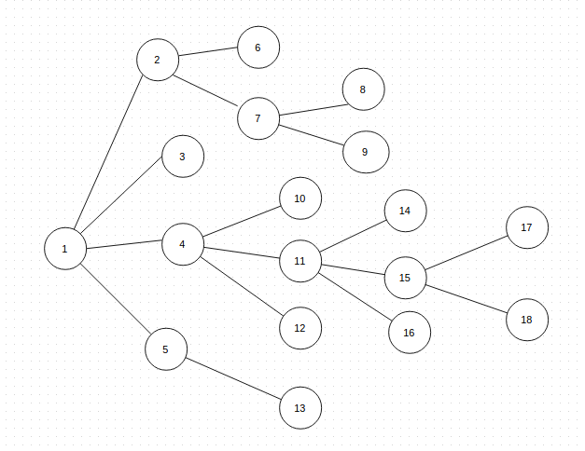

Demo Network – with broken links

Slide 18
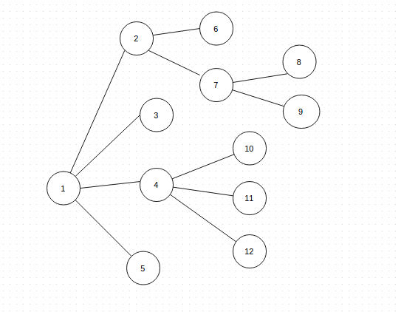
Network mapped by mapper

Slide 19
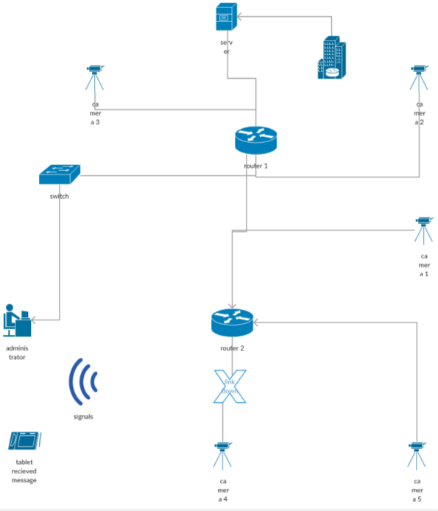
Architecture diagram

Slide 20
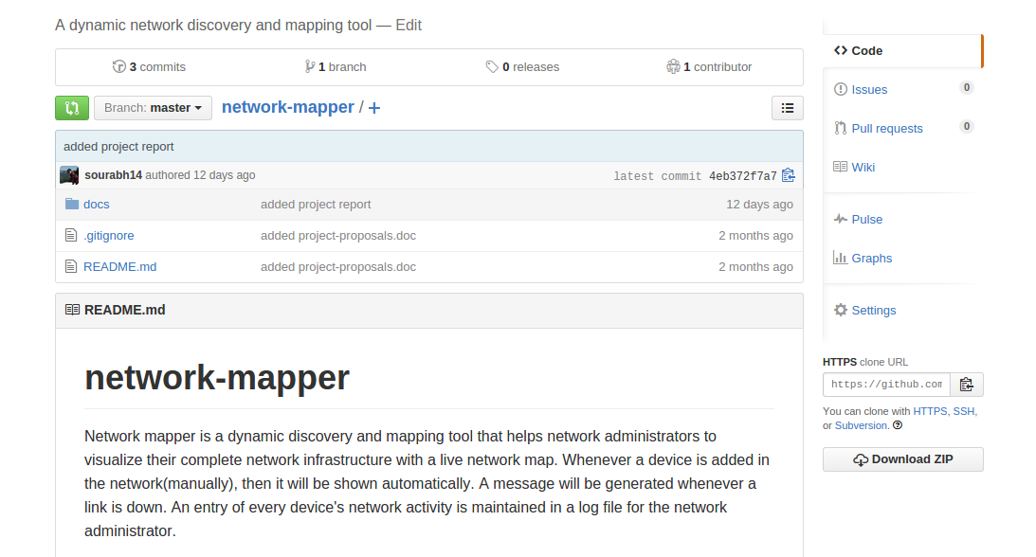
Version Control – Github
https://github.com/sourabh14/network-mapper

Slide 21
Thank You

