Slide 1

Introduction to {shiny} dashboards
Hugo Soubrier | February 10th, 2026 | Charité Mitte
B-IDDE workshop
Infectious Disease Dynamics (IDD)
Charité Center for Global Health (CCGH)

Slide 2
Workshop Agenda
Quick presentation (10min)
  Visualisation in R using {ggplot}
  Interactivity
  Shiny package
  Core of Shiny dashboard
Quick demo (5min)
Self pace tutorial (1h30)
Wrap-up (15min)

Slide 3
R {shiny} dashboards (10min)
1

Slide 4
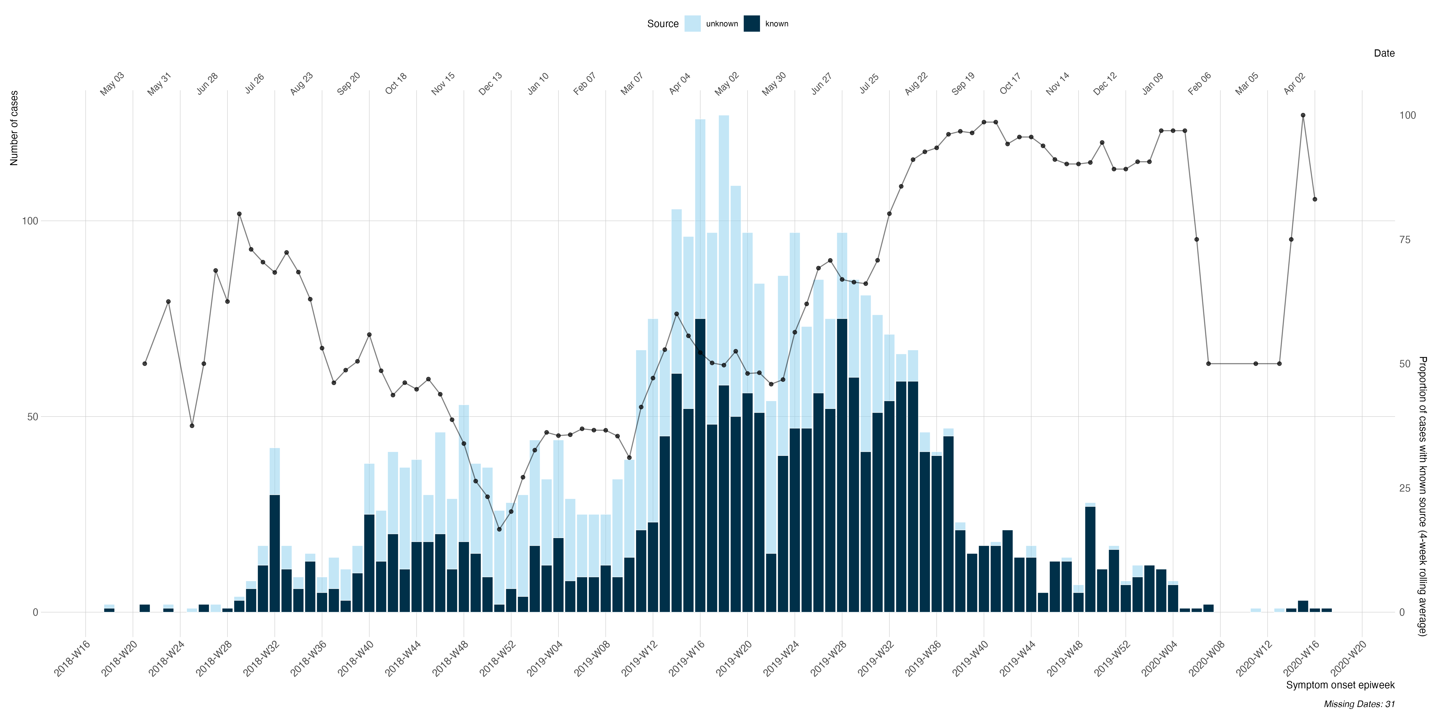
R visualisation (static)
R has a rich ecosystem for high‑quality but mostly static plots
R has many plotting systems: base graphics, ggplot2, lattice, and many extensions (e.g. cowplot, patchwork, gganimate, etc.).
ggplot2 implements the Grammar of Graphics: you build plots by layering data, aesthetics, and geoms. These plots can be very extensive, detailed and high quality.
Strengths: publication‑quality output, reproducible code, theming and faceting, easy integration with R Markdown/Quarto.
Author-driven messaging: the plot creator made aesthetic choices that led to a specific message delivered
These plots are static images. Data exploration is handled beforehand, by the creator of the image, who dictates exactly what the audience sees — a message is delivered and locked.
Weekly incidence of epidemiologically linked cases on the 10th EVD outbreak in DRC | Hugo Soubrier

Slide 5

Why interactivity ?
Interactivity adds “live” exploration via hover, zoom, click, and user inputs; this is powerful, but not always better.
How interactivity is done in R
Browser‑based HTML widgets: {plotly} and {highcharter} wrap JavaScript libraries so you can write R code and get interactive plots in HTML.
Common interactions: tooltips on hover, panning/zooming, legend clicks to hide/show series, exporting as PNG.
Interactivity becomes much stronger when combined with user inputs (sliders, dropdowns, checkboxes) that change what is plotted in real time.
Pros | Cons
Let users explore patterns themselves (e.g. zoom into a time window, select variables). | More technical and time consuming to develop
Great for dashboards, exploratory analysis, and demos. | More moving parts, harder to test and maintain than a static figure.
Can improve understanding for non‑technical stakeholders. | Risk of “toy dashboards” that look impressive but are poorly designed, misleading or impactless.
Can incorporate visualisations of many parameters (modelling) | Heavier for the browser; large data or many widgets can feel slow.
Get started with plotly in R: https://plotly.com/r/getting-started/
Wrapper for Highcharts library in R: https://jkunst.com/highcharter/
B-IDDE workshop | 10th February, 2026 | Hugo Soubrier

Slide 6
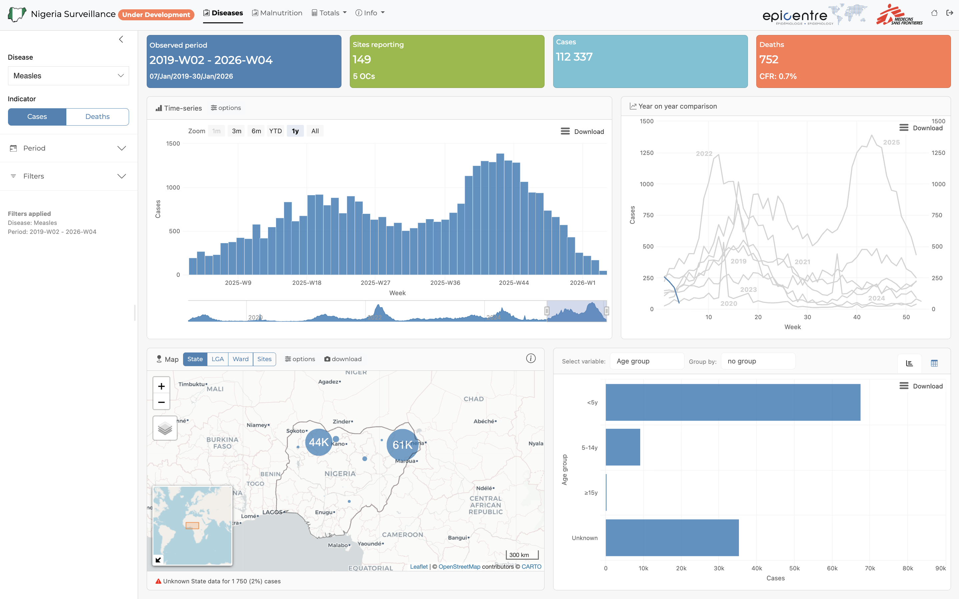
{shiny} package
Shiny is the framework that turns R code + interactivity into full web apps and dashboards.
{shiny} is an R package for building interactive web applications directly from R (no manual HTML/JS required).
you can host
  standalone applications on a webpage,
  embed interactive charts in R Markdown documents
  build dashboards.
  Extend applications: CSS themes, HTML widgets, and JavaScript actions
Definitions
Shiny app: a web application defined by a UI object and a server function.
  It can be a single interactive page, a tool, or a complex system.
Shiny dashboard: a Shiny app specifically designed to monitor, explore, or report data;
  usually arranged in panels, boxes, and tabs for at‑a‑glance insight.

Slide 7
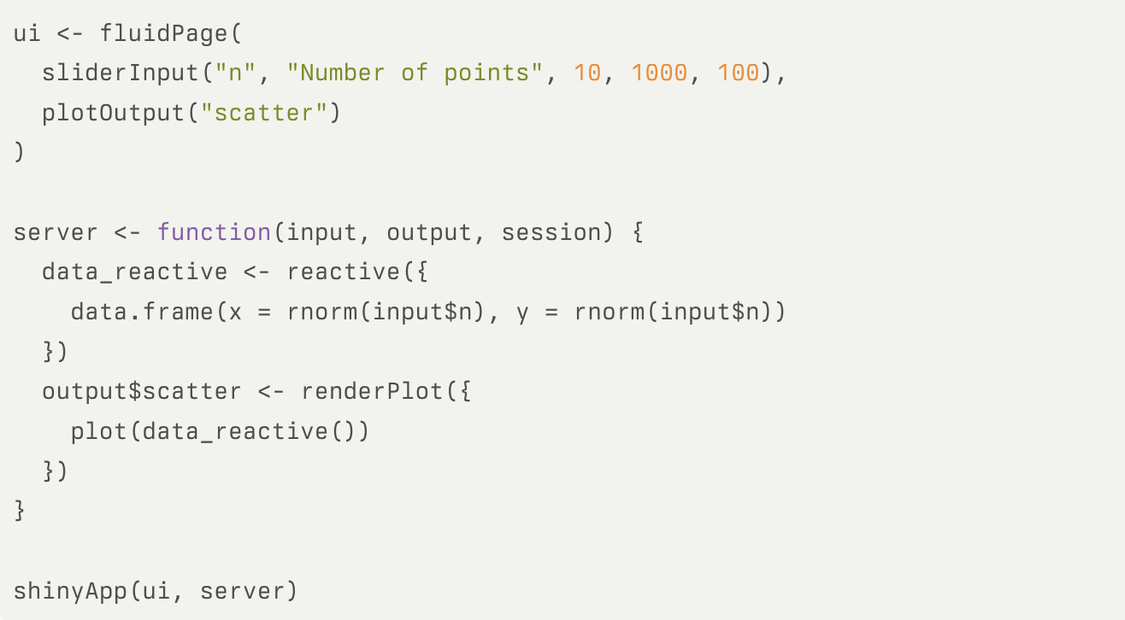
What is a shiny app?
Starts as with app.R and some key components:
User Interface (UI)
  Describes what the user sees: layouts, panels, tabs, and input/output widgets.
app.R
Server
  An R function that contains the logic: read inputs, transform data, create plots/tables, define outputs.
Reactivity (reactive expression)
  Connects the user (inputs) with the server logic and the visual outputs
  When an input changes (e.g. a slider), any reactive expression depending on it re‑runs, and downstream outputs update automatically.
  Inputs → reactive expressions → outputs.
Run the App
  Using shinyApp(ui, server)
  Opens the app in a standalone web page

Slide 8
Quick demo (5min)
2

Slide 9
Self pace tutorial (1h30)
3

Slide 10
Wrap-up (15min)
4

