Slide 1
Enterprise Resource Planning
Team K:
Chris, Robert, Josh, En, Michael

Slide 2
Contents
Background and Team Roles
Breakdown of Game Rounds
Success Strategies with BI & ERP
Facts and figures
Applying this to real world business decisions

Slide 3
Self-Organizing Team
On our first day we didn’t take much time to lay out the roles for each team member, everyone fell into a role quickly and stuck with it through every game round.
Chris - Team Lead & Data Analyst
Josh - Head Procurement Officer
Robert - Lead Marketing Manager
En - Deployment Comptroller
Michael - Project Flex Operator

Slide 4
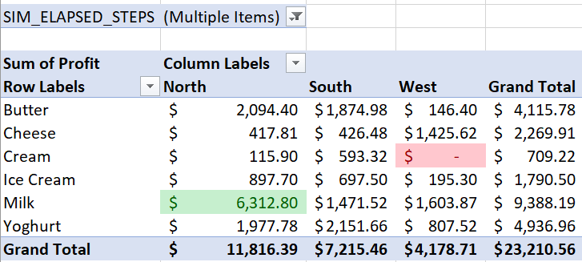
Team Lead & Data Analyst (Chris)
Kept strict watch and tabulations of sales around the country and instructed team to adjust supply chain as necessary for business to continue operation.
Primarily tools used:
Inventory Report in SAP
Summary Sales Report in SAP
Data tools in Excel

Slide 5
Head Procurement Officer (Josh)
Managed the purchasing and procurement of inventory for the main office.
Communicated with Team Lead and Deployment Comptroller to ensure each zone received enough goods.
Used (num of days forecast)*Quantity/Sim_Elapsed_Days to determine how many supplies to purchase.
Kept track of warehouse load and ensured we rarely went over the 4000 unit limit.

Slide 6
Lead Marketing Manager (Robert)
Adjusted the prices of our inventory items to match the fluctuations in the market accordingly.
Communicated with fellow team members on product price adjustments and other matters.
Adjusted prices to both meet and sometimes counter market demand.
Used pricing as a measure to control stock.

Slide 7
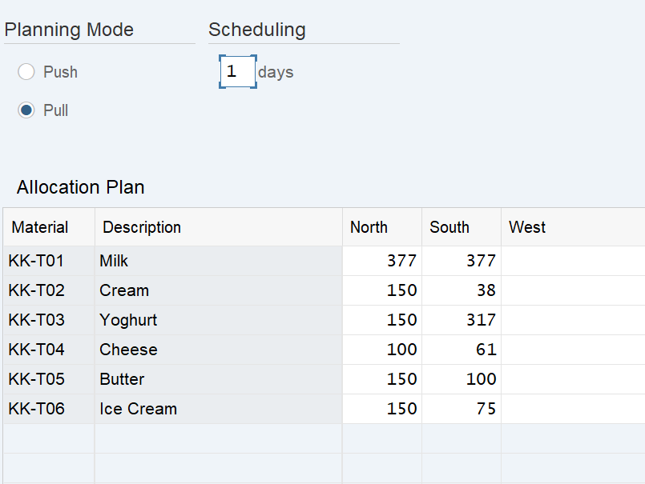
Deployment Comptroller (En)
Description: Managed the distribution of inventory items from the main warehouse to the regional locations throughout the country.
Communicated with Team Lead and Procurement Officer
Ensured correct amounts of inventory were being distributed without going over price limit (increased operating expenses)
Verified all channels and locations had correct amounts of inventory

Slide 8
Project Flex Operator (Michael)
Watched over analytical BI information provided by SAP and assisted with other team members tasks as necessary.
Communicated with Team members dependent on what role was being filled
Essentially filled the gaps within the group in order to get the assignment completed

Slide 9
Summary of First Round(s)
On our first few game (Logistics and Distribution) attempts, we were rather lacklustre with our overall return on investment. We saw marginal profits but had clear room for improvement in all facets of our company. We suspect that this is the case for most teams, as we were still getting used to utilizing the SAP software.
Main issues: Lack of tacit knowledge and general inexperience

Slide 10
Summary of 2nd Round
As we moved further into production with the distribution game, we started to see improvements with our Net Income, as we were more fleshed out in our individual roles and were more comfortable using the software. This round saw major improvements in our ROI, likely due to a more focused approach with selling our products.
Major Issue: Exorbitant operating expenses.

Slide 11
Summary of Final Round
The Final Round of the game was easily our most successful attempt in the SAP distribution game simulation. Our team broke over $20k USD by the end of Day 60, which is phenomenal compared to the measly $4k - $5k we were seeing in the early rounds.
Solution: Focus on reducing costs
We drilled down on the main issue we noticed from the last game attempt and focused on moving exact amounts to different locations, rather than “shotgun blasting” all of our supplies across our stores. This reduced the operating expenses that came with the movement costs.

Slide 12
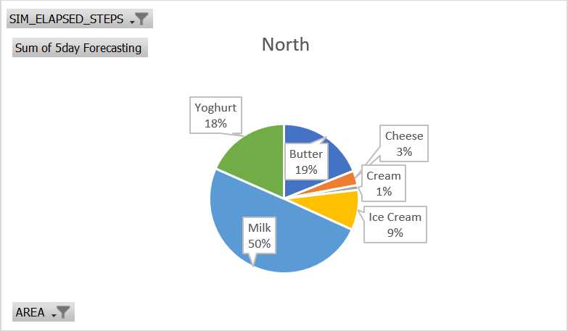
Sales breakdown for Northern areas.

Slide 13
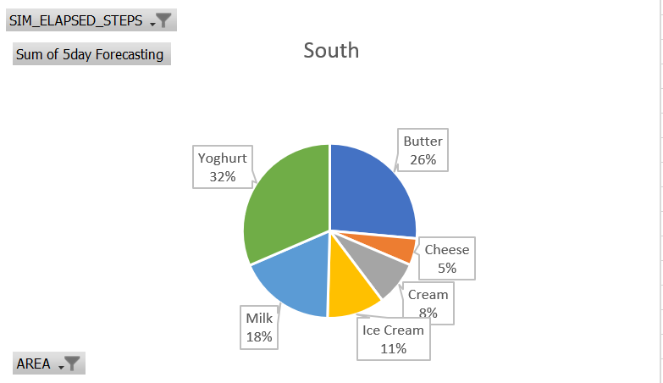
Sales breakdown for Southern areas

Slide 14
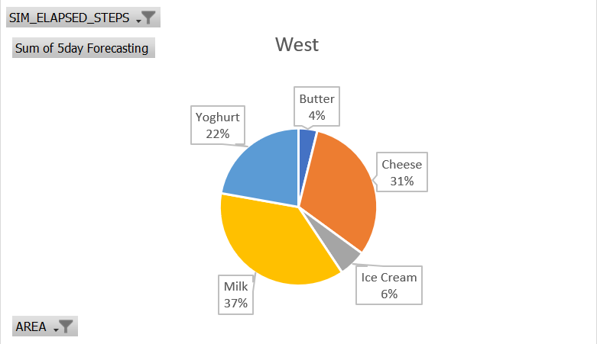
Sales breakdown for Western areas

Slide 15
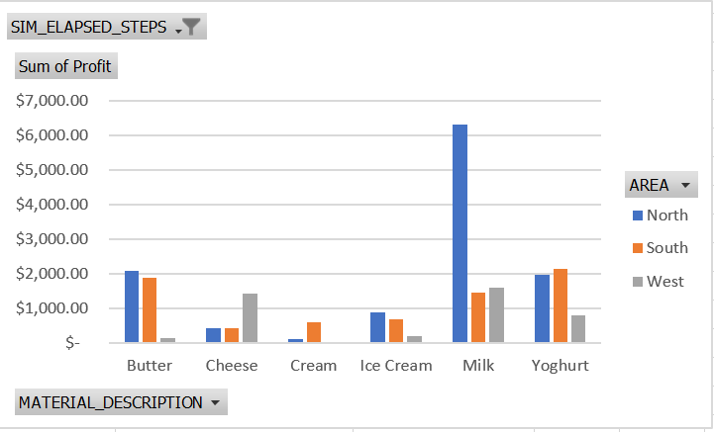
Profit of each product, by location

Slide 16
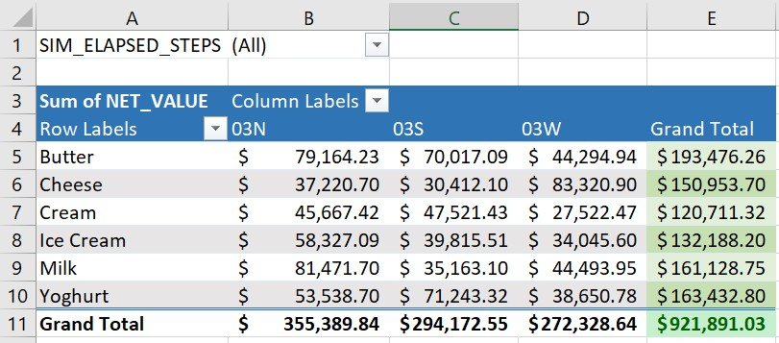
Revenue by Location

Slide 17
Achieving success using BI and ERP
Proper forecasting
Controlling inventory
Focus on highest grossing product
Continuous communication

