Slide 1
If only we had more…
Tenured Employees

Slide 2
Who we are
Nicholas Cellini
Allen Crane
Quincy Roundtree
Carter Graves
Heber Nielsen
A study in Employee Attrition for XYZ Lab Corp.
Research performed in R Studio

Slide 3
1.
We can do better than the 16% † average turnover rate for our industry
† https://www.shrm.org/hr-today/trends-and-forecasting/research-and-surveys/Documents/2017-Human-Capital-Benchmarking.pdf

Slide 4
$ 4.5 M
Estimated Annual Attrition Cost †
† Based on 16.1% Attrition; Median Monthly Salary of $4,919; Three-Month Productivity Loss; 10% Annual Salary Recruitment Fee

Slide 5
This is Maria.
Cheerful and courteous employee
Marketing whiz who excels at her sales job
Reliably delivers quality work with little oversight

Slide 6
This is also Maria.
Loathes her hectic travel schedule
Spends too much of her week commuting from her home in a distant mountainous suburb
Wishes she were more involved in strategic decision making
How do we solve a problem like Maria?
Notes:
This is the call to action. You’re the employer, and you are responsible for this outcome.

Slide 7
2.
We cannot change what we cannot quantify
Let’s measure, model, predict, and act.

Slide 8
Our Methodology
Gather 33 variables on 1,470 current and former employees from the past year
Clean and load the data. Split categorical data into levels in preparation for regression analysis
Slice a random 2/3’s of our data off to use as a training set. Use the remaining third to test our predictions
Perform Logistic Regression to predict attrition and try it out on the test set
Identify statistically significant contributing factors
A call to Action!

Slide 9
More on the modelling process
Logistic Regression
After splitting the data in train and test groups we run regression on the training set to predict attrition. Additionally, we identified key contributing factors.
Does it work?
Running the model against our test dataset and assuming probabilities greater than 50% indicate attrition results in 90% accuracy

Slide 10
3.
Lessons From the Data
Contributing Factors, Problem Spots and Trends

Slide 11
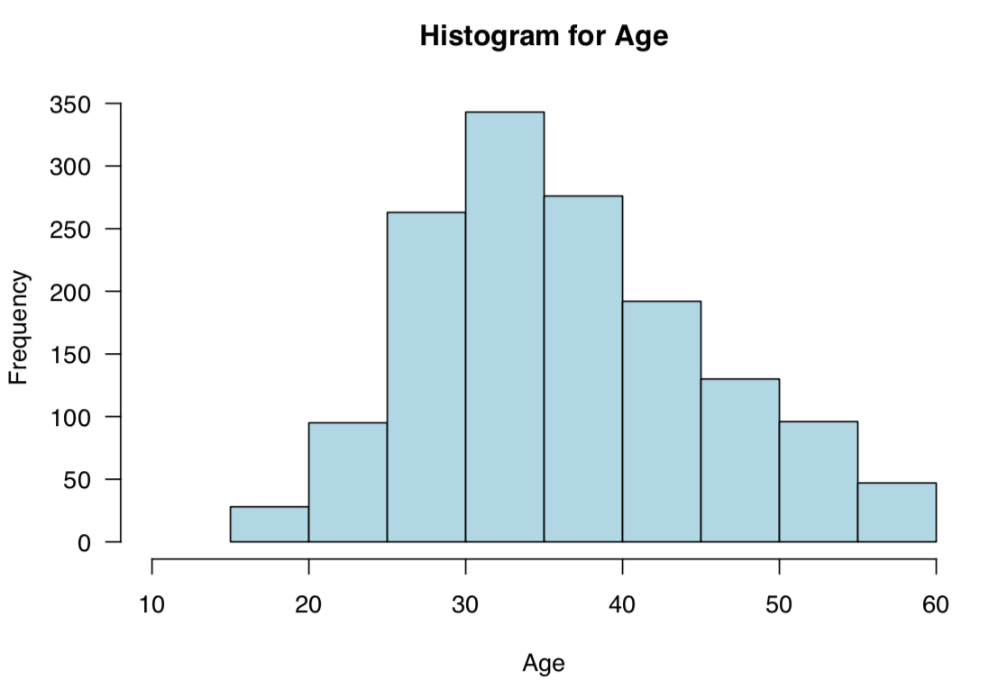
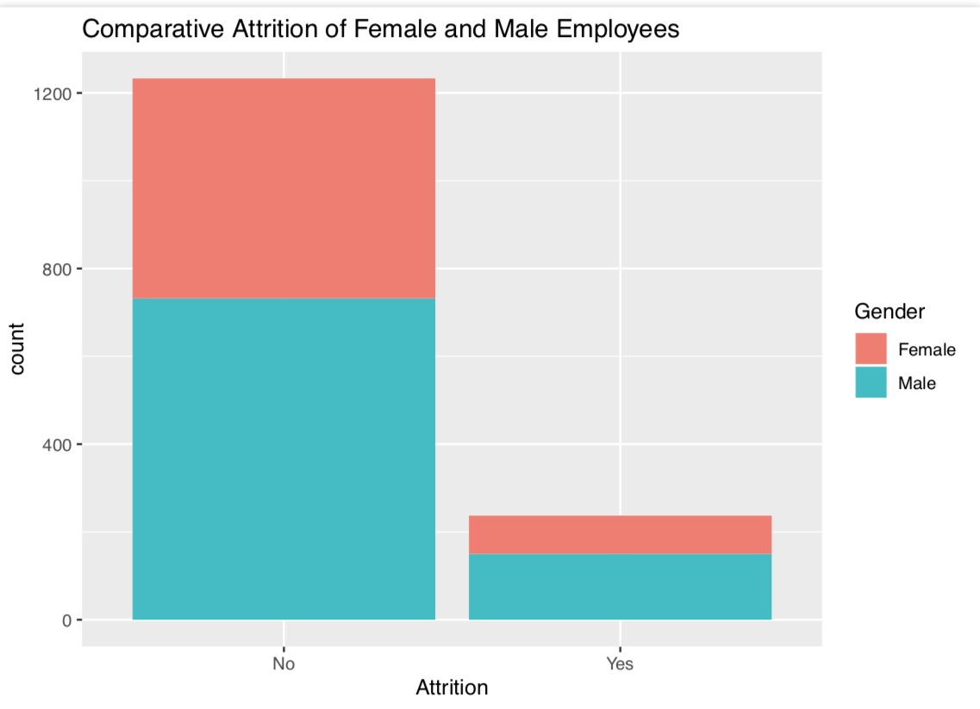
A little bit about XYZ employees
Median Age of 36
Predominantly Male Workforce with Similar Attrition across Gender

Slide 12
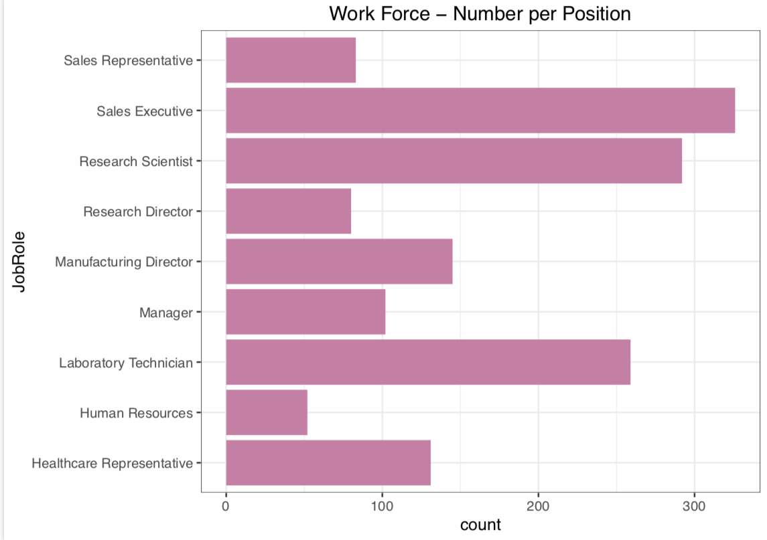
Counts by Role
Healthy R&D and Sales Budgets

Slide 13
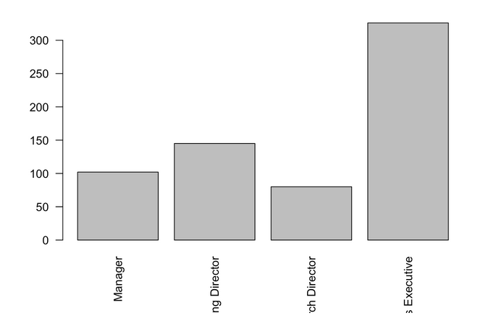
Excerpt by Role from Sales
# Executive ranks are Sales Heavy

Slide 14
Top three factors associated with turnover
Factor | Estimated Effect | Std. Error | Significance
Frequent Business Travel | .96 | .29 | .00095
Distance From Home | .056 | .015 | .00021
Low Involvement Level (1) | 2.38 | .65 | .00027

Slide 15
Notes on Notable Items
16.1% Overall Attrition
We can do better.
40% Sales Attrition
Are we burning them out?
Survey Results Are Great Predictors
While we included only one of the survey ratings in our top factors, all were strong predictors.

Slide 16
4.
Where do we go from here?
Insights & Recommendations

Slide 17
Recommendations
Maria’s Instagram tells a troubling tale.
#WorkTravelSucks
Online collaboration and sales meetings are mature and proven technologies. Increase their adoption within the organization
#TrafficBlues
Give time back to employees by reducing their commutes. Allow more employees to work from home when able and willing
#NobodyAskedMe
Involve line level employees with strategic decisions in HR policy and other staff functions. Ask for their opinions. Act on their advice.
Finally, heed the warnings signs in employee surveys! They mean business.

Slide 18
#SaveMaria #SaveMoney
Offer flexibility to work remote. Increase the use of online meetings. Involve her in decision making.

Slide 19

Thanks!
Any questions?

Slide 20
Appendix – Additional Significant Factors
Variable | Estimate | Std. Error | z value | Pr(>|z|)
DistFromHome | 0.0547109 | 0.0147769 | 3.7 | 0.00021 | ***
NumCompWrkd | 0.2413122 | 0.0534599 | 4.51 | 0.0000064 | ***
YrsLstPromo | 0.1927718 | 0.0578039 | 3.33 | 0.00085 | ***
BusTravel_Travel_Frequently | 0.9615042 | 0.2908421 | 3.31 | 0.00095 | ***
`EducField_Life Sciences` | -1.445134 | 0.4375596 | -3.3 | 0.00096 | ***
EnvironSat_1 | 1.7131066 | 0.366769 | 4.67 | 0.000003 | ***
JobInvolve_1 | 2.3760745 | 0.6530816 | 3.64 | 0.00027 | ***
JobSat_1 | 1.4109493 | 0.3512389 | 4.02 | 0.0000589 | ***
OverTime_No | -2.455127 | 0.2811395 | -8.73 | < 0.0000000000000002 | ***

