Slide 1
Using Data to Effectively Maximize Bank Telemarketing Campaigns
Springboard Capstone 1 Project
by
Crystal Chen

Slide 2
Banking Industry Performance Measurements
Average Number of Products Held by Each Consumer
Higher the average better the ranking for the banks.
Opening New Term Deposits
Allow banks to invest at a higher rate of return and lend collecting net interest margins.
Increasing Profitability
Using funds to increase profitability through investing and loans to borrowers.

Slide 3
Marketing Methods
Telemarketing
Electronic Communications
Advertising
In Branch Marketing
These methods can be hit or miss, but we could increase success rate by placing priority to those with higher probability of opening a term deposit account.

Slide 4
Purpose of Research
Use data to predict which consumers have a higher probability chance of subscribing to a new term deposit.
Allows bank to allocate resources to better optimize and maximize success rate outcome.
Suggest further research to improve success of model predictions.

Slide 5
Data Markers: 41,188 Entries 2008-2013
Age
Job
Marital Status
Education
Previous Loan Default
Housing Loan
Loan
Contact Month/Day
Previous Marketing Outcome
Employment Variation Rate (quarterly)
Consumer Price Index (mo)
Consumer Confidence Index (mo)
Euribor (3 month rate)
Number of Employees (quarterly)

Slide 6
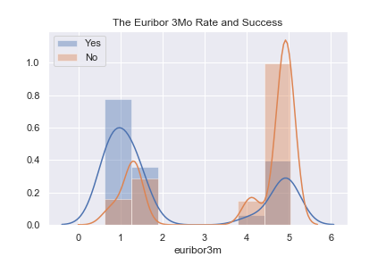
Data Trends
One of the highest indicators is the rate of The Euribor. Most new subscriber term deposits were open during high Euribor rates.
Finding the optimal interest rate while remaining profitable is important for opening new term deposits.

Slide 7
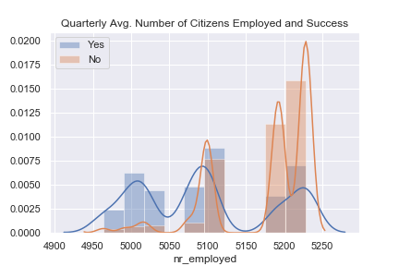
Data Trends
Employment is a high indicator of when new term deposit accounts were opened.
The higher the employment, the less likely clients opened accounts.
The higher average of employed citizens, the higher the rejection for new term deposits.

Slide 8
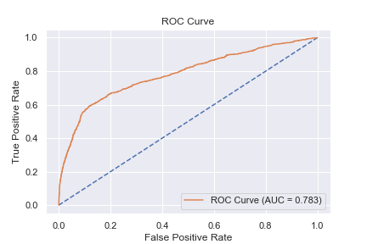
Predicting Probability of Successful Call
Use collected data to train models predicting the outcome of a marketing call. Clients either sign up for a term deposit or decline.
Using the Random Forest Classifier, the model has an accuracy of 89.9%
Model has a 78.3% of distinguishing between success and failure.

Slide 9
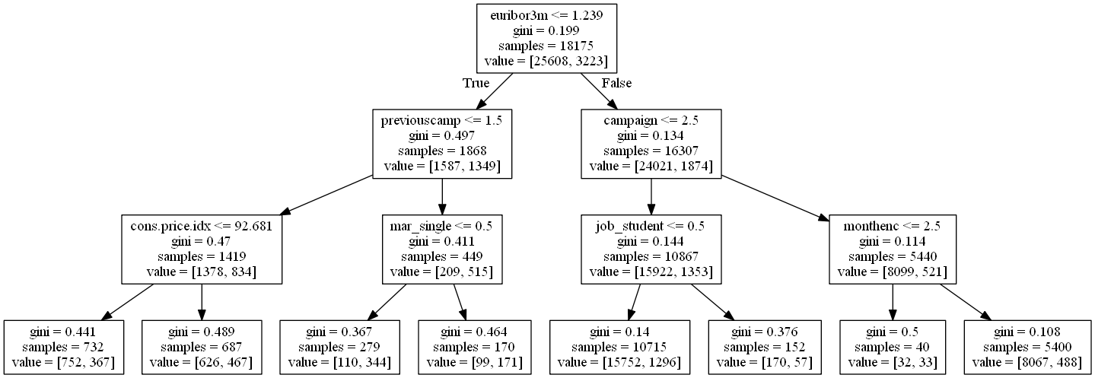
Random Forest Classifier

Slide 10
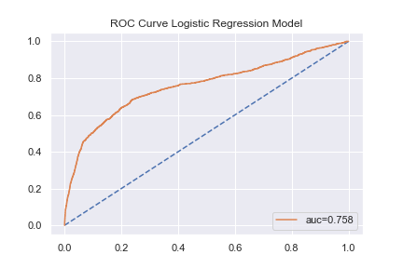
Logistic Regression Model
Logistic Regression Model has and accuracy of 89%
Model has 75.8% ability of distinguishing between success and failure of marketing calls.

Slide 11
Conclusion
Each model shows that the features of importance are not related to the client, but environmental factors such as the Euribor and average employment.
Insert feature importance image

Slide 12
Conclusion and Limitations
Each model provided above 75% accuracy in predicting the outcome of a marketing call.
If market conditions are not optimal, banks should focus marketing tactics and resources on other products, other than term deposits.
Some limitations of this data are missing specifics such as exact date of call, exact values that are not quarterly or averages.
Model can be further improved upon with excess data variables.

