Slide 2
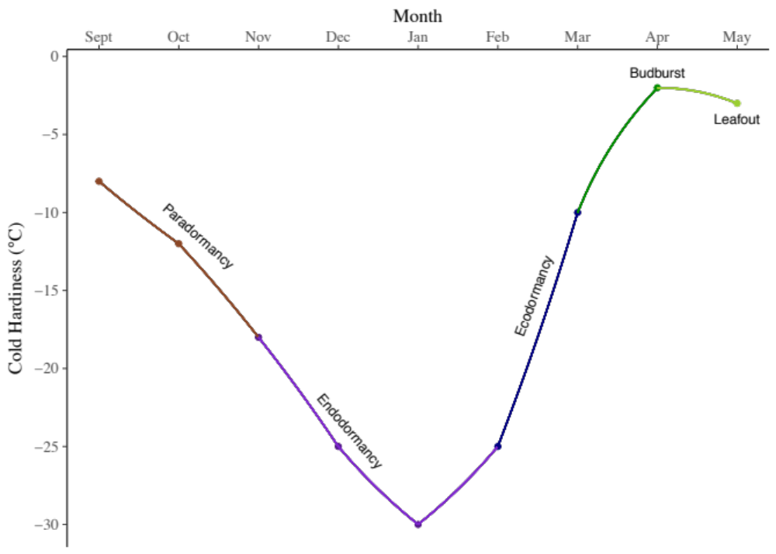
Frost tolerance
Duration of Vegetative Risk

Slide 3
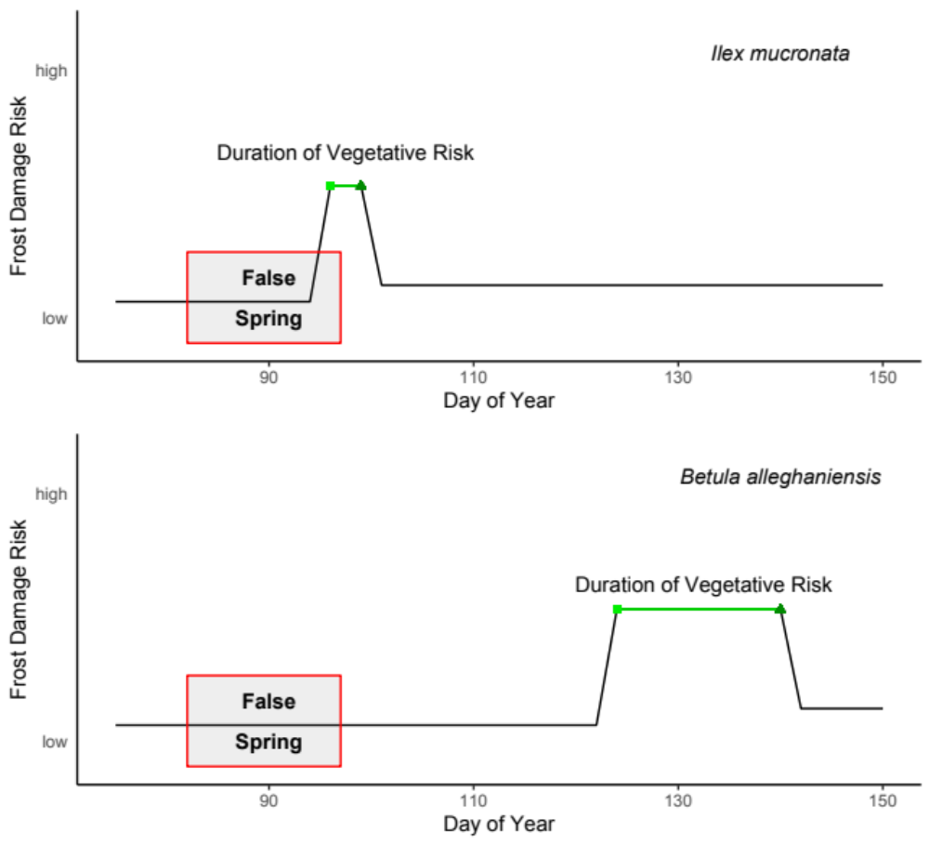
Species differences: tolerance vs avoidance

Slide 4
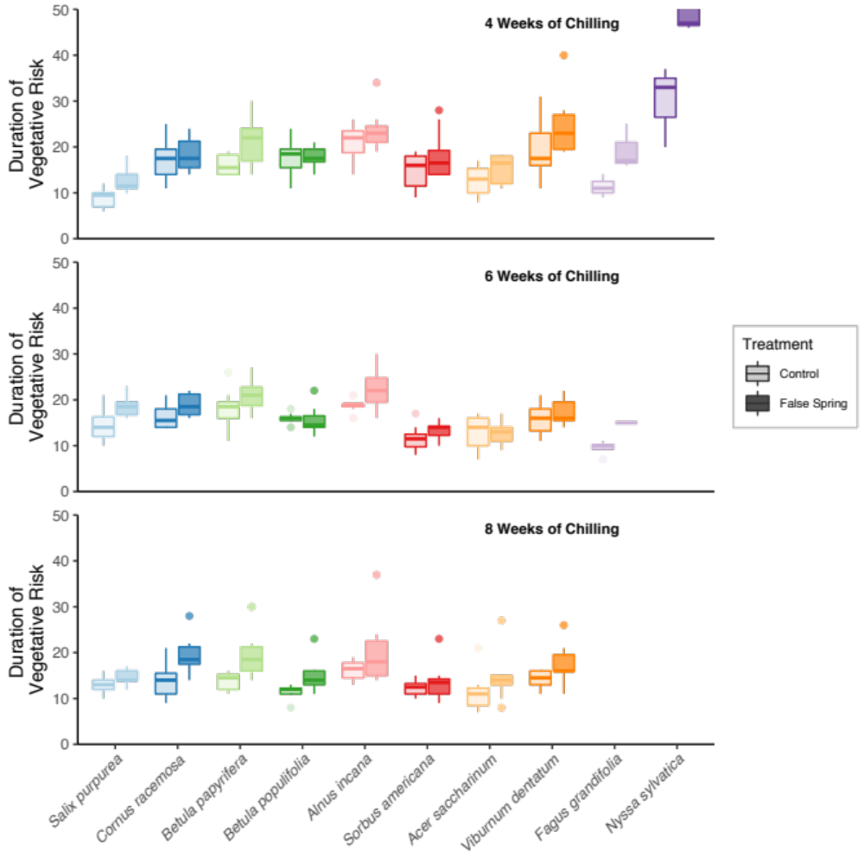

Slide 5
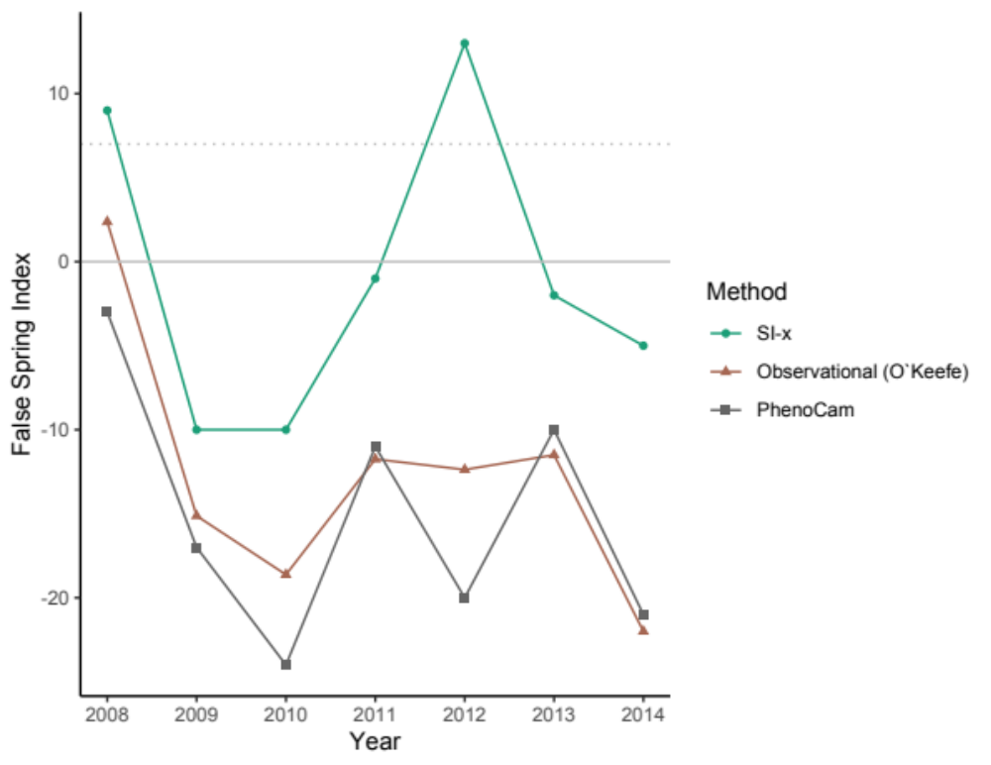

Slide 6
