Slide 1
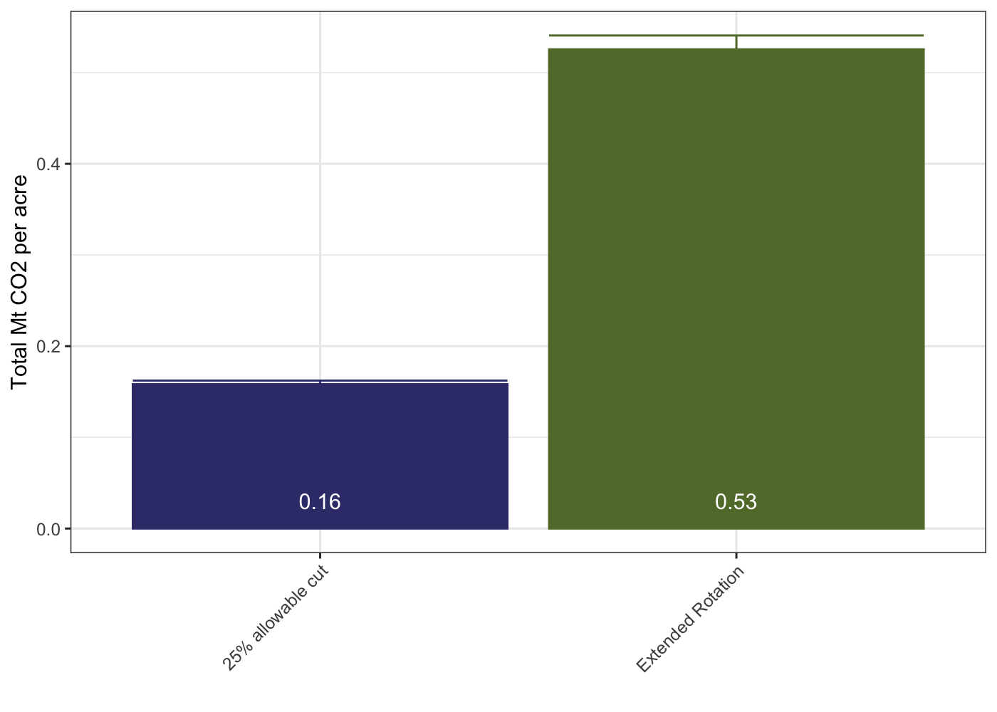
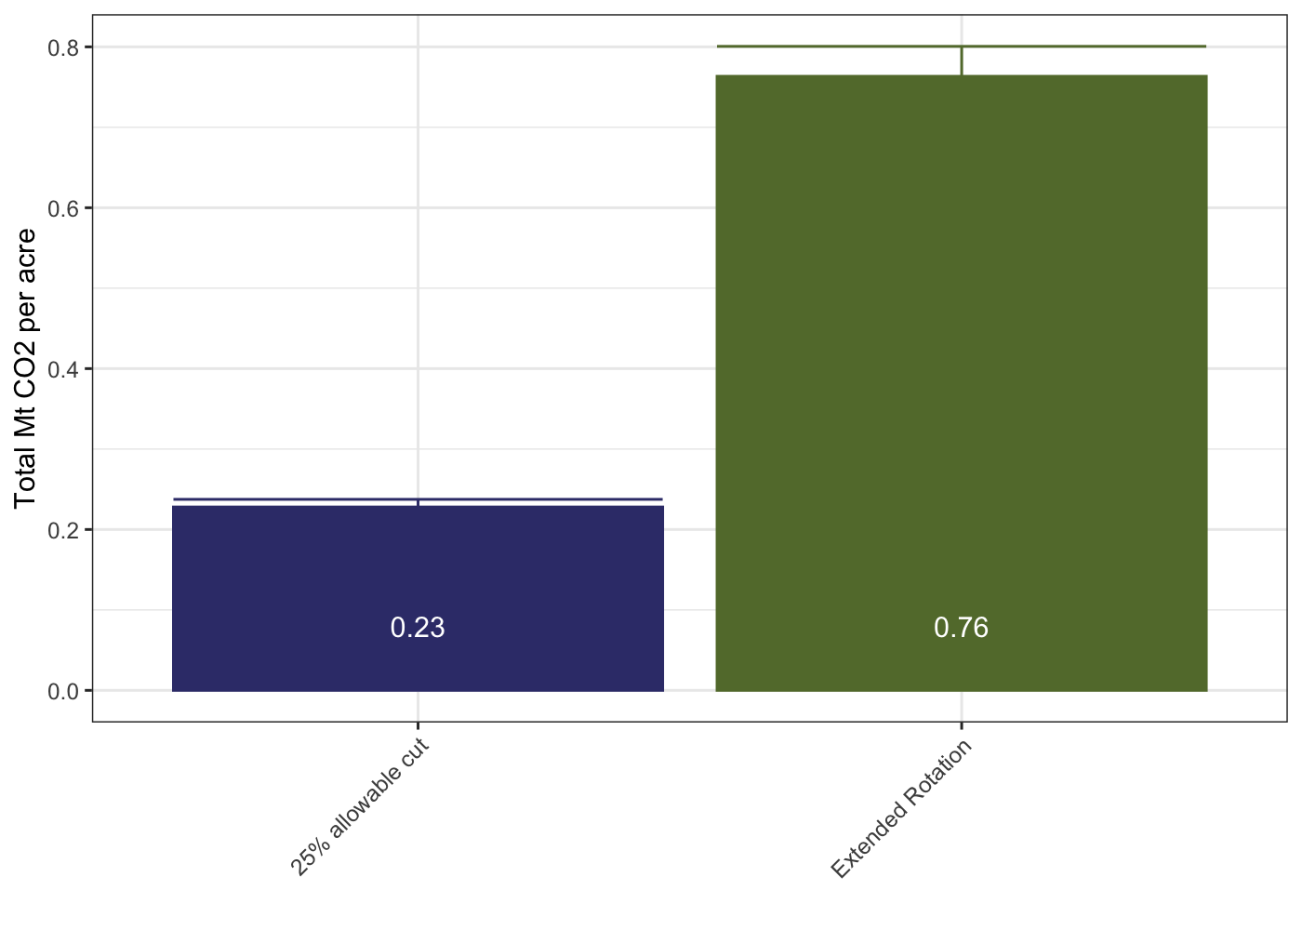
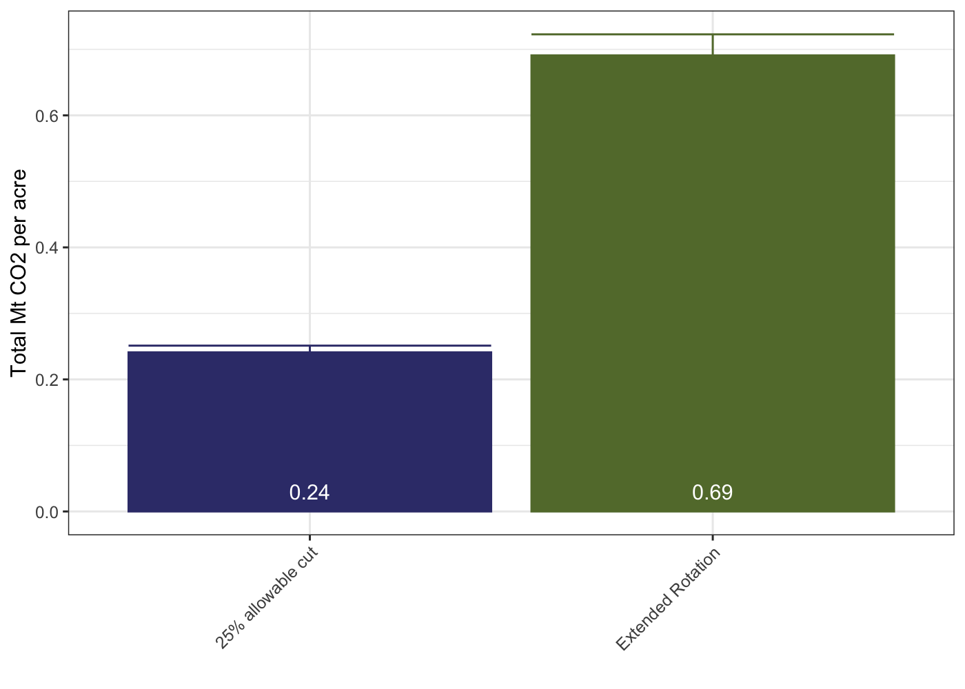
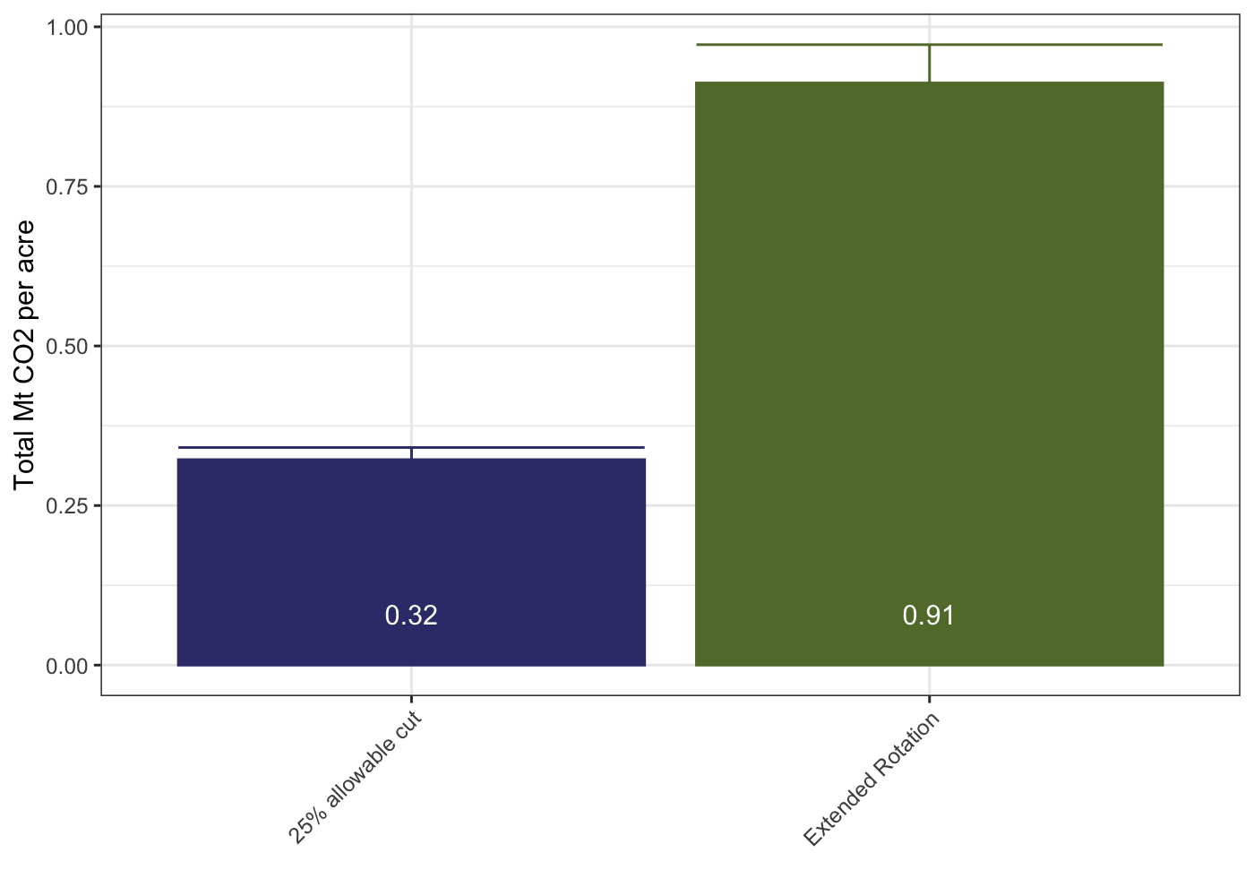


a)
All Plots – Oak / Hickory
Select Plots – Oak / Hickory
b)
All Plots – Oak / Hickory
Select Plots – Oak / Hickory
c)
All Plots – Oak / Hickory
Select Plots – Oak / Hickory
d)

