Slide 1
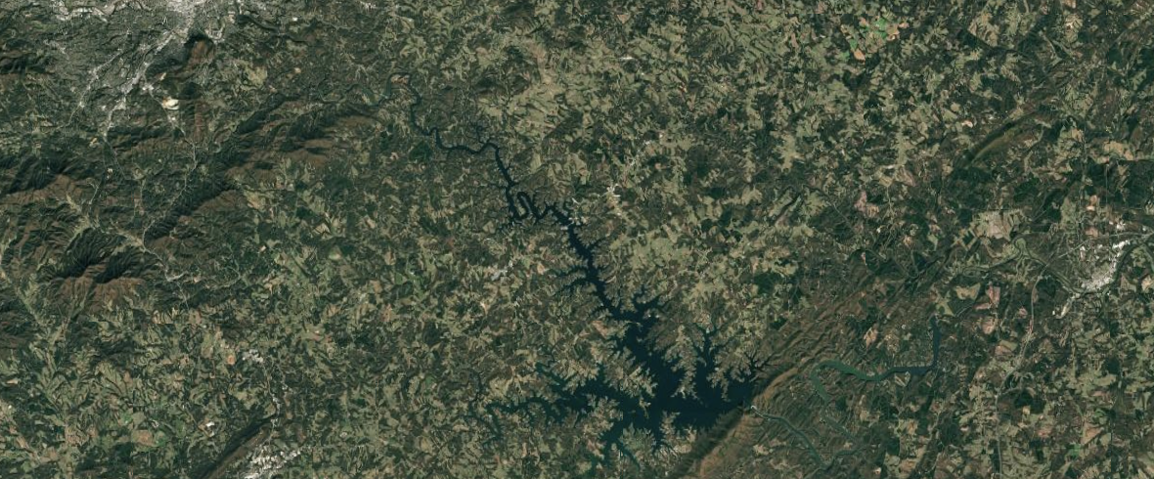
I)
II)
III)
IV)
Single Model, Static BAU
Blended Model, Static BAU
Blended Model, Dynamic BAU
Measured Blended, Dynamic BAU
*Assumes BAU scenario will 100% harvest over 25 years
*Assumes only some parcels in combined BAU scenario will harvest over 25 years
*Harvest intensity fluctuates over time
*Biomass is measured in the field and BAU

