Slide 1

In the weeds of carbon accounting for improved forest management protocols

Slide 2


Single Model, Static BAU
BAU: 100% harvest, with common practice % BA removed. Avg over 15 years
VS
IFM: Grow forward
Blended Model, Static BAU
BAU: assumes common practice % BA removed and % harvest likelihood. Avg over 15 years
VS
Randomly selects 10 FIA plots to be the Project
IFM: Grow forward
BAU: assumes common practice % BA removed and % harvest likelihood. Fluctuates over 15 years
Blended Model, Dynamic BAU
VS
IFM: Grow forward
BAU: 10 FIA plots matched with replacement based on Stand Age, Site class code, elevation, slope, relative density of overstory, relative density of understory, forest type, and ecoprovince
Measured Composite, Dynamic BAU
VS
IFM: Selected plots without a harvest event, measured over time

Slide 3
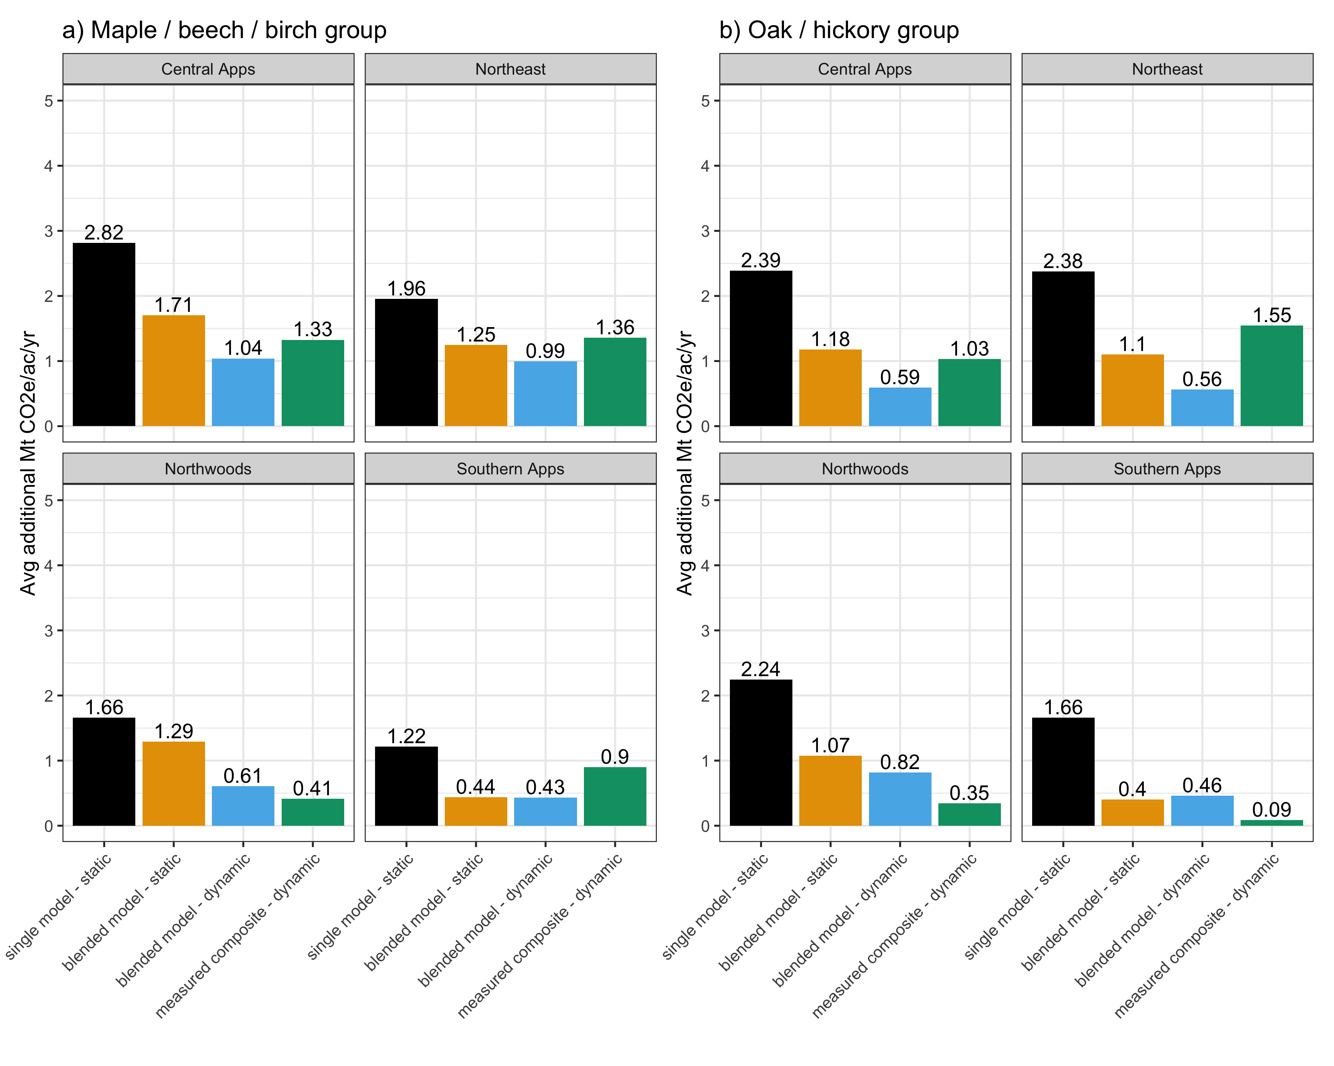
Mean additional Mt CO2e/ac/yr Across accounting methods

Slide 4
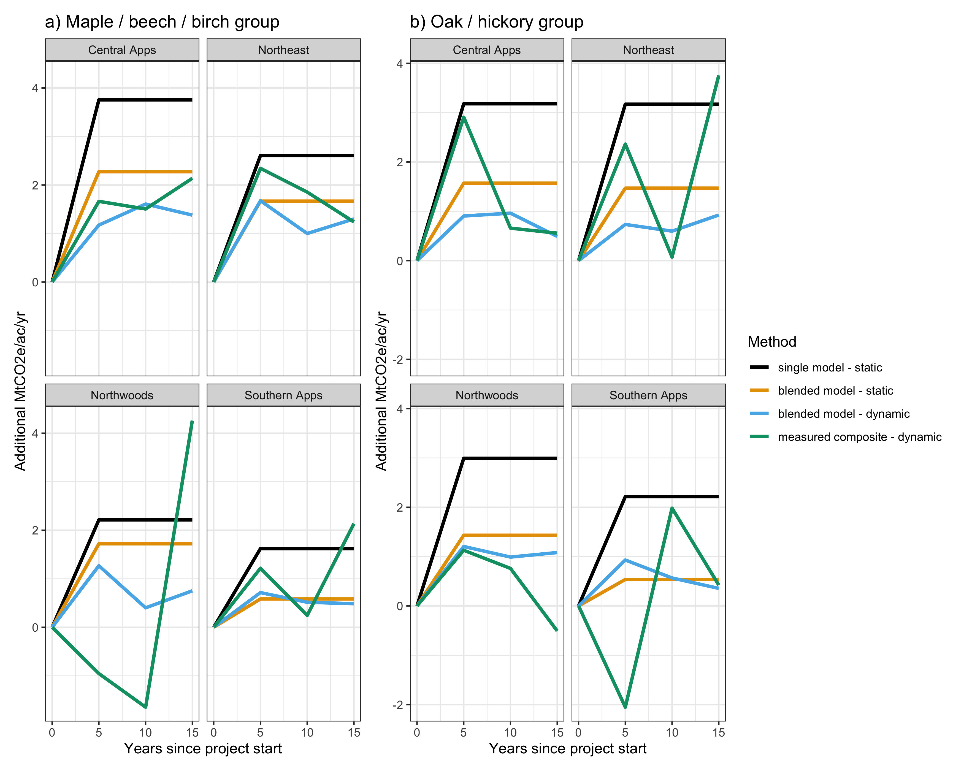
Detecting additionality over time

Slide 5
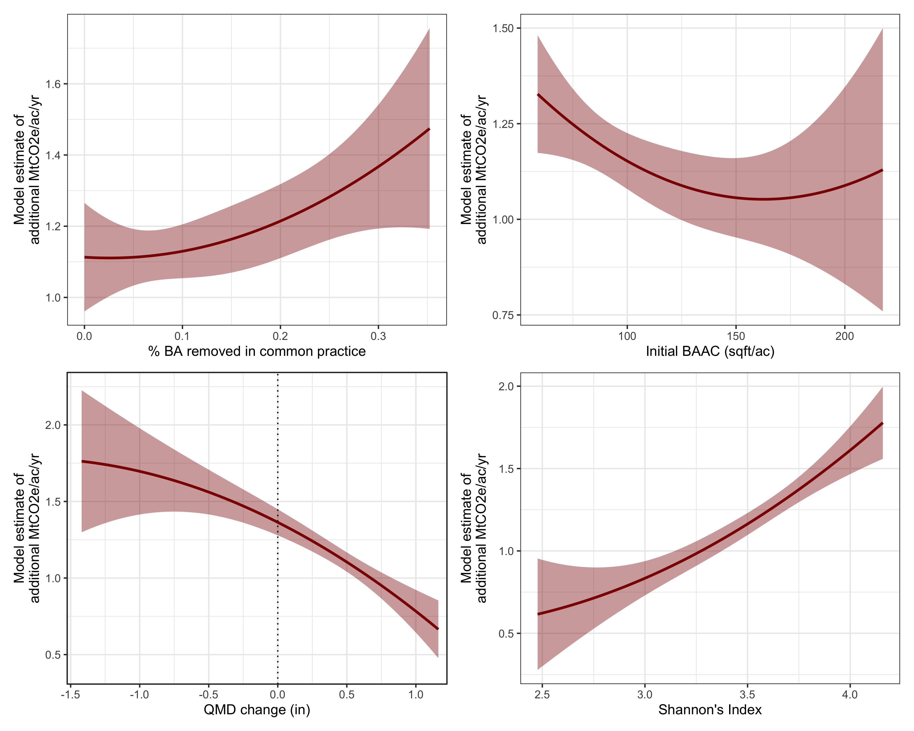
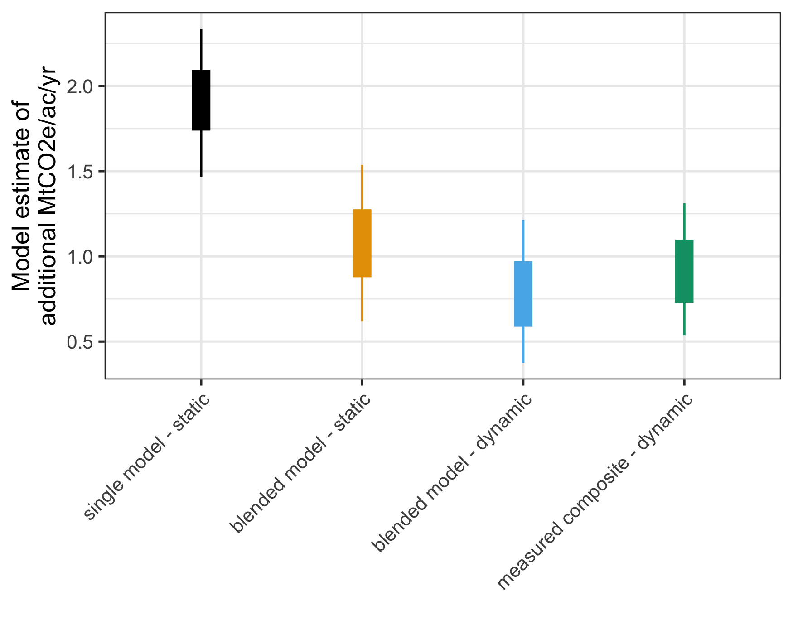
Model output
Notes:
distance to road, siteclcd, full suite of variables that we match to

Slide 6
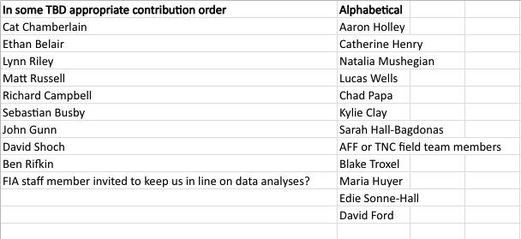
List of co-authors
Notes:
Jon Knott might be a good FIA scientist: https://research.fs.usda.gov/about/people/jonathan.knott
Christine and Nate; Chris Zimmerman and Laura Marx;
SIG folks; Kevin Yoder

