Slide 1
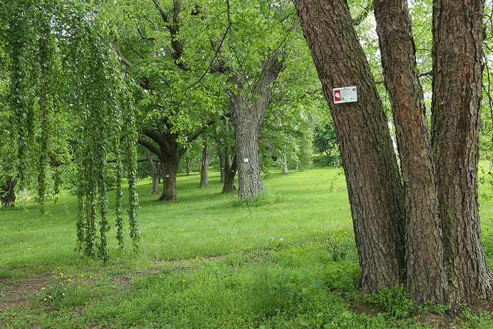
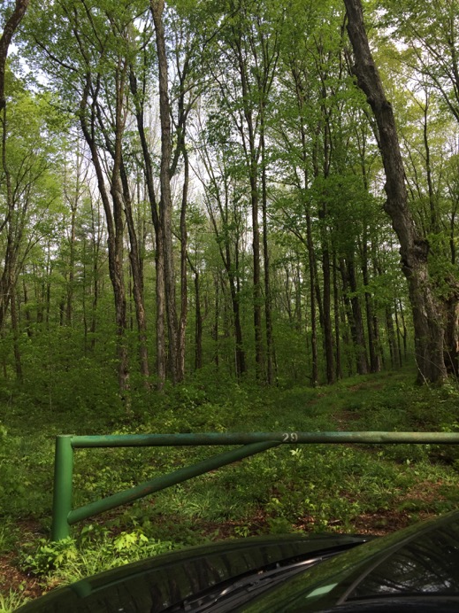
HARVARD FOREST
ARNOLD ARBORETUM

Slide 2
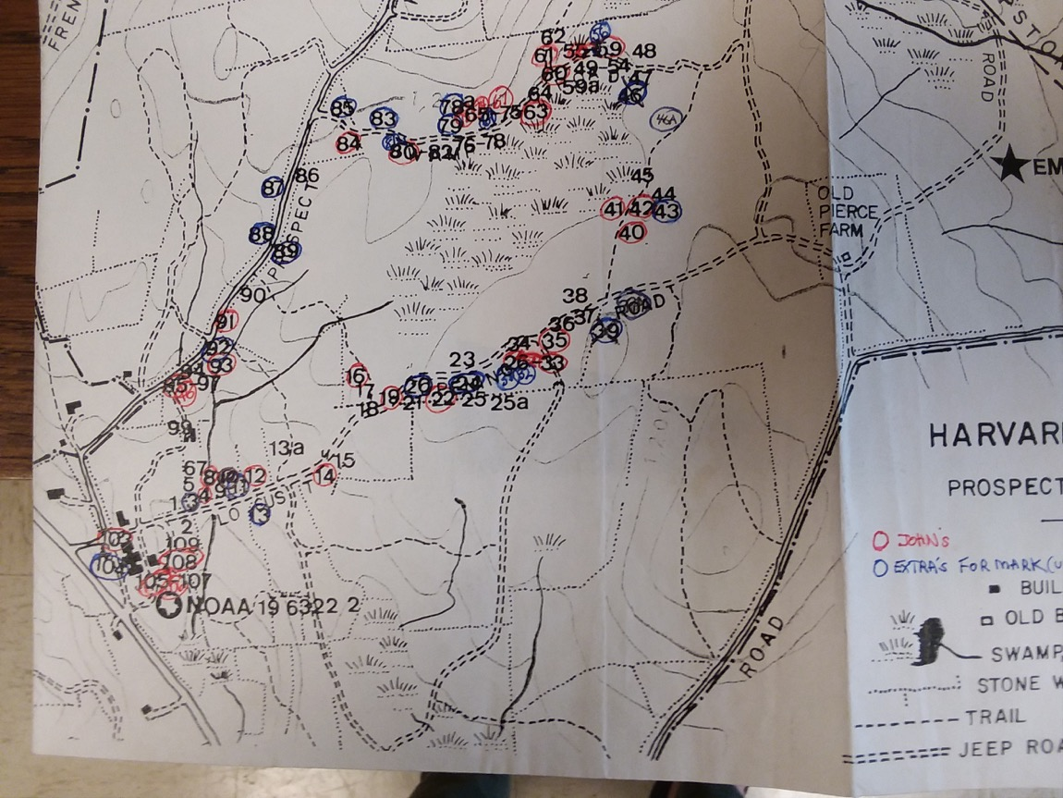

Slide 3
Main Aims:
How does the method used for measuring daily weather influence GDDs until budburst?
Where does the error fall?
Is there actually less interspecific variation when using Weather Station data as we’d expect?
Is anything else influencing our results, like provenance latitude?
How does sampling frequency influence GDDs until budburst?
Build a PMM in stan

Slide 4
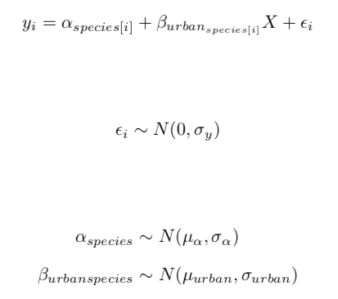
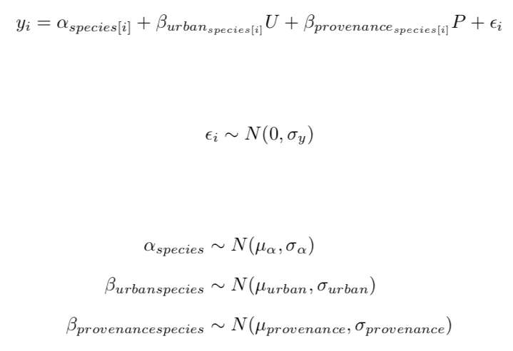
Just using Urban predictor
Adding in provenance

Slide 5
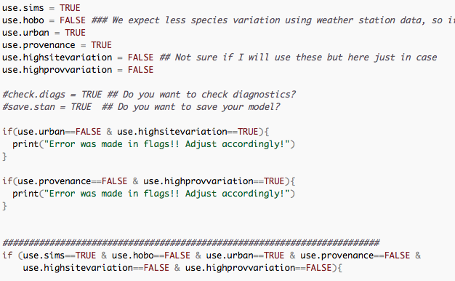
Main Aim 1: Flagging system

Slide 6
Fast-forward…
Many divergent transitions with real data using just urban predictor (0 = forest; 1 = urban)
Build new model in rstan using ncp – works!! Results to follow
Provenance won’t fit with real data in rstan or with ncp. Need to build a vcov in rstan as a next step.

Slide 7



Weather Station Data: less interspecific variation
Hobo Logger Data: more interspecific variation

Slide 8
Weather Station Data: real data
Hobo Logger Data: real data

Slide 9
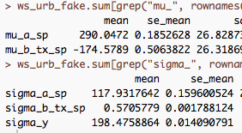
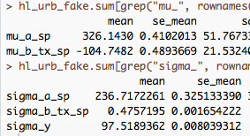
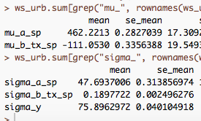
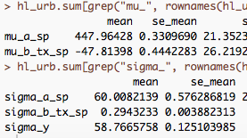
Weather Station Data: less interspecific variation
Hobo Logger Data: more interspecific variation
Weather Station Data: real data
Hobo Logger Data: real data

