Slide 1
Noisy Weather Station Data

Slide 2
Noisy Hobo Logger Data

Slide 3
Oh goodness...

Slide 4
Okay, so lots of sims data checks ensued...
And things seemed to be working well actually... So this might be really cool!

Slide 5
Next, I want to see if I could figure out what Fstar for each species
was using raw data
This is looking at the noisy hobo logger data

Slide 6
Cool!! There’s this relationship between fstarspp and mean minimum GDD using Weather Station data
(remember this is the more accurate method for this example)
And this makes sense right, because our observed GDDs will always be bigger than our fstar. With warming, we would expect to see this difference between min and mean increase

Slide 7
Just a quick detour...

Slide 8
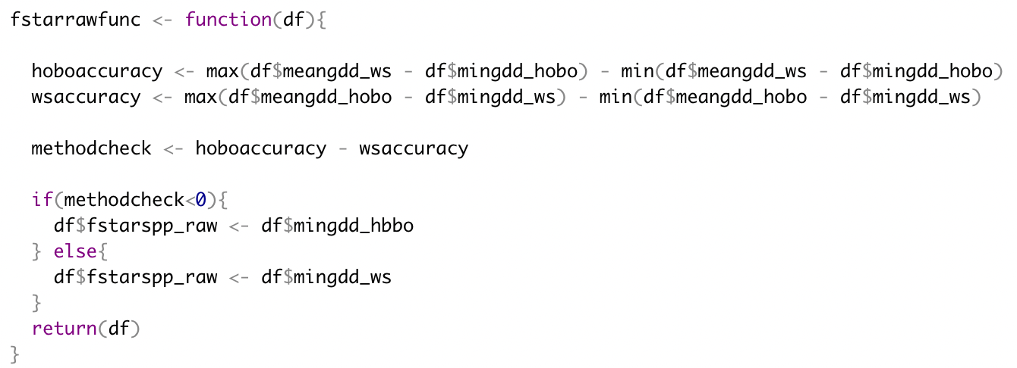
How do I calculate this “raw fstar” value?
So we’ve learned that the mean min for WS is closely related to fstarspp
If we have real data, how do we know which method is more accurate? Which mean min do we use?

Slide 10
”Raw fstarspp” value
Vs.
Fstarspp from sims

Slide 11
Alright so now we want to see if hobo loggers are more accurate estimates of GDD when we have microclimates....

Slide 12
So the way that I do this first is to see what microclimates do to our accuracy tests and muplot
NOISY WEATHER STATION DATA WITH MICROS!

Slide 13
NOISY HOBO LOGGER DATA WITH MICROS!

Slide 14
Next, I want to remove the noisy WS or noisy Hobo logger and just have microclimates...
The way I do this is I add variation around the microsites at both the Arb and the Forest...
This is NOT what I was hoping for... I wanted Hobo loggers to be better estimates of GDD

