Slide 1
Noisy Weather Station Data

Slide 2
Noisy Hobo Logger Data

Slide 3
Oh goodness...

Slide 4
Okay, so lots of sims data checks ensued...
And things seemed to be working well actually... So this might be really cool!

Slide 5
Next, I want to see if I could figure out what Fstar for each species
was using raw data
This is looking at the noisy hobo logger data

Slide 6
Cool!! There’s this relationship between fstarspp and mean minimum GDD using Weather Station data
(remember this is the more accurate method for this example)
And this makes sense right, because our observed GDDs will always be bigger than our fstar. With warming, we would expect to see this difference between min and mean increase

Slide 7
Just a quick detour...

Slide 8
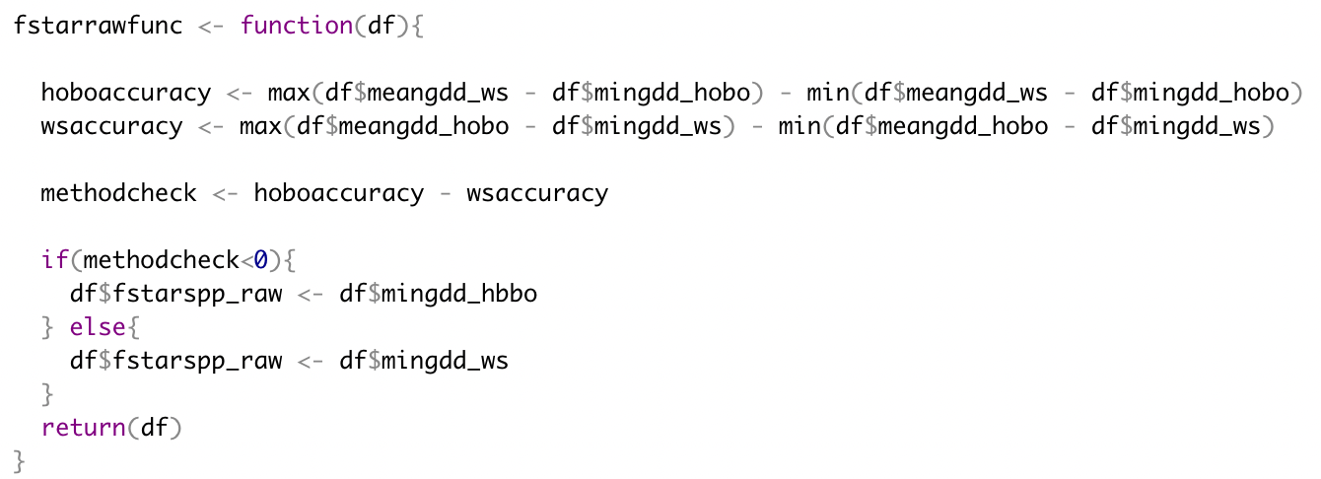
How do I calculate this “raw fstar” value?
So we’ve learned that the mean min for WS is closely related to fstarspp
If we have real data, how do we know which method is more accurate? Which mean min do we use?

Slide 10
”Raw fstarspp” value
Vs.
Fstarspp from sims

