Slide 1
DERopt Single Node Optimization Model
Mixed integer linear program
Techno-economic optimization and analysis
Inputs:
Site energy demand
Technology capital/O&M costs and operational characteristics
Utility energy costs
Local infrastructure limits
Outputs:
Optimal technology mix
Optimal operation strategies
Plant performance
Notes:
DERopt single node is a technoeconomic optimization model. We use the “single node” description to signify that the formulation is focused on a single facility, vs. a “multi node” formulation that will optimize the energy systems across multiple buildings and locations that share a common electrical distribution circuit. The model uses a mixed integer linear program formulation to predict the optimal technology selection, sizing, and operation of various types of technologies shown in the figure on the right. This diagram shows the current formulation technology set and does not include the expansion to include hydrogen production, storage, and use. The model optimizes for cost, but can include carbon emission cost, an emissions limit, and net zero energy requirements. Model output is the lowest cost option for meeting site energy demand while meeting site energy and/or environmental goals, while maintaining feasible operation across all energy system assets. The model also considers existing generation to predict optimal operation or to examine energy asset expansion.
Side note: we do have a multi-node model. However, we typically scale back energy system options to solar PV and battery energy storage.

Slide 2
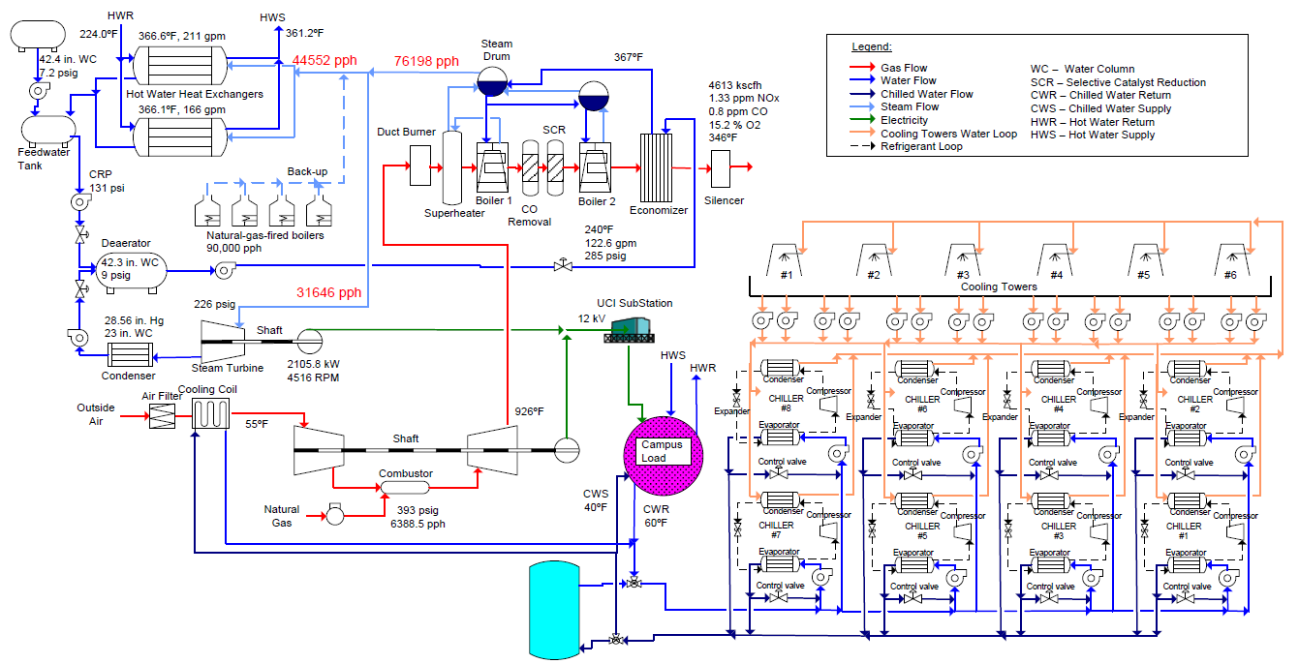
UCI Central Plant
District Heating
56 – 128 klbs/hr Steam HRSG
[1]
5.4 MW
Steam Turbine
13.5 MW Solar TitanTM 130
Gas Turbine
53,000 Ton-hour Cold TES Tank
[1]: Do, A.V., Performance and Controls of Gas Turbine-Driven Combined Cooling Heating and Power Systems for Economic Dispatch
16,500 Tons Chiller Plant
Notes:
A version of DERopt has been developed to model the UCI central plant. The model captures the operation of all critical components shown here as well as the 3.6 MW of solar PV and 1 MWh of electrical energy storage not shown here. This includes the 8 chillers that are used to cool all campus buildings, the cold thermal energy storage tank used to help balance cooling production and demand, the Solar Titan gas turbine that produces nearly all campus electricity, and components that operate off of the hot gas turbine exhaust gas, including the 5 MW steam turbine and district heating system.

Slide 3
Example Results
DERopt
Notes:
As an example of optimized results, this plot shows cooling plant operation to meet campus cooling demand for a week in September. Actual demand is captured from real central plant data showing professional operator dispatch designed to minimize the cost of energy by using energy storage to meet peak daily demand.
Optimized output from DERopt is shown in the top while real operation is shown in the bottom. Tick marks indicate 12 noon on each day.
The thin black line is campus cooling demand.
The thick blue line is the aggregated cooling output from all 8 chillers
The thick green and red line are charging and discharging of the TES tank, respectively.
These results show three things:
The DERopt model is able to emulate real life operation shown in the step behavior in chiller plant activity.
DERopt is able to suggest operational strategies that reduce chiller cycling by 50% as shown here with the smoother chiller output profile for DERopt
DERopt is able to more effectively manage thermal energy storage, using this asset to a) maintain chiller operation at peak COP set points, b) reduce chiller cycling, and c) meet large ramps in cooling demand that are difficult to meet with operational chillers. DERopt is also able to reduce energy use by reducing utilization of the cold thermal energy storage by using the resource to fill in energy gaps, not to do wholesale load shifting.
A critical benefit of DERopt is that it is able to realize the optimal dispatch of new and proposed energy systems. This is not readily obvious from this image. However, this result shows the potential to beat previously optimal dispatch strategies implemented by professional power plant operators when DERopt is paired with some consideration for what could happen in the future i.e., what energy demand will look like. Considering the potential to add hydrogen into the mix with expanded renewable assets and hydrogen vehicle planning, the operational complexity increases substantially beyond the current system and requires the analytical approach implemented in DERopt

