Slide 1

Team Members
1. Akhila Awoshetty
2. Mohammed Khaja mujahiddin
3. Chandramohan Chandanakumar

Slide 2

Sentiment Analysis for Multilingual Social Media Posts

Slide 3
Statement of Project Objectives
Objectives:
Develop a multilingual sentiment analysis system capable of analyzing social media posts in various languages.
Evaluate the system's performance by measuring accuracy, F1-score, and cross-lingual sentiment transfer capabilities.
Explore the potential for real-time sentiment analysis and language adaptability in a practical application.

Slide 4

Dataset
The primary dataset for training and testing the sentiment classifier will be the COVID-19 tweets dataset. This dataset is particularly suitable for this project due to its global reach, diverse sentiment distribution, and availability of sentiment labels. Here are the relevant details of the dataset:
Dataset Name: COVID-19 Tweets Dataset
Source: Twitter
Size: Approximately 500 million tweets
Languages: Global coverage, including English, Spanish, French, German, and Chinese
Sentiment Labels: Manually annotated for sentiment (positive, negative, neutral)
Relevance: The COVID-19 pandemic has generated a vast amount of social media data, reflecting global sentiment and concerns related to the pandemic. This dataset provides a rich source of sentiment-labeled text for training and evaluating the multilingual sentiment classifier.

Slide 5
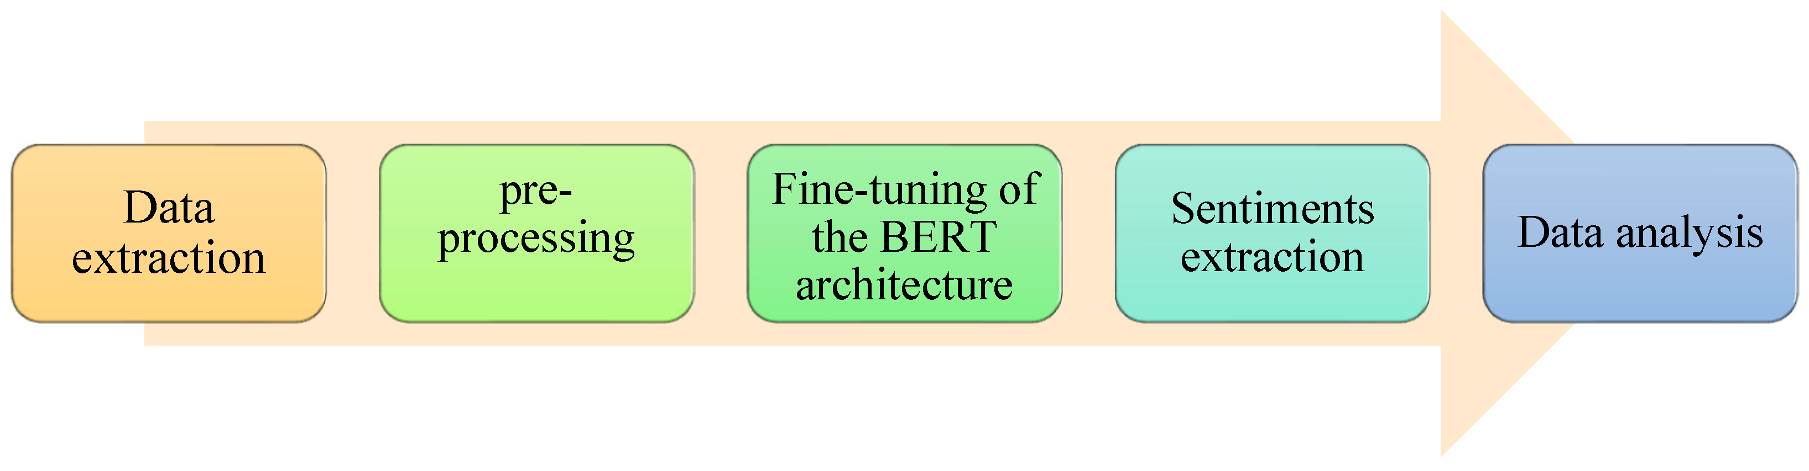
Block Diagram

Slide 6
Approach
Data Collection/ Preprocessing : Gather a diverse dataset of social media posts in multiple languages. Employ Python's NLTK and regular expressions for text normalization, tokenization, and special character handling.
Multilingual Embeddings: Fine-tune pre-trained multilingual word embeddings using Python libraries like TensorFlow or PyTorch.
Model Selection: Experiment with various deep learning models BERT-base-multilingual-uncased, using Python's deep learning frameworks.
BERT-base-multilingual-uncased is a pre-trained transformer model that is specifically designed for multilingual sentiment analysis, making it a suitable choice for this project.

Slide 7
Model Selection: Test different deep learning models, such as Transformers, LSTMs, and CNNs, utilizing Python’s deep learning frameworks.
Cross-Lingual Transfer Learning: Investigate Python-based methods for cross-lingual transfer learning to adapt pre-trained models across various languages.
Real-Time Application: Create an intuitive, real-time sentiment analysis platform with Python, Flask, TensorFlow Serving, and interactive data visualization tools.

Slide 8
Languages
The project will initially focus on analyzing social media posts in English, Spanish, French, German, and Chinese, covering a significant portion of global social media usage.
Datasets
Cross-Lingual Adaptation Dataset: For cross-lingual transfer learning, the project will utilize language-specific subsets of the COVID-19 tweets dataset or other relevant sentiment-labeled datasets for the target languages.
Pretrained Multilingual Models
CLAMP-multilingual-sentiment-covid19: This model is specifically pre-trained on the COVID-19 tweets dataset, incorporating sentiment-specific knowledge.

Slide 9
Deliverables
Diverse multilingual social media dataset.
Preprocessed dataset.
Sentiment analysis model with language adaptability.
User-friendly interface/API for real-time sentiment analysis.

Slide 10
Evaluation Methodology
Intra-Lingual Evaluation: Assess accuracy, F1-score, and other pertinent metrics for sentiment analysis within each language individually.
Cross-Lingual Evaluation: Evaluate the model’s capability to transfer sentiment knowledge across different languages.
Real-Time Performance: Assess the system’s response speed for conducting real-time sentiment analysis.
User Satisfaction: Collect user feedback through surveys or interviews to evaluate the system's user-friendliness, ease of use, and overall satisfaction

Slide 11
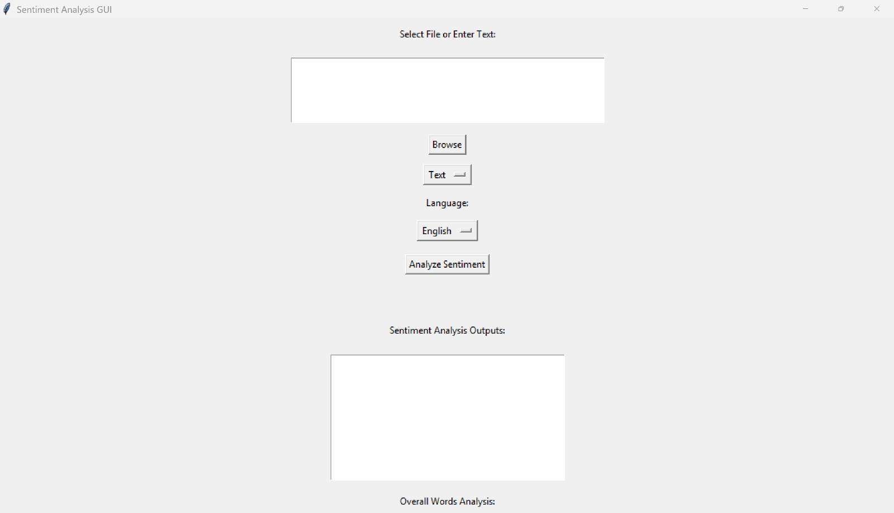
App Interface

Slide 12
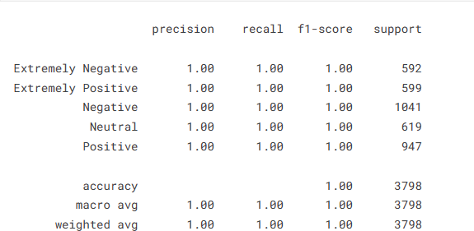
Results and discussions
The classification report outlines precision, recall, and F1-score metrics for each sentiment category. The model exhibits outstanding performance, achieving perfect scores across all metrics for each sentiment class, including 'Extremely Negative,' 'Extremely Positive,' 'Negative,' 'Neutral,' and 'Positive.' The accuracy score is also exceptionally high, reaching 100%, indicating the model's ability to accurately classify sentiments in the given dataset.

Slide 13
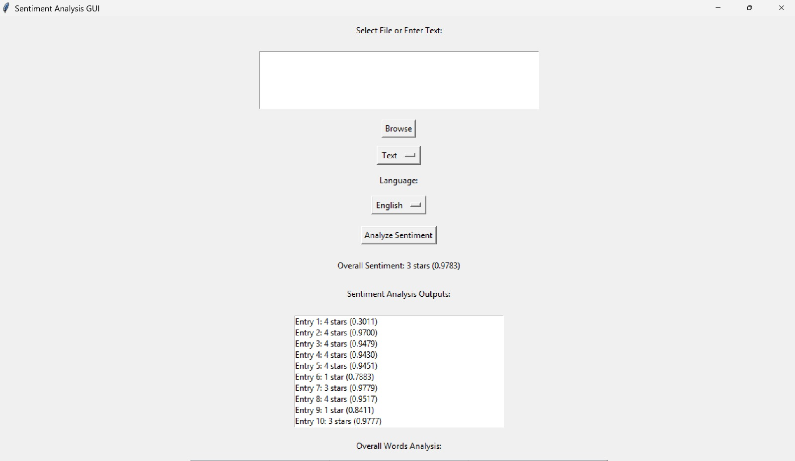
Output

Slide 14

conclusion
The sentiment analysis model for COVID-19 demonstrates exceptional performance with perfect precision, recall, and F1-score across all sentiment categories ('Extremely Negative,' 'Negative,' 'Neutral,' 'Positive,' 'Extremely Positive'), achieving 100% accuracy. The macro and weighted averages further highlight its robustness. This outcome showcases the model's effectiveness in accurately capturing and categorizing sentiments related to the pandemic. The Sentiment Analysis GUI, powered by BERT models, provides an intuitive interface for accurate analysis, prediction, and insights through visually appealing plots.

Slide 15
References / citations
Ravi, K., & Ravi, V. (2015). A survey on opinion mining and sentiment analysis: Tasks, approaches, and applications. Knowledge-Based Systems, 89, 14-46.
Zhao, Z., & Huang, M. L. (2016). Language-independent and language-adaptive sentiment analysis of multilingual texts. Knowledge and Information Systems, 48(3), 641-662.
Taboada, M., Brooke, J., Tofiloski, M., Voll, K., & Stede, M. (2011). Lexicon-based methods for sentiment analysis. Computational Linguistics, 37(2), 267-307.
Wu, D., Hu, J., Lu, L., Park, H., & Zhang, X. (2016). THUANE: Towards heterogeneous sentiment analysis. In Proceedings of the 25th ACM International on Conference on Information and Knowledge Management (pp. 2097-2100).

Slide 16


