Slide 2
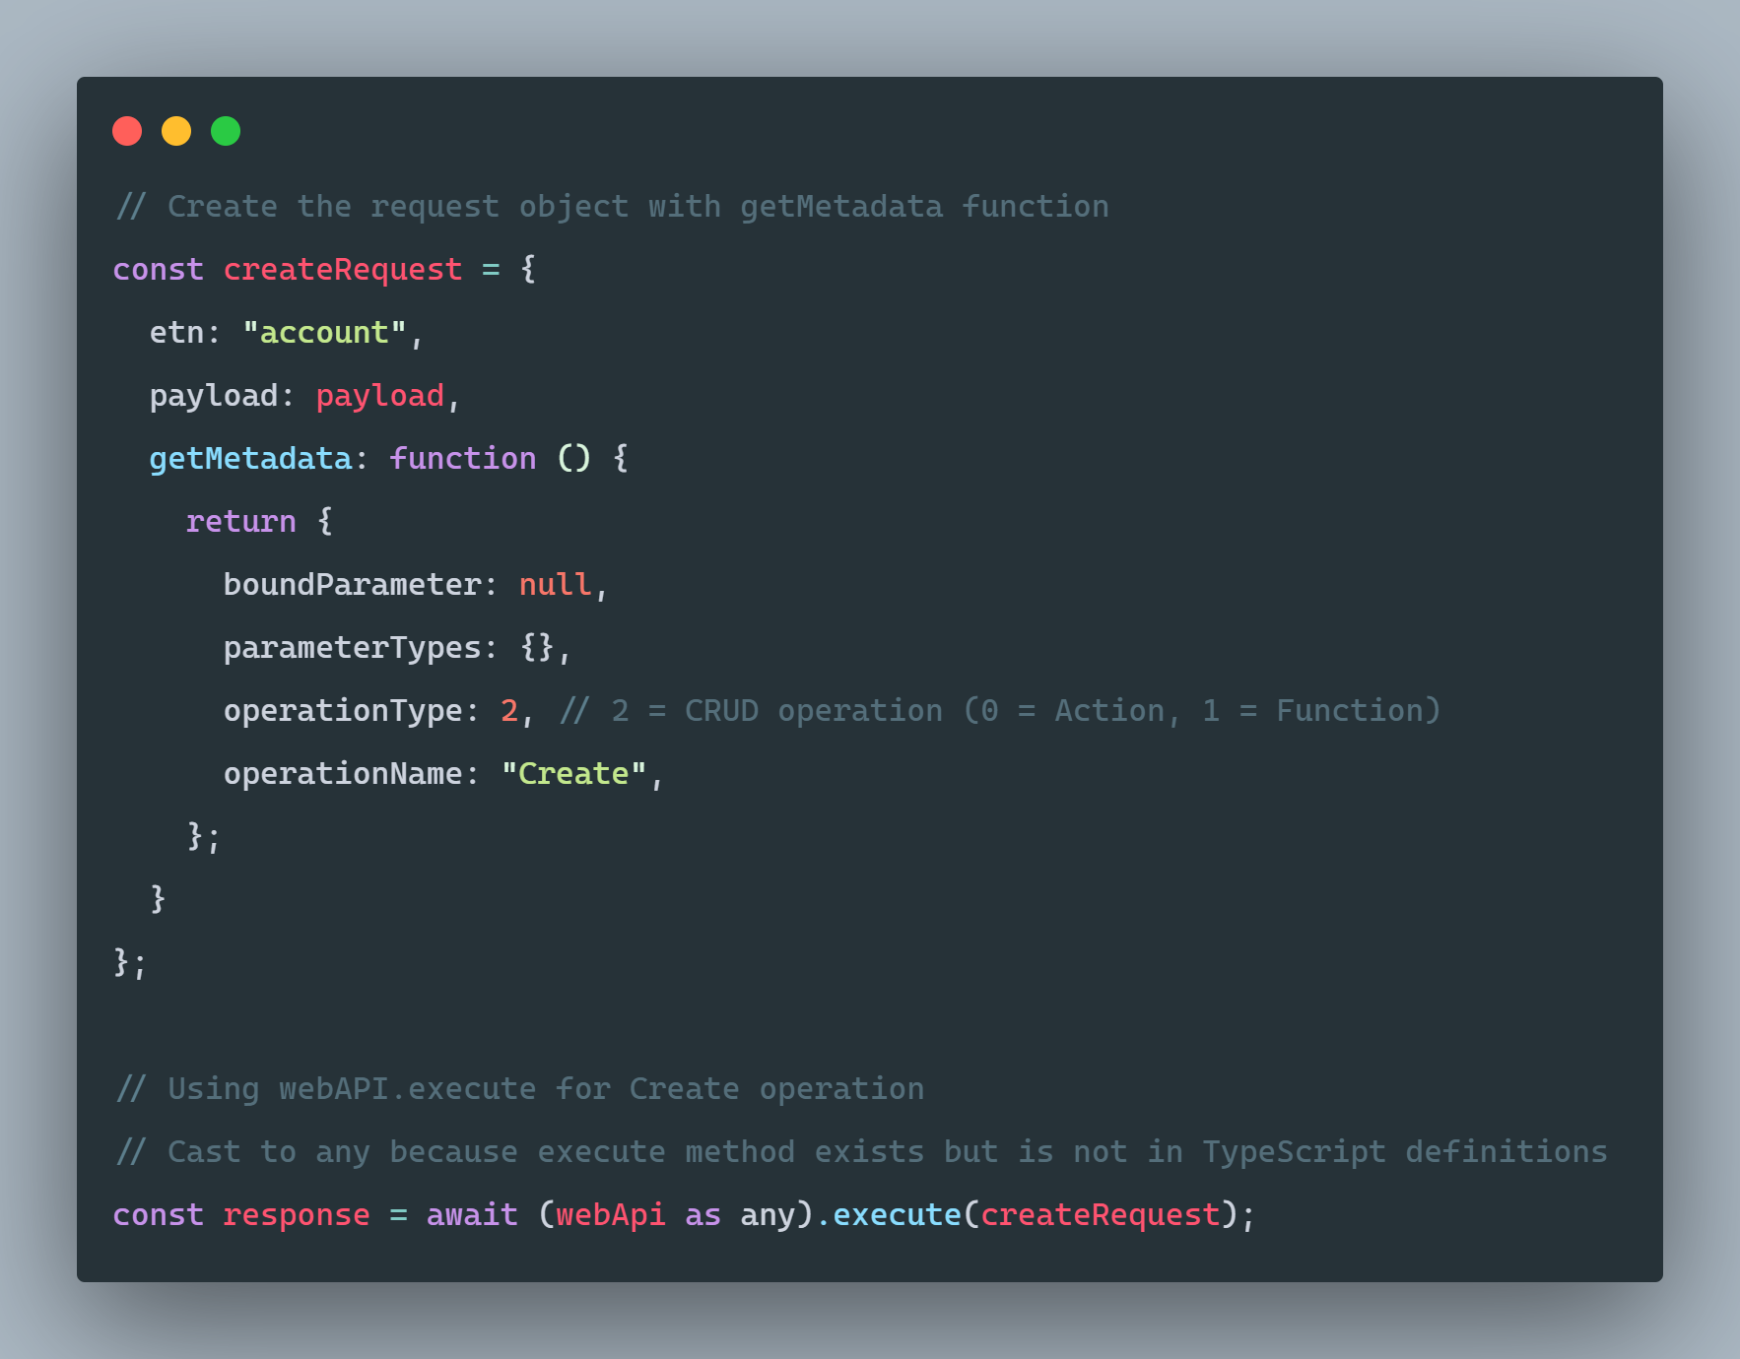
.EXECUTE()
Notes:
The execute method under webapi is not enumerated in the typescript classes and undocumented, so technically this is unsupported, but let's call it a "soft" unsupported because it follows the exact usage patterns of the Xrm webapi execute, so changes to it are almost impossible to imagine...
This can be used for a huge number of message types, including all API Functions and Actions (queueing, sharing, you name it!)

Slide 3
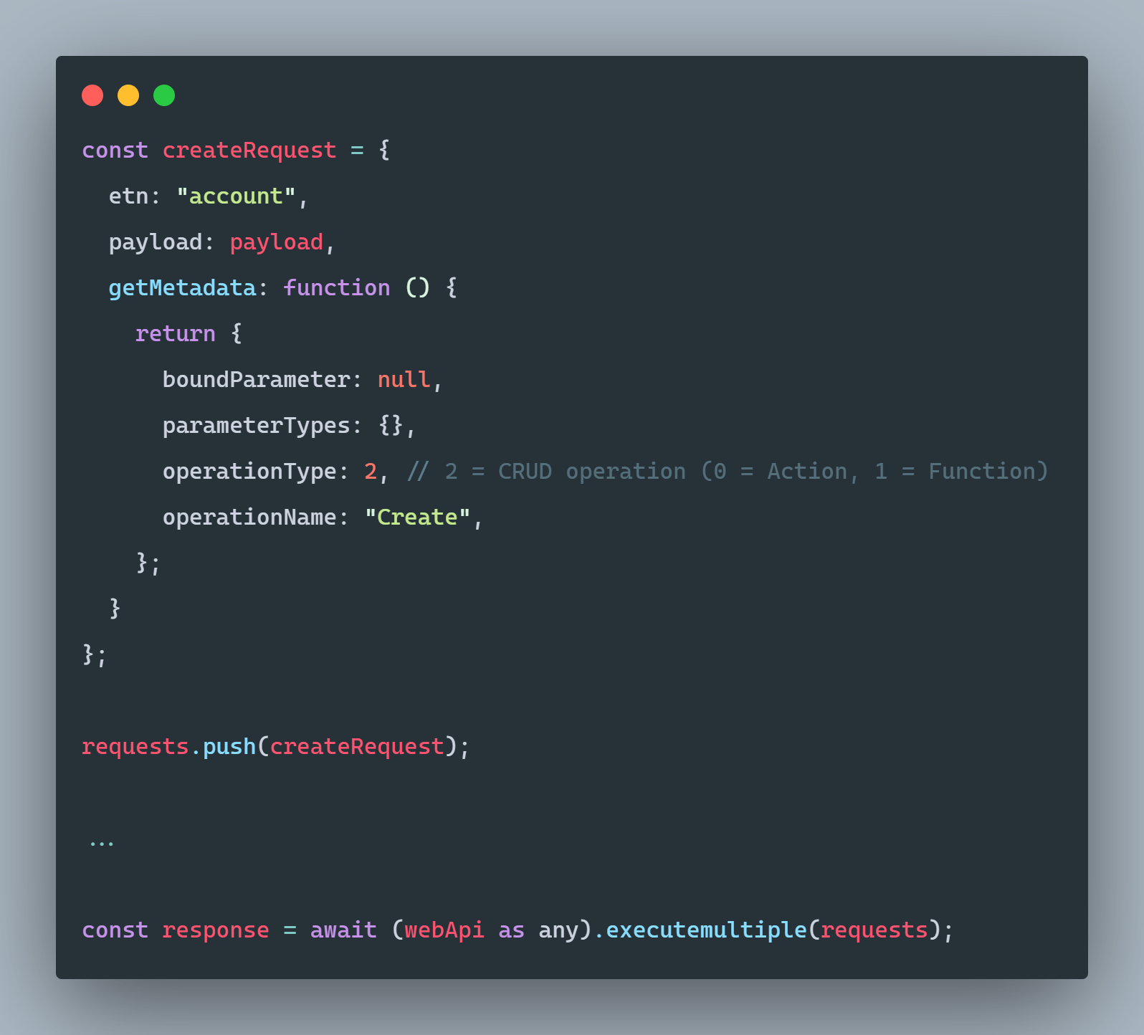
.EXECUTEMULTIPLE()
Notes:
The same is true of the ExecuteMultiple operation, exposed much the same way. This enables us to batch up an arbitrary number of requests, calling the API just once to handle all of them instead of nesting, multithreading, or any other approach. This is much more resource efficient and can greatly speed execution of large request batches...

Slide 4
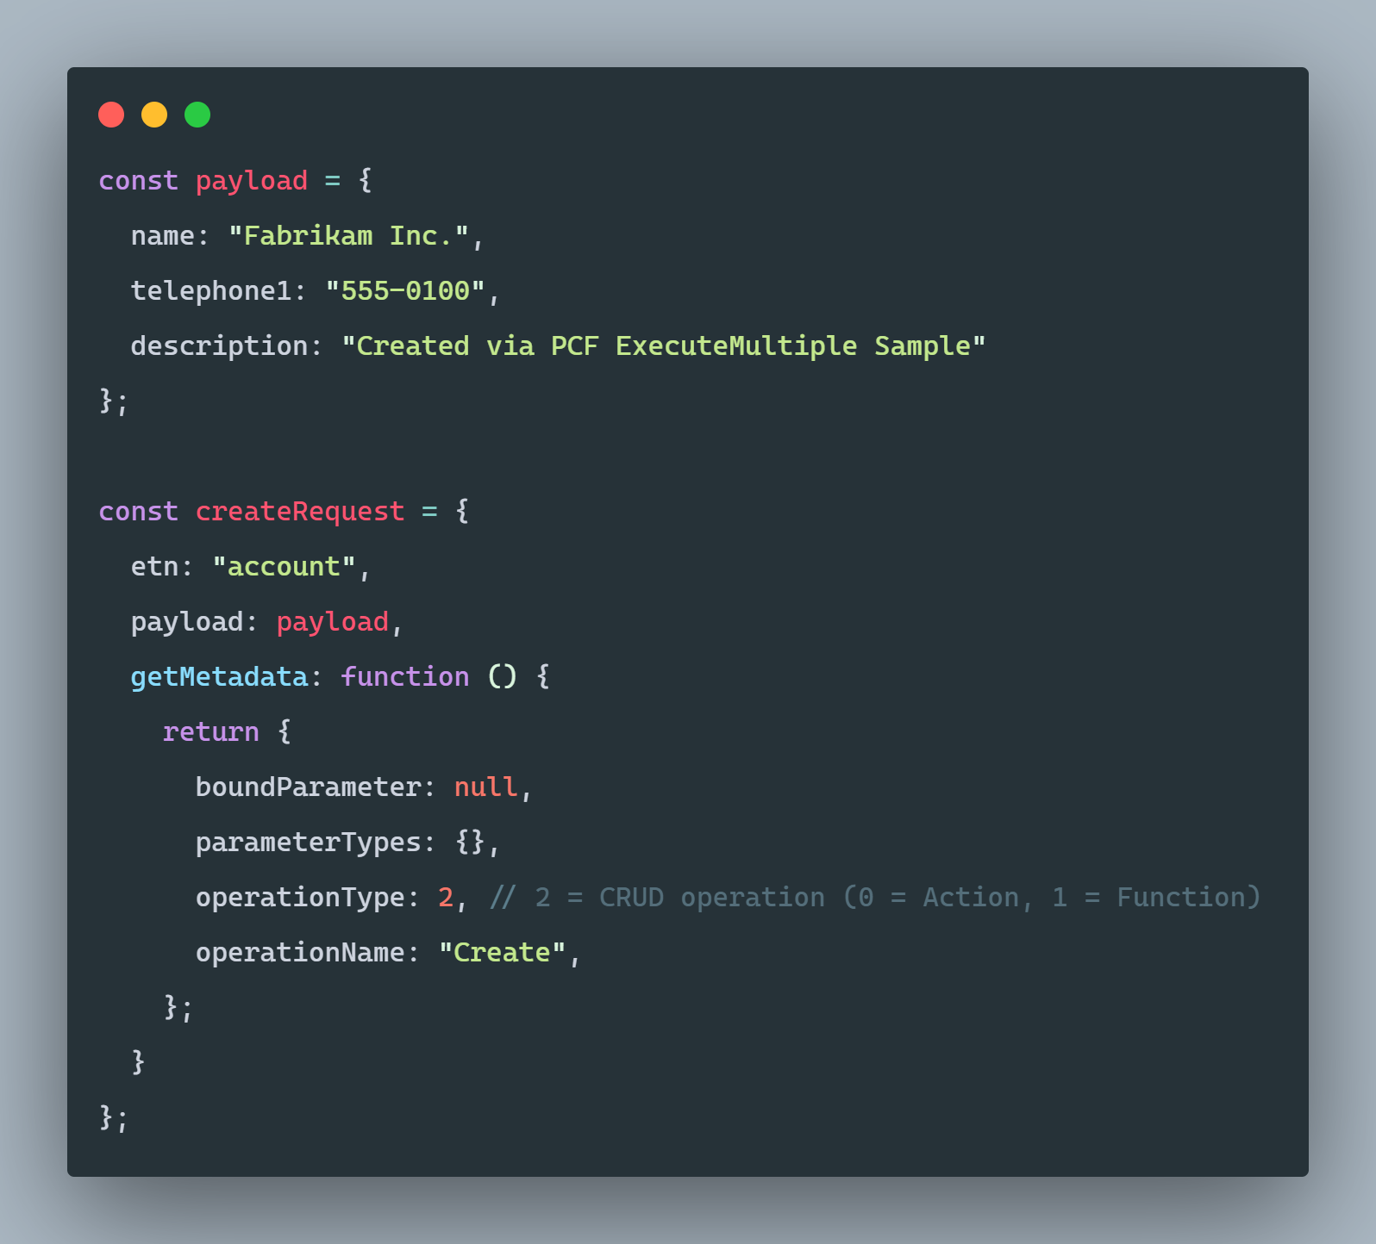
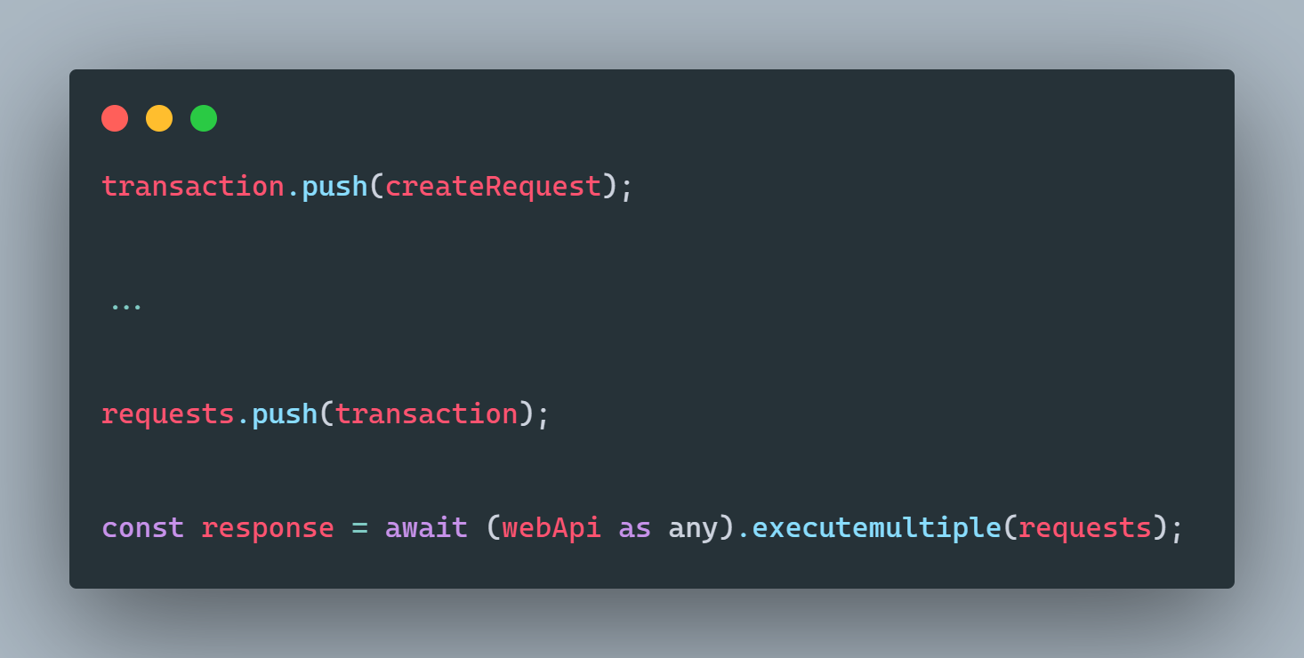
.BEASTMODE()
Notes:
Going even further, we can use executemultiple to not only bring efficiency to our parallel requests, but also to transaction-bind a request series, providing transaction backout safety in the event of individual transaction failure.

