Slide 1
FOLLOW-UP
TODAY
Keeping the lights — and the heat — on.
The Case
For Fossil
Fuels
Why cutting fossil fuels too fast can cost more lives than it saves — in Lusaka and in Alberta alike.
A steelman counter-argument
Choolwe
Analytics in Training • May 2026
Notes:
(~15 sec) Yesterday I argued we should cut fossil fuels. You all saw that talk, so I won't recap it. Today I want to make the most honest counter-argument I can — not because I've changed my mind on climate change, but because the picture I painted was incomplete. The story today is simple: reliable energy is survival, and clean energy alone can't guarantee it yet — not in Lusaka, and not in Alberta.

Slide 2
THE BIG IDEA • THE QUESTION THIS TALK TURNS ON
What if cutting fossil fuels too fast costs more lives than it saves?
A steelman I have to take seriously — even as someone who wants fossil fuels gone.
Choolwe • The Case For Fossil Fuels
2 / 10
Notes:
(~15 sec) Before any data, here's the one question this whole talk turns on. Yesterday I argued we should cut fossil fuels. But this is the steelman I couldn't shake: what if cutting them too fast costs more lives than it saves? Hold that question — everything today is my honest attempt to answer it.

Slide 3
PRIMER • WHAT WE'RE TALKING ABOUT
Fossil fuels are stored ancient sunlight — and still about 80% of the energy the world runs on.
Coal
Oil (petroleum)
Natural gas
Ancient land plants and swamp forests, buried and compressed. Mined as a solid.
Ancient ocean plankton and algae, cooked under pressure. Drilled as a liquid.
The same organic matter, cooked hotter. Drilled as a gas — mostly methane.
What we use them for today: electricity · transport · heat · industry (steel, cement, fertilizer) · cooking.
Choolwe • The Case For Fossil Fuels
3 / 10
Notes:
(~25 sec) Quick grounding before the argument. Fossil fuels are just stored ancient sunlight — plants and ocean plankton, buried and cooked over millions of years into coal, oil and gas. Burning them releases that stored energy, and the CO₂ that comes with it. They're still roughly 80% of all the energy humanity uses — not just electricity, but transport, heat, and the steel, cement and fertilizer modern life is built from. Hold that scale in mind for everything that follows.

Slide 4
THE BIG IDEA
Reliable energy is survival — and clean energy alone can't deliver it when we need it most. From Zambia's drought to a Canadian winter, cutting fossil fuels now costs lives.
The honest path is a managed transition, not abandonment.
Choolwe • The Case For Fossil Fuels
4 / 10
Notes:
(~20 sec) This is what I want you to walk out of the room remembering. Reliable energy is survival — and the clean-energy-only plan can't guarantee it yet. We have lived proof on two continents: Zambia's drought and a Canadian winter. So the honest answer isn't abandonment — it's a managed transition. Let me show you how I got there.

Slide 5
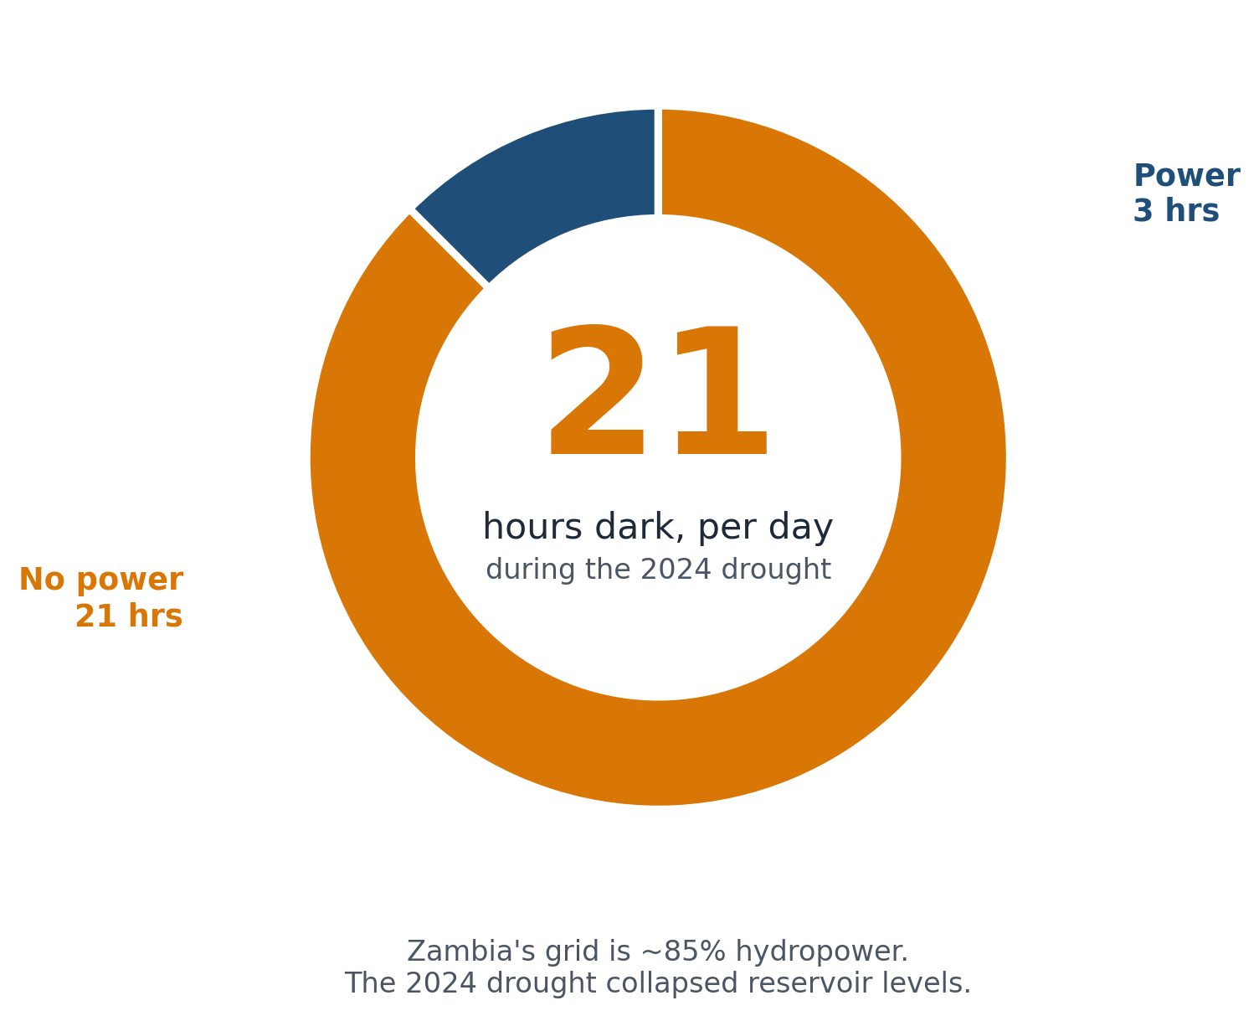
COMPLICATION • THE RELIABILITY TEST, IN THE SOUTH
Zambia bet 85% of its grid on "clean" hydropower — and a climate-driven drought left us in the dark for 21 hours a day.
THE BET
85% of installed capacity is hydropower.
THE LESSON
Firm, dispatchable power matters. Pretending otherwise is paid for in dark hospitals.
The answer isn't "burn more coal." It's "don't bet the grid on one weather pattern."
Choolwe • The Case For Fossil Fuels
5 / 10
Notes:
(~40 sec) We lived this. We did the 'clean' thing — 85% of our installed capacity is hydropower. Then the climate broke our climate solution. The 2024 drought collapsed reservoir levels and ZESCO ran load shedding of up to 21 hours a day. The lesson is NOT 'burn more coal.' The lesson is: firm, dispatchable power matters, and pretending otherwise is paid for in dark hospitals and empty cold-chains.

Slide 6
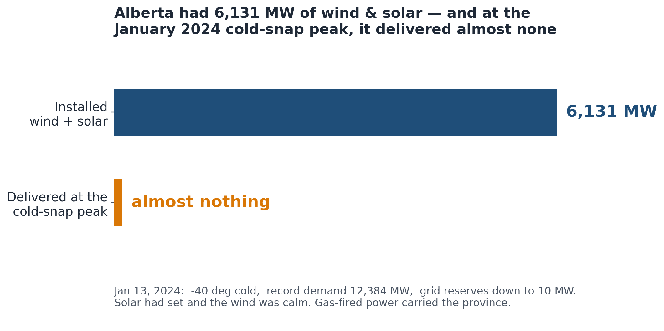
COMPLICATION • THE RELIABILITY TEST, IN THE NORTH
When it's coldest, clean energy is weakest — and fossil fuels are what keep people alive.
WHY WARMTH IS NON-NEGOTIABLE
~9× more
deaths from cold than from heat, worldwide.
GAS HEATS HALF OF CANADIAN HOMES
72% in Alberta, 62% in Ontario. In a -30°C winter, "no fossil fuels" means no heat.
It isn't only the poor South. A rich, modern province nearly went dark — and only firm power kept it alive.
Choolwe • The Case For Fossil Fuels
6 / 10
Notes:
(~45 sec) And it isn't only the poor South. In January 2024, Alberta — a rich, modern province — hit a minus-forty cold snap. Demand smashed a record at 12,384 megawatts. The province has over six thousand megawatts of wind and solar, but at the evening peak the sun had set and the wind was calm, so it delivered almost nothing. The grid fell to TEN megawatts of reserve and the government sent an emergency text telling everyone to cut power to essentials. Gas-fired plants carried the province. And remember — worldwide, cold kills about nine times as many people as heat. In most of the cold world, staying warm runs on fossil fuels: gas heats roughly half of Canadian homes. 'No fossil fuels' in a minus-thirty winter means no heat.

Slide 7
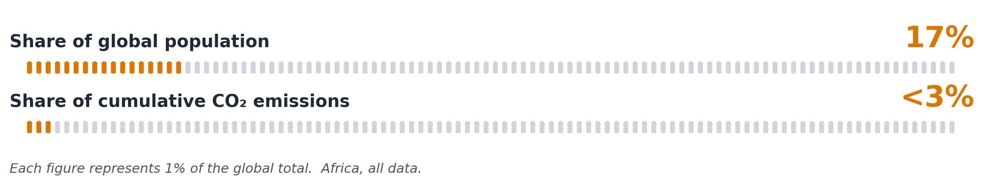
COMPLICATION • THE JUSTICE ASYMMETRY
Africa hosts 17% of the world's people, caused under 3% of cumulative emissions — and is being asked to skip the ladder every wealthy country climbed.
Every wealthy country got rich by burning coal, then oil, then gas.
Even the clean-energy supply chain itself — steel, cement, shipping — still runs on fossil fuels today.
Choolwe • The Case For Fossil Fuels
7 / 10
Notes:
(~40 sec) Now the justice layer. Every wealthy country on Earth got rich by burning coal, then oil, then gas. They are now asking the continent that contributed least to the problem to skip that ladder — using clean-energy technology whose OWN supply chain still runs on fossil fuels. That's not a climate plan. That's an injustice with a green sticker on it.

Slide 8
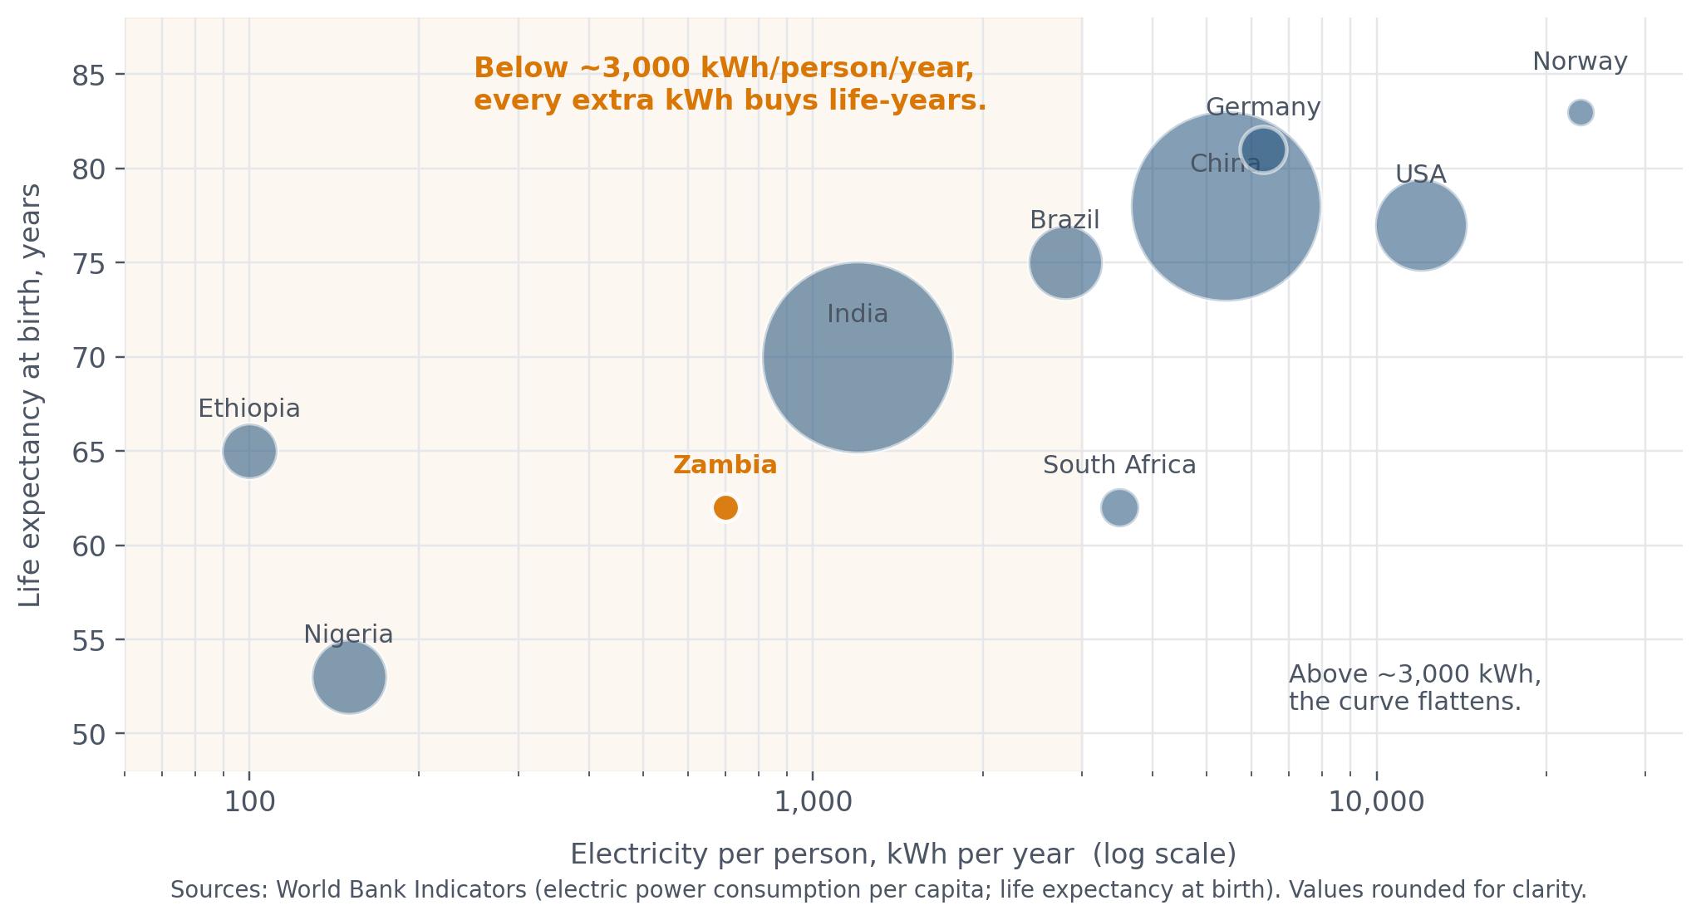
BRIDGE • WHAT ENERGY ACCESS BUYS
Below ~3,000 kWh per person per year, every extra kWh buys life-years. Zambia sits right on the steep part of the curve.
Choolwe • The Case For Fossil Fuels
8 / 10
Notes:
(~30 sec) This is the Hans Rosling curve. Below about three thousand kilowatt-hours per person per year, every additional kilowatt-hour translates directly into life-years — through clinics, refrigerated vaccines, lit classrooms, water pumps. Zambia is right on the steep part of that curve. Cutting energy access there costs life-years immediately. That's why the moral arithmetic doesn't end with climate.

Slide 9
RESOLUTION • THE MANAGED TRANSITION
Gas as a bridge, renewables stacked on top, firm power kept until storage can carry the load — in that order.
NOW — BRIDGE
BUILD-OUT
THEN — RETIRE
Natural gas
Renewables, hard
Phase fossil fuels down
Emits 50–60% less CO₂ than coal. Firm and dispatchable — the power that carried Alberta and would have spared Zambia. Africa holds ~13% of proven gas reserves.
Solar in Zambia is already the cheapest new capacity. Wind, hydro diversification, storage — scaled in parallel, not waited for.
When grids are firm and storage can carry the load, retire gas plants. Not before. Not as a slogan. As an engineering schedule.
Choolwe • The Case For Fossil Fuels
9 / 10
Notes:
(~50 sec) I'm not arguing fossil fuels forever. I'm arguing for a MANAGED transition. Natural gas as a bridge — emits half what coal does, and it's the firm power that carried Alberta and would have spared Zambia; Africa holds 13% of global reserves. Renewables scaled aggressively on top — solar in Zambia is already the cheapest new capacity. And firm power kept on until storage and grid infrastructure can stand alone. That's how we keep the lights and the heat on while decarbonising.

Slide 10
APPENDIX • SOURCES
Every statistic on every slide, with a citation.
Full notes preserved in the repo at research/notes.md.
Africa electricity access (~600M without)
Africa cumulative CO₂ emissions (<3%; sub-Saharan ~0.55%)
IEA, Financing Electricity Access in Africa (2025)
Energy for Growth Hub (citing Our World in Data)
Africa population share (~17% global)
Zambia capacity mix (85% hydropower; ~3,986 MW)
UN World Population Prospects
Global Legal Insights, Energy Laws and Regulations 2025: Zambia
Zambia 2024 load shedding (up to 21 hrs/day)
Cold kills ~9× more than heat (~4.6M vs ~489k deaths/yr)
Pulitzer Center; Afrobarometer AD1178 (2025)
The Lancet Planetary Health (Gasparrini et al.)
Canadian homes heated by gas (~half; 72% AB, 62% ON)
Alberta cold-snap grid alert (record 12,384 MW; reserves to 10 MW)
Statistics Canada — How Canadians heat their home
AESO / Alberta MSA, Jan & Apr 2024 Event Report
Natural gas vs coal CO₂ (50–60% less); Africa gas reserves (~13%)
Steel & cement embodied emissions in renewables
Atlantic Council, Natural gas in Africa's energy transition
MIT Climate Portal
Life expectancy vs electricity per capita (illustrative)
World Bank Indicators (kWh/capita; life expectancy at birth)
Choolwe • The Case For Fossil Fuels
10 / 10
Notes:
Reference slide for Q&A. If anyone questions a stat, the source is here. Full URLs are in the repo's research/notes.md.

