Slide 1
FOLLOW-UP
REPLY TO LAST WEEK
“How Climate Change Affects the World We Live In”
The Case
Today: the other half of the story.
For Fossil
Why cutting fossil fuels now can cost more lives than it saves.
Fuels
Choolwe
A steelman counter-argument
Analytics in Training • May 2026
Notes:
(~10 sec) Last week I argued we should cut fossil fuels. Today I want to make the most honest counter-argument I can — not because I've changed my mind on climate change, but because the picture I painted was incomplete.

Slide 2
PRIMER • WHAT WE'RE TALKING ABOUT
Fossil fuels are stored ancient sunlight — and still about 80% of the energy the world runs on.
Coal
Oil (petroleum)
Natural gas
Ancient land plants and swamp forests, buried and compressed. Mined as a solid.
Ancient ocean plankton and algae, cooked under pressure. Drilled as a liquid.
The same organic matter, cooked hotter. Drilled as a gas — mostly methane.
What we use them for today: electricity · transport · heat · industry (steel, cement, fertilizer) · cooking.
Choolwe • The Case For Fossil Fuels
2 / 10
Notes:
(~25 sec) Quick grounding before the argument. Fossil fuels are just stored ancient sunlight — plants and ocean plankton, buried and cooked over millions of years into coal, oil and gas. Burning them releases that stored energy, and the CO₂ that comes with it. They're still roughly 80% of all the energy humanity uses — not just electricity, but transport, heat, and the steel, cement and fertilizer modern life is built from. Hold that scale in mind for everything that follows.

Slide 3
THE BIG IDEA
Africa caused 3% of climate change but pays the highest price — and pure clean-energy already failed us in last year's drought.
The honest path forward is a managed transition, not abandonment.
Choolwe • The Case For Fossil Fuels
3 / 10
Notes:
(~20 sec) This is what I want you to walk out of the room remembering. Let me show you how I got there.

Slide 4
SITUATION • WHAT I ARGUED LAST WEEK
Last week, the case was: fossil fuels drive climate change, climate change kills, therefore — cut fossil fuels.
CO₂ at record highs
Rising temperature, rising disasters
Original conclusion
Fossil fuels = ~90% of human CO₂ emissions.
98% chance one of the next five years will be the warmest on record.
Reduce emissions and restore forests.
I stand by the data. What follows is what that deck didn't show.
Choolwe • The Case For Fossil Fuels
4 / 10
Notes:
(~30 sec) The climate data hasn't moved. CO₂ is rising, temperatures are rising, disasters are increasing. That deck was honest about half the story. Today I want to show you the other half.

Slide 5
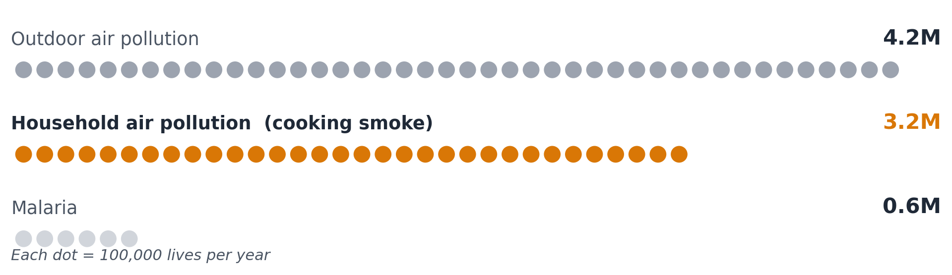
COMPLICATION • THE PRESENT-DAY DEATH TOLL
Cooking smoke kills ~3.2 million people every year — most in homes that have no clean fuel.
WHAT MY FIRST
DECK LEFT OUT
815,000
deaths in sub-Saharan
Africa, every year.
From a problem we already know how to solve: clean fuel.
Choolwe • The Case For Fossil Fuels
5 / 10
Notes:
(~40 sec) My last deck counted future deaths from climate change. It did not count the 3.2 million people who die EVERY YEAR right now from cooking on open fires because they have no clean fuel. In sub-Saharan Africa alone that's 815,000 deaths a year — most of them women and children. Energy poverty has a body count today.

Slide 6
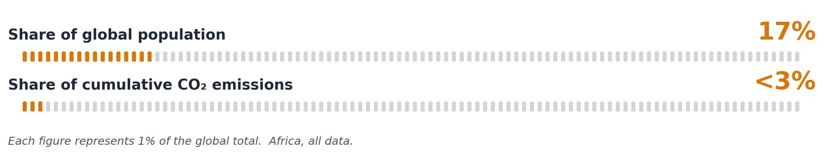
COMPLICATION • THE JUSTICE ASYMMETRY
Africa hosts 17% of the world's people, caused under 3% of cumulative emissions — and is being asked to skip the ladder every wealthy country climbed.
Every wealthy country got rich by burning coal, then oil, then gas.
Even the clean-energy supply chain itself — steel, cement, shipping — still runs on fossil fuels today.
Choolwe • The Case For Fossil Fuels
6 / 10
Notes:
(~40 sec) Look at this asymmetry. Every wealthy country on Earth got rich by burning coal, then oil, then gas. They are now asking the continent that contributed least to the problem to skip that ladder — using clean-energy technology whose OWN supply chain still runs on fossil fuels. That's not a climate plan. That's an injustice with a green sticker on it.

Slide 7
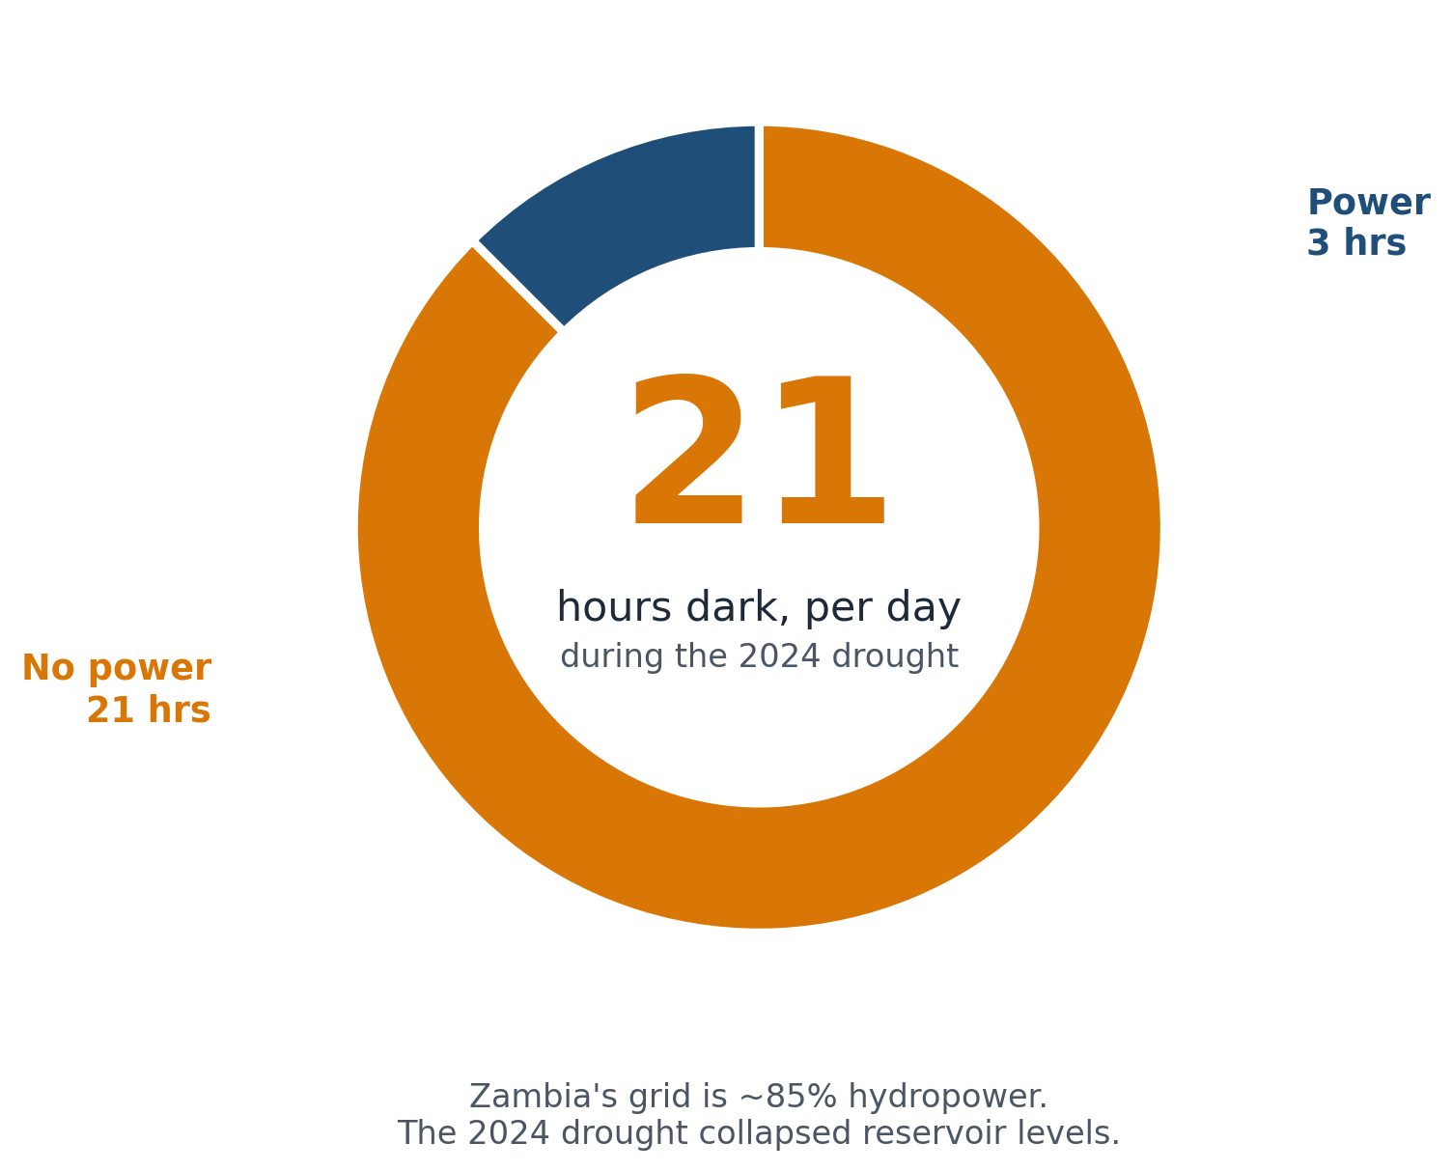
COMPLICATION • THE ZAMBIA LESSON
Zambia bet 85% of its grid on "clean" hydropower — and a climate-driven drought left us in the dark for 21 hours a day.
THE BET
85% of installed capacity is hydropower.
THE LESSON
Firm, dispatchable power matters. Pretending otherwise is paid for in dark hospitals.
The answer isn't "burn more coal." It's "don't bet the grid on one weather pattern."
Choolwe • The Case For Fossil Fuels
7 / 10
Notes:
(~40 sec) We lived this. We did the 'clean' thing — 85% of our installed capacity is hydropower. Then the climate broke our climate solution. ZESCO ran load shedding of up to 21 hours a day. The lesson is NOT 'burn more coal.' The lesson is: firm power matters, and pretending otherwise is paid for in dark hospitals and empty cold-chains.

Slide 8
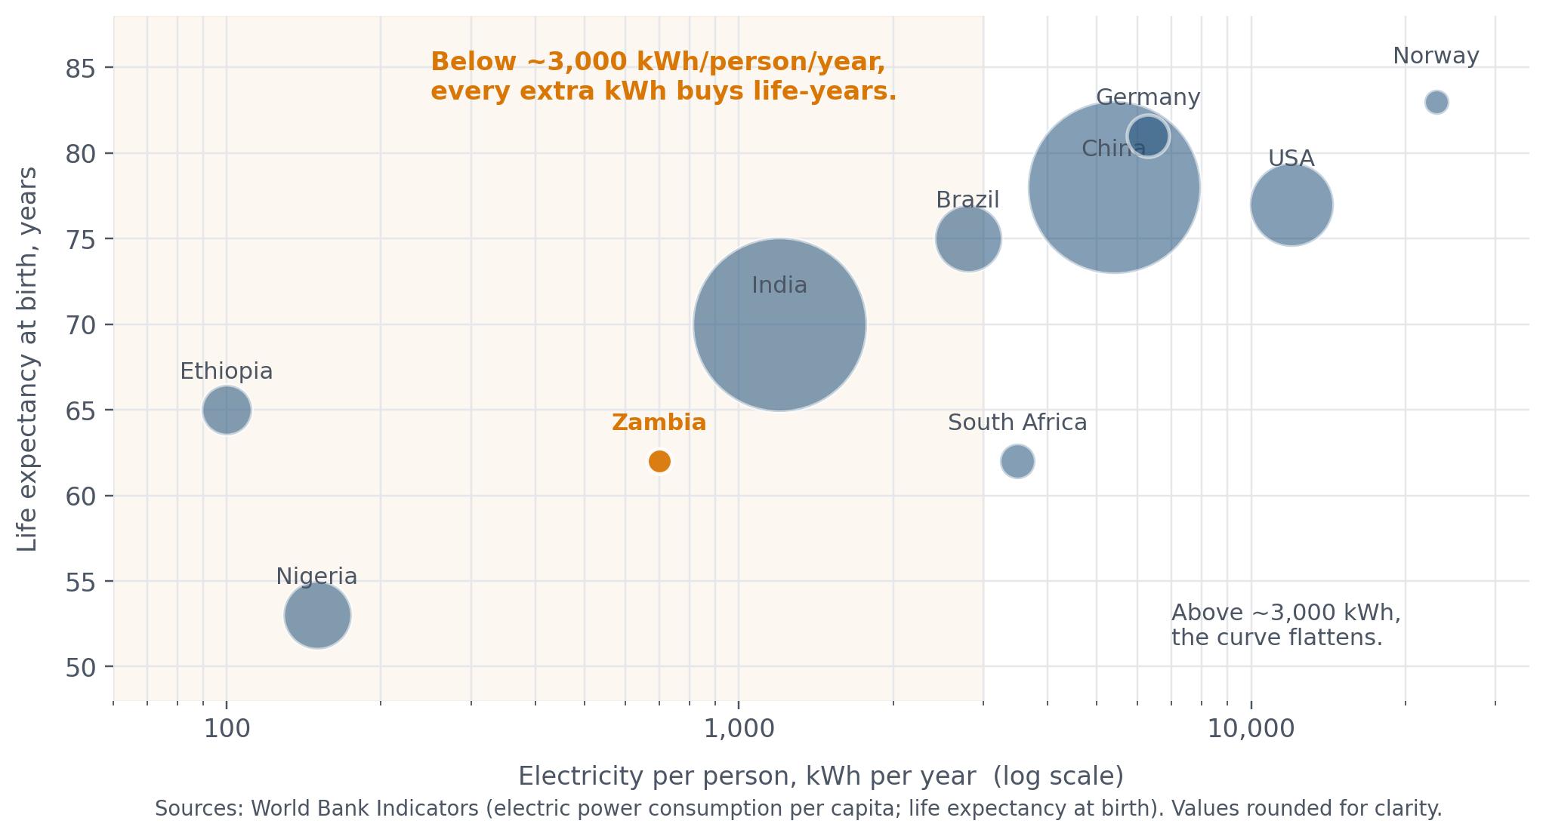
BRIDGE • WHAT ENERGY ACCESS BUYS
Below ~3,000 kWh per person per year, every extra kWh buys life-years. Zambia sits right on the steep part of the curve.
Choolwe • The Case For Fossil Fuels
8 / 10
Notes:
(~30 sec) This is the Hans Rosling curve. Below about three thousand kilowatt-hours per person per year, every additional kilowatt-hour translates directly into life-years — through clinics, refrigerated vaccines, lit classrooms, water pumps. Zambia is right on the steep part of that curve. Cutting energy access there costs life-years immediately. That's why the moral arithmetic doesn't end with climate.

Slide 9
RESOLUTION • THE MANAGED TRANSITION
Gas as a bridge, renewables stacked on top, firm power kept until storage can carry the load — in that order.
NOW — BRIDGE
BUILD-OUT
THEN — RETIRE
Natural gas
Renewables, hard
Phase fossil fuels down
Emits 50–60% less CO₂ than coal. Africa holds ~13% of proven gas reserves. Faster to deploy than nuclear, firm in a way solar alone is not.
Solar in Zambia is already the cheapest new capacity. Wind, hydro diversification, storage — scaled in parallel, not waited for.
When grids are firm and storage can carry the load, retire gas plants. Not before. Not as a slogan. As an engineering schedule.
Choolwe • The Case For Fossil Fuels
9 / 10
Notes:
(~50 sec) I'm not arguing fossil fuels forever. I'm arguing for a MANAGED transition. Natural gas as a bridge — emits half what coal does and Africa holds 13% of global reserves. Renewables scaled aggressively on top — solar in Zambia is already the cheapest new capacity. And firm power kept on until storage and grid infrastructure can stand alone. That's how we lift the bottom billion while decarbonising the top.

Slide 10
APPENDIX • SOURCES
Every statistic on every slide, with a citation.
Full notes preserved in the repo at research/notes.md.
Cooking-smoke deaths (~3.2M/yr global)
Sub-Saharan Africa household air pollution deaths (~815k/yr)
WHO Household Air Pollution Fact Sheet
IEA, Universal Access to Clean Cooking in Africa (2024)
Outdoor air pollution deaths (~4.2M/yr)
Africa electricity access (~600M without; ~730M globally)
WHO Ambient Air Pollution
IEA, Financing Electricity Access in Africa (2025)
Africa cumulative CO₂ emissions (<3%; sub-Saharan ~0.55%)
Africa population share (~17% global)
Energy for Growth Hub (citing Our World in Data)
UN World Population Prospects
Zambia capacity mix (85% hydropower; ~3,986 MW)
Zambia 2024 load shedding (up to 21 hrs/day)
Global Legal Insights, Energy Laws and Regulations 2025: Zambia
Pulitzer Center; Afrobarometer AD1178 (2025)
Natural gas vs coal CO₂ (50–60% less); Africa gas reserves (~13%)
Steel & cement embodied emissions in renewables
Atlantic Council, Natural gas in Africa's energy transition
MIT Climate Portal
Life expectancy vs electricity per capita (illustrative)
World Bank Indicators (kWh/capita; life expectancy at birth)
Choolwe • The Case For Fossil Fuels
10 / 10
Notes:
Reference slide for Q&A. If anyone questions a stat, the source is here. Full URLs are in the repo's research/notes.md.

