Slide 1

Customer behaviours on CREDIT CARD DATA
Clelia Chelmi
Lilly Kolliniati
Source data: 💳 Credit Card Data- Intermediate 🗃️ Dataset (kaggle.com)

Slide 2


Agenda
Introduction
Data overview
Model overview
Summary and Next Steps

Slide 3


Introduction
Who are we?
What do we want to achieve?
Consultant agency:
Clelly & Co
Hired by the Credit Card company
.
Group the customers based on their spending behavioural patterns
Create recommendations to increase the cards’ usage by customers
.
Why?
Credit Card company want to improve their marketing strategy and offer personalised services to its customers and improve customer satisfaction

Slide 4



Data overview

Slide 5
DATA overview
DATA Preprocessing
Data collected from appr. 9000 customers and with 18 behavioural variables in the last 12 months
Behavioural variables: balance, spending, purchases, etc
From further analysis via data visualisation we noticed:
Missing values
Skewed distribution
Outliers

Slide 6
DATA overview
DATA CLEANING & TRANSFORMATION
To address the issues we identified earlier:
To fill in the missing values: Median Simple Imputer (due to not normal distribution)
We normalised the data
We removed any outliers with the Isolation Forest algorithm
To prepare ahead of the model creation, we also decided to perform a dimensionality reduction technique

Slide 7
DATA overview
MODEL PREPARATION
PC | Behavioural variable >0.57
PC1 | Credit Limit
PC2 | Minimum Payments
PC3 | Cash Advance
PC4 | Payments
PC5 | Balance
PC6 | Purchases
PC7 | One-Off Purchases
Dimensionality reduction technique using PCA:
7 PCs explaining 99% of the variance in the dataset
Identified the most significant underlying behavioural variable for each PC (threshold>0.57)

Slide 8
Model overview

Slide 9
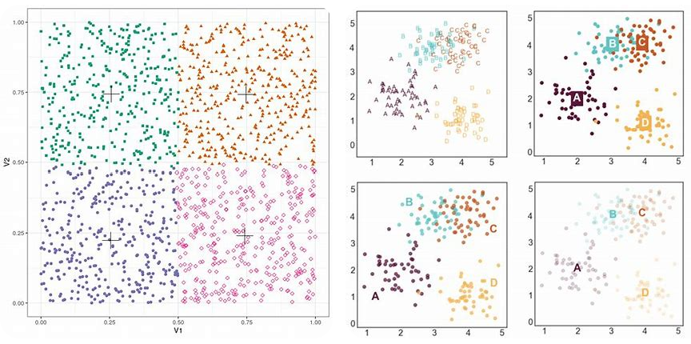
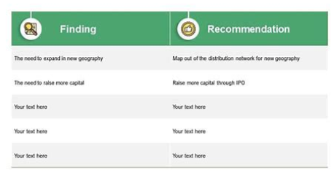
MODEL overview
MODEL DECISION: CLUSTERING
Customer credit card data
Group customers based on behavioural data
Recommendations for customer groups

Slide 10
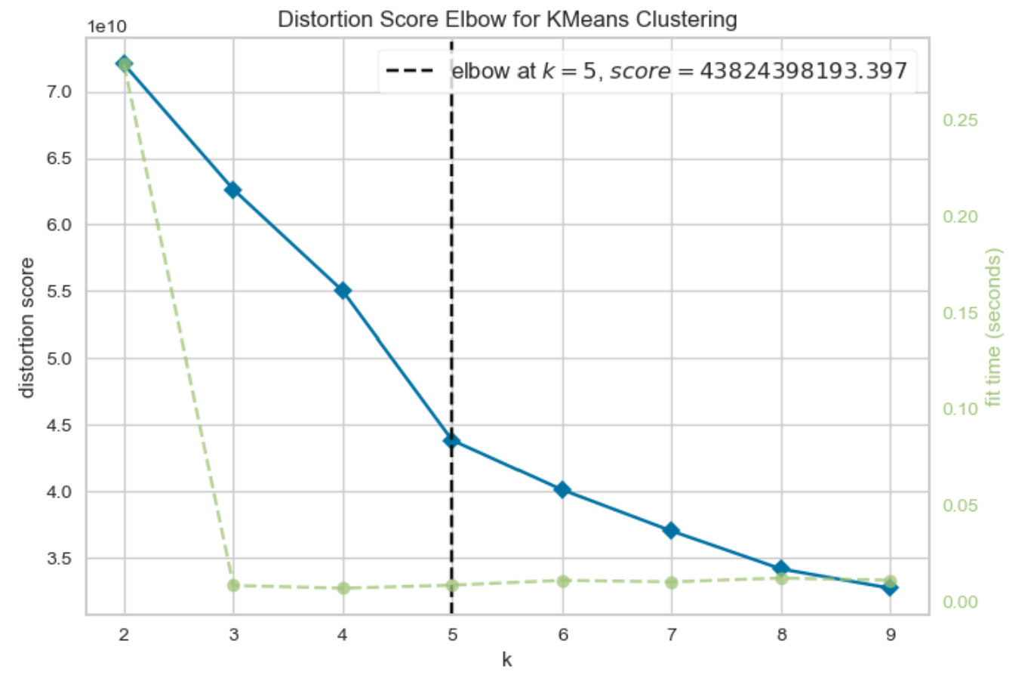
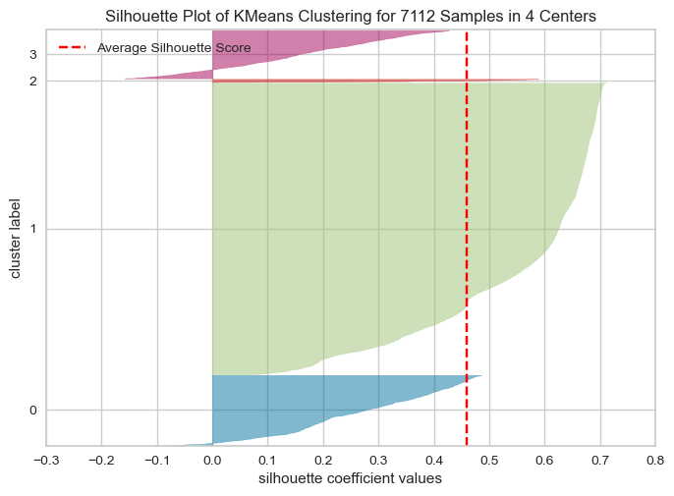
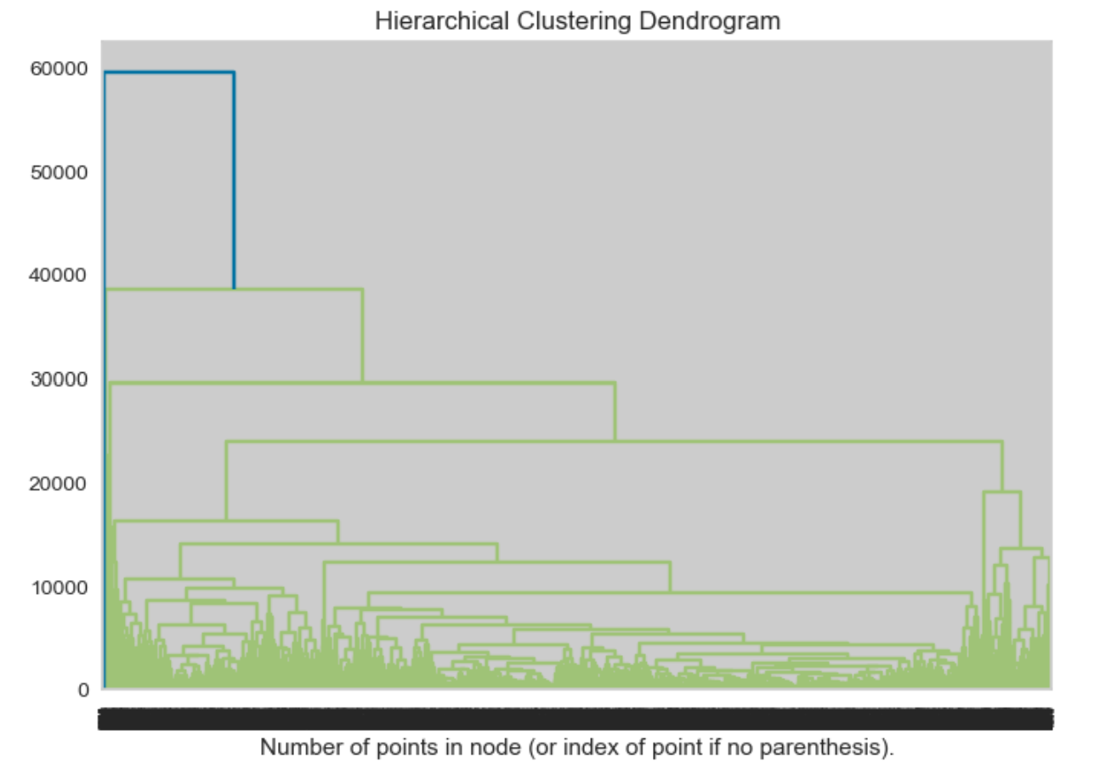
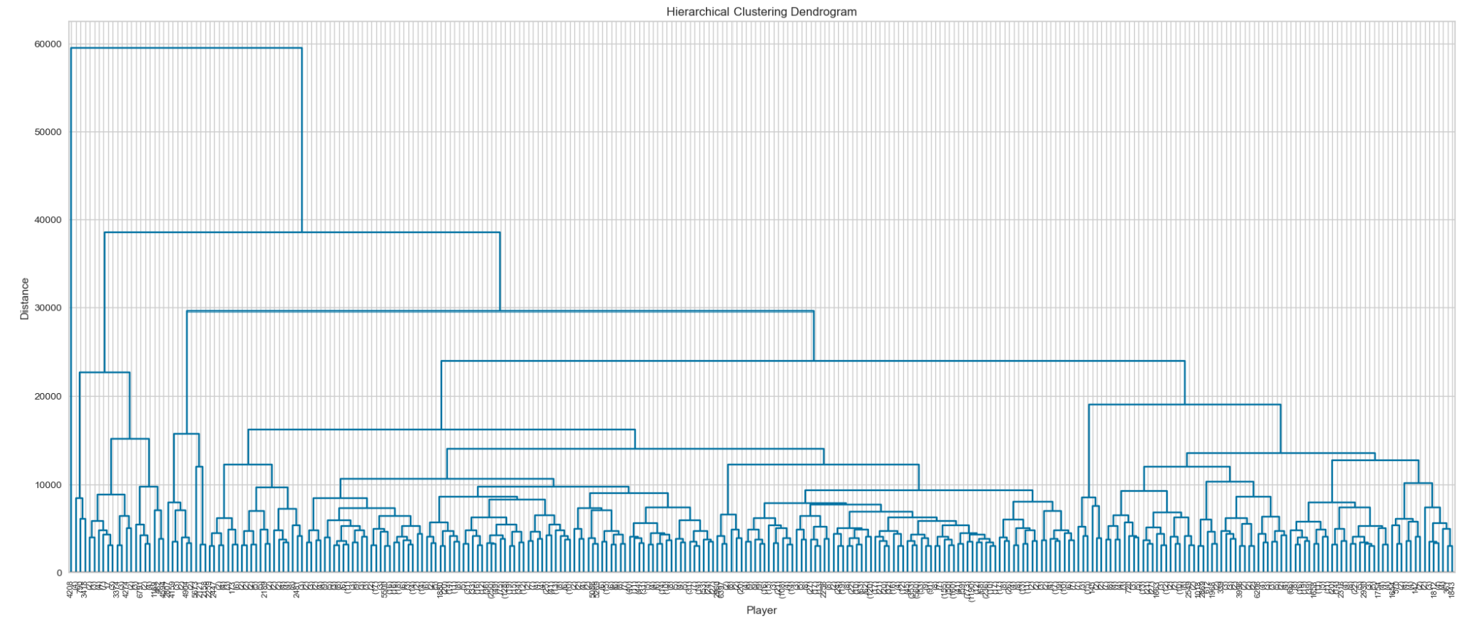
Overview of CLUSTERS
from the charts we can see that the optimal number of cluster is 4

Slide 11
Conclusion & Summary

Slide 12


Customer segmentation
Cluster | PC1: Credit Limit | PC2: Min.Pay | PC3: Cash adv. | PC4: Payments | PC5: Balance | PC6: Purchaces | PC7: 1-off Purchase | Conclusion
1 |  |  |  |  |  |  |  | Conservative users
2 |  |  |  |  |  |  |  | High activity users
3 |  |  |  |  |  |  |  | Cash dependent users
4 |  |  |  |  |  |  |  | Business / Strategic users

Slide 13
Recommendations / Next steps
 | Proposal 1 | Proposal 2
Conservative users | Reward program | Education and Awareness Campaigns
High activity users | Premium Membership | Customized Offers
Cash dependent users | Alternative Financing Options | Cashback Rewards
Business / Strategic users | Rewards for Diversified Spending | Investment Opportunities

Slide 14

Thank you

