Slide 1
Project1:Web Scraping
- Chaoran Chen

Slide 2
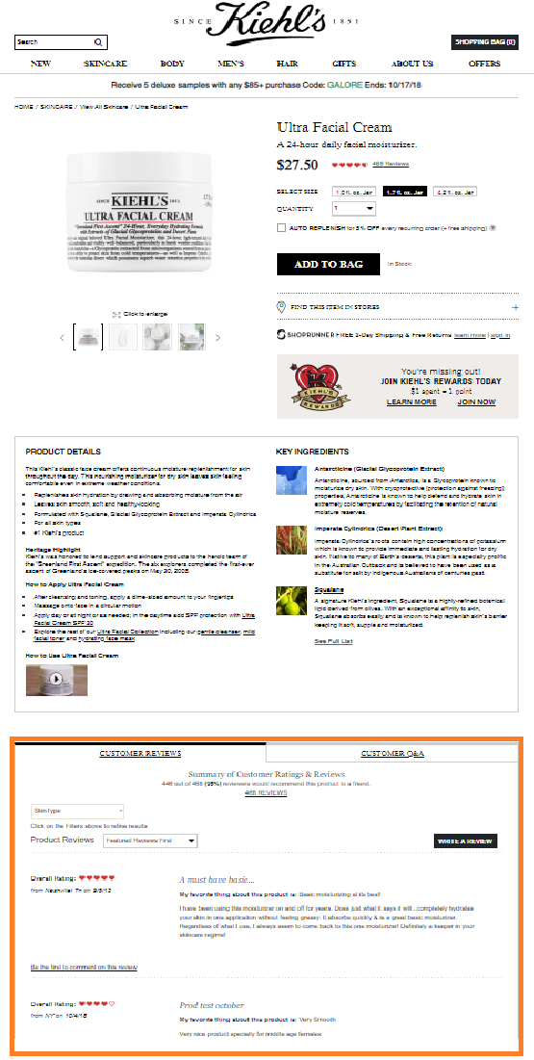
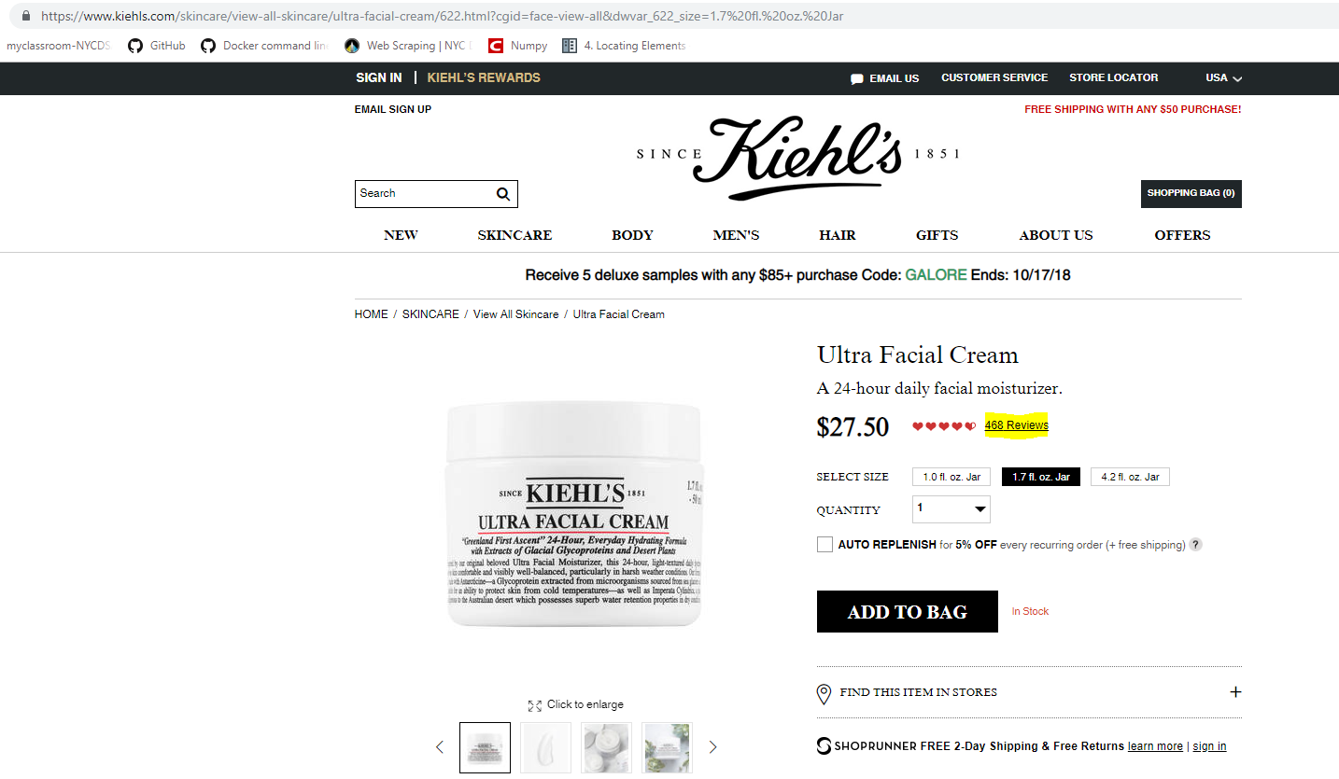
About the website
Notes:
Website link:
https://www.kiehls.com/skincare/view-all-skincare/ultra-facial-cream/622.html?cgid=face-view-all&dwvar_622_size=1.7%20fl.%20oz.%20Jar

Slide 3
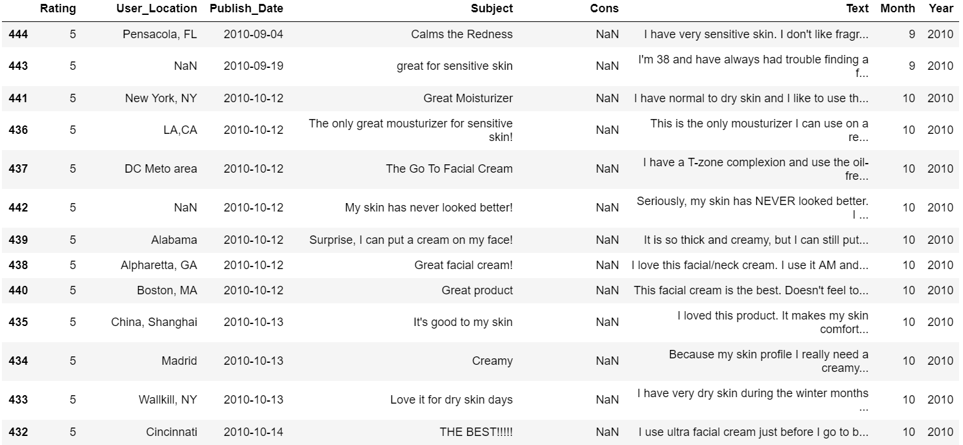
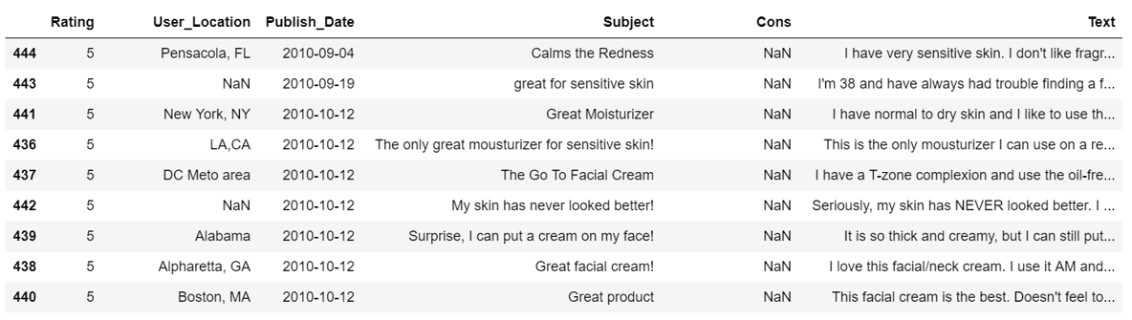
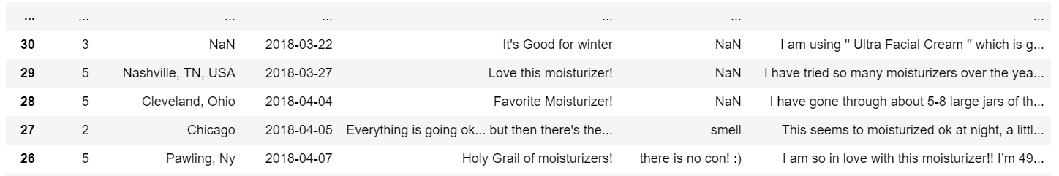
Web Scraping with selenium

Slide 4
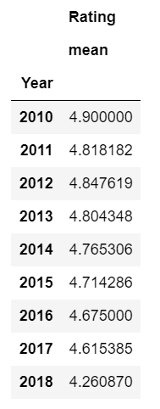
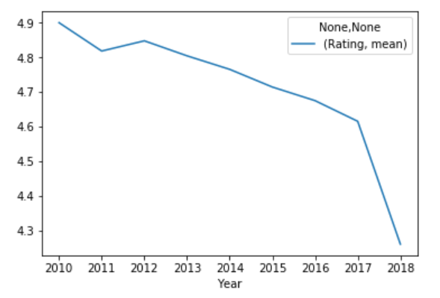
Rating Trend

Slide 5
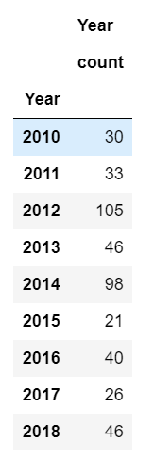
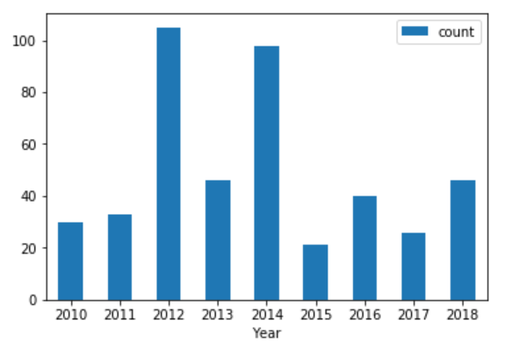
Rating count

Slide 6
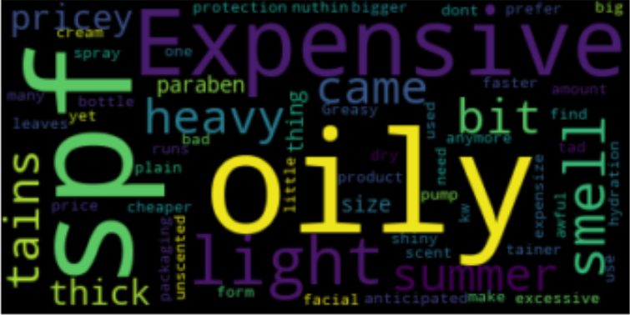
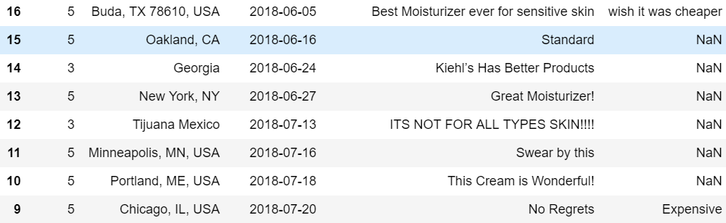
Frequent words from “cons”

Slide 7
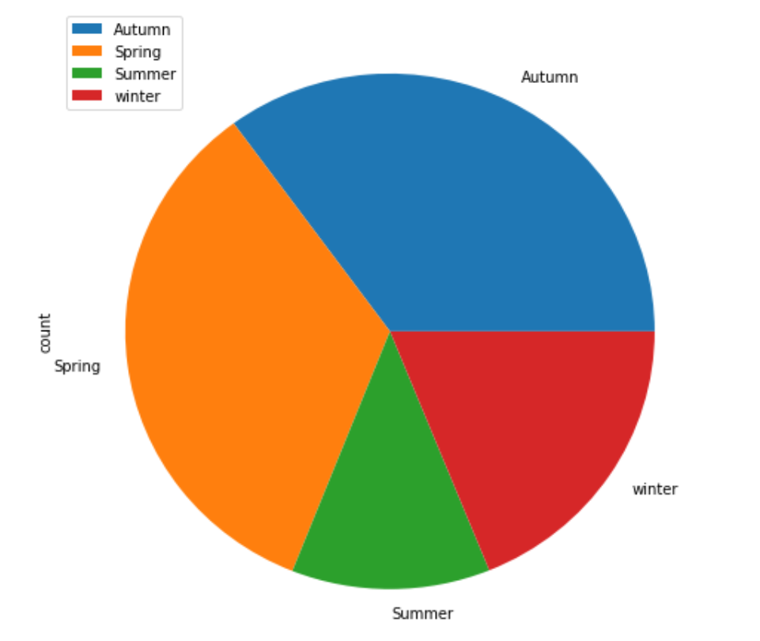
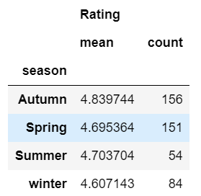
Rating impacted by seasons

Slide 8
To be continued
- Multiple products comparison
- Rating from different locations customers
…

Slide 9
Thank you!

