Slide 1
Coming Up Next…
Getting started with the Fake News Challenge data

Slide 2
Coming Up Next…
Getting started with the Fake News Challenge data
Introduction to the Fake News Challenge

Slide 3
Coming Up Next…
Getting started with the Fake News Challenge data
Introduction to the Fake News Challenge
Rule-based models (our first algorithm!)

Slide 4
Coming Up Next…
Getting started with the Fake News Challenge data
Introduction to the Fake News Challenge
Rule-based models (our first algorithm!)
Discussion of evaluation metrics

Slide 5
Coming Up Next…
Getting started with the Fake News Challenge data
Introduction to the Fake News Challenge
Rule-based models (our first algorithm!)
Discussion of evaluation metrics
Building a more sophisticated classifier

Slide 6
Coming Up Next…
Getting started with the Fake News Challenge data
Introduction to the Fake News Challenge
Rule-based models (our first algorithm!)
Discussion of evaluation metrics
Building a more sophisticated classifier

Slide 7
Loading the Data
AI4ALL Princeton: NLP Group

Slide 8
Review of Python and Pandas
Notes:
Today will continue to work on becoming familiar with Python and Pandas, and FNC.
What did you find easy or difficult?

Slide 9
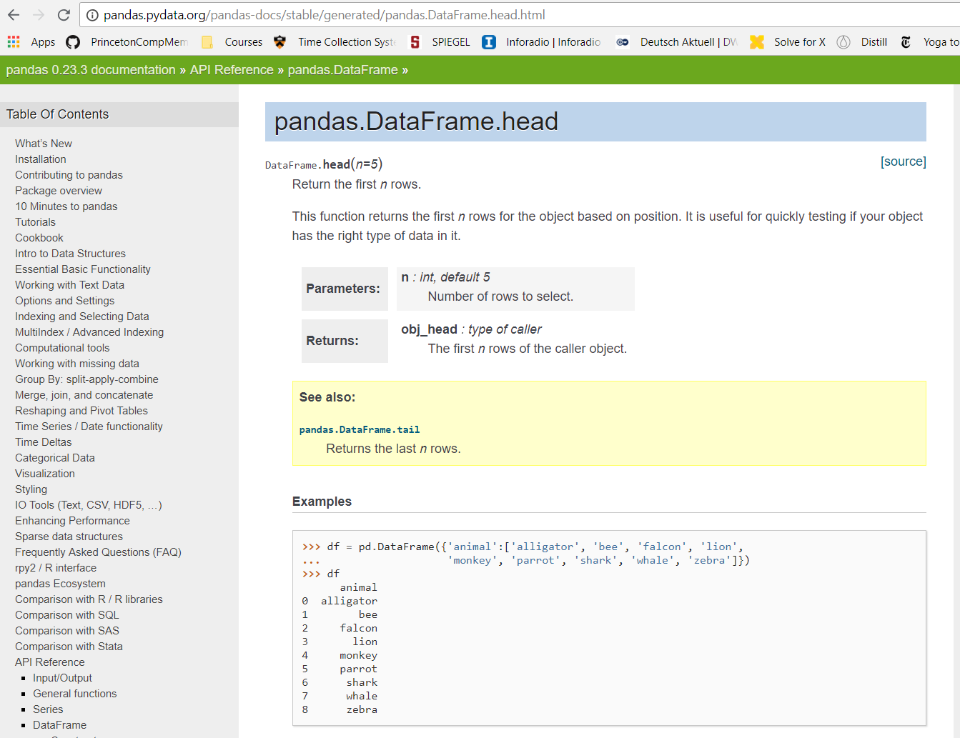
Notes:
- Using online documentation

Slide 10
Some helpful commands:
pd.read_csv()
pd.unique(series)
df.columns
df.shape
df.head()
df[column_name]
len(array)
Notes:
- Discuss what each one does with a partner.

Slide 11
Some helpful commands:
pd.read_csv()
pd.unique(series)
df.columns
df.shape
df.head()
df[column_name]
len(array)
With a partner,
look up these functions
and discuss what they do
Notes:
- Discuss what each one does with a partner.

Slide 12
Now let’s get to the FNC data!

Slide 13
Go to https://github.com/cchen23/AI4ALL_NLP_student
Download 2018_07_24.zip
Unzip the file
Open Terminal
source ~/miniconda3/bin/activate
jupyter notebook
Open Day2_NLP_LoadingTheData.ipynb

Slide 14
Feedback Form
http://bit.ly/2uFuaPl

