Slide 1
Word Vectors
Princeton AI4ALL: NLP Group

Slide 2
What’s Next

Slide 3
Overview of the Week
Monday (today)
1-3: Introduction to Word Vectors
Tuesday
1-3: Word Vectors + FNC
Wednesday
1-3: Lexical Overlaps
Thursday
9:30-12: Putting together the FNC + Discussion
1-3: Minipresentations (10 minutes per person) + Free time to work on presentation.
Friday
9:30-10:30: Free time to finish/practice presentation.
10:30-12, 1-3: Presentations with other groups.

Slide 4
Info about NLP & Ethics/Policy minipresentations
Find a topic related to NLP and ethics/policy (can be a paper, news article, general topic of debate).
Prepare either a presentation with slides, or a few questions for debate/discussion.
Lead a mini-session about this topic!
We can do sign-ups to avoid overlaps.

Slide 5
Info about presentations
Friday presentation sessions: 20 min to educate other campers about their project + 10 min for questions
Audience: other campers
Visuals: Poster/slides/handouts/something creative
Friday banquet: 5 min to give a spotlight about project.
Audience: visitors
No visuals

Slide 6
Overview of the FNC Classifier
Lexical overlap
Semantic Similarities
Classifier
Prediction

Slide 7
How should we represent words?

Slide 8
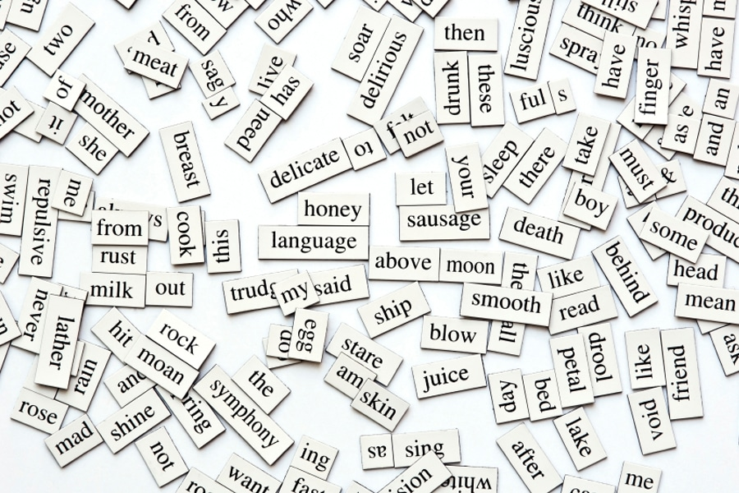
https://www.fluentu.com/blog/educator-english/wp-content/uploads/sites/13/2014/11/beginner-esl-vocabulary-how-to-teach-100-words-in-one-lesson.jpg
Notes:
- A lot of words in the world, we have associations between them based on their meaning.

Slide 9
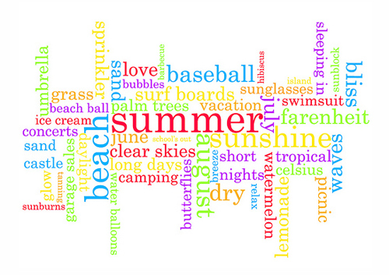
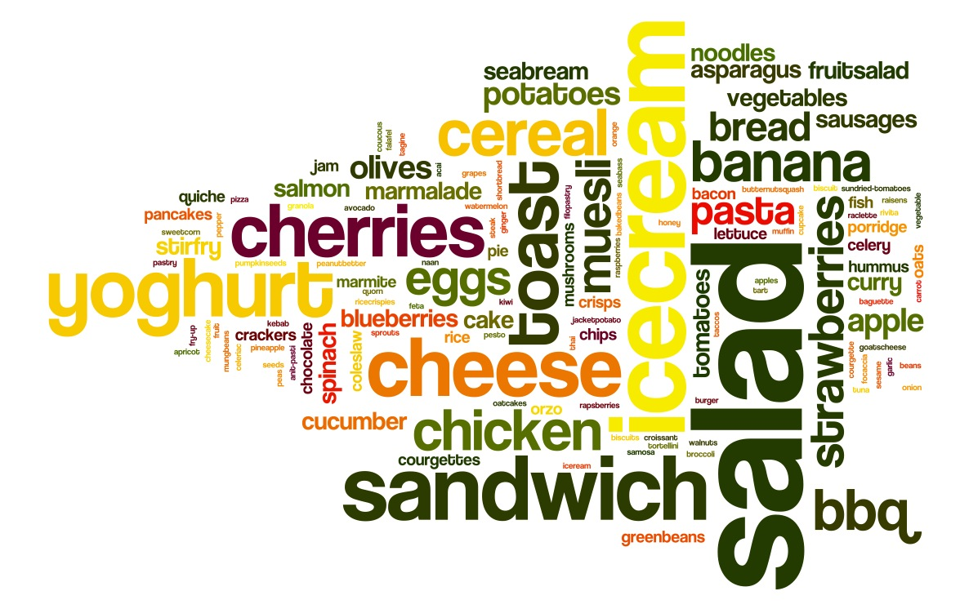

https://foodscapesbristol.files.wordpress.com/2013/07/day-5.jpg
https://antarasdiary.com/30-brilliant-typography-inspirations-featuring-the-word-summer/
https://www.canstockphoto.com/music-word-cloud-34509746.html
Notes:
- Certain words tend to fall into the same groups.

Slide 10
To communicate this information to computers… quantitatively represent words, where more similar words have similar representations
Notes:
How to provide computers with info about similarities btwn words?
Need quantitative representation. Want more similar words to be more similar.

Slide 11
To communicate this information to computers… quantitatively represent words, where more similar words have similar representations
Notes:
How to provide computers with info about similarities btwn words?
Need quantitative representation. Want more similar words to be more similar.

Slide 12
To communicate this information to computers… quantitatively represent words, where more similar words have similar representations
Notes:
How to provide computers with info about similarities btwn words?
Need quantitative representation. Want more similar words to be more similar.

Slide 13
What are word vectors?

Slide 14
What are vectors?
y
x
Notes:
- Coordinate axes

Slide 15
What are vectors?
y
x
Notes:
- Size and direction.

Slide 16
What are vectors?
(2.5,1)
(3,1)
y
x
(2, -3)
Notes:
- Some vectors are more similar than others.

Slide 17
How do we measure similarity between vectors?
Notes:
- Angles between vectors

Slide 18




How do we measure similarity between vectors?
$$90°$$
$$180°$$
$$0°$$
$$270°$$

Slide 19


How do we measure similarity between vectors?
$$90°$$
1
$$θ$$
$$180°$$
$$cos(θ)$$
$$0°$$
$$270°$$

Slide 20





How do we measure similarity between vectors?
$$\cos\left(90°\right)=0$$
$$\cos\left(45°\right)≈0.7$$
$$\cos\left(180°\right)=−1$$
$$\cos\left(0°\right)=1$$
$$\cos\left(270°\right)=0$$

Slide 21
How do we measure similarity between vectors?
Use the cosine similarity between vectors

Slide 22
What if we want more information?
Vectors in 6 dimensions
Vectors in 2 dimensions
3
1
-2
4
1
0.7
2.5
1
0.5
-2
9
1
3
1
2.5
1
2
-3
Notes:
- Can be in many dimensions.

Slide 23
What if we want more information?
Vectors in 6 dimensions
Vectors in 2 dimensions
3
1
-2
4
1
0.7
2.5
1
0.5
-2
9
1
3
1
2.5
1
2
-3
Notes:
- Can be in many dimensions.

Slide 24
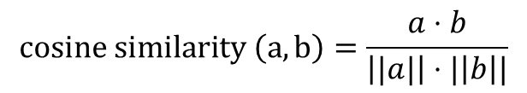
What if we want more information?
Vectors in 6 dimensions
3
1
-2
4
1
0.7
2.5
1
0.5
-2
9
1
$$cosine similarity \left(a,b\right)=\frac{a⋅b}{\left||a|\right|⋅|\left|b\right||}$$
Notes:
- Can be in many dimensions.

Slide 25
How do we create word vectors?

Slide 26
How do we know if words are similar?

Slide 27
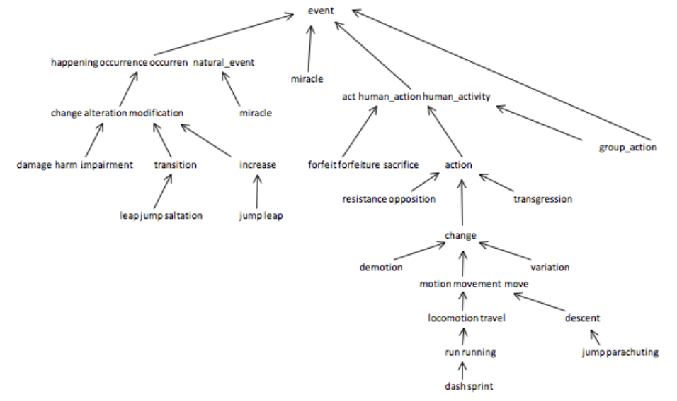
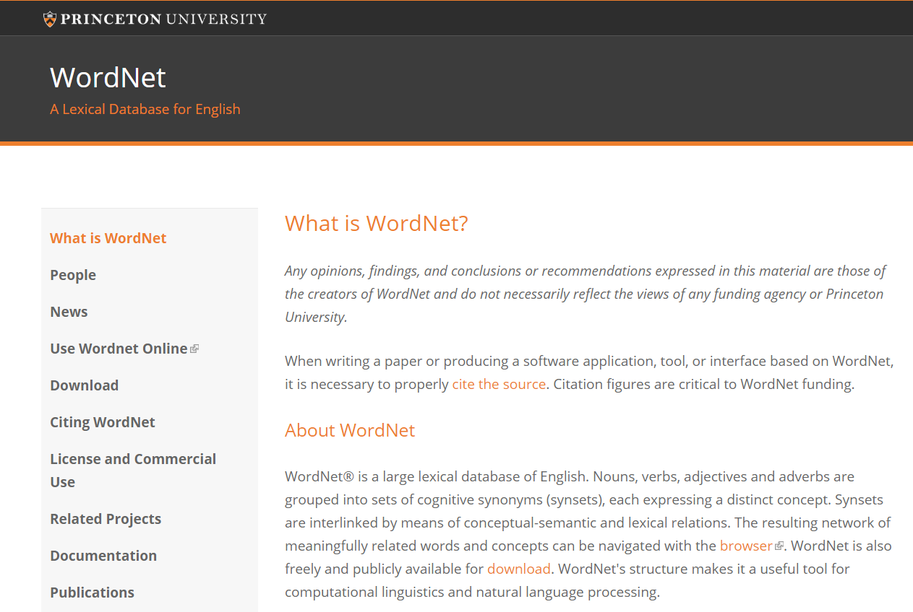
How do we know if words are similar?
https://wordnet.princeton.edu/
https://www.cs.princeton.edu/courses/archive/fall12/cos226/assignments/wordnet.html
Notes:
- Lexical database

Slide 28
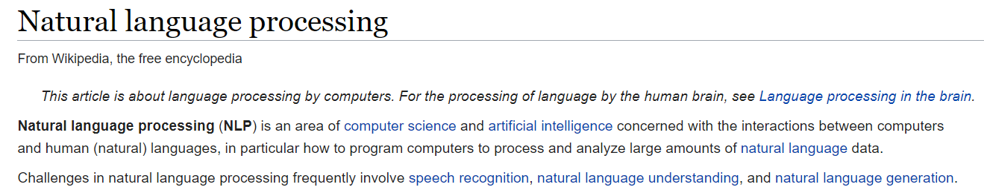
How do we know if words are similar?
Notes:
- Idea: Words that occur together tend to be similar.

Slide 29
How do we know if words are similar?
Notes:
- Idea: Words that occur together tend to be similar.

Slide 30
Distributional Hypothesis
“You shall know a word by the company it keeps”
John Rupert Firth (1957)

Slide 31
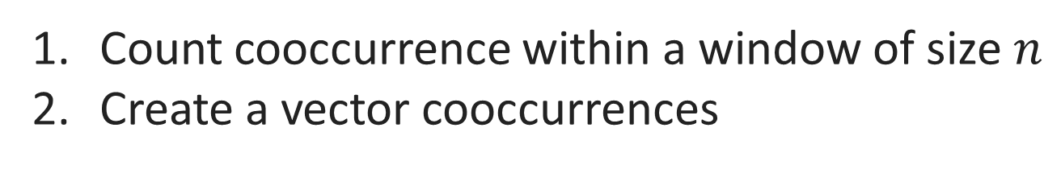
How do we find the distribution of nearby words?
Count cooccurrence within a window of size $n$
Create a vector cooccurrences

Slide 32
How do we find the distribution of nearby words?
Count cooccurrence within a window of size $n$
Create a vector cooccurrences
Any problems with this?
Notes:
- Some words not as informative

Slide 33
Some words are more informative than others…
Notes:
- Some words not as informative

Slide 34
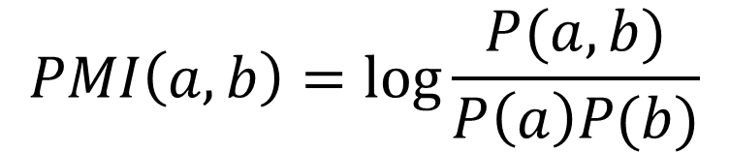
Pointwise Mutual Information (PMI)
$$PMI\left(a,b\right)=\log{\frac{P(a,b)}{P\left(a\right)P(b)}}$$
Notes:
- Some words not as informative

Slide 35
How can we represent sentences given word embeddings?
Notes:
Average of words
Other methods

Slide 36
How can we use word vectors?

Slide 37
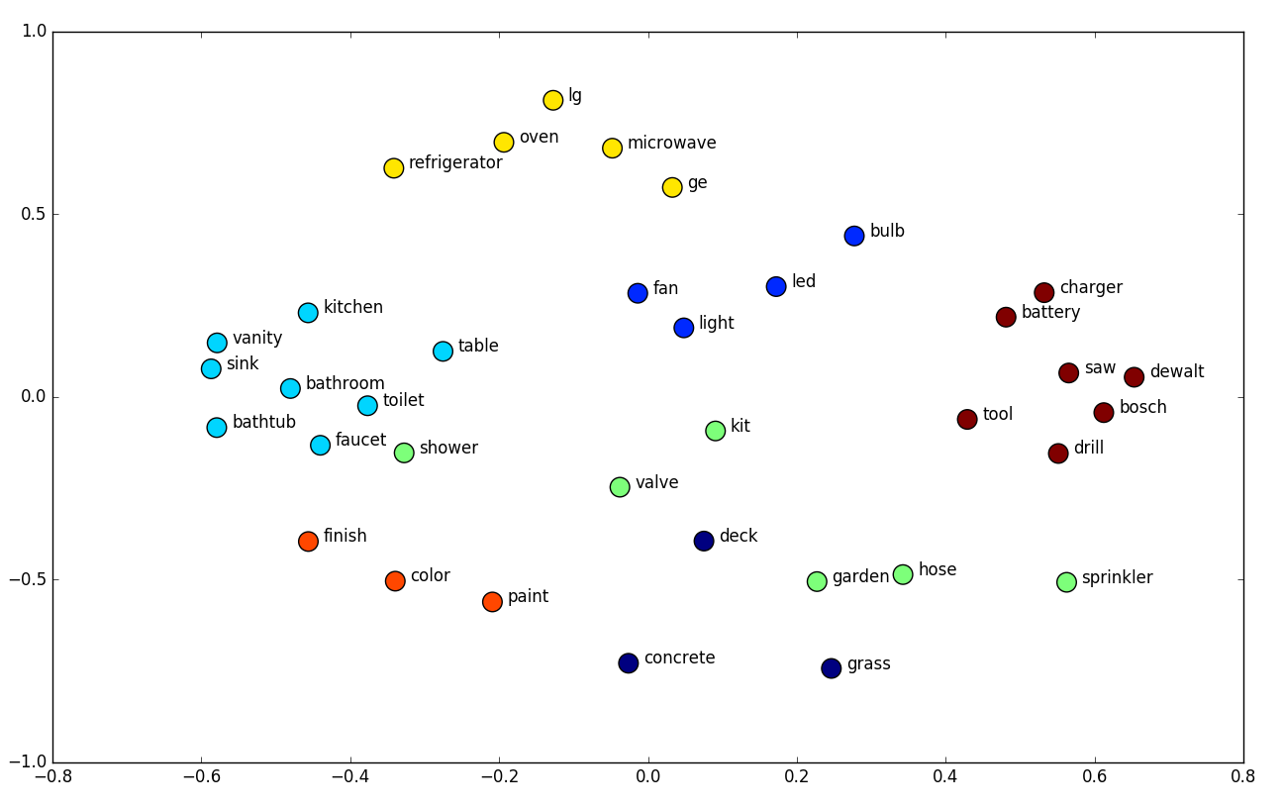
https://towardsdatascience.com/deep-learning-structured-data-8d6a278f3088
Notes:
- clusters

Slide 38
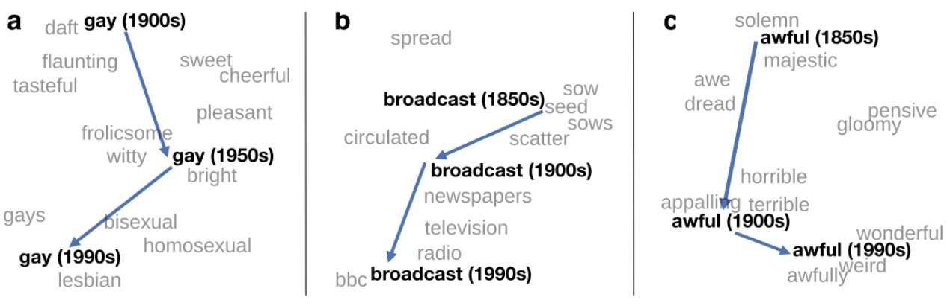
http://ruder.io/word-embeddings-2017/
Notes:
- Clusters over time

Slide 39
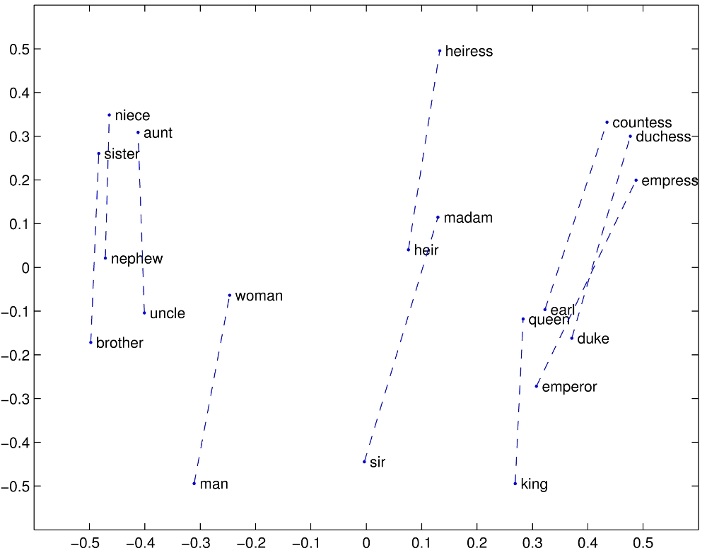
https://nlp.stanford.edu/projects/glove/images/man_woman.jpg
Notes:
- analogies

Slide 40
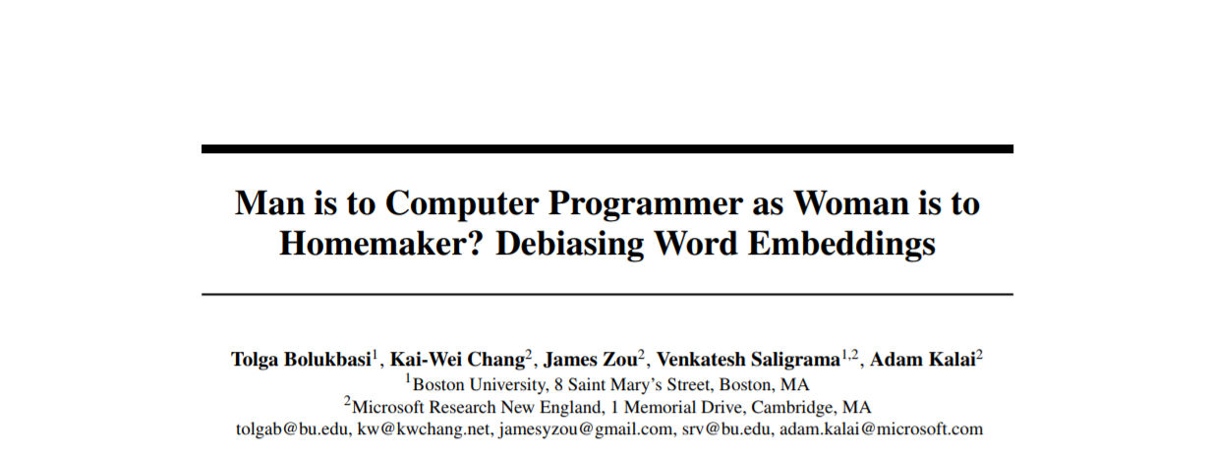

https://papers.nips.cc/paper/6228-man-is-to-computer-programmer-as-woman-is-to-homemaker-debiasing-word-embeddings.pdf

Slide 41
https://papers.nips.cc/paper/6228-man-is-to-computer-programmer-as-woman-is-to-homemaker-debiasing-word-embeddings.pdf

Slide 42
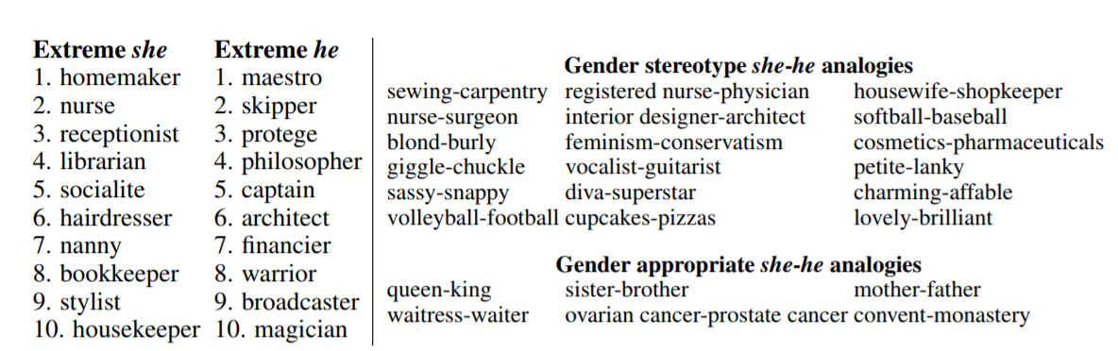
https://papers.nips.cc/paper/6228-man-is-to-computer-programmer-as-woman-is-to-homemaker-debiasing-word-embeddings.pdf

Slide 43
Github.com/cchen23/AI4ALL_NLP_Student
Day10_WordVectors.zip
source ~/miniconda3/bin/activate
jupyter notebook

Slide 44
Poll for tomorrow’s review: http://bit.ly/2ANGceX

Slide 45
Mini-presentation sign-ups
http://bit.ly/2M6dJ8K

