Slide 1
NLP for Social Good
Splash 2018

Slide 2
What is it?
…and why do we care?

Slide 3
What is “NLP”?
“Natural-language processing (NLP) is an area of computer science and artificial intelligence concerned with the interactions between computers and human (natural) languages, in particular how to program computers to fruitfully process large amounts of natural language data.”
- Wikipedia
https://en.wikipedia.org/wiki/Natural-language_processing

Slide 4
What is “NLP”?
“Natural-language processing (NLP) is an area of computer science and artificial intelligence concerned with the interactions between computers and human (natural) languages, in particular how to program computers to fruitfully process large amounts of natural language data.”
- Wikipedia
https://en.wikipedia.org/wiki/Natural-language_processing

Slide 5
What is “NLP”?
“Natural-language processing (NLP) is an area of computer science and artificial intelligence concerned with the interactions between computers and human (natural) languages, in particular how to program computers to fruitfully process large amounts of natural language data.”
- Wikipedia
https://en.wikipedia.org/wiki/Natural-language_processing

Slide 6
What is “NLP”?
“Natural-language processing (NLP) is an area of computer science and artificial intelligence concerned with the interactions between computers and human (natural) languages, in particular how to program computers to fruitfully process large amounts of natural language data.”
- Wikipedia
https://en.wikipedia.org/wiki/Natural-language_processing

Slide 7
What is “NLP”?
“Natural-language processing (NLP) is an area of computer science and artificial intelligence concerned with the interactions between computers and human (natural) languages, in particular how to program computers to fruitfully process large amounts of natural language data.”
- Wikipedia
https://en.wikipedia.org/wiki/Natural-language_processing

Slide 8
What is “NLP”?
“Natural-language processing (NLP) is an area of computer science and artificial intelligence concerned with the interactions between computers and human (natural) languages, in particular how to program computers to fruitfully process large amounts of natural language data.
Challenges in natural-language processing frequently involve speech recognition, natural-language understanding, and natural-language generation.”
- Wikipedia
https://en.wikipedia.org/wiki/Natural-language_processing

Slide 9
Why do we care?

Slide 10
“Analysts at Gartner (gated) estimate that upward of 80% of enterprise data today is unstructured.”
https://www.forbes.com/sites/forbestechcouncil/2017/06/05/the-big-unstructured-data-problem/#13919ec4493a

Slide 11
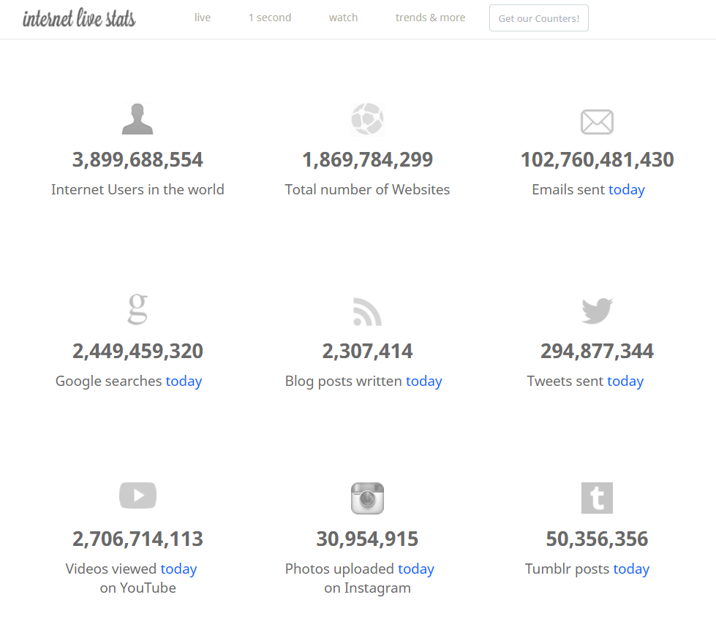
http://www.internetlivestats.com/

Slide 12
What can we work on?

Slide 13
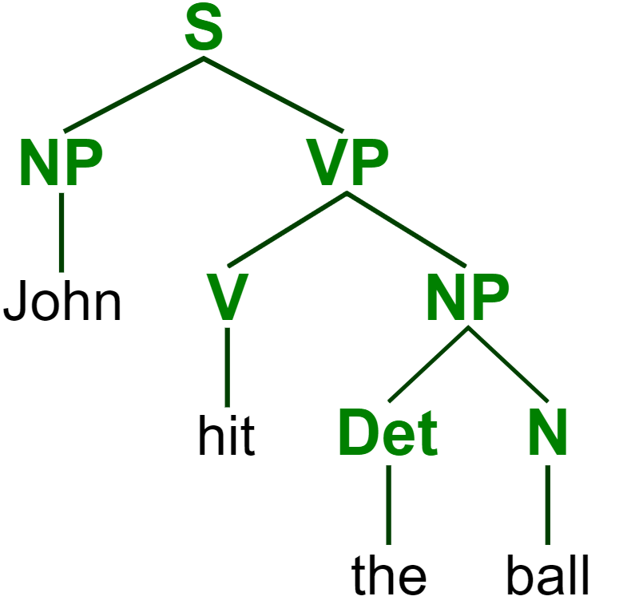
https://commons.wikimedia.org/wiki/File:ParseTree.svg
Notes:
Parse tree: sentence; noun phrase, verb phrase; verb, determiner, noun

Slide 14
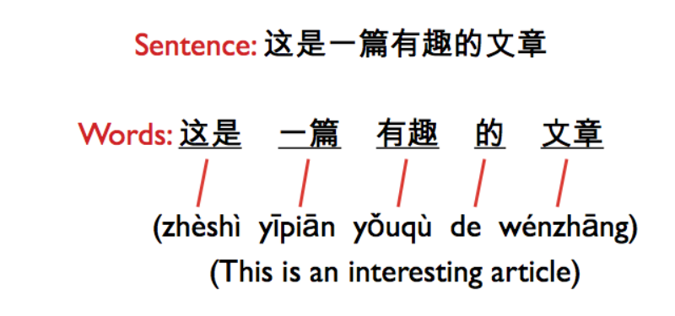
http://iconictranslation.com/2014/10/language-challenge-7-chinese/

Slide 15
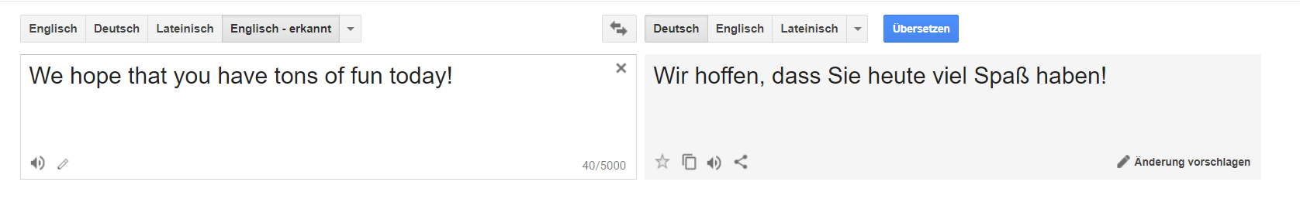
translate.google.com

Slide 16
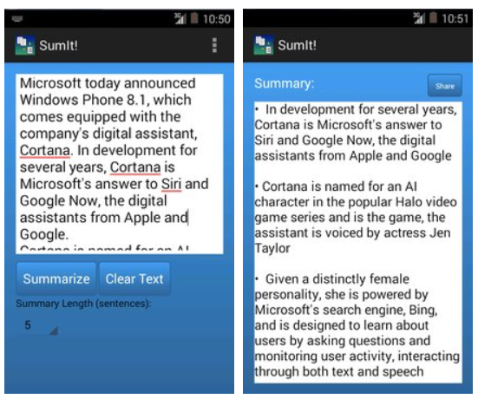
https://apkpure.com/sumit-text-summarization/com.karimo.sumit_final

Slide 17
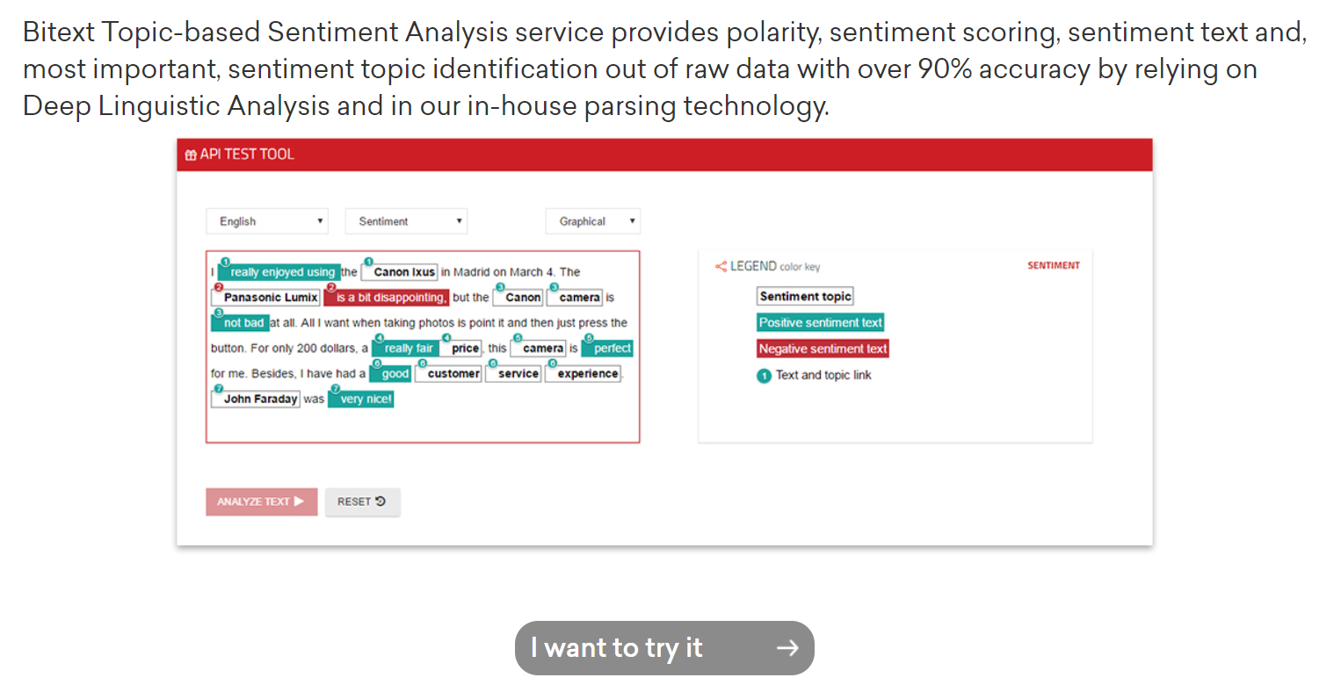
https://www.bitext.com/sentiment-analysis/

Slide 18
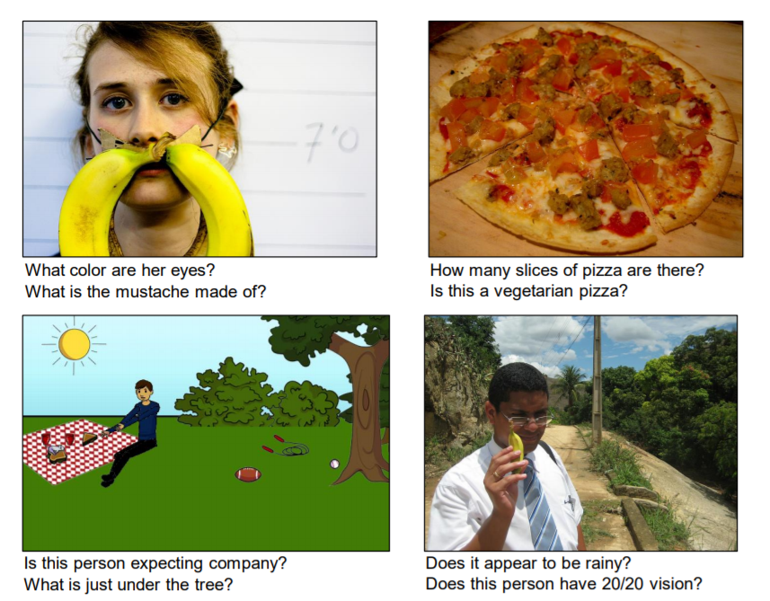
A. Agrawal et al., “VQA: Visual Question Answering,” arXiv:1505.00468 [cs], May 2015.

Slide 19

https://matlab1.com/support-vector-machine-speech-recognition/

Slide 20
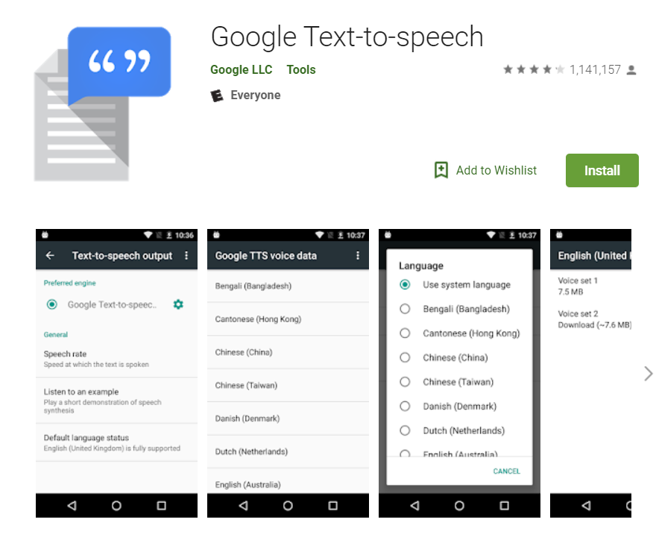
https://play.google.com/store/apps/details?id=com.google.android.tts&hl=en_US

Slide 21
What makes it difficult?

Slide 22

https://www.ecenglish.com/en/social/blog/ec-central/2015/11/23/vocab-review-homophones

Slide 23
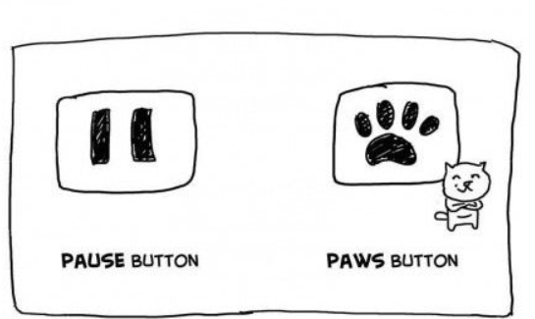
https://i.pinimg.com/originals/0a/92/15/0a921501fa2c6ad60f2e7cde0c8e90a4.jpg

Slide 24
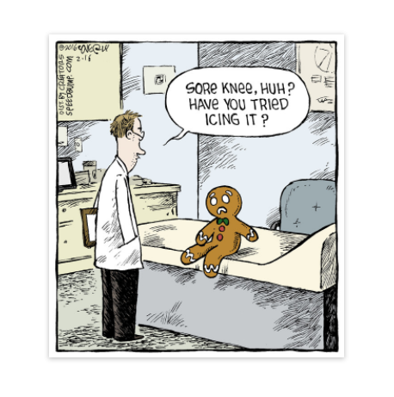
https://www.creators.com/read/speed-bump/02/16/165650

Slide 25
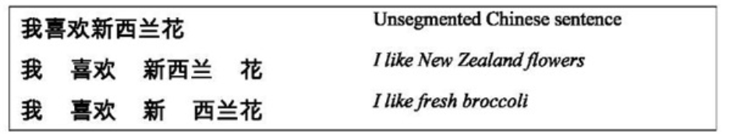
http://what-when-how.com/how-to-build-a-digital-library/word-segmentation-and-sorting-digital-library/
Notes:
Segmentation

Slide 26

http://onthesannyside.blogspot.com/2015/08/fun-with-dangling-modifiers.html

Slide 27

http://explosm.net/comics/1206

Slide 28

https://imgur.com/r/thesimpsons/1ZKxV5O
Notes:
Ambiguous sentences: https://www.teatime-mag.com/magazines/wp-content/themes/tt/print/teatime61/print.pdf

Slide 29
How does it work?
…and how can we make it work?

Slide 30
Where do we use it?
…and how do we use it?

Slide 31
What else could we do?
…and what should we do?

Slide 32
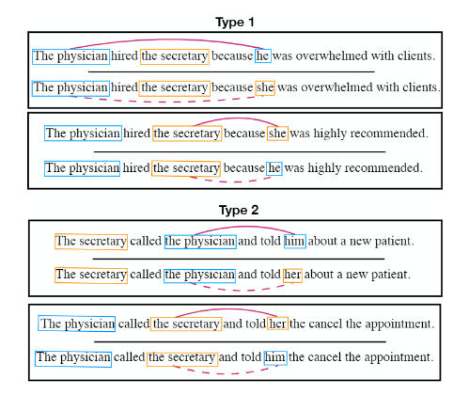
https://github.com/uclanlp/corefBias/blob/master/NAACL2018_CorefBias.pdf

Slide 33
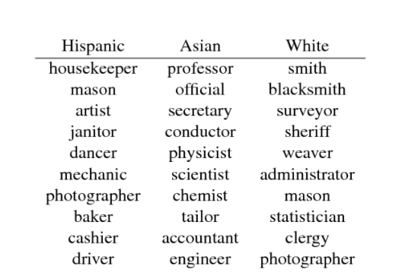
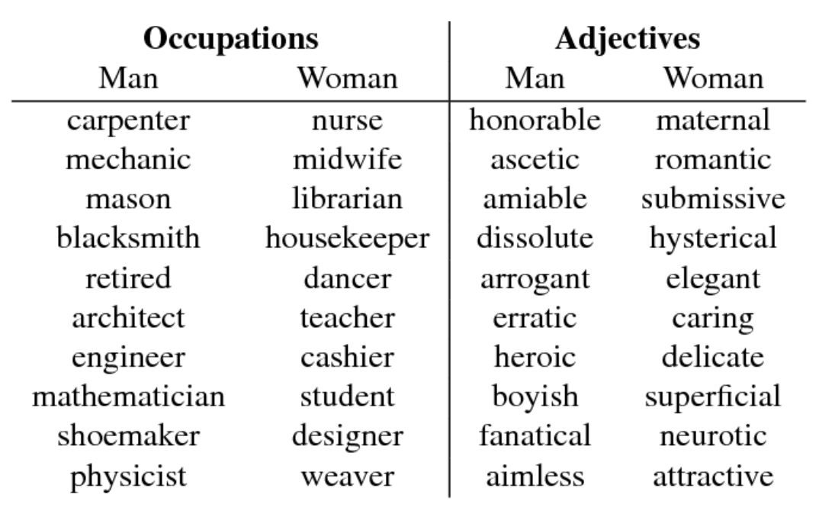
https://www.semanticscholar.org/paper/Word-Embeddings-Quantify-100-Years-of-Gender-and-Garg-Schiebinger/56e8985fa61037662650803d48177d752e9ce557

Slide 34
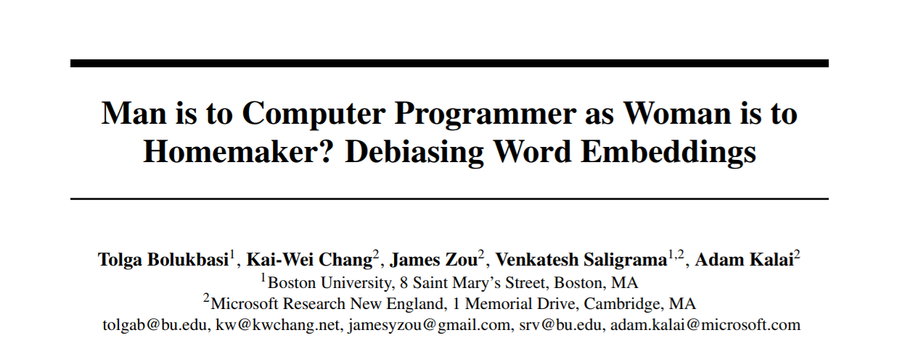
https://papers.nips.cc/paper/6228-man-is-to-computer-programmer-as-woman-is-to-homemaker-debiasing-word-embeddings.pdf

Slide 35
What can we do in the future?
Notes:
Bias, HCI, benefits/risks

Slide 36
Questions?
…and answers?

