Slide 1
Word Vectors
Princeton AI4ALL: NLP Group

Slide 2
How should we represent words?

Slide 3
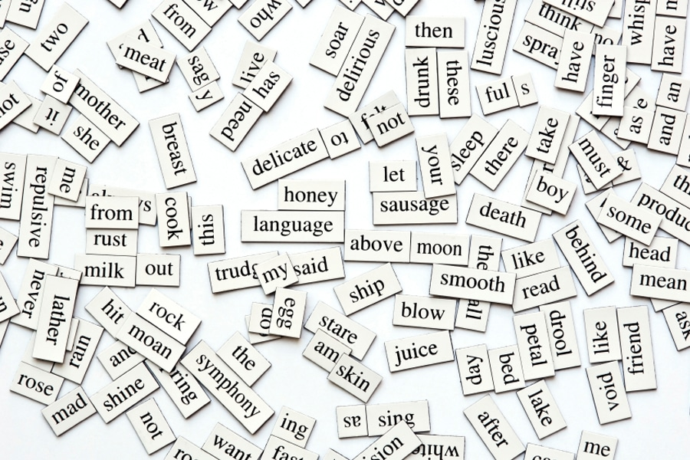
https://www.fluentu.com/blog/educator-english/wp-content/uploads/sites/13/2014/11/beginner-esl-vocabulary-how-to-teach-100-words-in-one-lesson.jpg
Notes:
- A lot of words in the world, we have associations between them based on their meaning.

Slide 4
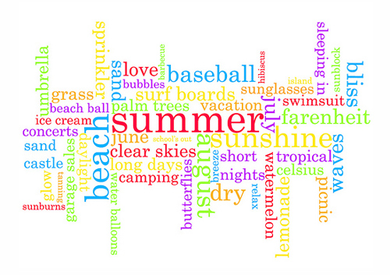
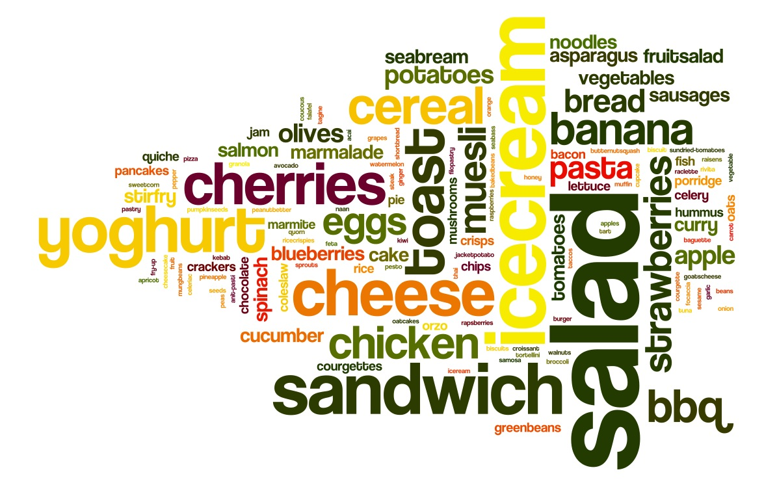

https://foodscapesbristol.files.wordpress.com/2013/07/day-5.jpg
https://antarasdiary.com/30-brilliant-typography-inspirations-featuring-the-word-summer/
https://www.canstockphoto.com/music-word-cloud-34509746.html
Notes:
- Certain words tend to fall into the same groups.

Slide 5
To communicate this information to computers… quantitatively represent words, where more similar words have similar representations
Notes:
How to provide computers with info about similarities btwn words?
Need quantitative representation. Want more similar words to be more similar.

Slide 6
To communicate this information to computers… quantitatively represent words, where more similar words have similar representations
Notes:
How to provide computers with info about similarities btwn words?
Need quantitative representation. Want more similar words to be more similar.

Slide 7
To communicate this information to computers… quantitatively represent words, where more similar words have similar representations
Notes:
How to provide computers with info about similarities btwn words?
Need quantitative representation. Want more similar words to be more similar.

Slide 8
What are word vectors?

Slide 9
What are vectors?
y
x
Notes:
- Coordinate axes

Slide 10
What are vectors?
y
x
Notes:
- Size and direction.

Slide 11
What are vectors?
(2.5,1)
(3,1)
y
x
(2, -3)
Notes:
- Some vectors are more similar than others.

Slide 12
How do we measure similarity between vectors?
Notes:
- Angles between vectors

Slide 13




How do we measure similarity between vectors?
$$90°$$
$$180°$$
$$0°$$
$$270°$$

Slide 14


How do we measure similarity between vectors?
$$90°$$
1
$$θ$$
$$180°$$
$$cos(θ)$$
$$0°$$
$$270°$$

Slide 15





How do we measure similarity between vectors?
$$\cos\left(90°\right)=0$$
$$\cos\left(45°\right)≈0.7$$
$$\cos\left(180°\right)=−1$$
$$\cos\left(0°\right)=1$$
$$\cos\left(270°\right)=0$$

Slide 16
How do we measure similarity between vectors?
Use the cosine similarity between vectors

Slide 17
What if we want more information?
Vectors in 6 dimensions
Vectors in 2 dimensions
3
1
-2
4
1
0.7
2.5
1
0.5
-2
9
1
3
1
2.5
1
2
-3
Notes:
- Can be in many dimensions.

Slide 18
What if we want more information?
Vectors in 6 dimensions
Vectors in 2 dimensions
3
1
-2
4
1
0.7
2.5
1
0.5
-2
9
1
3
1
2.5
1
2
-3
Notes:
- Can be in many dimensions.

Slide 19
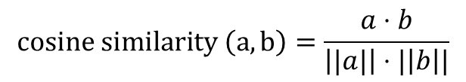
What if we want more information?
Vectors in 6 dimensions
3
1
-2
4
1
0.7
2.5
1
0.5
-2
9
1
$$cosine similarity \left(a,b\right)=\frac{a⋅b}{\left||a|\right|⋅|\left|b\right||}$$
Notes:
- Can be in many dimensions.

Slide 20
How do we create word vectors?

Slide 21
How do we know if words are similar?

Slide 22
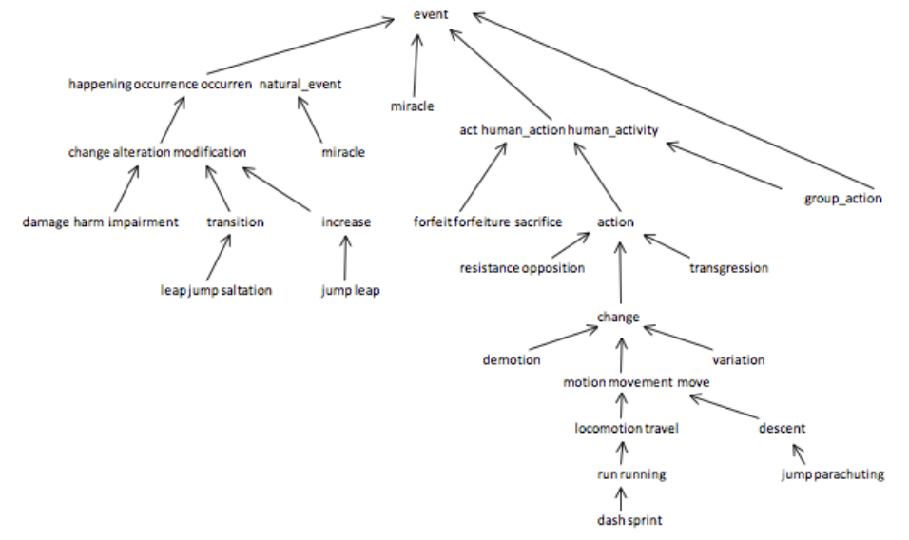
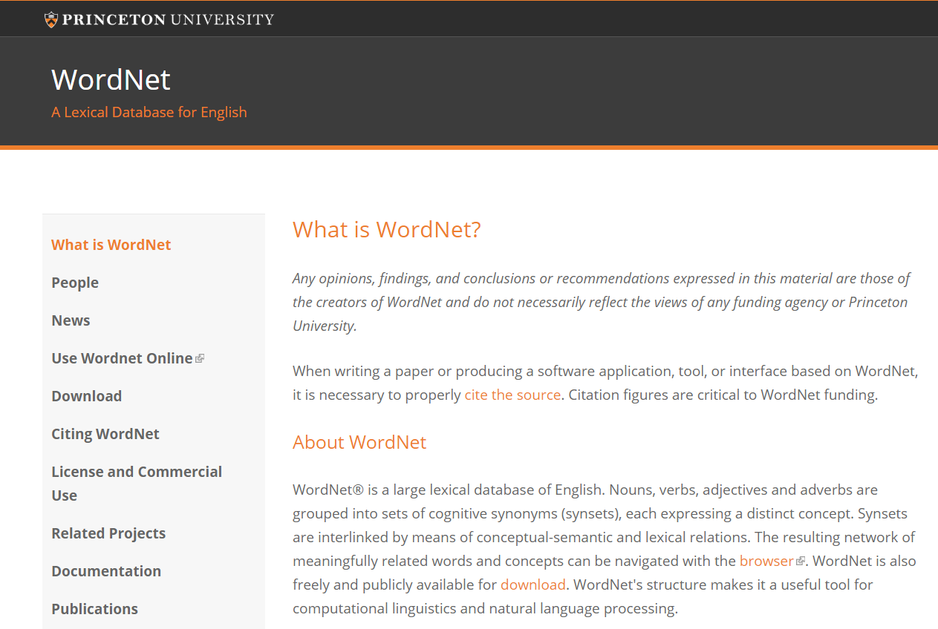
How do we know if words are similar?
https://wordnet.princeton.edu/
https://www.cs.princeton.edu/courses/archive/fall12/cos226/assignments/wordnet.html
Notes:
- Lexical database

Slide 23
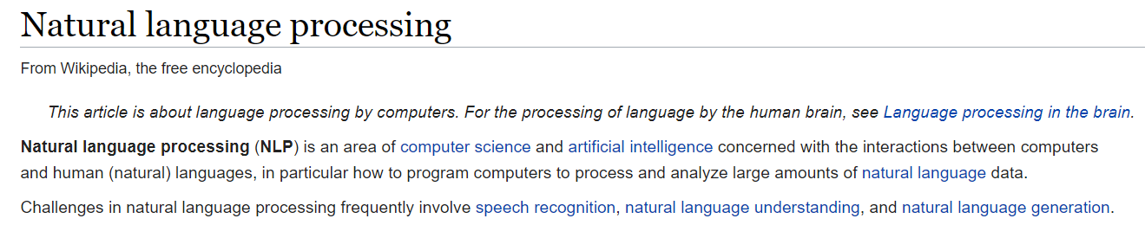
How do we know if words are similar?
Notes:
- Idea: Words that occur together tend to be similar.

Slide 24
How do we know if words are similar?
Notes:
- Idea: Words that occur together tend to be similar.

Slide 25
Distributional Hypothesis
“You shall know a word by the company it keeps”
John Rupert Firth (1957)

Slide 26
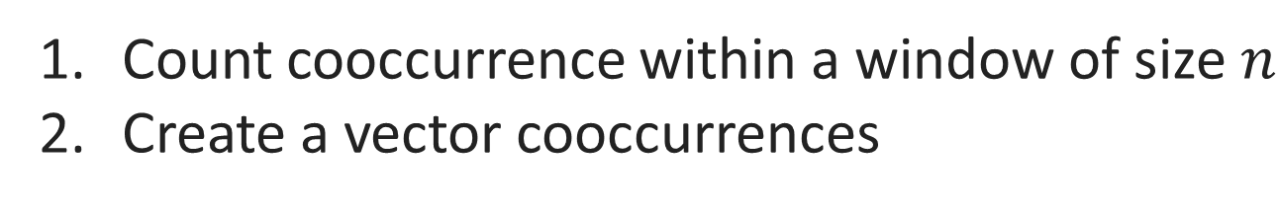
How do we find the distribution of nearby words?
Count cooccurrence within a window of size $n$
Create a vector cooccurrences

Slide 27
How do we find the distribution of nearby words?
Count cooccurrence within a window of size $n$
Create a vector cooccurrences
Any problems with this?
Notes:
- Some words not as informative

Slide 28
Some words are more informative than others…
Notes:
- Some words not as informative

Slide 29
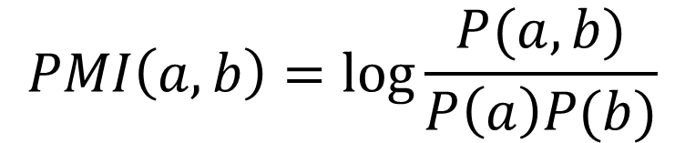
Pointwise Mutual Information (PMI)
$$PMI\left(a,b\right)=\log{\frac{P(a,b)}{P\left(a\right)P(b)}}$$
Notes:
- Some words not as informative

Slide 30
How can we represent sentences given word embeddings?
Notes:
Average of words
Other methods

Slide 31
How can we use word vectors?

Slide 32
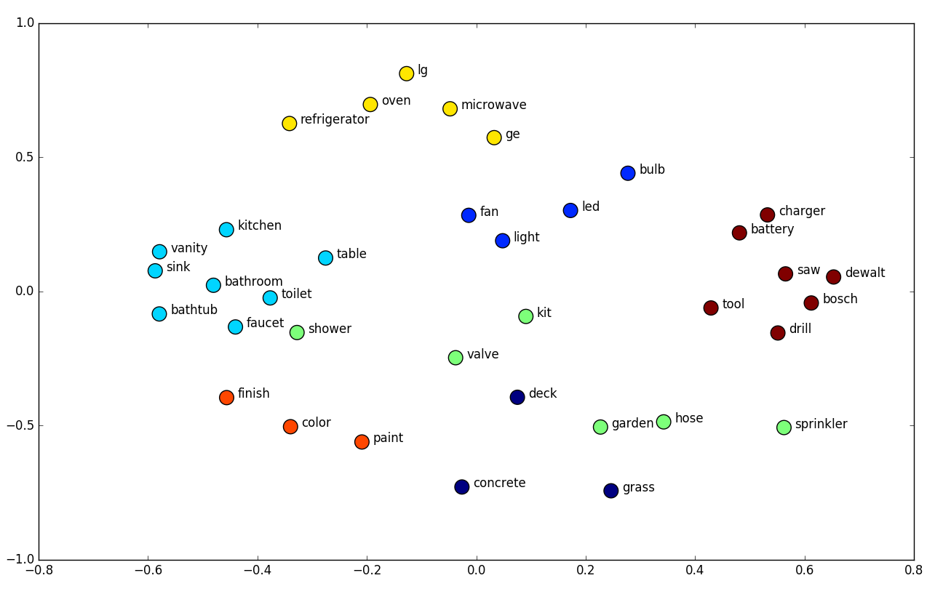
https://towardsdatascience.com/deep-learning-structured-data-8d6a278f3088
Notes:
- clusters

Slide 33
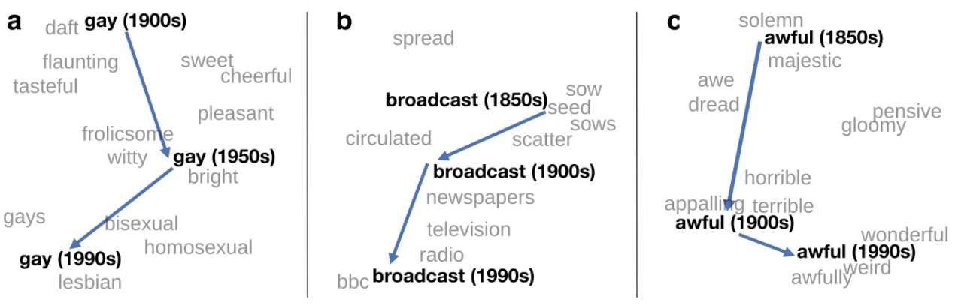
http://ruder.io/word-embeddings-2017/
Notes:
- Clusters over time

Slide 34
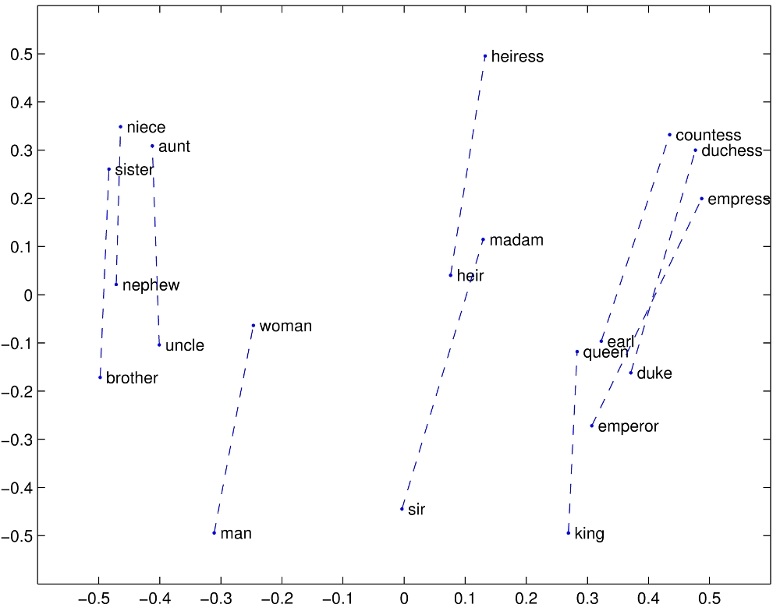
https://nlp.stanford.edu/projects/glove/images/man_woman.jpg
Notes:
- analogies

Slide 35
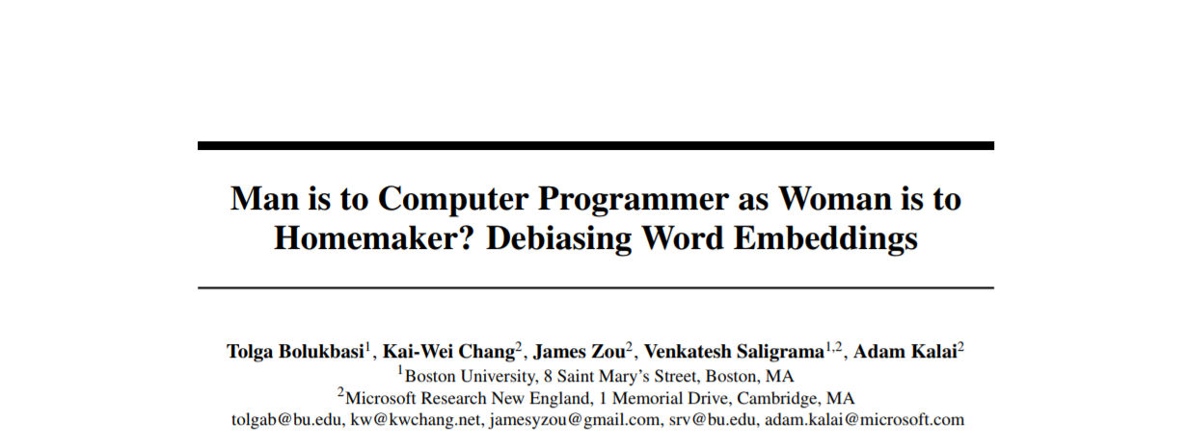

https://papers.nips.cc/paper/6228-man-is-to-computer-programmer-as-woman-is-to-homemaker-debiasing-word-embeddings.pdf

Slide 36
https://papers.nips.cc/paper/6228-man-is-to-computer-programmer-as-woman-is-to-homemaker-debiasing-word-embeddings.pdf

Slide 37
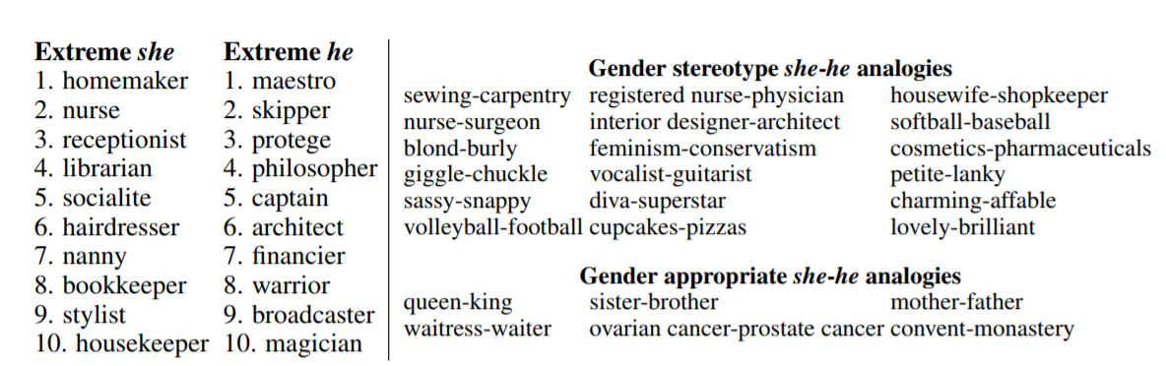
https://papers.nips.cc/paper/6228-man-is-to-computer-programmer-as-woman-is-to-homemaker-debiasing-word-embeddings.pdf

