Slide 1
Data Representation and Exploration
AI4ALL Princeton: NLP Group

Slide 2
How do we represent a body of text?

Slide 3
Recap: How do we represent words?

Slide 4
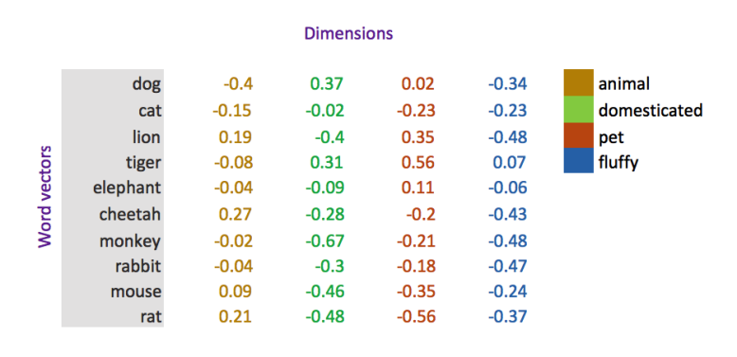

$$θ$$
https://medium.com/@jayeshbahire/introduction-to-word-vectors-ea1d4e4b84bf

Slide 5
How do we represent many words?

Slide 6
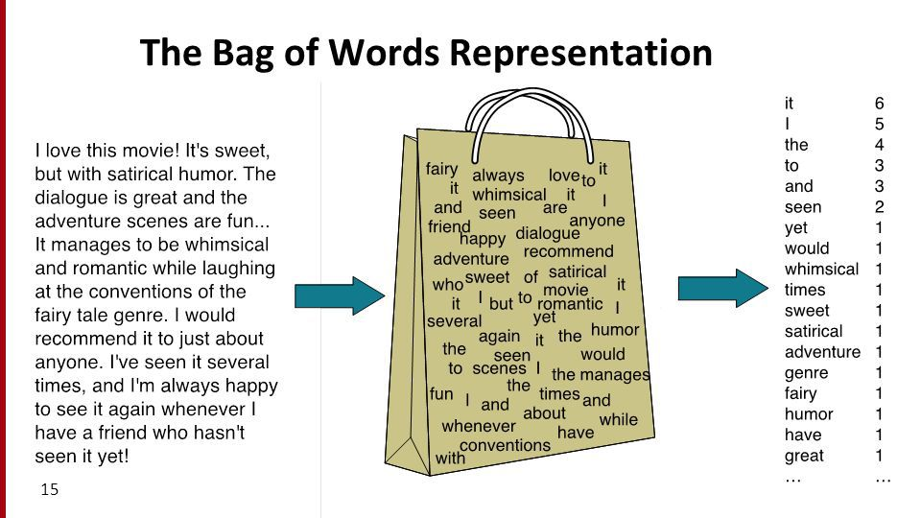
http://thecaffeinedev.com/twitter-sentiment-analysis-intro-machine-learning-beginners-part2/

Slide 7
Some words are more important than others

Slide 8
Some words are more important than others
How can we use this to improve our representation?

Slide 9

Term Frequency Inverse Document Frequency
$$\frac{word frequency in document}{length of document}$$

Slide 10

Inverse Document Frequency
$$log\frac{number of documents}{number of documents with word}$$

Slide 11


Term Frequency Inverse Document Frequency (TF-IDF)
$$\frac{word frequency in document}{length of document}$$
$$log\frac{number of documents}{number of documents with word}$$
$$∗$$

Slide 12
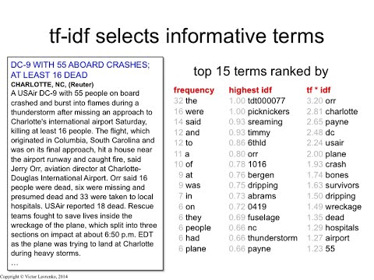
https://www.youtube.com/watch?v=zvFGNpbAfEI

Slide 13
How can we improve representations?

Slide 14

http://ai4all.princeton.edu/about
Notes:
- Casing, tokenization, stemming

Slide 15
['princeton', 'ai4al', 'is', 'intend', 'to', 'increas', 'divers', 'and', 'inclus', 'in', 'the', 'field', 'of', 'artifici', 'intellig', '.']
http://ai4all.princeton.edu/about
Notes:
- Casing, tokenization, stemming

Slide 16
Exploring a new dataset

Slide 17
What can we explore for a new dataset?
Statistics about the data?
Visualizations?
Manual analysis?
Notes:
Statistics (number of examples, length of things)
Examples of inputs and outputs
Visualizations

Slide 18
What can we explore for a new dataset?
Statistics about the data?
Visualizations?
Manual analysis?
Discuss with your neighbors
Notes:
Apply things from this morning
Statistics (number of examples, length of things)
Examples of inputs and outputs
Visualizations

