Slide 1
Putting it all together!
AI4ALL NLP Group

Slide 2
Lexical overlap
Semantic Similarities
Classifier
Prediction

Slide 3
Recap:
Lexical Overlap
Semantic Similarity

Slide 4
Training a Classifier
We use our feature extraction to create vectors from the appropriate training set
We feed a set of feature vectors and a set of binary class labels into a classifier
It trains on those examples
At the end, we run the classifiers on our test set, and pick out the label it thought was most likely

Slide 5
The Classifier
Using a package called xgboost, a really powerful machine learning classifier
They do almost all the work for us --- just feed it the right data!
Algorithm called gradient boosting, which is a way of combining several weak predictors to make a stronger predictor. Often it is used with decision trees. Imagine adding together a bunch of pretty-good decision trees in a way you know reduces the error, you’d get an even better decision-maker.
Read more here: http://blog.kaggle.com/2017/01/23/a-kaggle-master-explains-gradient-boosting/

Slide 6
Creating the training sets
How do we pick out the data to train our classifier?
Headline | Body_ID | Stance
“Blah blah” | 0 | unrelated
“Blah blah” | 1 | discuss
“Blah blah” | 2 | agree
“Blah blah” | 3 | disagree

Slide 7
Creating the training sets
Unrelated vs related
Headline | Body_ID | Stance
“Blah blah” | 0 | unrelated
“Blah blah” | 1 | discuss
“Blah blah” | 2 | agree
“Blah blah” | 3 | disagree

Slide 8
Creating the training sets
Discuss vs not-discuss
Headline | Body_ID | Stance
“Blah blah” | 0 | unrelated
“Blah blah” | 1 | discuss
“Blah blah” | 2 | agree
“Blah blah” | 3 | disagree

Slide 9
Creating the training sets
Agree vs not-agree
Headline | Body_ID | Stance
“Blah blah” | 0 | unrelated
“Blah blah” | 1 | discuss
“Blah blah” | 2 | agree
“Blah blah” | 3 | disagree

Slide 10
Creating the training sets
Disagree vs not-disagree
Headline | Body_ID | Stance
“Blah blah” | 0 | unrelated
“Blah blah” | 1 | discuss
“Blah blah” | 2 | agree
“Blah blah” | 3 | disagree

Slide 11
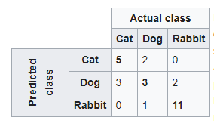
Evaluation
Confusion matrix
https://en.wikipedia.org/wiki/Confusion_matrix

Slide 12
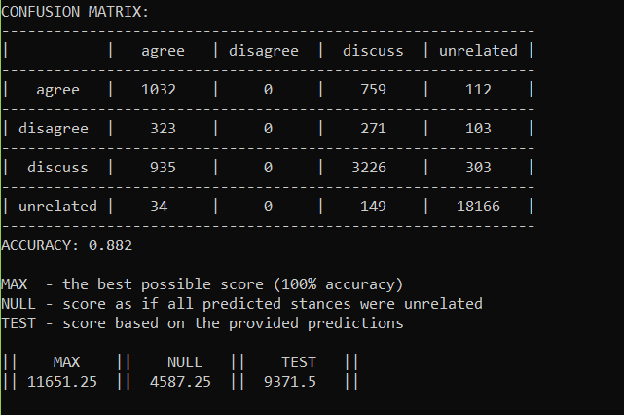
Results

Slide 13
The original 4th place solution
https://github.com/shangjingbo1226/fnc-1

Slide 14
Other solutions
https://github.com/hanselowski/athene_system
https://github.com/uclmr/fakenewschallenge
https://github.com/Cisco-Talos/fnc-1

