Slide 1
NLP for Social Good
Splash 2018

Slide 2
What is it?
…and why do we care?

Slide 3
What is “NLP”?
“Natural-language processing (NLP) is an area of computer science and artificial intelligence concerned with the interactions between computers and human (natural) languages, in particular how to program computers to fruitfully process large amounts of natural language data.”
- Wikipedia
https://en.wikipedia.org/wiki/Natural-language_processing

Slide 4
What is “NLP”?
“Natural-language processing (NLP) is an area of computer science and artificial intelligence concerned with the interactions between computers and human (natural) languages, in particular how to program computers to fruitfully process large amounts of natural language data.”
- Wikipedia
https://en.wikipedia.org/wiki/Natural-language_processing

Slide 5
What is “NLP”?
“Natural-language processing (NLP) is an area of computer science and artificial intelligence concerned with the interactions between computers and human (natural) languages, in particular how to program computers to fruitfully process large amounts of natural language data.”
- Wikipedia
https://en.wikipedia.org/wiki/Natural-language_processing

Slide 6
What is “NLP”?
“Natural-language processing (NLP) is an area of computer science and artificial intelligence concerned with the interactions between computers and human (natural) languages, in particular how to program computers to fruitfully process large amounts of natural language data.”
- Wikipedia
https://en.wikipedia.org/wiki/Natural-language_processing

Slide 7
What is “NLP”?
“Natural-language processing (NLP) is an area of computer science and artificial intelligence concerned with the interactions between computers and human (natural) languages, in particular how to program computers to fruitfully process large amounts of natural language data.”
- Wikipedia
https://en.wikipedia.org/wiki/Natural-language_processing

Slide 8
What is “NLP”?
“Natural-language processing (NLP) is an area of computer science and artificial intelligence concerned with the interactions between computers and human (natural) languages, in particular how to program computers to fruitfully process large amounts of natural language data.
Challenges in natural-language processing frequently involve speech recognition, natural-language understanding, and natural-language generation.”
- Wikipedia
https://en.wikipedia.org/wiki/Natural-language_processing

Slide 9
Why do we care?

Slide 10
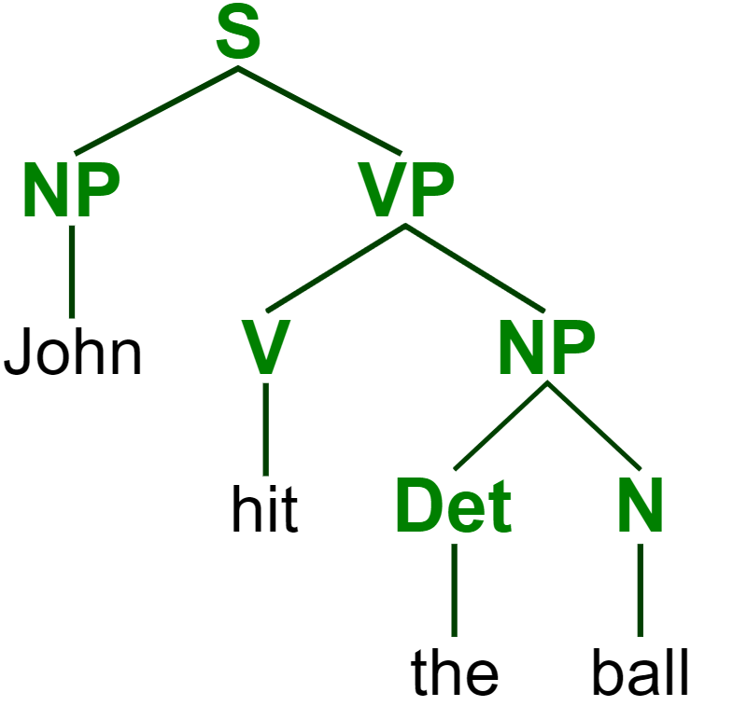
https://commons.wikimedia.org/wiki/File:ParseTree.svg
Notes:
Parse tree: sentence; noun phrase, verb phrase; verb, determiner, noun

Slide 11
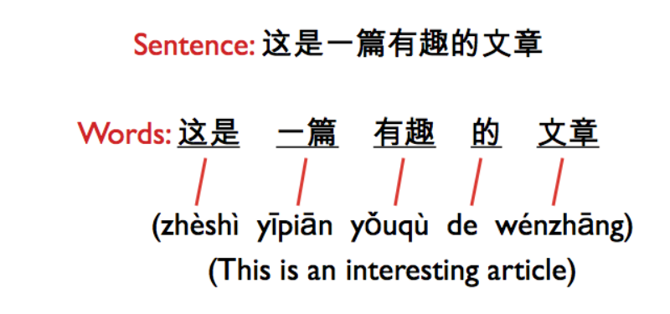
http://iconictranslation.com/2014/10/language-challenge-7-chinese/

Slide 12
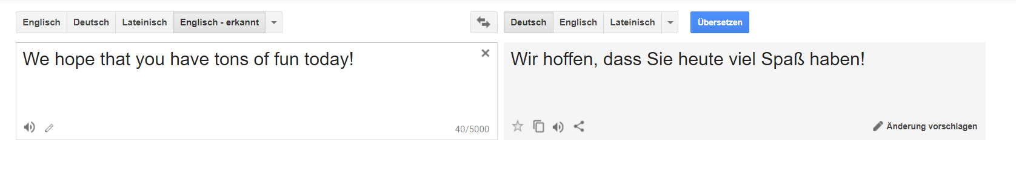
translate.google.com

Slide 13
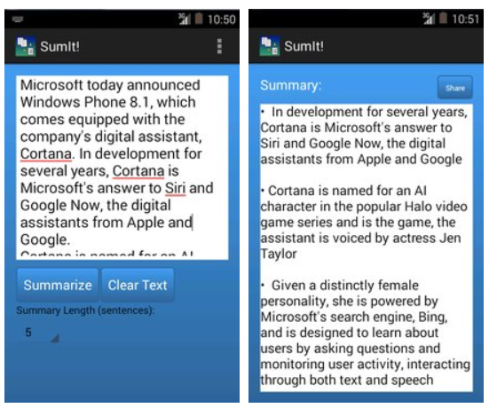
https://apkpure.com/sumit-text-summarization/com.karimo.sumit_final

Slide 14
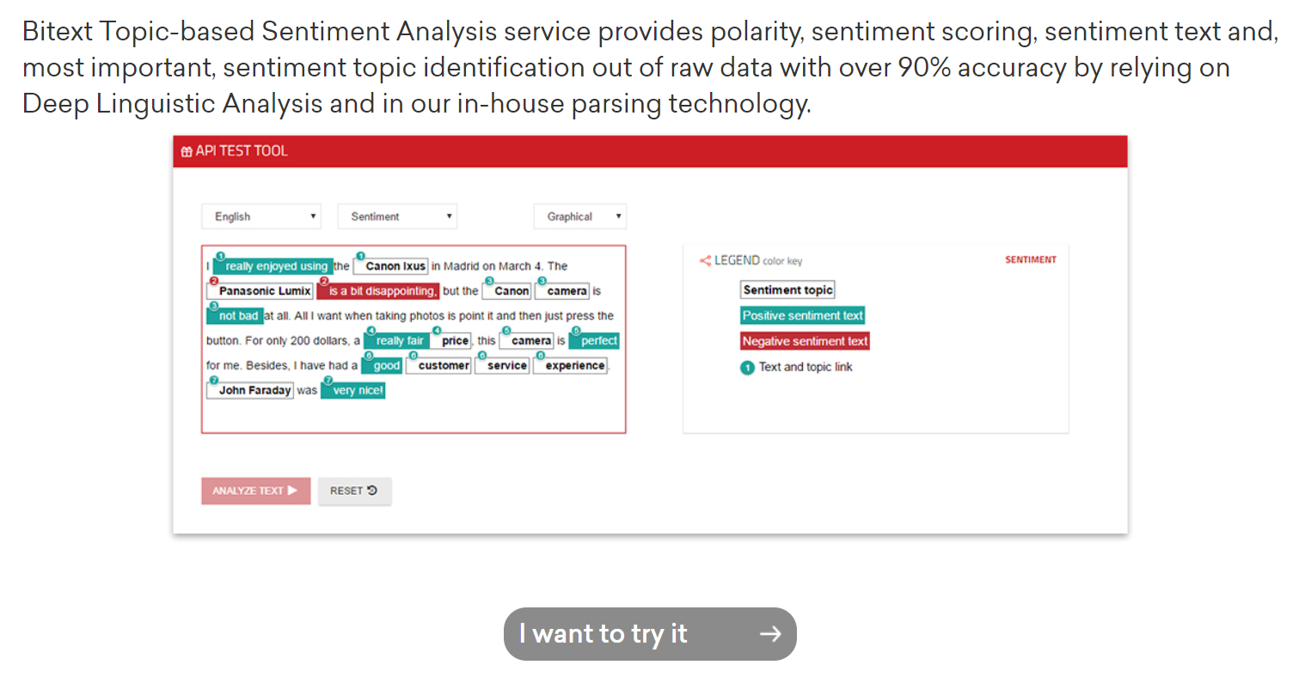
https://www.bitext.com/sentiment-analysis/

Slide 15
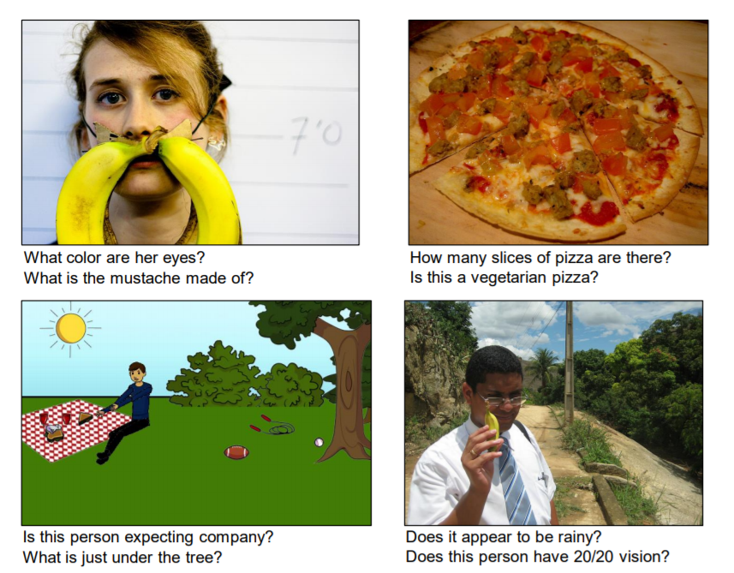
A. Agrawal et al., “VQA: Visual Question Answering,” arXiv:1505.00468 [cs], May 2015.

Slide 16

https://matlab1.com/support-vector-machine-speech-recognition/

Slide 17

https://play.google.com/store/apps/details?id=com.textsprecher

Slide 18
What makes it difficult?

Slide 19

https://www.ecenglish.com/en/social/blog/ec-central/2015/11/23/vocab-review-homophones

Slide 20
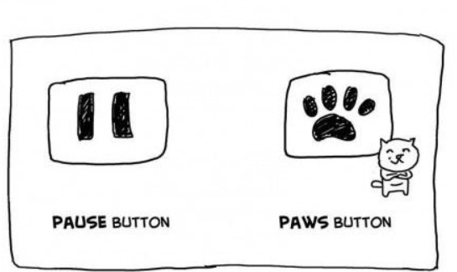
https://i.pinimg.com/originals/0a/92/15/0a921501fa2c6ad60f2e7cde0c8e90a4.jpg

Slide 21
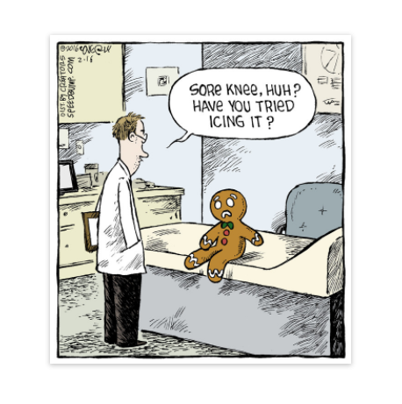
https://www.creators.com/read/speed-bump/02/16/165650

Slide 22
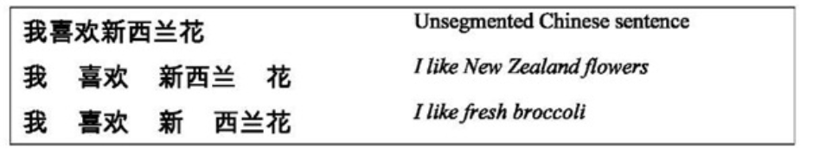
http://what-when-how.com/how-to-build-a-digital-library/word-segmentation-and-sorting-digital-library/
Notes:
Segmentation

Slide 23

http://onthesannyside.blogspot.com/2015/08/fun-with-dangling-modifiers.html

Slide 24

http://explosm.net/comics/1206

Slide 25

https://imgur.com/r/thesimpsons/1ZKxV5O
Notes:
Ambiguous sentences: https://www.teatime-mag.com/magazines/wp-content/themes/tt/print/teatime61/print.pdf

Slide 26
How does it work?
…and how can we make it work?

Slide 27
Where do we use it?
…and how do we use it?

Slide 28
What else could we do?
…and what should we do?

Slide 29
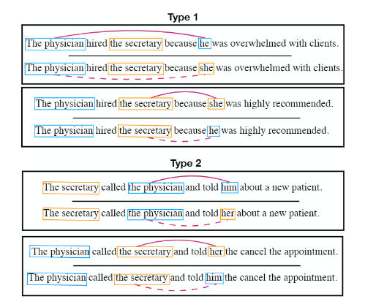
https://github.com/uclanlp/corefBias/blob/master/NAACL2018_CorefBias.pdf

Slide 30
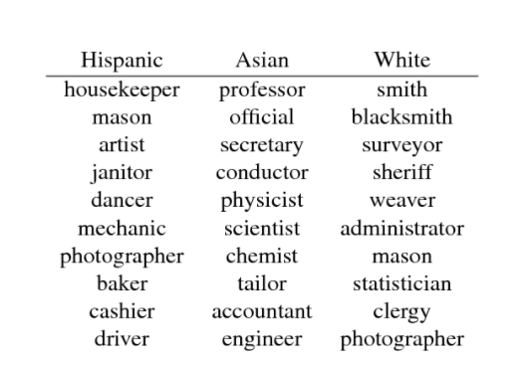
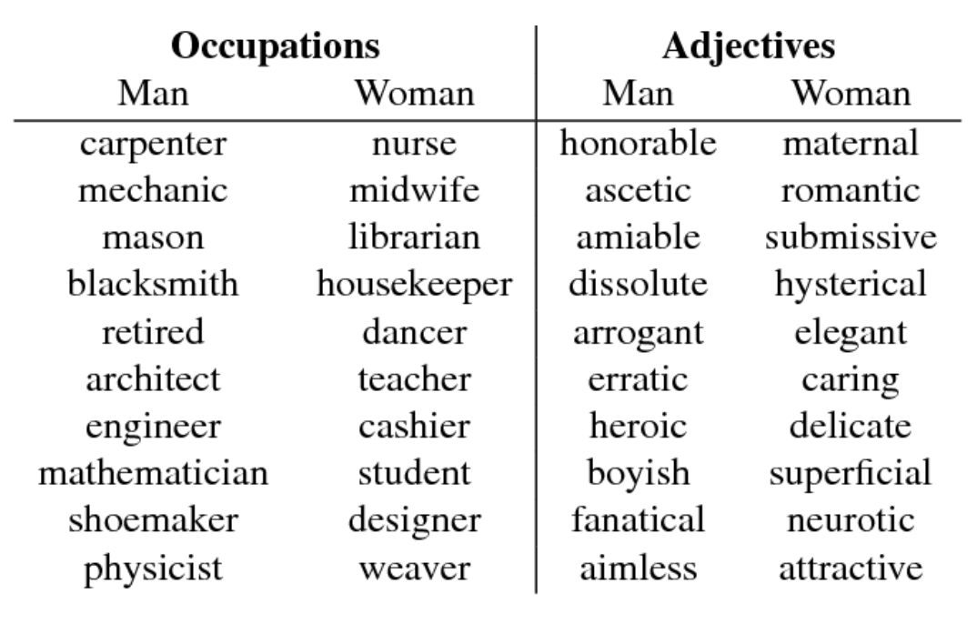
https://www.semanticscholar.org/paper/Word-Embeddings-Quantify-100-Years-of-Gender-and-Garg-Schiebinger/56e8985fa61037662650803d48177d752e9ce557

Slide 31
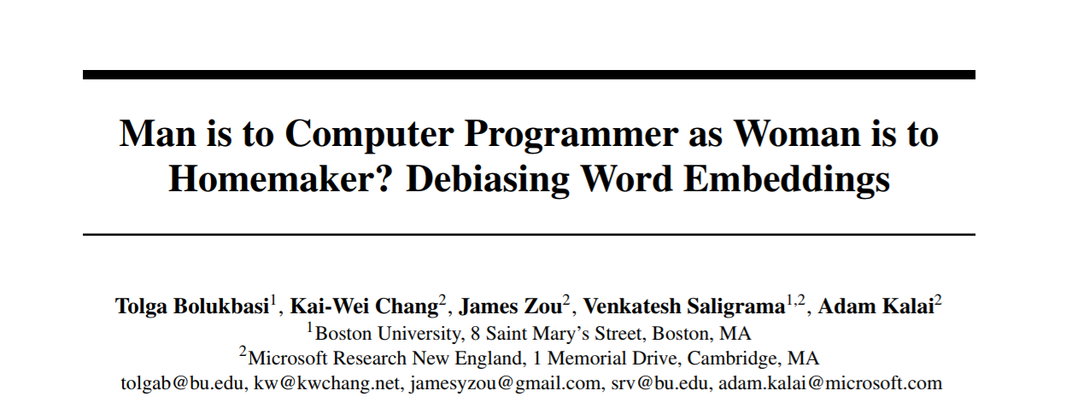
https://papers.nips.cc/paper/6228-man-is-to-computer-programmer-as-woman-is-to-homemaker-debiasing-word-embeddings.pdf

Slide 32
What can we do in the future?
Notes:
Bias, HCI, benefits/risks

Slide 33
Questions?
…and answers?

