Slide 1
Word Vectors
Princeton AI4ALL: NLP Group

Slide 2
What’s Next

Slide 3
Overview of the Week, Option 1 (with minipresentations)
Monday (today)
1-3: Introduction to Word Vectors
Tuesday
1-3: Word Vectors + FNC
Wednesday
1-3: Lexical Overlaps
Thursday
9:30-12: Putting together the FNC + Discussion
1-3: Minipresentations (10 minutes per person) + Free time to work on presentation.
Friday
9:30-10:30: Free time to finish/practice presentation.
10:30-12, 1-3: Presentations with other groups.

Slide 4
Overview of the Week, Option 2 (no minipresentations)
Monday (today)
1-3: Introduction to Word Vectors
Tuesday
1-3: Word Vectors + FNC
Wednesday
1-3: Lexical Overlaps
Thursday
9:30-12: Putting together the FNC + Discussion
1-3: Free time to work on presentation.
Friday
9:30-10:30: Free time to finish/practice presentation.
10:30-12, 1-3: Presentations with other groups.

Slide 5
Info about NLP & Ethics/Policy minipresentations
Find a topic related to NLP and ethics/policy (can be a paper, news article, general topic of debate).
Prepare either a presentation with slides, or a few questions for debate/discussion.
Lead a mini-session about this topic!
We can do sign-ups to avoid overlaps.

Slide 6
Info about presentations
Friday presentation sessions: 20 min to educate other campers about their project + 10 min for questions
Audience: other campers
Visuals: Poster/slides/handouts/something creative
Friday banquet: 5 min to give a spotlight about project.
Audience: visitors
No visuals

Slide 7
Overview of the FNC Classifier

Slide 8
How should we represent words?

Slide 9
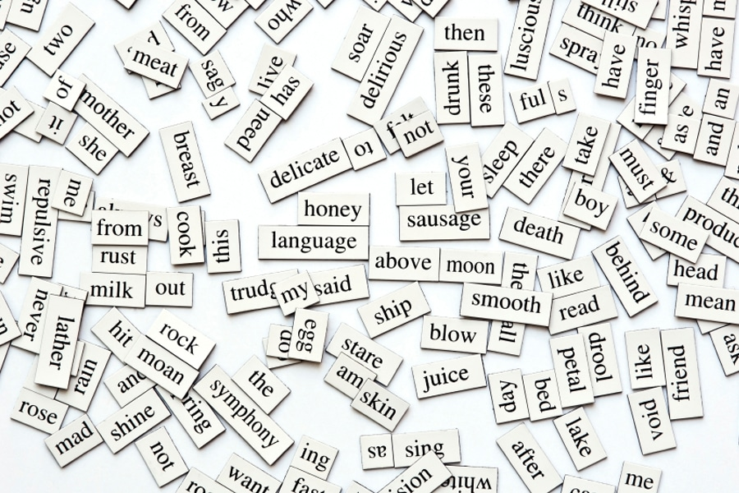
https://www.fluentu.com/blog/educator-english/wp-content/uploads/sites/13/2014/11/beginner-esl-vocabulary-how-to-teach-100-words-in-one-lesson.jpg
Notes:
- A lot of words in the world, we have associations between them based on their meaning.

Slide 10
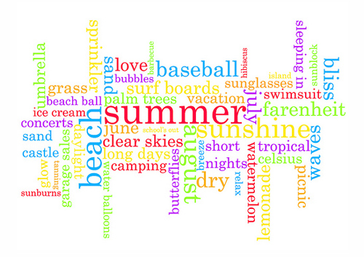
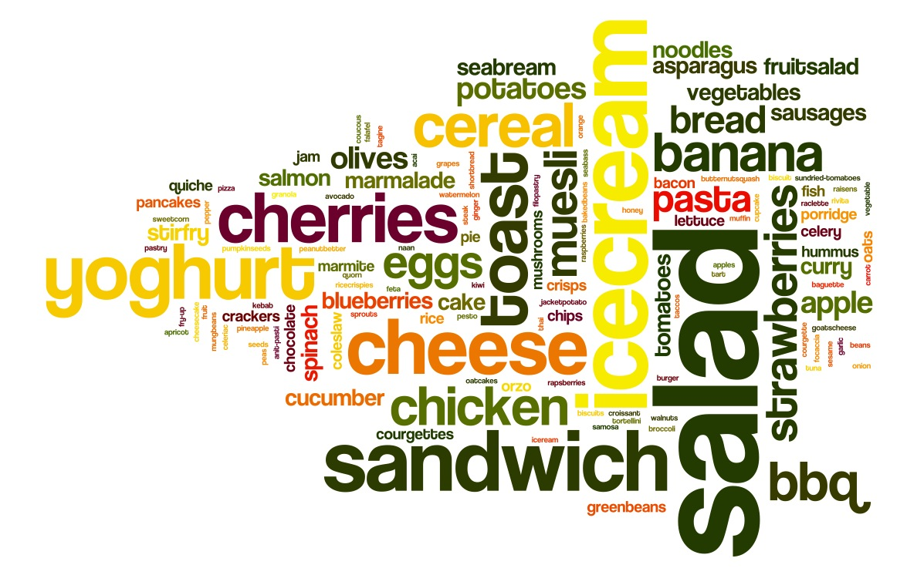

https://foodscapesbristol.files.wordpress.com/2013/07/day-5.jpg
https://antarasdiary.com/30-brilliant-typography-inspirations-featuring-the-word-summer/
https://www.canstockphoto.com/music-word-cloud-34509746.html
Notes:
- Certain words tend to fall into the same groups.

Slide 11
To communicate this information to computers… quantitatively represent words, where more similar words have similar representations
Notes:
How to provide computers with info about similarities btwn words?
Need quantitative representation. Want more similar words to be more similar.

Slide 12
To communicate this information to computers… quantitatively represent words, where more similar words have similar representations
Notes:
How to provide computers with info about similarities btwn words?
Need quantitative representation. Want more similar words to be more similar.

Slide 13
To communicate this information to computers… quantitatively represent words, where more similar words have similar representations
Notes:
How to provide computers with info about similarities btwn words?
Need quantitative representation. Want more similar words to be more similar.

Slide 14
What are word vectors?

Slide 15
What are vectors?
y
x
Notes:
- Coordinate axes

Slide 16
What are vectors?
y
x
Notes:
- Size and direction.

Slide 17
What are vectors?
(2.5,1)
(3,1)
y
x
(2, -3)
Notes:
- Some vectors are more similar than others.

Slide 18
How do we measure similarity between vectors?
Notes:
- Angles between vectors

Slide 19




How do we measure similarity between vectors?
$$90°$$
$$180°$$
$$0°$$
$$270°$$

Slide 20


How do we measure similarity between vectors?
$$90°$$
1
$$θ$$
$$180°$$
$$cos(θ)$$
$$0°$$
$$270°$$

Slide 21





How do we measure similarity between vectors?
$$\cos\left(90°\right)=0$$
$$\cos\left(45°\right)≈0.7$$
$$\cos\left(180°\right)=−1$$
$$\cos\left(0°\right)=1$$
$$\cos\left(270°\right)=0$$

Slide 22
How do we measure similarity between vectors?
Use the cosine similarity between vectors

Slide 23
What if we want more information?
Vectors in 6 dimensions
Vectors in 2 dimensions
3
1
-2
4
1
0.7
2.5
1
0.5
-2
9
1
3
1
2.5
1
2
-3
Notes:
- Can be in many dimensions.

Slide 24
What if we want more information?
Vectors in 6 dimensions
Vectors in 2 dimensions
3
1
-2
4
1
0.7
2.5
1
0.5
-2
9
1
3
1
2.5
1
2
-3
Notes:
- Can be in many dimensions.

Slide 25
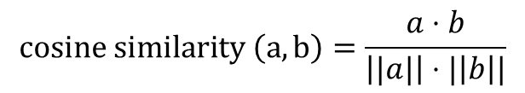
What if we want more information?
Vectors in 6 dimensions
3
1
-2
4
1
0.7
2.5
1
0.5
-2
9
1
$$cosine similarity \left(a,b\right)=\frac{a⋅b}{\left||a|\right|⋅|\left|b\right||}$$
Notes:
- Can be in many dimensions.

Slide 26
How do we create word vectors?

Slide 27
How do we know if words are similar?

Slide 28
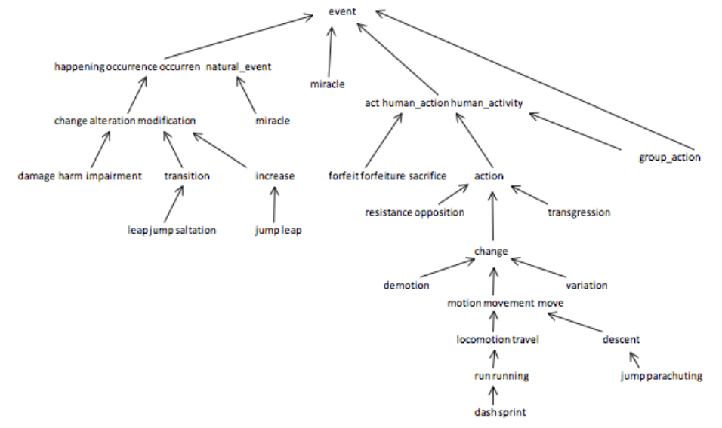
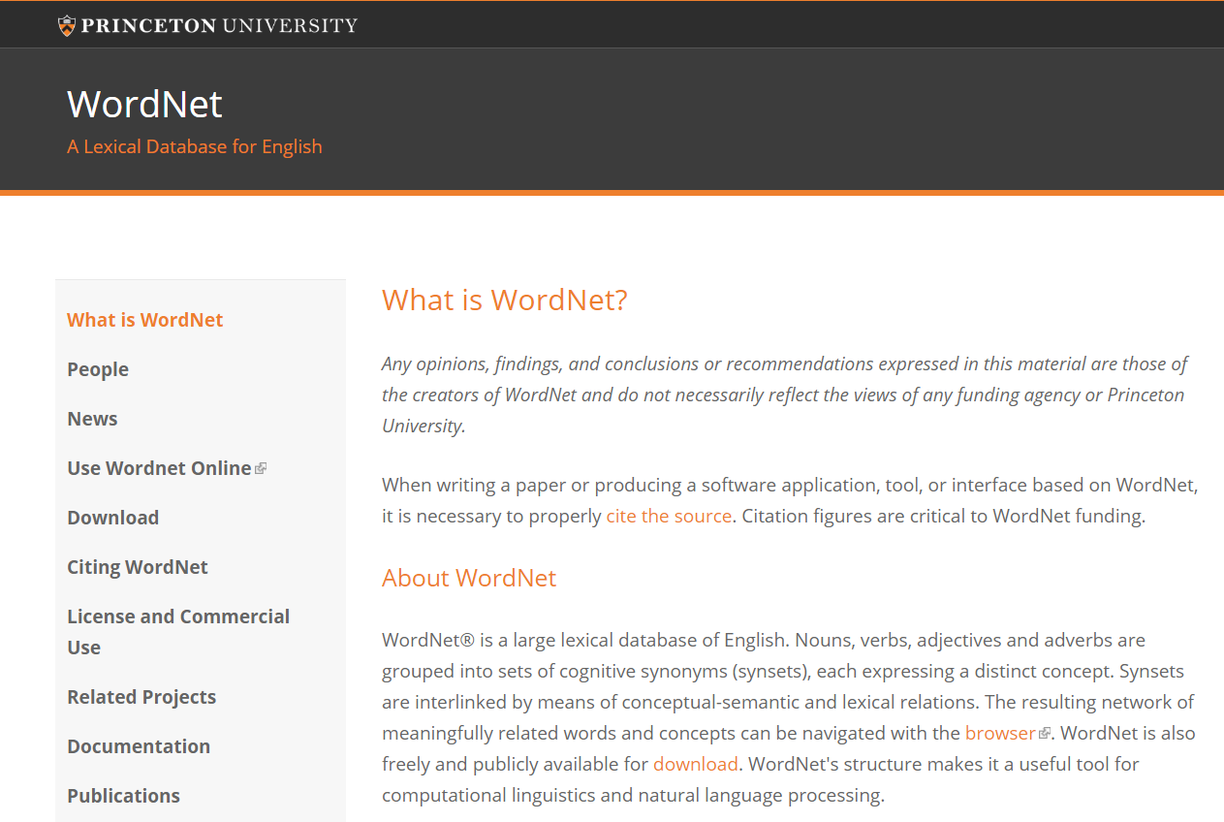
How do we know if words are similar?
https://wordnet.princeton.edu/
https://www.cs.princeton.edu/courses/archive/fall12/cos226/assignments/wordnet.html
Notes:
- Lexical database

Slide 29
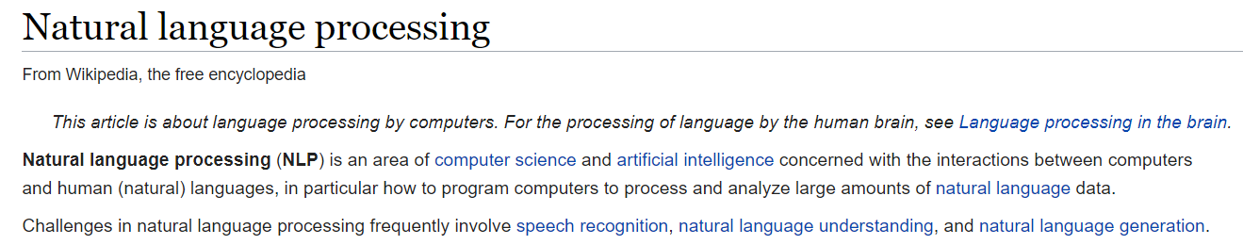
How do we know if words are similar?
Notes:
- Idea: Words that occur together tend to be similar.

Slide 30
How do we know if words are similar?
Notes:
- Idea: Words that occur together tend to be similar.

Slide 31
Distributional Hypothesis
“You shall know a word by the company it keeps”
John Rupert Firth (1957)

Slide 32
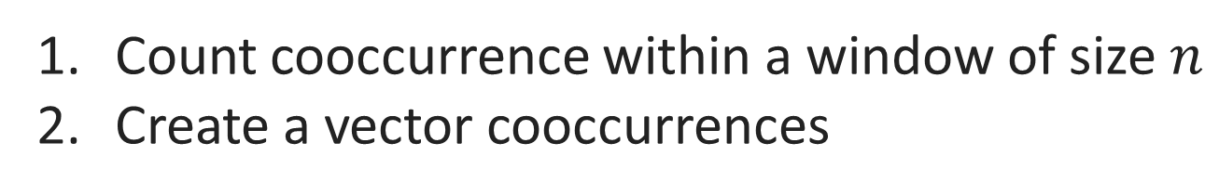
How do we find the distribution of nearby words?
Count cooccurrence within a window of size $n$
Create a vector cooccurrences

Slide 33
How do we find the distribution of nearby words?
Count cooccurrence within a window of size $n$
Create a vector cooccurrences
Any problems with this?
Notes:
- Some words not as informative

Slide 34
Some words are more informative than others…
Notes:
- Some words not as informative

Slide 35
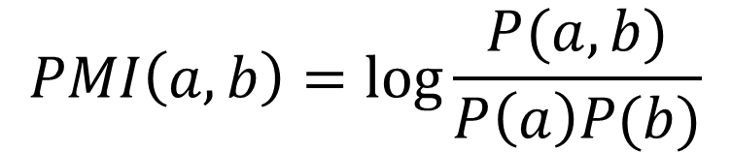
Pointwise Mutual Information (PMI)
$$PMI\left(a,b\right)=\log{\frac{P(a,b)}{P\left(a\right)P(b)}}$$
Notes:
- Some words not as informative

Slide 36
How can we represent sentences given word embeddings?
Notes:
Average of words
Other methods

Slide 37
How can we use word vectors?

Slide 38
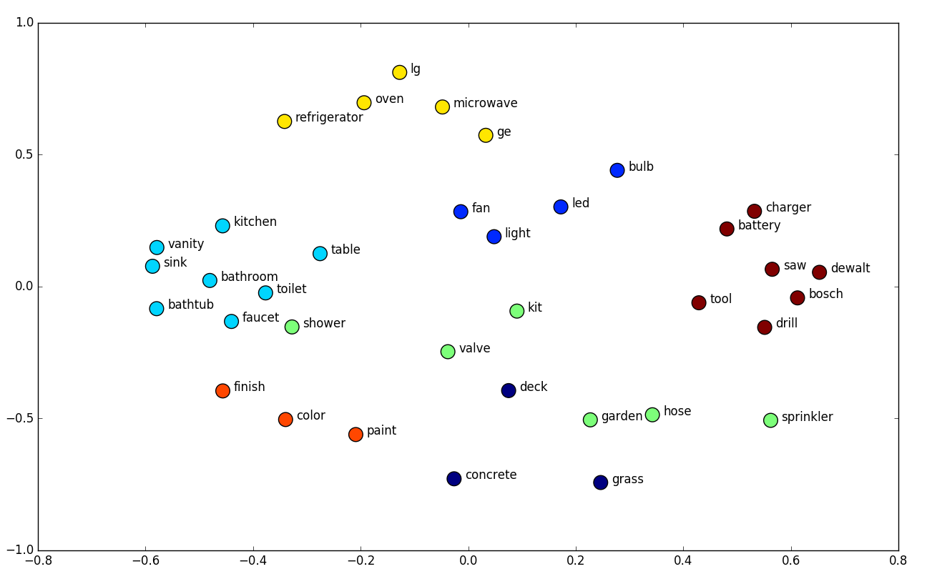
https://towardsdatascience.com/deep-learning-structured-data-8d6a278f3088
Notes:
- clusters

Slide 39
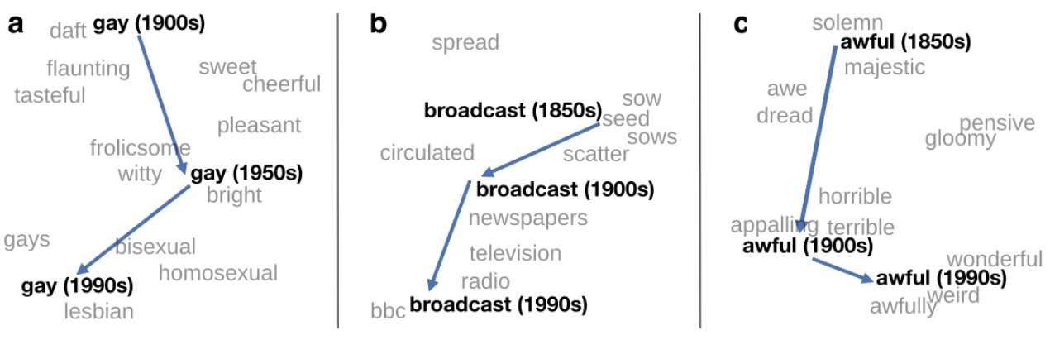
http://ruder.io/word-embeddings-2017/
Notes:
- Clusters over time

Slide 40
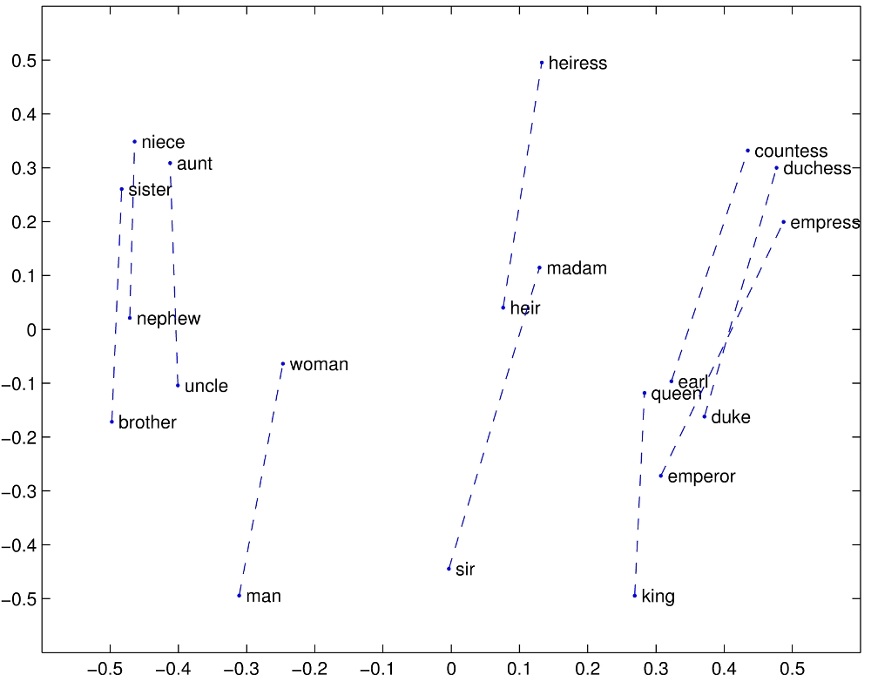
https://nlp.stanford.edu/projects/glove/images/man_woman.jpg
Notes:
- analogies

Slide 41
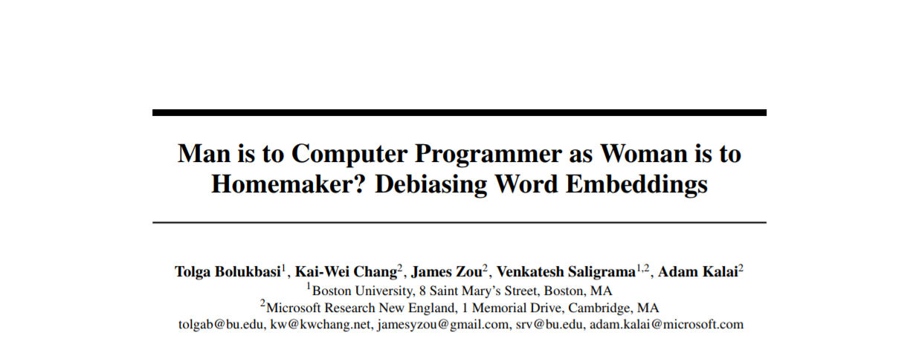

https://papers.nips.cc/paper/6228-man-is-to-computer-programmer-as-woman-is-to-homemaker-debiasing-word-embeddings.pdf

Slide 42
https://papers.nips.cc/paper/6228-man-is-to-computer-programmer-as-woman-is-to-homemaker-debiasing-word-embeddings.pdf

Slide 43
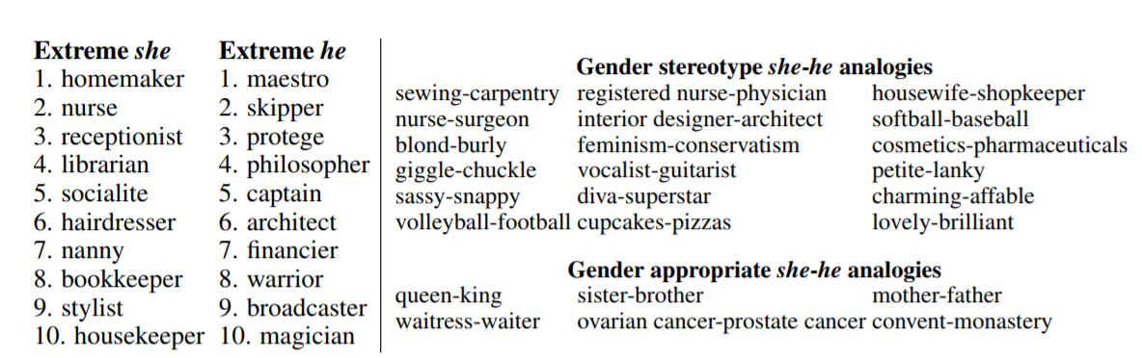
https://papers.nips.cc/paper/6228-man-is-to-computer-programmer-as-woman-is-to-homemaker-debiasing-word-embeddings.pdf

