Slide 1
Loading the Data
AI4ALL Princeton: NLP Group

Slide 2
Review of Python and Pandas
Notes:
Today will continue to work on becoming familiar with Python and Pandas, and FNC.
What did you find easy or difficult?

Slide 3
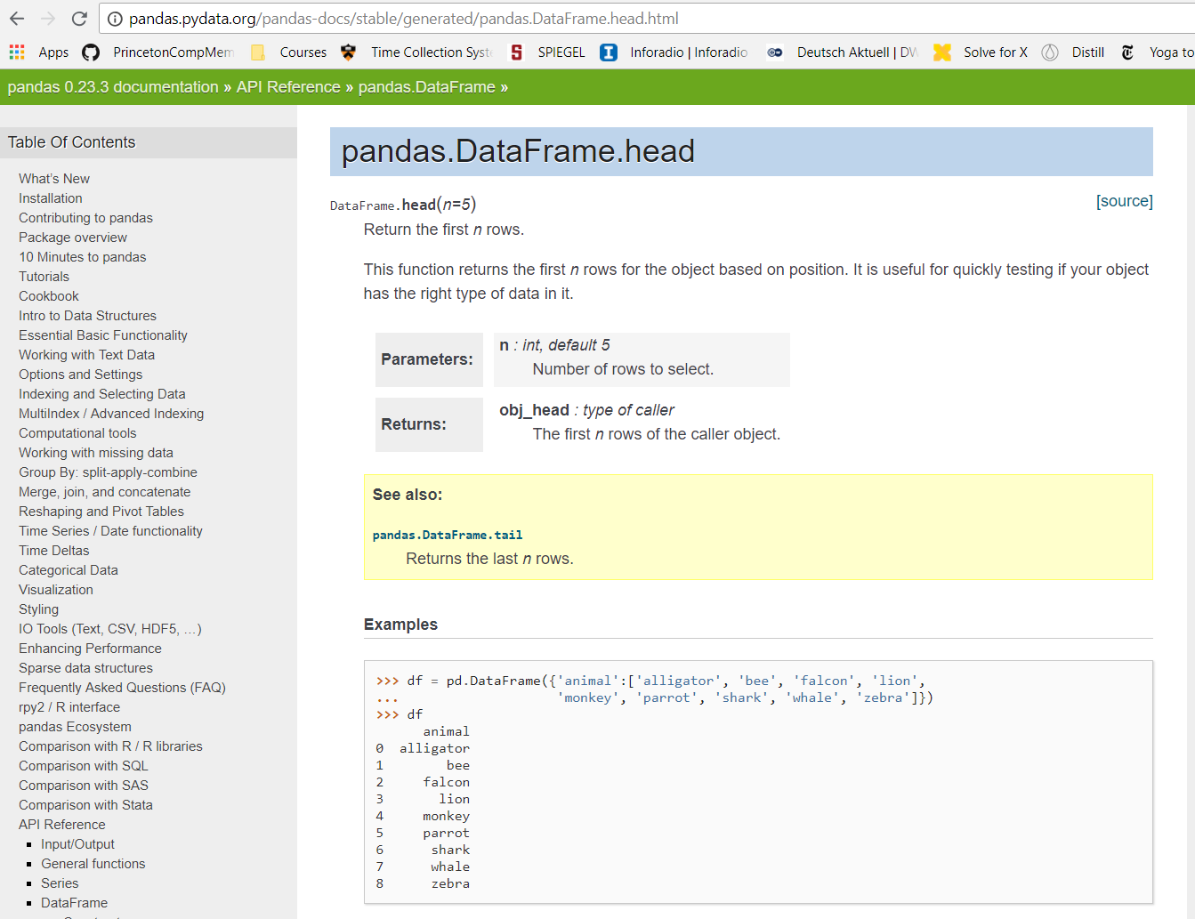
Notes:
- Using online documentation

Slide 4
Some helpful commands:
pd.read_csv()
pd.unique(series)
df.columns
df.shape
df.head()
df[column_name]
len(array)
Notes:
- Discuss what each one does

Slide 5
Now let’s get to the FNC data!

