Slide 1
Evaluation Metrics
Princeton AI4ALL 2018
Material adapted from Stanford AI4ALL 2017

Slide 2
Plan for today
How to evaluate the performance of a classifier?
Implement an evaluation metric and evaluate your rule-based classifier

Slide 3
Evaluation
How can we determine whether one classifier is better than another?
How can we determine whether making changes to a classifier actually leads to improvements?
E.g. does writing an additional rule help, or make things worse?

Slide 4
Overview
You have labeled data (each input labeled with its true category)
Split the data into training examples and test examples
Develop your classifier using the training examples
Use the classifier to label all the test examples
Compare the classifier's labels with the true labels and measure performance
Notes:
Ask and explain why the train/test split is necessary. Why not evaluate on the training set?

Slide 5
Example: Tumor classification
Example | Predicted label | True label
1 | Benign | Malignant
2 | Benign | Malignant
3 | Malignant | Malignant
4 | Benign | Benign
5 | Malignant | Benign
6 | Benign | Benign
7 | Benign | Benign
8 | Malignant | Malignant
9 | Benign | Benign
10 | Benign | Benign
How would you measure the performance of the classifier?
Notes:
What is the accuracy of this classifier? # correct = 8 , # of examples = 10, accuracy = 80%

Slide 6
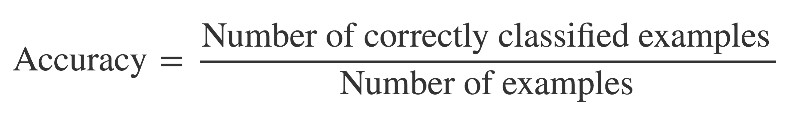
Accuracy

Slide 7
Example: Tumor classification
Example | Predicted label | True label | Correct?
1 | Benign | Malignant | No
2 | Benign | Malignant | No
3 | Malignant | Malignant | Yes
4 | Benign | Benign | Yes
5 | Malignant | Benign | No
6 | Benign | Benign | Yes
7 | Benign | Benign | Yes
8 | Malignant | Malignant | Yes
9 | Benign | Benign | Yes
10 | Benign | Benign | Yes
Notes:
What is the accuracy of this classifier? # correct = 8 , # of examples = 10, accuracy = 80%

Slide 8
Example: Tumor classification
Example | Predicted label | True label | Correct?
1 | Benign | Malignant | No
2 | Benign | Malignant | No
3 | Malignant | Malignant | Yes
4 | Benign | Benign | Yes
5 | Malignant | Benign | No
6 | Benign | Benign | Yes
7 | Benign | Benign | Yes
8 | Malignant | Malignant | Yes
9 | Benign | Benign | Yes
10 | Benign | Benign | Yes
Accuracy = 70%
Notes:
What is the accuracy of this classifier? # correct = 8 , # of examples = 10, accuracy = 80%

Slide 9
A very bad classifier
Example | Predicted label | True label
1 | Benign | Malignant
2 | Benign | Malignant
3 | Benign | Malignant
4 | Benign | Benign
5 | Benign | Benign
6 | Benign | Benign
7 | Benign | Benign
8 | Benign | Malignant
9 | Benign | Benign
10 | Benign | Benign
Just classify everything as benign!

Slide 10
A very bad classifier
Example | Predicted label | True label | Correct?
1 | Benign | Malignant | No
2 | Benign | Malignant | No
3 | Benign | Malignant | No
4 | Benign | Benign | Yes
5 | Benign | Benign | Yes
6 | Benign | Benign | Yes
7 | Benign | Benign | Yes
8 | Benign | Malignant | No
9 | Benign | Benign | Yes
10 | Benign | Benign | Yes
Just classify everything as benign!
Accuracy = 60%

Slide 11
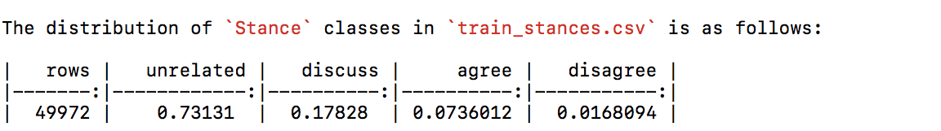
Accuracy
Accuracy is not a good measure when there is an uneven distribution of labels in the data
e.g. benign is much more common than malignant
Our data is split very unevenly across classes:

Slide 12
True and false positives, true and false negatives
For a binary classifier, the two categories are sometimes called positive and negative
E.g. detecting tumours: malignant = positive, benign = negative
If your classifier positively labels a tumour (i.e. you think it's malignant), the labeling is a
True positive if you're correct (it really is malignant)
False positive if you're wrong (it's actually benign)
If your classifier negatively labels a tumour (i.e. you think it's benign), the labeling is a
True negative if you're correct (it's really benign)
False negative if you're wrong (it's actually malignant)

Slide 13
True and false positives, true and false negatives
 |  | Predicted label
 |  | malignant | benign
True label | malignant | True positive | False negative
 | benign | False positive | True negative

Slide 14
Example: Tumor classification
Example | Predicted label | True label
1 | Benign | Malignant
2 | Benign | Malignant
3 | Malignant | Malignant
4 | Benign | Benign
5 | Malignant | Benign
6 | Benign | Benign
7 | Benign | Benign
8 | Malignant | Malignant
9 | Benign | Benign
10 | Benign | Benign
Notes:
Fill in TP/TN/FN/FP for each row

Slide 15
Example: Tumor classification
Example | Predicted label | True label
1 | Benign | Malignant | FN
2 | Benign | Malignant
3 | Malignant | Malignant
4 | Benign | Benign
5 | Malignant | Benign
6 | Benign | Benign
7 | Benign | Benign
8 | Malignant | Malignant
9 | Benign | Benign
10 | Benign | Benign
Notes:
Fill in TP/TN/FN/FP for each row

Slide 16
Example: Tumor classification
Example | Predicted label | True label
1 | Benign | Malignant | FN
2 | Benign | Malignant | FN
3 | Malignant | Malignant
4 | Benign | Benign
5 | Malignant | Benign
6 | Benign | Benign
7 | Benign | Benign
8 | Malignant | Malignant
9 | Benign | Benign
10 | Benign | Benign
Notes:
Fill in TP/TN/FN/FP for each row

Slide 17
Example: Tumor classification
Example | Predicted label | True label
1 | Benign | Malignant | FN
2 | Benign | Malignant | FN
3 | Malignant | Malignant | TP
4 | Benign | Benign
5 | Malignant | Benign
6 | Benign | Benign
7 | Benign | Benign
8 | Malignant | Malignant
9 | Benign | Benign
10 | Benign | Benign
Notes:
Fill in TP/TN/FN/FP for each row

Slide 18
Example: Tumor classification
Example | Predicted label | True label
1 | Benign | Malignant | FN
2 | Benign | Malignant | FN
3 | Malignant | Malignant | TP
4 | Benign | Benign | TN
5 | Malignant | Benign
6 | Benign | Benign
7 | Benign | Benign
8 | Malignant | Malignant
9 | Benign | Benign
10 | Benign | Benign
Notes:
Fill in TP/TN/FN/FP for each row

Slide 19
Example: Tumor classification
Example | Predicted label | True label
1 | Benign | Malignant | FN
2 | Benign | Malignant | FN
3 | Malignant | Malignant | TP
4 | Benign | Benign | TN
5 | Malignant | Benign | FP
6 | Benign | Benign
7 | Benign | Benign
8 | Malignant | Malignant
9 | Benign | Benign
10 | Benign | Benign
Notes:
Fill in TP/TN/FN/FP for each row

Slide 20
Example: Tumor classification
Example | Predicted label | True label
1 | Benign | Malignant | FN
2 | Benign | Malignant | FN
3 | Malignant | Malignant | TP
4 | Benign | Benign | TN
5 | Malignant | Benign | FP
6 | Benign | Benign | TN
7 | Benign | Benign
8 | Malignant | Malignant
9 | Benign | Benign
10 | Benign | Benign
Notes:
Fill in TP/TN/FN/FP for each row

Slide 21
Example: Tumor classification
Example | Predicted label | True label
1 | Benign | Malignant | FN
2 | Benign | Malignant | FN
3 | Malignant | Malignant | TP
4 | Benign | Benign | TN
5 | Malignant | Benign | FP
6 | Benign | Benign | TN
7 | Benign | Benign | TN
8 | Malignant | Malignant
9 | Benign | Benign
10 | Benign | Benign
Notes:
Fill in TP/TN/FN/FP for each row

Slide 22
Example: Tumor classification
Example | Predicted label | True label
1 | Benign | Malignant | FN
2 | Benign | Malignant | FN
3 | Malignant | Malignant | TP
4 | Benign | Benign | TN
5 | Malignant | Benign | FP
6 | Benign | Benign | TN
7 | Benign | Benign | TN
8 | Malignant | Malignant | TP
9 | Benign | Benign
10 | Benign | Benign
Notes:
Fill in TP/TN/FN/FP for each row

Slide 23
Example: Tumor classification
Example | Predicted label | True label
1 | Benign | Malignant | FN
2 | Benign | Malignant | FN
3 | Malignant | Malignant | TP
4 | Benign | Benign | TN
5 | Malignant | Benign | FP
6 | Benign | Benign | TN
7 | Benign | Benign | TN
8 | Malignant | Malignant | TP
9 | Benign | Benign | TN
10 | Benign | Benign
Notes:
Fill in TP/TN/FN/FP for each row

Slide 24
Example: Tumor classification
Example | Predicted label | True label
1 | Benign | Malignant | FN
2 | Benign | Malignant | FN
3 | Malignant | Malignant | TP
4 | Benign | Benign | TN
5 | Malignant | Benign | FP
6 | Benign | Benign | TN
7 | Benign | Benign | TN
8 | Malignant | Malignant | TP
9 | Benign | Benign | TN
10 | Benign | Benign | TN
Notes:
Fill in TP/TN/FN/FP for each row

Slide 25
Other examples
For detecting spam email, what are true positives?
Actual spam emails that are moved to the spam folder
For detecting hateful YouTube comments, what are false positives?
Comments that are not hateful but are classified as such
For detecting fake news, what are false negatives?
A fake news article that is classified as a real news article

Slide 26
What next?
How should we combine these measures (true and false positives and negatives) into an overall measure of performance?

Slide 27
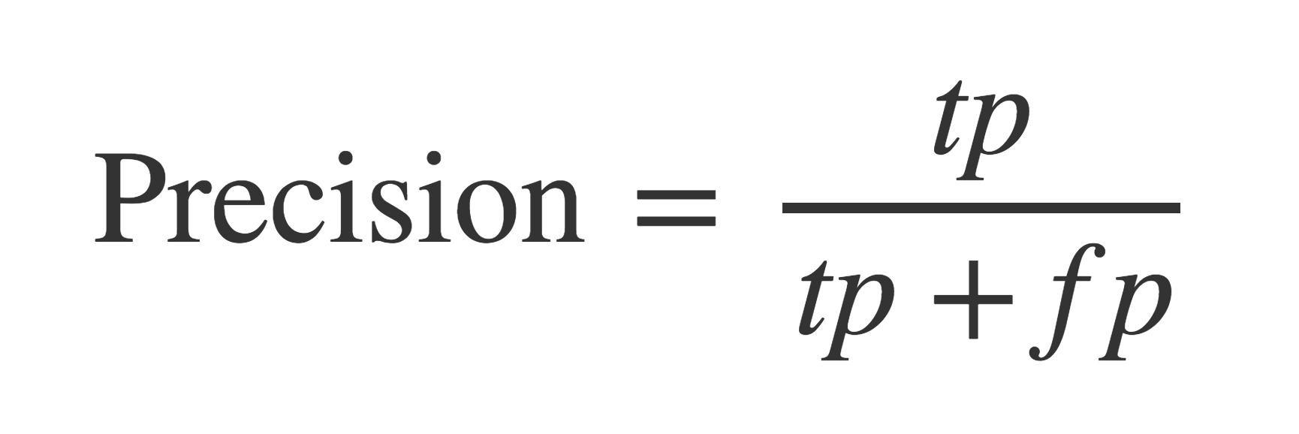
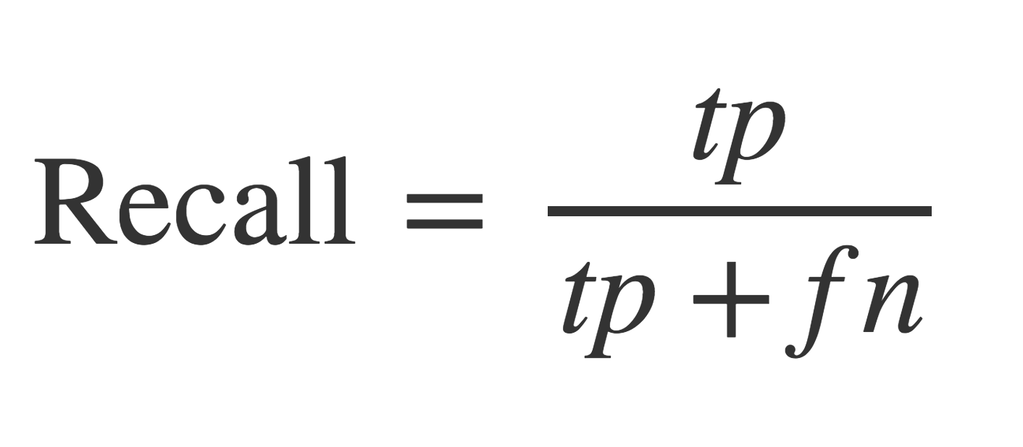
Precision and Recall
Precision: "Of all those labeled positive, how many were correctly labeled?"
Recall: "Of all the true positive examples, how many did the classifier detect?"
Notes:
Now calculate on exercise sheet

Slide 28
Precision and Recall
Why do precision and recall matter?
High recall means your classifier has few false negatives
e.g. few malignant tumors go undetected
High precision means your classifier has few false positives
e.g. few "false alarms" on benign tumors
For detecting malignant tumors, which is more important?
High recall
For convicting someone of a crime, which is more important?
High precision
For detecting spam email, which is more important?
Both are important

Slide 29
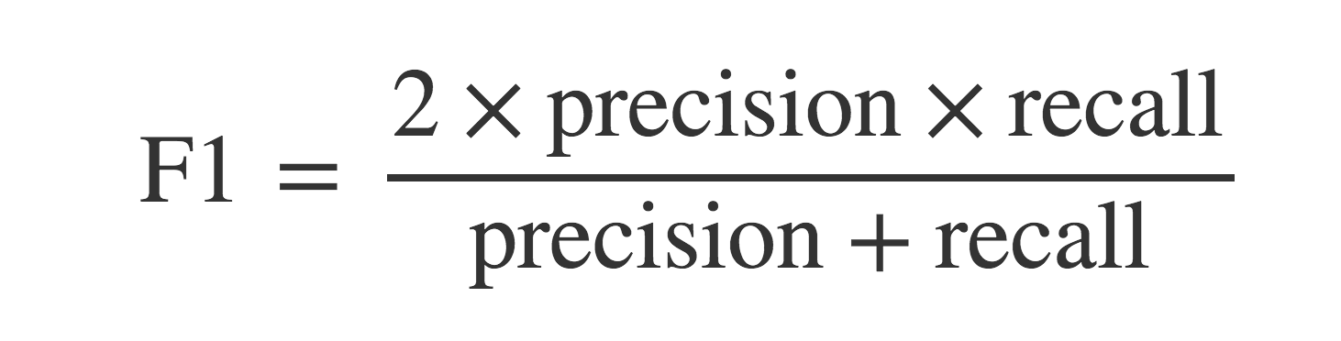
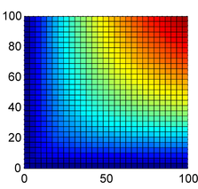
F1 score
How to combine precision and recall into a single balanced measure?
recall
This is called the harmonic mean, a type of average.
F1 is only high if both precision and recall are high.
precision
Notes:
Calculate on paper

Slide 30
Our project
How should we measure performance for the Fake News Challenge?
How about accuracy? (% correctly labeled)
Bad idea: we have unbalanced categories. Labeling all ‘Unrelated’ would get you over 70% accuracy
F1 measure?
Yes: but how to combine for our 4 categories?
Take the average!
Average F1 = average of F1 score for each category

