Slide 1
Evaluation
Princeton AI4ALL NLP Group

Slide 2
Recap

Slide 3
Linear regression and standard deviation
Python functions
File organization

Slide 4
Evaluation Metrics
Material adapted from Stanford AI4ALL 2017

Slide 5
Plan for today
How to evaluate the performance of a classifier?
Implement an evaluation metric and evaluate your rule-based classifier

Slide 6
Evaluation
How can we determine whether one classifier is better than another?
How can we determine whether making changes to a classifier actually leads to improvements?
E.g. does writing an additional rule help, or make things worse?

Slide 7
Overview
You have labeled data (each input labeled with its true category)
Split the data into training examples and test examples
Develop your classifier using the training examples
Use the classifier to label all the test examples
Compare the classifier's labels with the true labels and measure performance
Notes:
Ask and explain why the train/test split is necessary. Why not evaluate on the training set?

Slide 8
Example | Predicted label | True label
1 | Benign | Malignant
2 | Benign | Malignant
3 | Malignant | Malignant
4 | Benign | Benign
5 | Malignant | Benign
6 | Benign | Benign
7 | Benign | Benign
8 | Malignant | Malignant
9 | Benign | Benign
10 | Benign | Benign
How would you measure the performance of the classifier?
Notes:
What is the accuracy of this classifier? # correct = 8 , # of examples = 10, accuracy = 80%

Slide 9
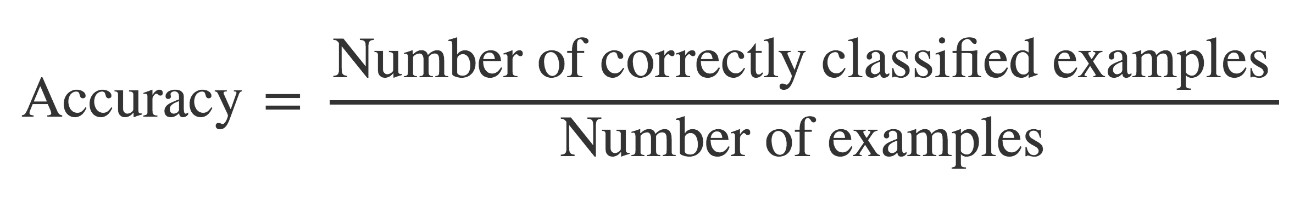
Accuracy

Slide 10
Example | Predicted label | True label | Correct?
1 | Benign | Malignant | No
2 | Benign | Malignant | No
3 | Malignant | Malignant | Yes
4 | Benign | Benign | Yes
5 | Malignant | Benign | No
6 | Benign | Benign | Yes
7 | Benign | Benign | Yes
8 | Malignant | Malignant | Yes
9 | Benign | Benign | Yes
10 | Benign | Benign | Yes
Accuracy?
Notes:
What is the accuracy of this classifier? # correct = 8 , # of examples = 10, accuracy = 80%

Slide 11
Example | Predicted label | True label | Correct?
1 | Benign | Malignant | No
2 | Benign | Malignant | No
3 | Malignant | Malignant | Yes
4 | Benign | Benign | Yes
5 | Malignant | Benign | No
6 | Benign | Benign | Yes
7 | Benign | Benign | Yes
8 | Malignant | Malignant | Yes
9 | Benign | Benign | Yes
10 | Benign | Benign | Yes
Accuracy = 70%
Notes:
What is the accuracy of this classifier? # correct = 8 , # of examples = 10, accuracy = 80%

Slide 12
Example | Predicted label | True label | Correct?
1 | Benign | Malignant | No
2 | Benign | Malignant | No
3 | Malignant | Malignant | Yes
4 | Benign | Benign | Yes
5 | Malignant | Benign | No
6 | Benign | Benign | Yes
7 | Benign | Benign | Yes
8 | Malignant | Malignant | Yes
9 | Benign | Benign | Yes
10 | Benign | Benign | Yes
Just classify everything as benign!
Accuracy?
Notes:
What is the accuracy of this classifier? # correct = 8 , # of examples = 10, accuracy = 80%

Slide 13
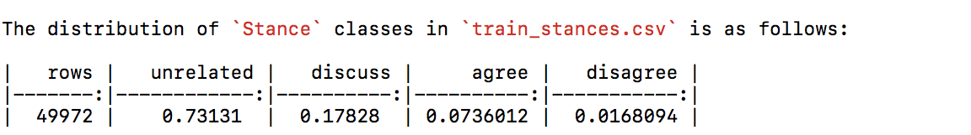
Accuracy
Accuracy not a good when uneven distribution of labels in the data

Slide 14
 |  | Predicted label
 |  | malignant | benign
True label | malignant | True positive | False negative
 | benign | False positive | True negative

Slide 15
Example | Predicted label | True label
1 | Benign | Malignant
2 | Benign | Malignant
3 | Malignant | Malignant
4 | Benign | Benign
5 | Malignant | Benign
6 | Benign | Benign
7 | Benign | Benign
8 | Malignant | Malignant
9 | Benign | Benign
10 | Benign | Benign
Notes:
Fill in TP/TN/FN/FP for each row

Slide 16
Example | Predicted label | True label
1 | Benign | Malignant | FN
2 | Benign | Malignant | FN
3 | Malignant | Malignant | TP
4 | Benign | Benign | TN
5 | Malignant | Benign | FP
6 | Benign | Benign | TN
7 | Benign | Benign | TN
8 | Malignant | Malignant | TP
9 | Benign | Benign | TN
10 | Benign | Benign | TN
Notes:
Fill in TP/TN/FN/FP for each row

Slide 17
What about for spam classification?
True positives?
False positives?
True negatives?
False negatives?

Slide 18
What next?

Slide 19
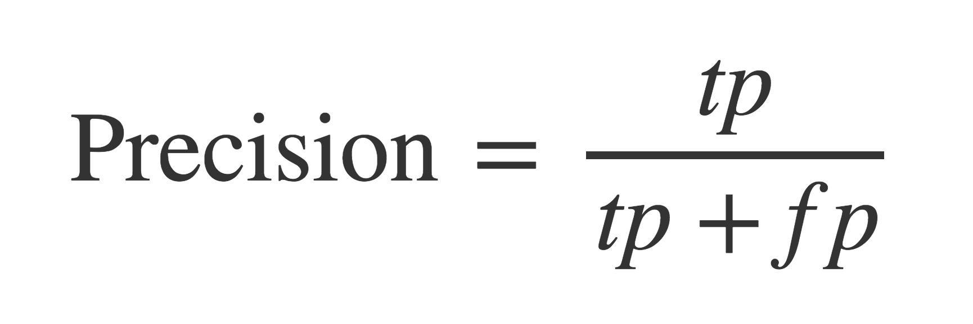
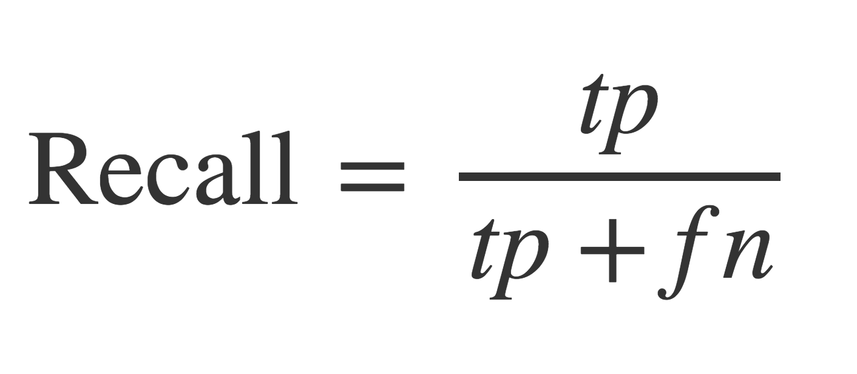
Precision and Recall
Precision: "Of all those labeled positive, how many were correctly labeled?"
Recall: "Of all the true positive examples, how many did the classifier detect?"
Notes:
Now calculate on exercise sheet

Slide 20
Precision and Recall
Why do precision and recall matter?
High recall:
High precision:
For detecting malignant tumors, which is more important?
For convicting someone of a crime, which is more important?
For detecting spam email, which is more important?

Slide 21
Precision and Recall
Why do precision and recall matter?
High recall: classifier has few false negatives
e.g. few malignant tumors go undetected
High precision: classifier has few false positives
e.g. few "false alarms" on benign tumors
For detecting malignant tumors, which is more important?
High recall
For convicting someone of a crime, which is more important?
High precision
For detecting spam email, which is more important?
Both are important

Slide 22
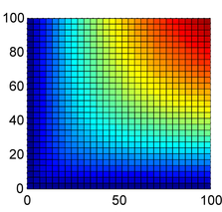
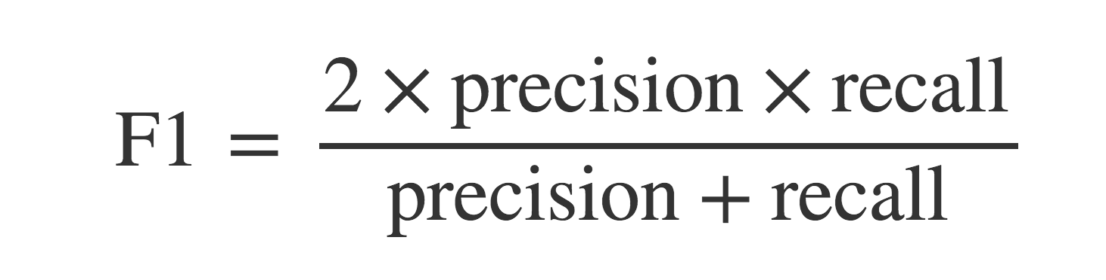
How to combine precision and recall into a single balanced measure?
Harmonic mean
recall
precision
Notes:
Calculate on paper

Slide 23
How should we measure performance for the Fake News Challenge?

Slide 24
Go to AI4ALL_NLP_Student folder in Terminal
Type git pull
Type unzip Day6_evaluation
Go to the Day6_evaluation folder in Terminal
Type source ~/miniconda3/bin/activate
Type jupyter notebook

Slide 25
http://bit.ly/2Om1YZX

