Slide 1
Intro to Rule-Based Modeling and Other Topics
Princeton AI4ALL: NLP Group
Notes:
- What is a rule-based system?

Slide 2
Wordnet
Princeton AI4ALL: NLP Group
Notes:
- What is a rule-based system?

Slide 3
wordnet.princeton.edu
http://www.nltk.org/howto/wordnet.html

Slide 4
Some Background Material
Notes:
- What is a rule-based system?

Slide 5
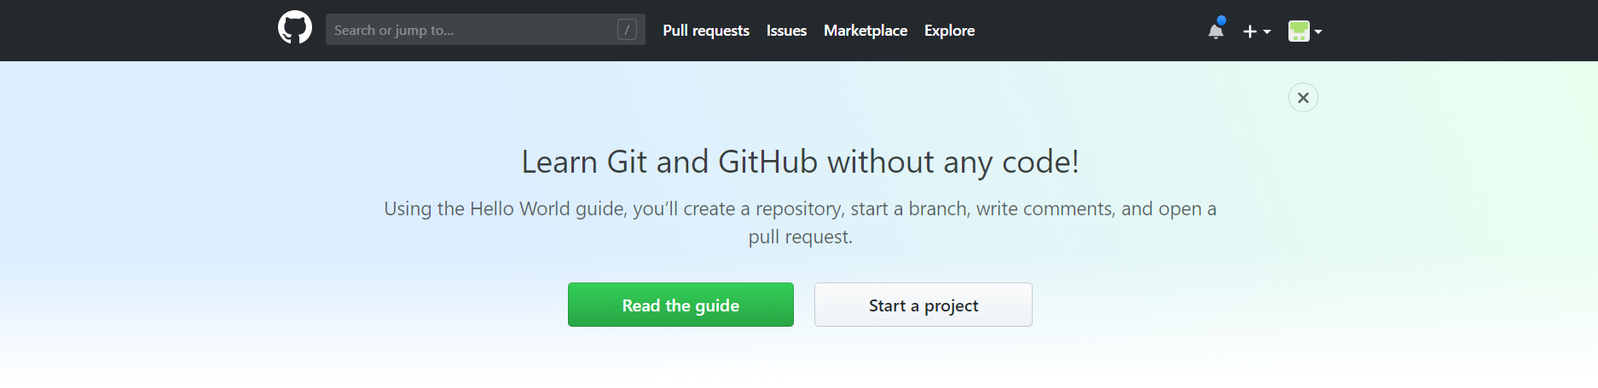

Slide 6
Github
git clone […]

Slide 7
Github
git clone […]
git pull

Slide 8
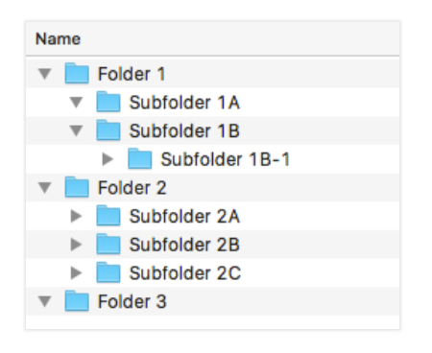
Folders
https://zapier.com/blog/organize-files-folders/

Slide 9
Folders
ls
pwd
cd [path]
cd .
cd ..
Cheat sheet: https://gist.github.com/poopsplat/7195274

Slide 10
Folders
ls
pwd
cd [path]
cd .
cd ..
Now let’s practice:
Open terminal
Type cd ~
Cheat sheet: https://gist.github.com/poopsplat/7195274

Slide 11
Review of Python and Pandas
Princeton AI4ALL: NLP Group
Notes:
- What is a rule-based system?

Slide 12
Parameters + Functions Dataframes Documentation Errors

Slide 13
Rule-Based Approaches
Notes:
- What is a rule-based system?

Slide 14
What is classification?
“Spam” vs “Ham”
“Tumor” vs “No tumor”
“Positive” vs “Negative”

Slide 15
Constructing rule-based approaches
Notes:
- Motivate rule-based approaches

Slide 16
How would you classify these as a person?
SIX chances to win CASH! From 100 to 20,000 pounds txt> CSH11 and send to 87575. Cost 150p/day, 6days, 16+ TsandCs apply Reply HL 4 info
Just forced myself to eat a slice. I'm really not hungry tho. This sucks. Mark is getting worried. He knows I'm sick when I turn down pizza. Lol
https://www.kaggle.com/benvozza/spam-classification/data
Notes:
Intuitively, how would you classify this?
Why did you classify it this way?

Slide 17
How might you write a classifier to do this classification automatically?
SIX chances to win CASH! From 100 to 20,000 pounds txt> CSH11 and send to 87575. Cost 150p/day, 6days, 16+ TsandCs apply Reply HL 4 info
Just forced myself to eat a slice. I'm really not hungry tho. This sucks. Mark is getting worried. He knows I'm sick when I turn down pizza. Lol
https://www.kaggle.com/benvozza/spam-classification/data
Notes:
Intuitively, how would you classify this?
Why did you classify it this way?

Slide 18
How might you write a classifier to do this classification automatically?
spam_words =
nonspam_words =
if _________________:
else:
Notes:
- Pseudocode

Slide 19
What about this example?
Social worker and able bodied . Can help bring meals to people , or simply drop off donations - can provide toiletries , blankets , jackets , hats , food , etc .
Going out to scavenge for allergy medicine . Hopefully someone is open otherwise my next painting with be splatter technique . # sandy
Went to my old job to get some food b4 this storm lmao
https://github.com/abisee/sailors2017/blob/master/data/labeled-data-singlelabels-test.csv
Notes:
- What about the sentiment of text?

Slide 20
What might you want to classify? How would you do that?
Social worker and able bodied . Can help bring meals to people , or simply drop off donations - can provide toiletries , blankets , jackets , hats , food , etc .
Going out to scavenge for allergy medicine . Hopefully someone is open otherwise my next painting with be splatter technique . # sandy
Went to my old job to get some food b4 this storm lmao
https://github.com/abisee/sailors2017/blob/master/data/labeled-data-singlelabels-test.csv
Notes:
- What about the sentiment of text?

Slide 21
How might you write a classifier to do this classification automatically?
Social worker and able bodied . Can help bring meals to people , or simply drop off donations - can provide toiletries , blankets , jackets , hats , food , etc .
Going out to scavenge for allergy medicine . Hopefully someone is open otherwise my next painting with be splatter technique . # sandy
Went to my old job to get some food b4 this storm lmao
https://github.com/abisee/sailors2017/blob/master/data/labeled-data-singlelabels-test.csv
Notes:
- What about the sentiment of text?

Slide 22
bit.ly/2uQ9vrQ

