Slide 1
Data Representation and Exploration
AI4ALL Princeton: NLP Group

Slide 2
How do we represent a body of text?

Slide 3
How do we represent many words?

Slide 4
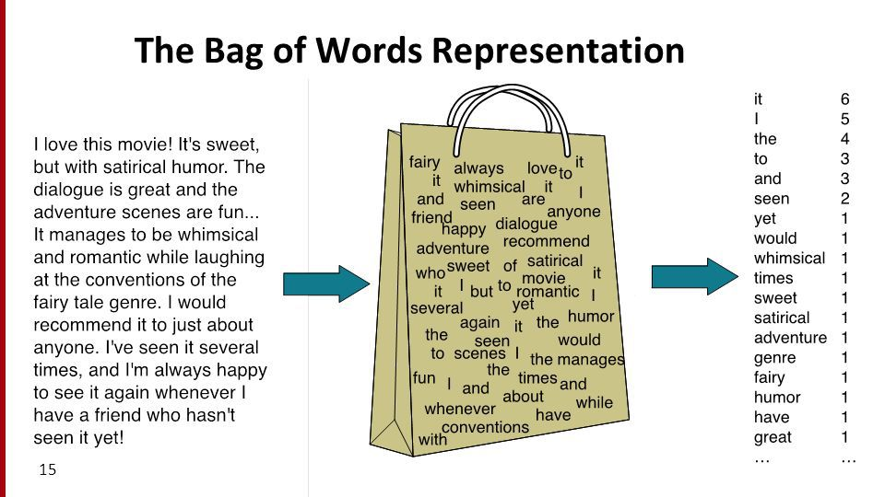
http://thecaffeinedev.com/twitter-sentiment-analysis-intro-machine-learning-beginners-part2/

Slide 5
Some words are more important than others

Slide 6
Some words are more important than others
How can we use this to improve our representation?

Slide 7

Term Frequency Inverse Document Frequency
$$\frac{word frequency in document}{length of document}$$

Slide 8

Inverse Document Frequency
$$log\frac{number of documents}{number of documents with word}$$

Slide 9


Term Frequency Inverse Document Frequency (TF-IDF)
$$\frac{word frequency in document}{length of document}$$
$$log\frac{number of documents}{number of documents with word}$$
$$∗$$

Slide 10
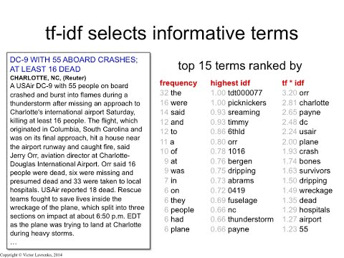
https://www.youtube.com/watch?v=zvFGNpbAfEI

Slide 11
How can we improve representations?

Slide 12

http://ai4all.princeton.edu/about
Notes:
- Casing, tokenization, stemming

Slide 13
['princeton', 'ai4al', 'is', 'intend', 'to', 'increas', 'divers', 'and', 'inclus', 'in', 'the', 'field', 'of', 'artifici', 'intellig', '.']
http://ai4all.princeton.edu/about
Notes:
- Casing, tokenization, stemming

Slide 14
Exploring a new dataset

Slide 15
What can we explore for a new dataset?
Statistics about the data?
Visualizations?
Manual analysis?
Notes:
Statistics (number of examples, length of things)
Examples of inputs and outputs
Visualizations

Slide 16
What can we explore for a new dataset?
Statistics about the data?
Visualizations?
Manual analysis?
Discuss with your neighbors
Notes:
Apply things from this morning
Statistics (number of examples, length of things)
Examples of inputs and outputs
Visualizations

