Slide 1
Word Vectors and FNC
AI4ALL NLP Group

Slide 2
Overview of the Week
Wednesday
9:30-12: Review + time to work on presentations.
1-3: Word vectors with FNC + time to work on presentations.
Thursday
9:30-12: Putting it all together + time to work on presentations.
1-3: Minipresentations (1-2:30 per person) + time to work on presentation.
Friday
9:30-10:30: Free time to finish/practice presentation.
10:30-12, 1-3: Presentations with other groups.

Slide 3
Wrapping up FNC
Today and tomorrow: shorter FNC slides+workshops, more time to work on presentations.
Today: Short slides+exercises with semantic similarity, then time to work on presentations.

Slide 4
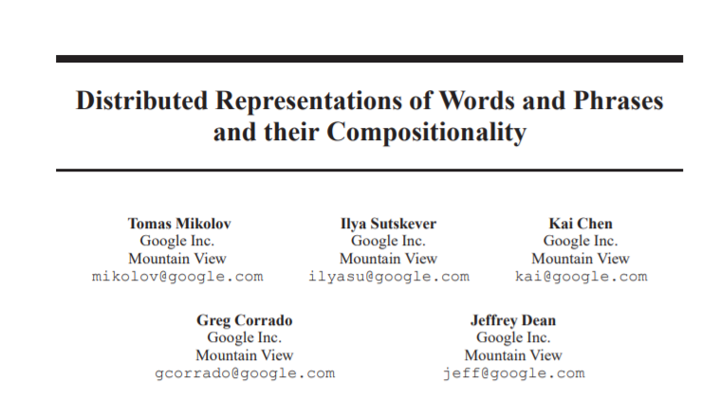
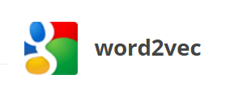
A set of pre-trained word vectors
https://papers.nips.cc/paper/5021-distributed-representations-of-words-and-phrases-and-their-compositionality.pdf
https://code.google.com/archive/p/word2vec/

Slide 5
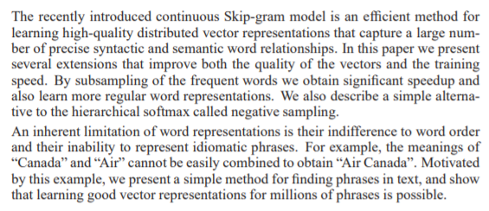
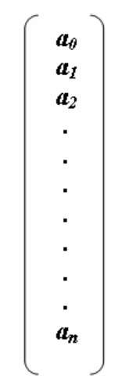
Converting a headline into a vector
How can we go from
to
https://papers.nips.cc/paper/5021-distributed-representations-of-words-and-phrases-and-their-compositionality.pdf
https://www.researchgate.net/figure/Fig-2-Graphical-illustration-of-matrix-converter-operations-for-both-1D-vector-to-2D_fig2_266674755

Slide 6
Once we have vectors for headlines and article bodies, what next?

Slide 7
Quick workshop, then presentation work-time

