Slide 1
Putting it all together!
AI4ALL NLP Group

Slide 2
Lexical overlap
Semantic Similarities
Classifier
Prediction

Slide 3
Recap:
Lexical Similarity
Semantic Similarity

Slide 4
The Code
Generate_submission.py
1. Load the data.
2. Train and predict.
train_and_predict_3_steps() in main.py
extract_features in features.py
3. Save results.

Slide 5
The Code
Generate_submission.py
1. Load the data.
2. Train and predict.
train_and_predict_3_steps() in main.py
extract_features in features.py
3. Save results.

Slide 6
Reading the Code
github.com/cchen23/AI4ALL_NLP_student/
Download 2018_08_09.zip
Pair/Group activity:
Read through the code in the src/ folder
Write a trace of the main functions of the code, and annotate the trace with a short description of what each function does.

Slide 7
The Classifier
http://blog.kaggle.com/2017/01/23/a-kaggle-master-explains-gradient-boosting/

Slide 8
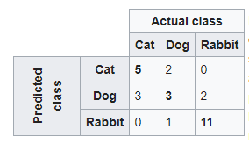
Evaluation
Confusion matrix
https://en.wikipedia.org/wiki/Confusion_matrix

Slide 9
Results
Pair/group activity:
Read through the scorer_simplified.py file.
Explain in words how the file scores the submission.
Run
python scorer_simplified.py data/competition_test_stances.csv src/results/submission.csv
Examine the results.

Slide 10
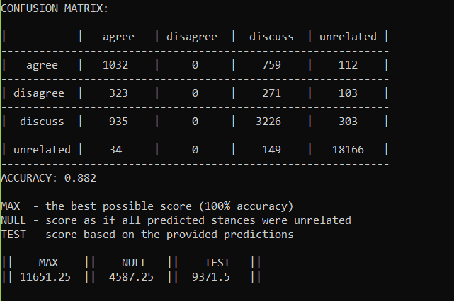
Results

Slide 11
The original 4th place solution
https://github.com/shangjingbo1226/fnc-1

Slide 12
Other solutions
https://github.com/hanselowski/athene_system
https://github.com/uclmr/fakenewschallenge
https://github.com/Cisco-Talos/fnc-1

