Slide 1

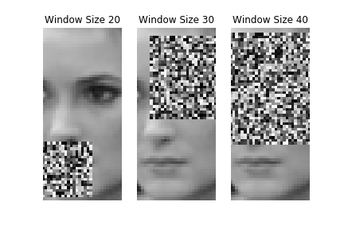
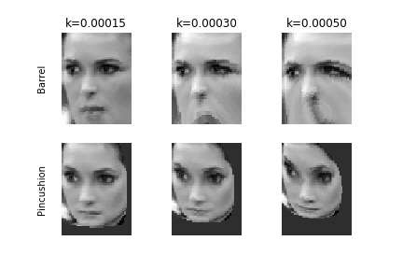
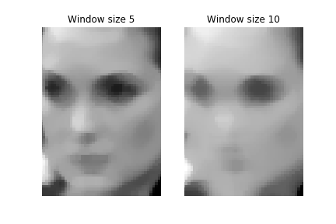
Robustness of Face Recognition to Image Manipulations
COS 429 Computer Vision
Project Adviser: Kyle Genova
Cathy Chen (cc27), Zachary Liu (zsliu), Lindy Zeng (lindy)
Motivation
Implementation
Results
Humans can often recognize faces even if it is distorted or occluded
Computer facial recognition applications must continue to recognize faces even when the face may look slightly different
Goal: Implement/use a variety of face recognition algorithms and implement image manipulations. Analyze the impact of each manipulation on the accuracy of the algorithms.
Occlusion
Radial Distortion
More results
Blur
Deep Feature Interpretation
Background and Related Work
Traditional statistical methods and deep learning used in face recognition problems
Image manipulations from linear algebras, mimicking lens distortion, neural networks
Psychology indicates that image manipulation may equalize face recognition ability in human beings
Any way to represent the algorithms visually? We could make flow charts of what they do? Or add equations representing what they do.
Results and Discussion
VGG-FACE outperforms the statistical methods for face recognition (PCA, Sparse Representation)
Overall decrease in performance across all algorithms for manipulated images
Manipulation specifics
Methods
Face recognition algorithms
PCA
Sparse Representation
With Dimension Reduction
With Combined L1 Loss
VGG-FACE
Image Manipulations
Occlusion
Radial Distortion
Blur
Deep Feature Interpretation
Dataset
Labeled Faces in the Wild (LFW)
Results
Baseline Performance
[Graph of results on no manipulation task with different splits]
[Motivation: different amounts of training data to represent different cases.]
Performance with Distortion
[Performance plots]
[Plot change in performance vs baseline performance]
Works Cited
[1] Face Recognition Homepage - Algorithms.
[2] Pierre Drap and Julien Lefèvre. An Exact Formula for Calculating Inverse Radial Lens Distortions. Sensors (Basel, Switzerland), 16(6), June 2016.
[3]
Just copy over from paper?
Annoying blank space here ☹
If there’s space, could describe the algorithms here and put the results in the other column.
Acknowledgements
Professor Olga Russakovsky
Kyle Genova, Riley Simmons-Edler

